Slide 1
Construction
Route: Construction
Topic: Practical construction calculus
Lesson 2: Using the trapezoidal rule and Simpson’s rule in construction
Notes:
Image © Shutterstock/Freedomz

Slide 2
In this lesson, we will:
Introduction
General competencies
English:
E2 Present information and ideas
E5 Synthesise information
Maths:
M2 Estimate, calculate and spot errors
M3 Work with proportion
M4 Use rules and formulae
M5 Process data
Digital:
D3 Communicate and collaborate
estimate the area under a curve and apply this to a range of construction situations using the trapezoidal rule;
estimate the area under a curve and apply this to a range of construction situations using Simpson’s rule;
compare the benefits and limitations of using the mid-ordinate, trapezoidal and Simpson’s rule in different situations.
Lesson 2: Using the trapezoidal rule and Simpson’s rule in construction

Slide 3

Activity: Mid-ordinate rule steps
Introduction
Rearrange the steps into the correct order.
Calculate the area of each interval.
Divide the base width of the cross-section into equal intervals.
Plot the ‘x’ and ‘y’ co-ordinates on graph paper.
Find the height at each midpoint.
Find the sum of all the interval areas.
Determine the midpoint of each interval.
Lesson 2: Using the trapezoidal rule and Simpson’s rule in construction

Slide 4
Answer: Mid-ordinate rule steps
Introduction
Step 1: Plot the ‘x’ and ‘y’ co-ordinates on graph paper.
Step 2: Divide the base width of the cross-section into equal intervals.
Step 3: Determine the midpoint of each interval.
Step 4: Find the height at each midpoint.
Step 5: Calculate the area of each interval.
Step 6: Find the sum of all the interval areas.
Lesson 2: Using the trapezoidal rule and Simpson’s rule in construction

Slide 5

Recall: What is meant by an embankment?
Introduction
Embankments are structures built to support roads, railways or canals.
They provide a stable foundation and allow the construction of these routeways over obstacles such as valleys, rivers and uneven terrain.
Lesson 2: Using the trapezoidal rule and Simpson’s rule in construction
Notes:
Image © Shutterstock/syarifjmt

Slide 6
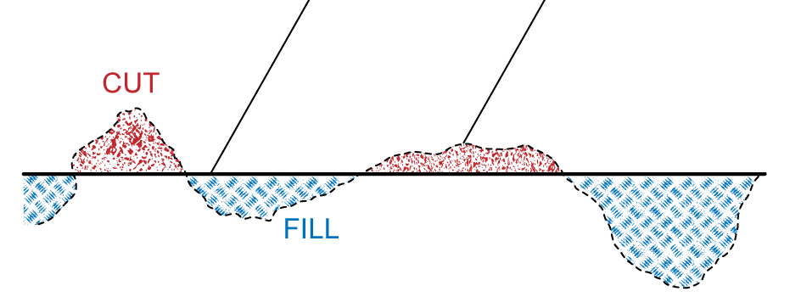
Recall: What is meant by cut and fill?
Introduction
Cut and fill is used to modify the topography of a site by:
  cut: excavating material from one location;
  fill: using the material to fill another location.
Soil, rocks, gravel or other debris is
moved to create a level surface or the
desired slope for construction activities.
This method minimises the amount of
material that needs to be transported to
or from the site.
Proposed formation level
Level of existing terrain
Lesson 2: Using the trapezoidal rule and Simpson’s rule in construction

Slide 7

The trapezoidal rule
Activity 1
The trapezoidal rule is another rule that can be used to estimate the area under a curve.
The curve is divided into equal intervals.
Each interval of the cross-section is treated as a trapezium.
We use the ordinates at the endpoints of each interval. Remember: an ordinate is the y-coordinate on a graph for a given x-coordinate.
Lesson 2: Using the trapezoidal rule and Simpson’s rule in construction
Notes:
Image © Shutterstock/anutr tosirikul

Slide 8
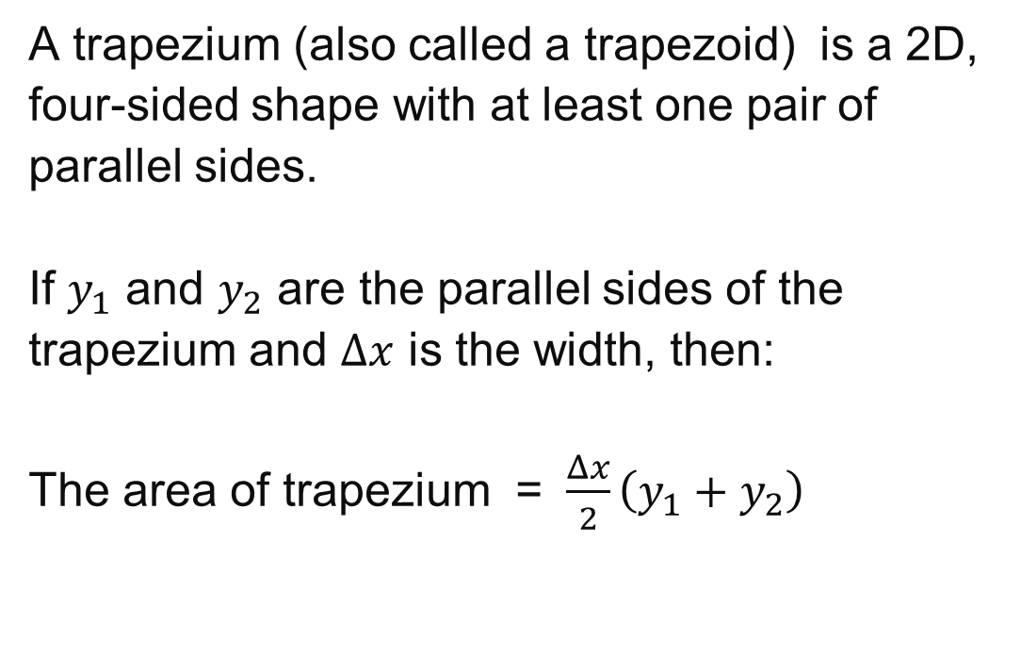



Area of a trapezium
Activity 1
Lesson 2: Using the trapezoidal rule and Simpson’s rule in construction

Slide 9
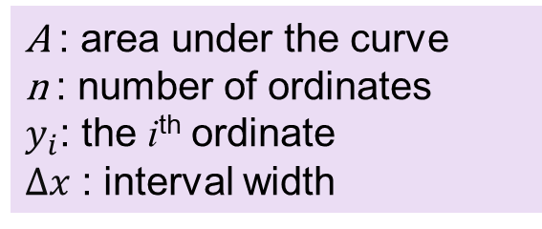
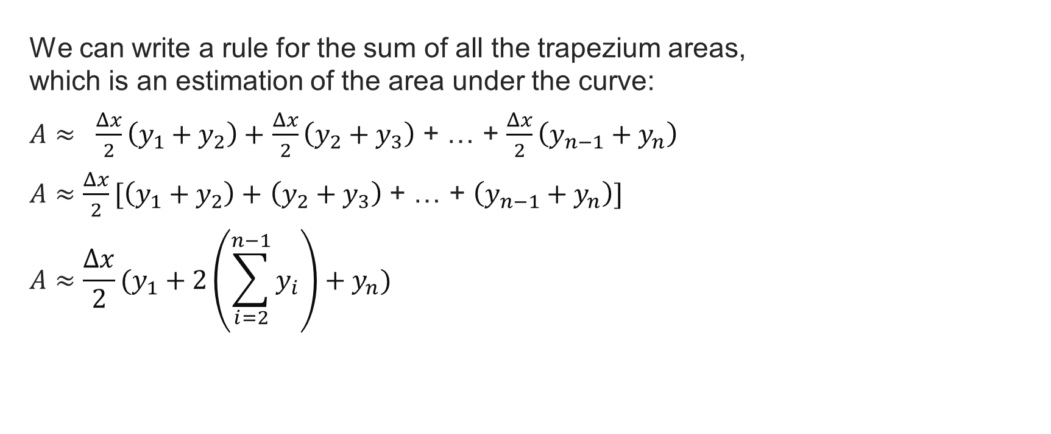
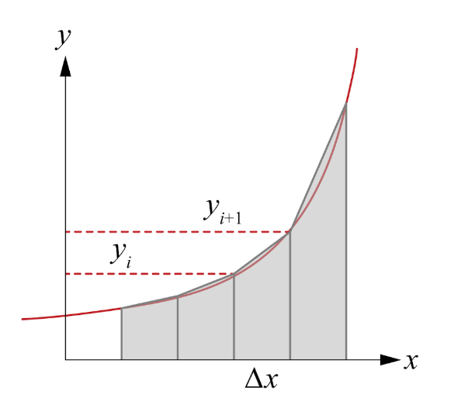
Trapezoidal rule formula
Activity 1
Lesson 2: Using the trapezoidal rule and Simpson’s rule in construction

Slide 10
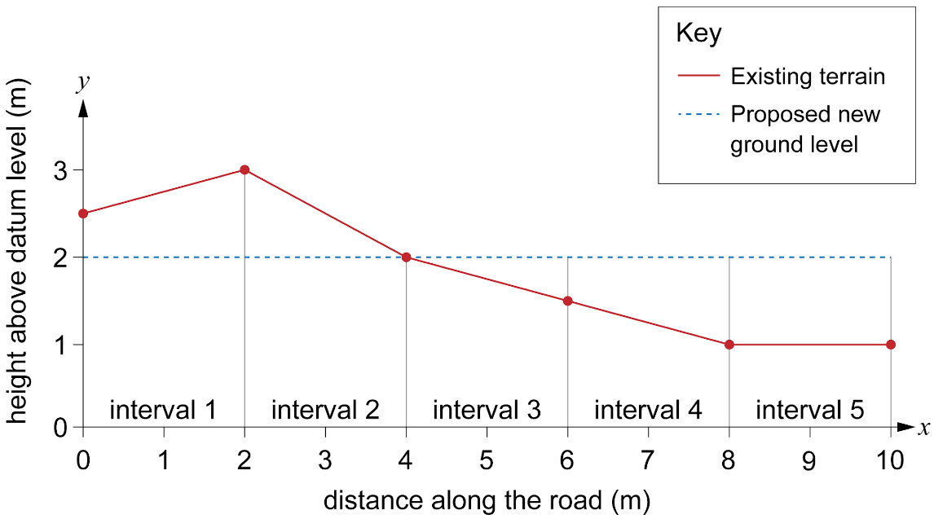
Using the trapezoidal rule
Activity 1
Look at this graph of a cross-section of a road.
This curve has six ordinates (labelled
y₁ to y₆).
The first ordinate y₁ is 2.5 metres.
Find the ordinates:
y₃
y₄
Lesson 2: Using the trapezoidal rule and Simpson’s rule in construction

Slide 11
Worked example: Trapezium rule
Activity 1
You are tasked with designing a road that must pass through uneven terrain. To create a level road, you will need to cut soil from higher areas and fill soil to lower areas.
The cross-section of the terrain along a
10-metre stretch of road is shown in the table.
Use the trapezium rule to calculate how much material will need to be brought onto site to create
a suitable ground level to construct the road.
The road is to be 8 m wide.
Position (m) | Existing elevation (m) | Desired elevation (m)
0 | 2.5 | 2
2 | 3 | 2
4 | 2 | 2
6 | 1.5 | 2
8 | 1 | 2
10 | 1 | 2
Activity 1 worked example sheet can be used.
Lesson 2: Using the trapezoidal rule and Simpson’s rule in construction

Slide 12
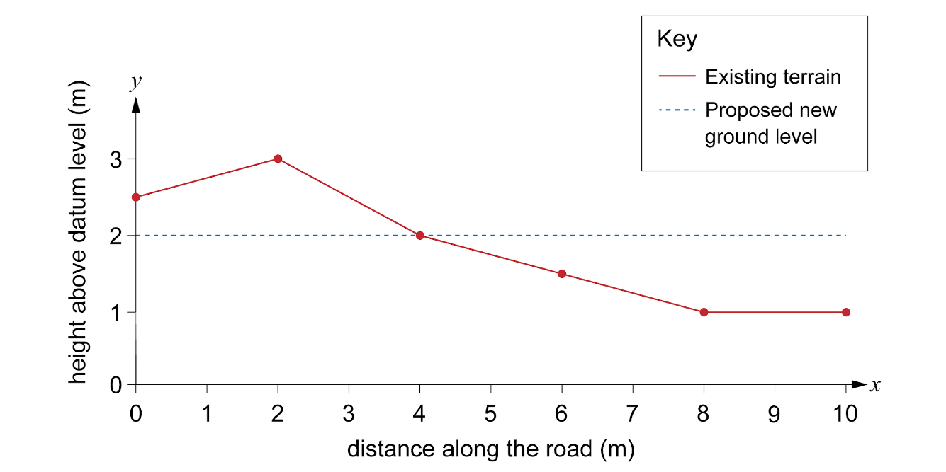
Worked example: Trapezium rule
Activity 1
Step 1: Plot the curve on graph paper.
Position (m) | Existing elevation (m) | Desired elevation (m)
0 | 2.5 | 2
2 | 3 | 2
4 | 2 | 2
6 | 1.5 | 2
8 | 1 | 2
10 | 1 | 2
Lesson 2: Using the trapezoidal rule and Simpson’s rule in construction

Slide 13
Worked example: Trapezium rule
Activity 1
Step 2: Divide the base width of the cross-section into equal intervals.
The base width is 10 m.
Use 5 intervals.
10 ÷ 5 = 2 m
Add the intervals to the graph.
Lesson 2: Using the trapezoidal rule and Simpson’s rule in construction

Slide 14
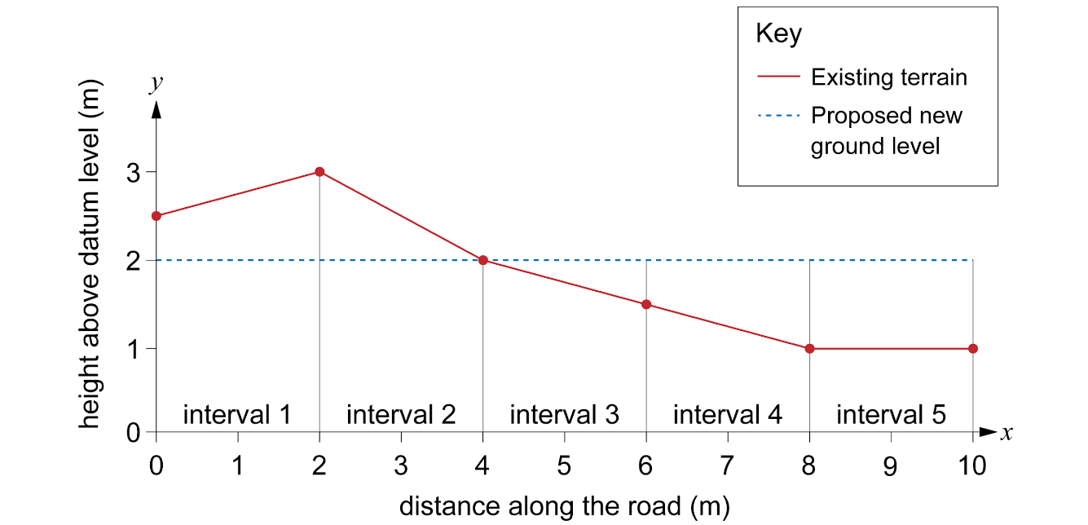
Worked example: Trapezium rule
Activity 1
Step 2: Divide the base width of the cross-section into equal intervals.
Lesson 2: Using the trapezoidal rule and Simpson’s rule in construction

Slide 15
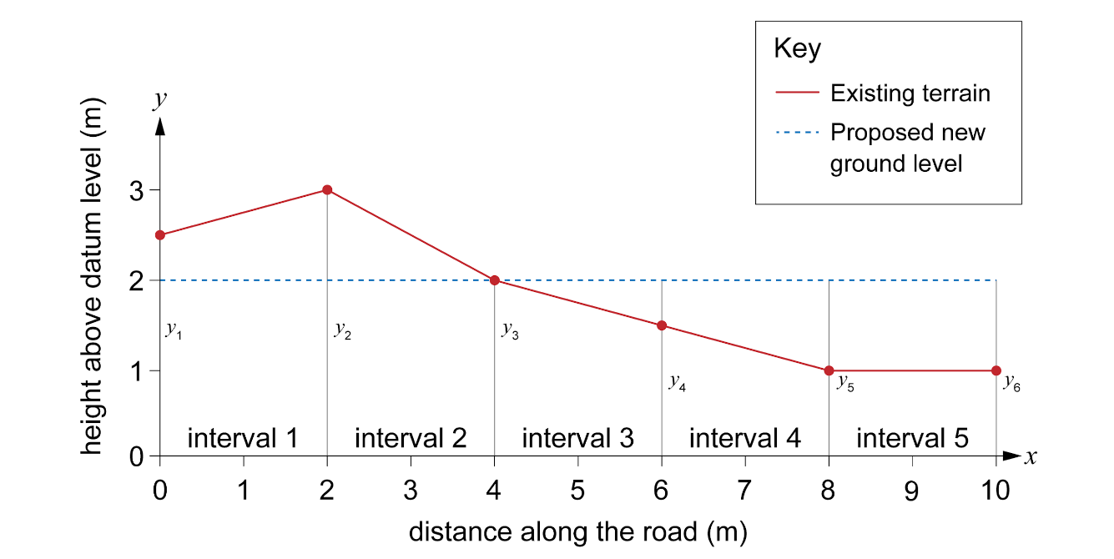
Worked example: Trapezium rule
Activity 1
Step 3: Label the points where you will measure the ordinates.
Lesson 2: Using the trapezoidal rule and Simpson’s rule in construction

Slide 16
Worked example: Trapezium rule
Activity 1
Step 4: Measure the height of the cut or fill at each point.
Measure from the proposed level to the ordinate
y₁ = 0.5 m
y₂ = 1 m
y₃ = 0 m
y₄ = –0.5 m
y₅ = –1 m
y₆ = –1 m
Lesson 2: Using the trapezoidal rule and Simpson’s rule in construction

Slide 17
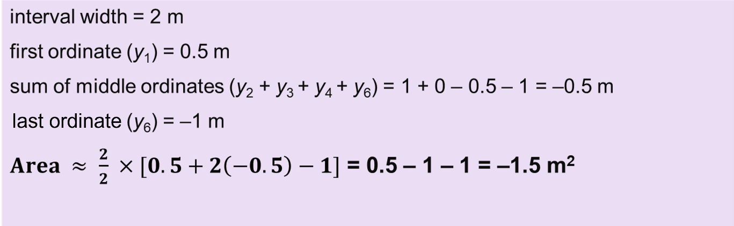
Worked example: Trapezium rule
Activity 1
Step 5: Use the trapezium rule to calculate the area of cut and fill.
y₁ = 0.5 m
y₂ = 1 m
y₃ = 0 m
y₄ = –0.5 m
y₅ = –1 m
y₆ = –1 m
Lesson 2: Using the trapezoidal rule and Simpson’s rule in construction

Slide 18
Using the trapezoidal rule
Activity 1
We can break down the trapezoidal rule into a number of steps.
Step 1: Plot the x- and y-coordinates on graph paper.
Step 2: Divide the base width of the cross-section into equal intervals.
Step 3: Label the points where you will measure the ordinates.
Step 4: Find the heights of each ordinate.
Step 5: Use the trapezoidal rule to calculate the area of cut and fill.
Lesson 2: Using the trapezoidal rule and Simpson’s rule in construction

Slide 19

Using the trapezoidal rule: practice
Activity 1
Complete the practice questions on the worksheet.
Resources needed
L2 Activity 1 Worksheet
L2 Activity 1 Worksheet answers
Calculator
Graph paper
Lesson 2: Using the trapezoidal rule and Simpson’s rule in construction
Notes:
Image © Shutterstock/4045

Slide 20
Reflection questions
Activity 1
Why is it important to divide the base width into intervals of equal width when using the trapezoidal rule?
How might the shape of the embankment affect the accuracy of your area calculation using the trapezoidal rule?
Can you think of any other real-world applications where the trapezoidal rule might be useful?
Lesson 2: Using the trapezoidal rule and Simpson’s rule in construction

Slide 21
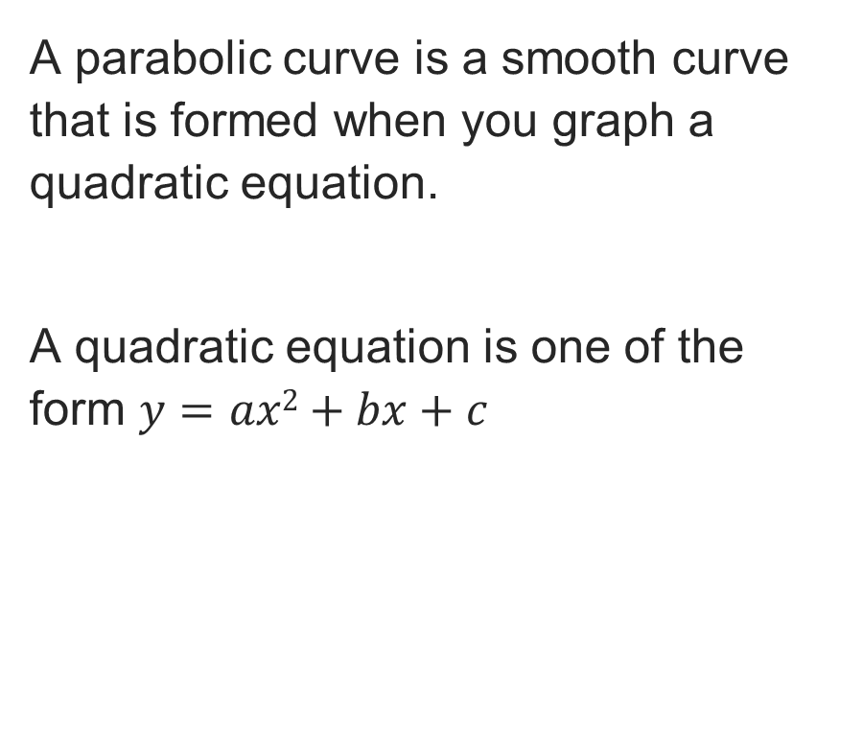
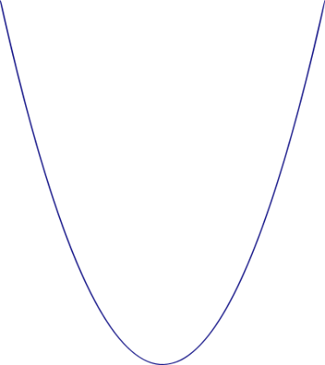
Parabolic curves
Activity 2
y
O
x
Lesson 2: Using the trapezoidal rule and Simpson’s rule in construction

Slide 22

Parabolic curves
Activity 2
Parabolic curves are seen in real life.
For example:
the path of water from a fountain;
the shape of certain bridges;
the shape of a roof.
Why do you think parabolic curves are
used in construction?
Lesson 2: Using the trapezoidal rule and Simpson’s rule in construction
Notes:
Image © Shutterstock/zdast

Slide 23
Simpson’s rule
Activity 2
Simpson’s rule is a numerical method used to approximate the area under a curve.
It works by dividing the area into an even number of intervals and fitting a parabolic curve to each interval to approximate the curve.
Generally, Simpson’s rule is more accurate than the trapezoidal rule for estimating the area under a curve as it uses curves instead of straight lines to approximate the shape.
Lesson 2: Using the trapezoidal rule and Simpson’s rule in construction

Slide 24
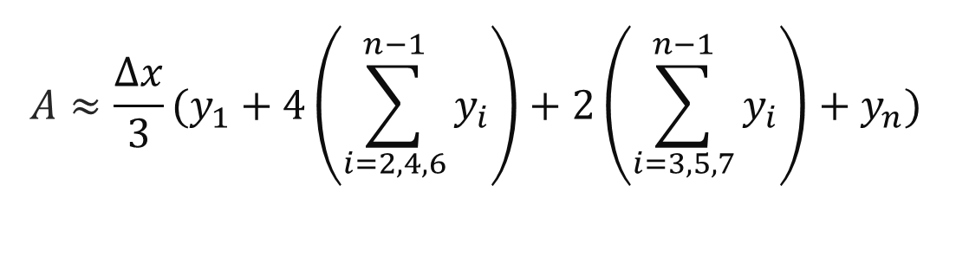
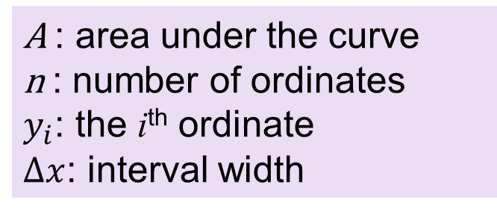
Simpson’s rule formula
Activity 2
Remember: Simpson’s rule can only be used with an odd number of ordinates. This means there needs to be an even number of intervals.
Lesson 2: Using the trapezoidal rule and Simpson’s rule in construction

Slide 25
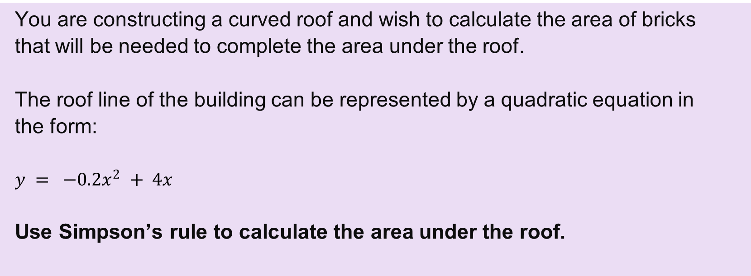
Worked example: Simpson’s rule
Activity 2
You are constructing a curved roof and wish to calculate the area of bricks that will be needed to complete the area under the roof.
The roof line of the building can be represented by a quadratic equation in the form:
Use Simpson’s rule to calculate the area under the roof.
Activity 2 worked example sheet can be used.
Lesson 2:Using the trapezoidal rule and Simpson’s rule in construction

Slide 26
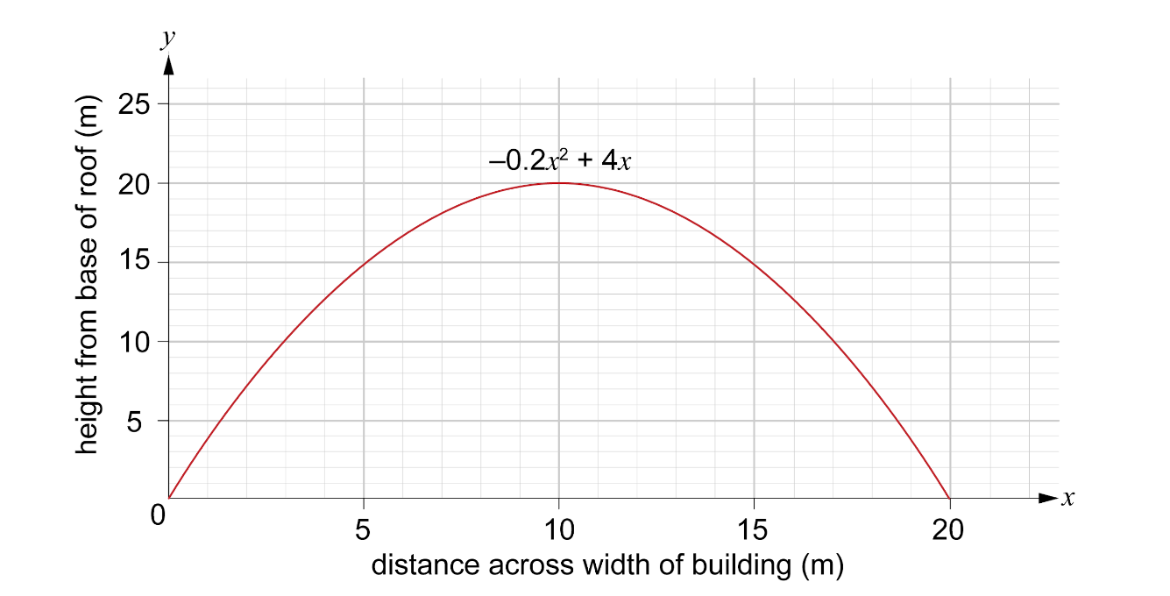
Worked example: Simpson’s rule
Activity 2
Step 1: Plot the curve on graph paper.
Lesson 2: Using the trapezoidal rule and Simpson’s rule in construction

Slide 27
Worked example: Simpson’s rule
Activity 2
Step 2: Divide the base width of the cross-section into equal intervals.
Simpson’s Rule requires an odd number of ordinates and, therefore, an even number of intervals.
The base width is 20 m
10 intervals gives 11 ordinates.
interval width = 20 ÷ 10 = 2 m
Add the intervals to the graph.
Lesson 2: Using the trapezoidal rule and Simpson’s rule in construction

Slide 28
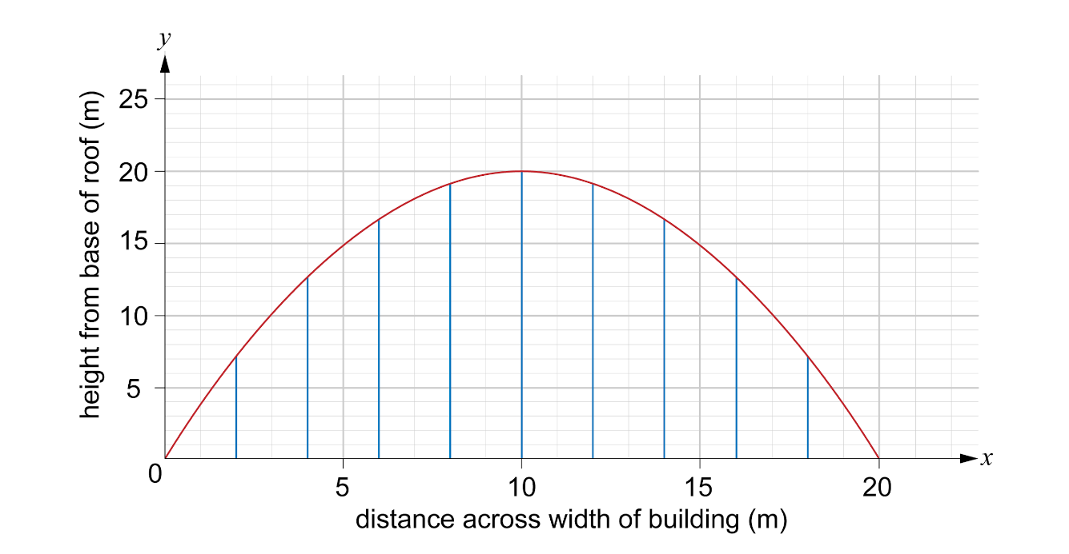
Worked example: Simpson’s rule
Activity 2
Step 2: Divide the base width of the cross-section into equal intervals.
Lesson 2: Using the trapezoidal rule and Simpson’s rule in construction

Slide 29
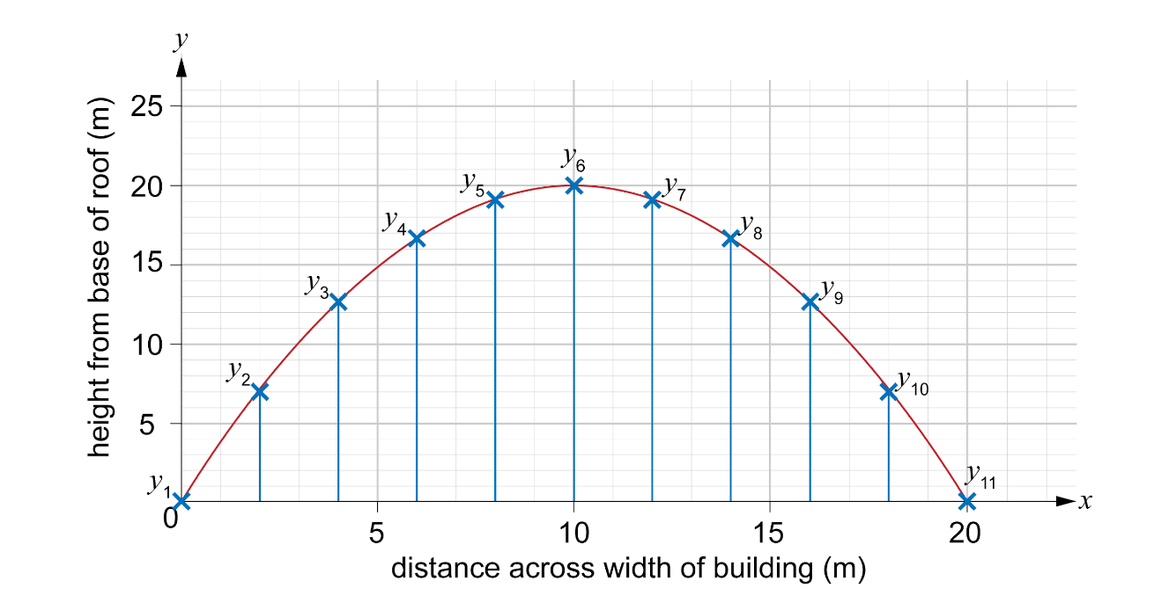
Worked example: Simpson’s rule
Activity 2
Step 3: Label the points where you will measure the ordinates.
Lesson 2: Using the trapezoidal rule and Simpson’s rule in construction

Slide 30
Worked example: Simpson’s rule
Activity 2
Step 4: Find the height of each ordinate
y₁ = 0 m
y₂ = 7.5 m
y₃ = 13 m
y₄ = 17 m
y₅ = 19 m
y₆ = 20 m
y₇ = 19 m
y₈ = 17 m
y₉ = 13 m
y₁₀ = 7.5 m
y₁₁ = 0 m
Lesson 2: Using the trapezoidal rule and Simpson’s rule in construction

Slide 31
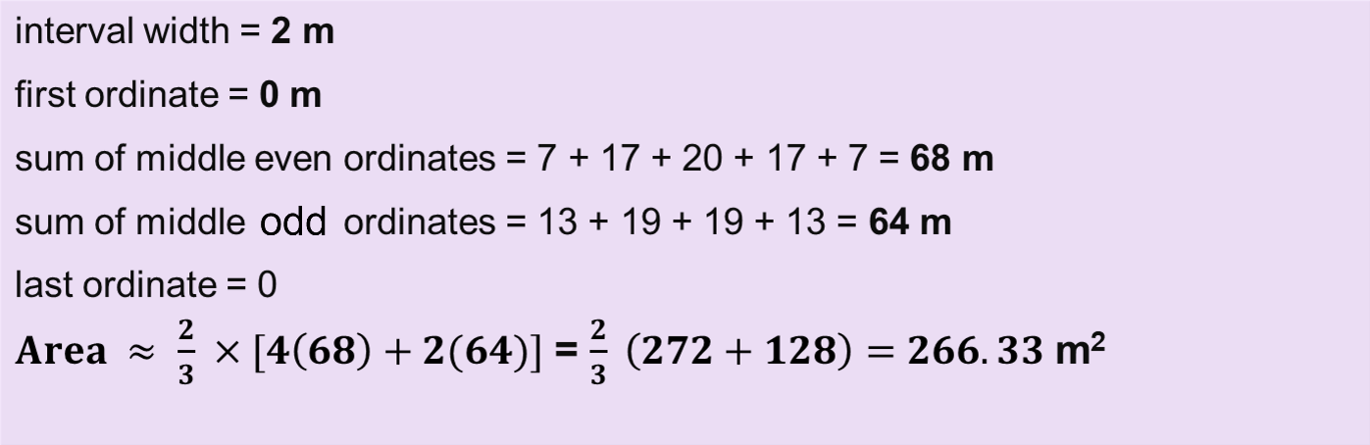
Worked example: Simpson’s rule
Activity 2
Step 5: Calculate the area under the curve using Simpson’s rule.
y₁ = 0 m
y₂ = 7 m
y₃ = 13 m
y₄ = 17 m
y₅ = 19 m
y₆ = 20 m
y₇ = 19 m
y₈ = 17 m
y₉ = 13 m
y₁₀ = 7 m
y₁₁ = 0 m
Lesson 2: Using the trapezoidal rule and Simpson’s rule in construction

Slide 32
Activity 2
Using Simpson’s rule
We can break down Simpson’s rule into a number of steps.
Step 1: Plot the curve on graph paper.
Step 2: Divide the base width of the cross-section into equal intervals.
Step 3: Label the points where you will measure the ordinates.
Step 4: Find the height of each ordinate.
Step 5: Use Simpson’s rule formula to estimate the area under the curve.
Lesson 2: Using the trapezoidal rule and Simpson’s rule in construction

Slide 33

Simpson’s vs trapezoidal rule
Activity 2
Which rule do you think is likely to be most accurate for calculating the area under a curved roof?
Are there any situations where one rule would be better than the other?
Lesson 2: Using the trapezoidal rule and Simpson’s rule in construction
Notes:
Image © Shutterstock/Toniflap

Slide 34
Using the Simpson’s rule: practice
Activity 2
Complete the practice questions on the worksheet.
Resources needed
L2 Activity 2 Worksheet
L2 Activity 2 Worksheet answers
Calculator
Graph paper
Lesson 2: Using the trapezoidal rule and Simpson’s rule in construction

Slide 35
Comparing rules
Plenary
Identify the rules to which each statements applies.
 | Mid-ordinate rule | Trapezoidal rule | Simpson’s rule
Divide the base width into intervals of equal width.
Use mid-points to determine the ordinates.
Can be used with an even or odd number of ordinates.
Can be used with an odd number of intervals.
Areas of fill should be represented as negative values.
Lesson 2: Using the trapezoidal rule and Simpson’s rule in construction

Slide 36
Comparing rules: answers
Plenary
 | Mid-ordinate rule | Trapezoidal rule | Simpson’s rule
Divide the base width into intervals of equal width. | ✔ | ✔ | ✔
Use mid-points to determine the ordinates. | ✔
Can be used with an even or odd number of ordinates. | ✔ | ✔
Can be used with an odd number of intervals. | ✔ | ✔
Areas of fill should be represented as negative values. | ✔ | ✔ | ✔
Lesson 2: Using the trapezoidal rule and Simpson’s rule in construction

Slide 37
In this lesson, we have:
Plenary
General competencies
English:
E2 Present information and ideas
E5 Synthesise information
Maths:
M2 Estimate, calculate and spot errors
M3 Work with proportion
M4 Use rules and formulae
M5 Process data
Digital:
D3 Communicate and collaborate
estimated the area under a curve and applied this to a range of construction situations using the trapezoidal rule;
estimated the area under a curve and applied this to a range of construction situations using Simpson’s rule;
compared the benefits and limitations of using the mid-ordinate, trapezoidal and Simpson’s rule in different situations.
Lesson 2: Using the trapezoidal rule and Simpson’s rule in construction

Slide 38
Consolidation
Consolidation
Study the case study and use the mid-ordinate rule, trapezoidal rule and Simpson’s rule to calculate the area of cut and fill for a road.
Compare the results you have obtained from the three methods, explaining any differences in the calculated areas and why those differences might have occurred.
Resources needed
L2 Consolidation Worksheet
L2 Consolidation answers 1
L2 Consolidation answers 2
Calculator
Graph paper
Lesson 2: Using the trapezoidal rule and Simpson’s rule in construction

