Slide 1
Construction
Route: Construction
Topic: Practical construction calculus
Lesson 4: Using integration in construction
Notes:
Image © Shutterstock/Freedomz

Slide 2
In this lesson, we will:
Introduction
General competencies
English:
E2 Present information and ideas
E5 Synthesise information
Maths:
M2 Estimate, calculate and spot errors
M3 Proportion
M4 Use rules and formulae
M5 Process data
M8 Communicate using maths
Digital:
D3 Communicate and collaborate
use integration to determine the area under a curve in various construction situations;
measure and analyse total heat loss through a wall;
use integration to calculate the total amount of heat lost through a wall in a specific time period.
Lesson 4: Using integration in construction

Slide 3

Using integration in construction
Introduction
As you watch the video, make a list of different ways integration is used in the construction industry.
Lesson 4: Using integration in construction
Notes:
Use of calculus in the construction industry video: https://vimeo.com/1111914156/70b6d7679b

Slide 4
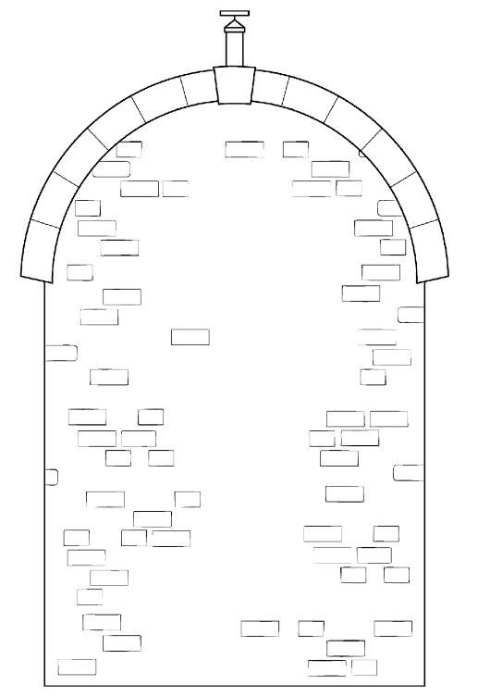
Integration for the area under a curve
Activity 1
Integration can be used to calculate the area under a curve, for example, when working out how many bricks to use under a curved roof.
Follow along using the Activity 1 Worked example worksheet.
Lesson 4: Using integration in construction

Slide 5
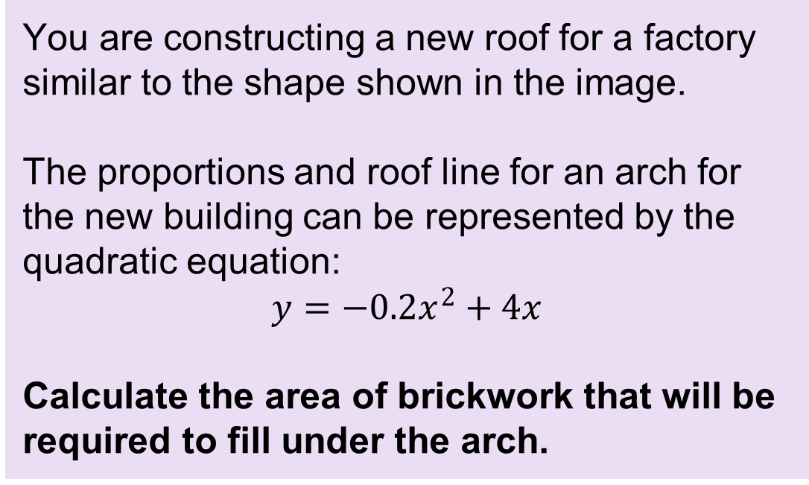
Worked example: Integration
Activity 1
You are constructing a new roof for a factory similar to the shape shown in the image.
The proportions and roof line for an arch for the new building can be represented by the quadratic equation:
$$y=−0.2x^{2}+4x$$
Calculate the area of brickwork that will be required to fill under the arch.
Lesson 4: Using integration in construction

Slide 6
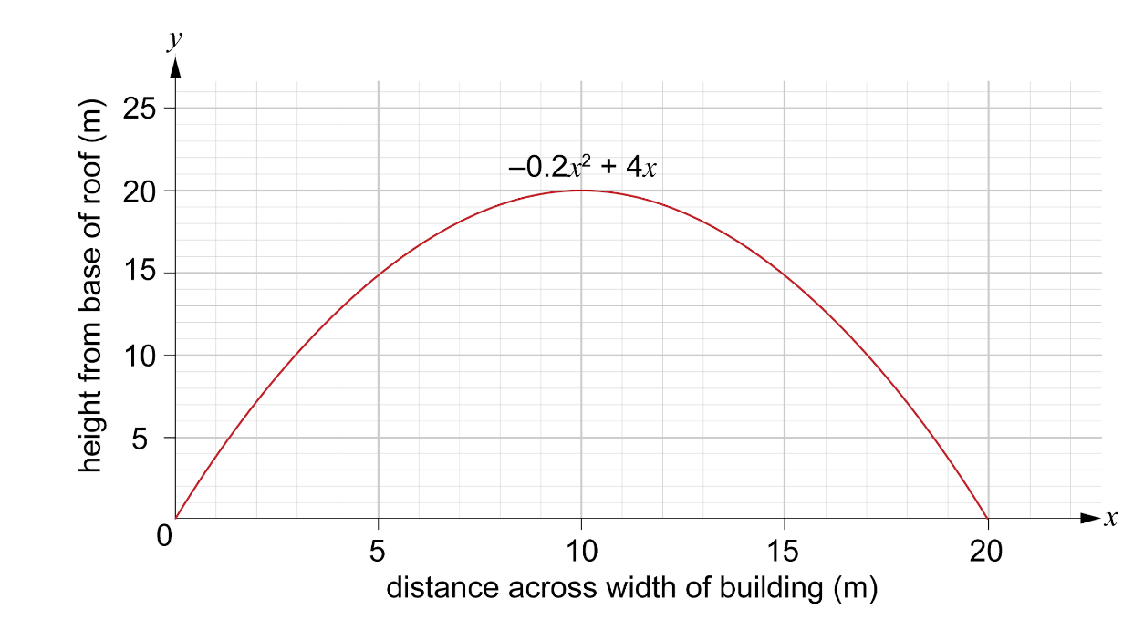
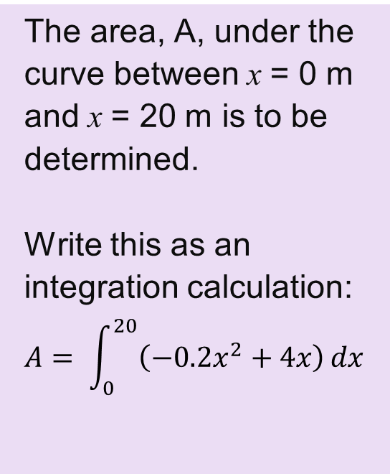
Worked example: Integration
Activity 1
The roof line is shown in the graph.
The area, A, under the curve between x = 0 m and x = 20 m is to be determined.
Write this as an integration calculation:
Lesson 4: Using integration in construction

Slide 7
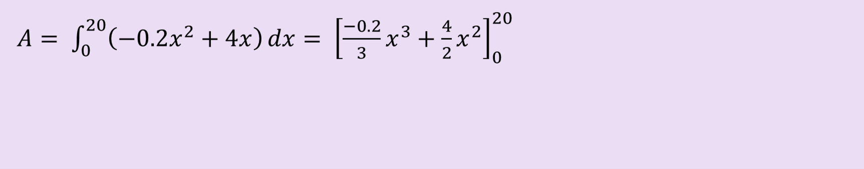
Worked example: Integration
Activity 1
Step 1: Integrate each term.
This is a definite integral: use square brackets and add the limits to the top and bottom bracket.
To integrate, add 1 to the power and divide by the new power.
Lesson 4: Using integration in construction

Slide 8
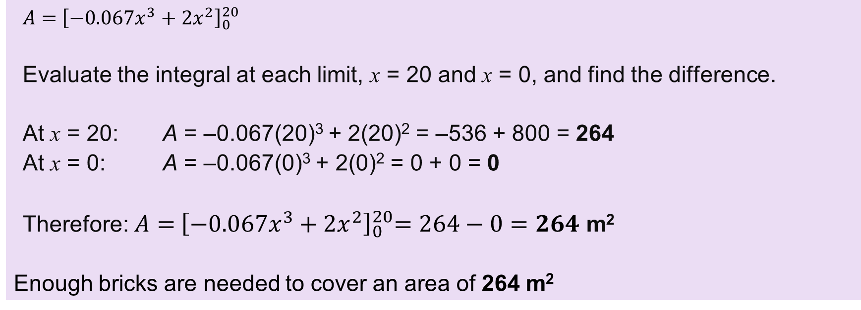
Worked example: Integration
Activity 1
Step 2: Apply definite limits.
Lesson 4: Using integration in construction

Slide 9
Integration for the area under a curve: practice
Activity 1
Complete the practice questions on the worksheet.
Resources needed
L4 Activity 1 worksheet
L4 Activity 1 worksheet answers
Calculator
Lesson 4: Using integration in construction

Slide 10
Analysing heat loss through a wall
Activity 2
Locate a brick/block cavity wall and estimate the age of its construction. Look up its age in the reference table on the worksheet and determine its U-value.
Measure the temperature on both the inside and outside of a wall every 20 minutes, at least 4–7 times.
Enter the data into a spreadsheet and calculate the temperature difference between inside and outside at each time interval.
Plot this data on a line graph and use the spreadsheet to generate a best fit line and display its equation.
Integrate the equation to find the total heat loss over the time period studied.
Resources needed
L4 Activity 2 worksheet
Thermometers
Excel spreadsheet
Lesson 4: Using integration in construction

Slide 11
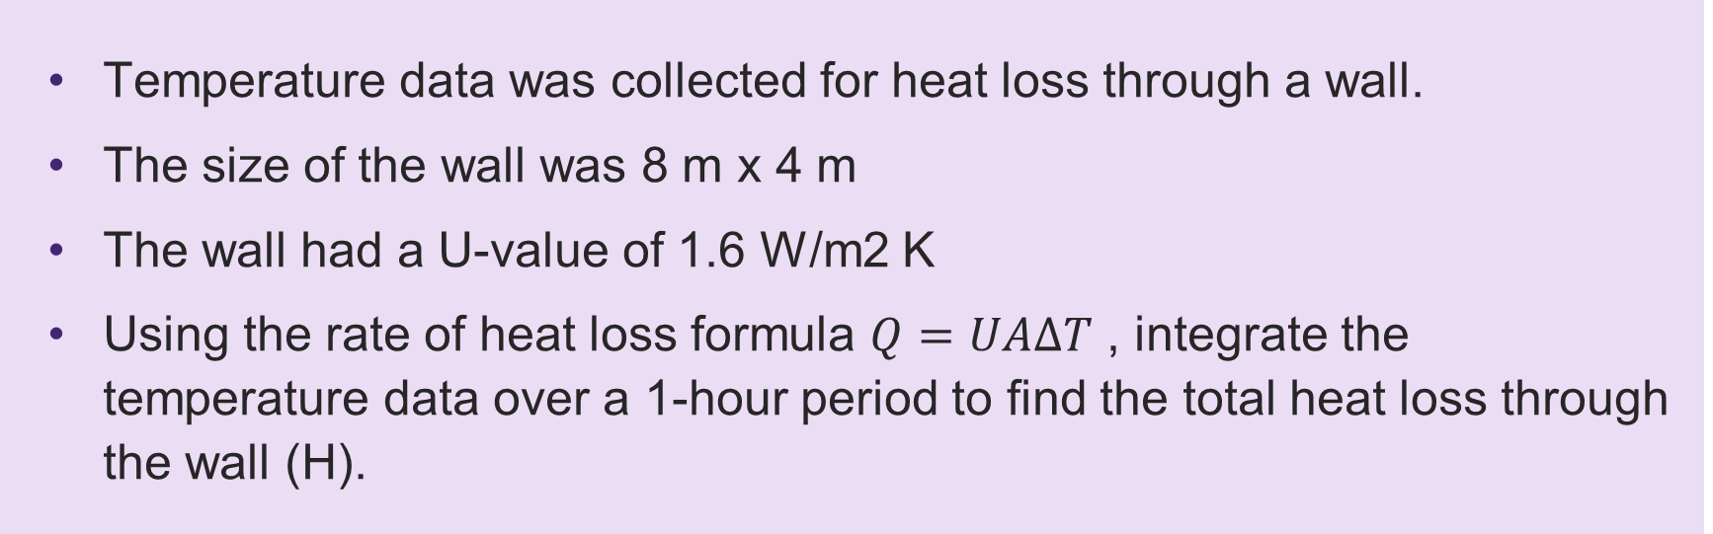
Analysing heat loss through a wall: worked example
Activity 2
Temperature data was collected for heat loss through a wall.
The size of the wall was 8 m x 4 m
The wall had a U-value of 1.6 W/m2 K
Using the rate of heat loss formula $Q=UA∆T$ , integrate the temperature data over a 1-hour period to find the total heat loss through the wall (H).
Lesson 4: Using integration in construction

Slide 12
Analysing heat loss through a wall: worked example
Activity 2
Time t (minutes) | Inside temperature (°C) | Outside temperature (°C) | ∆T (°C)
0 | 26 | 11 | 15
10 | 26 | 12 | 14
20 | 26 | 14 | 12
30 | 26 | 16 | 11
40 | 26 | 18 | 8
50 | 26 | 19 | 7
60 | 26 | 21 | 5
Lesson 4: Using integration in construction

Slide 13
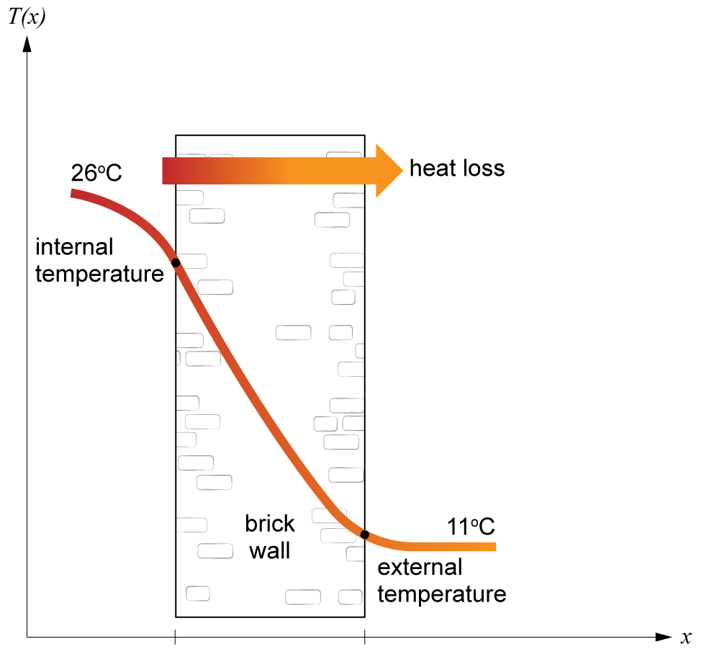
Analysing heat loss through a wall: worked example
Activity 2
Lesson 4: Using integration in construction

Slide 14
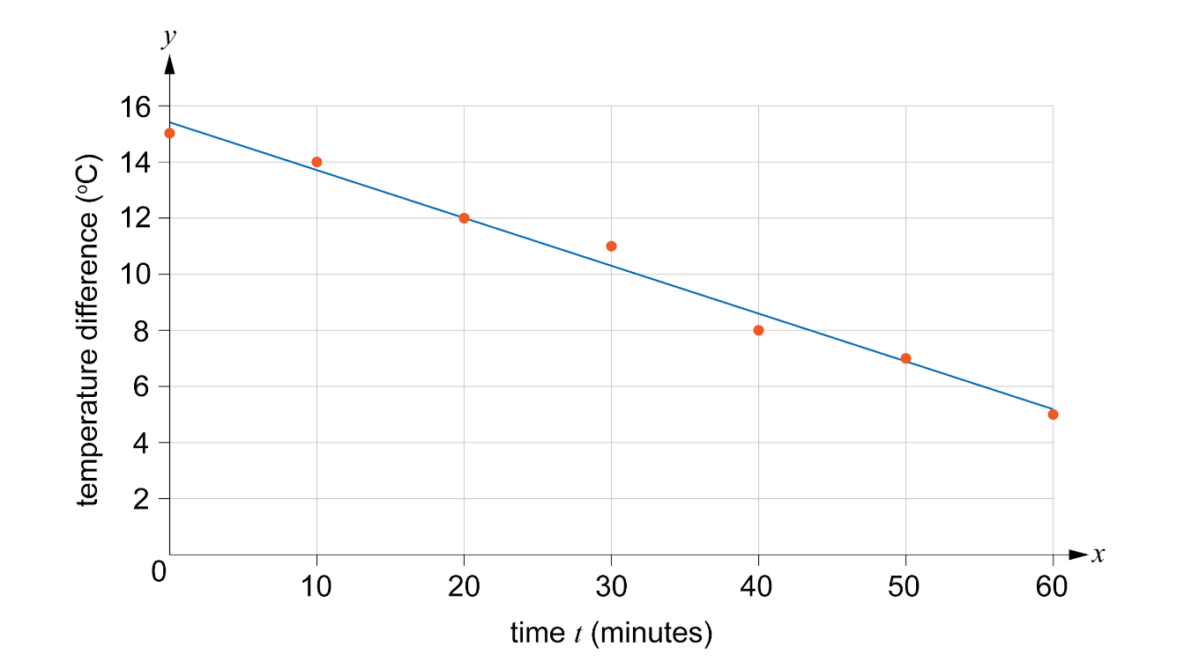
Analysing heat loss through a wall: worked example
Activity 2
Plotting the data for time and temperature difference, we can see the points are roughly linear.
Lesson 4: Using integration in construction

Slide 15
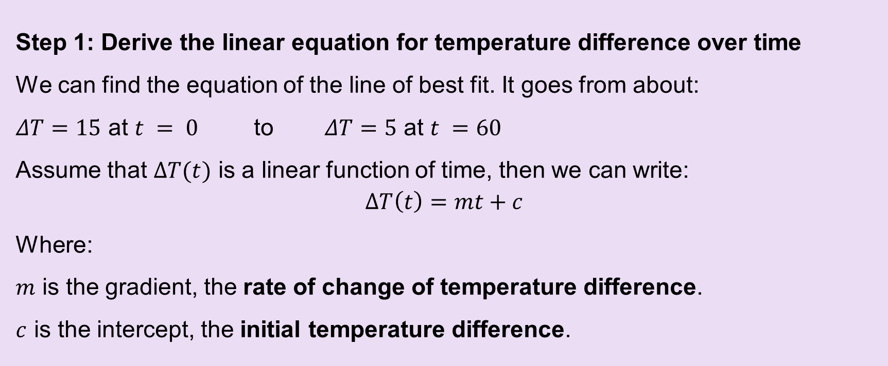
Analysing heat loss through a wall: worked example
Activity 2
Step 1: Derive the linear equation for temperature difference over time.
We can find the equation of the line of best fit. It goes from about:
Where:
m is the gradient, the rate of change of temperature difference.
c is the intercept, the initial temperature difference.
Lesson 4: Using integration in construction

Slide 16
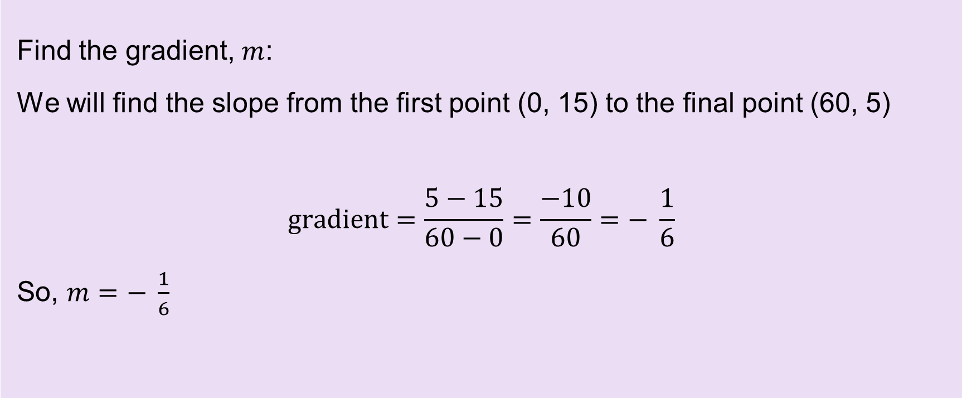
Analysing heat loss through a wall: worked example
Activity 2
Find the gradient, m:
We will find the slope from the first point (0, 15) to the final point (60, 5)
Lesson 4: Using integration in construction

Slide 17
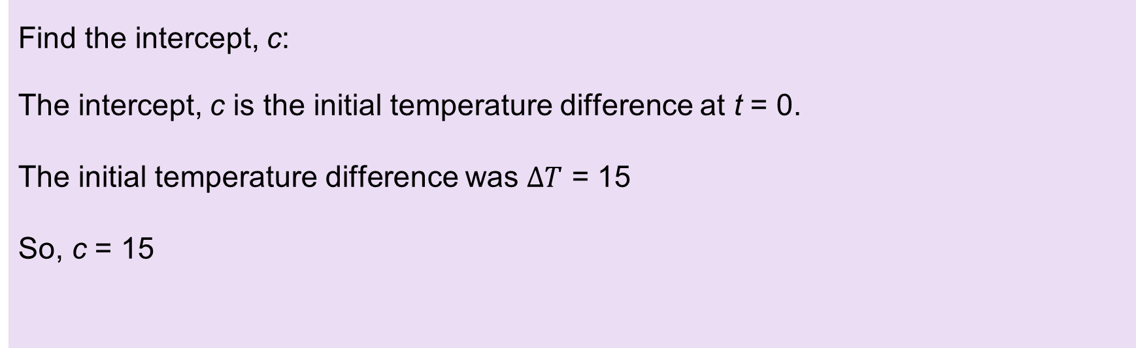
Analysing heat loss through a wall: worked example
Activity 2
Find the intercept, c:
The intercept, c is the initial temperature difference at t = 0.
The initial temperature difference was $∆T$ = 15
So, c = 15
Lesson 4: Using integration in construction

Slide 18
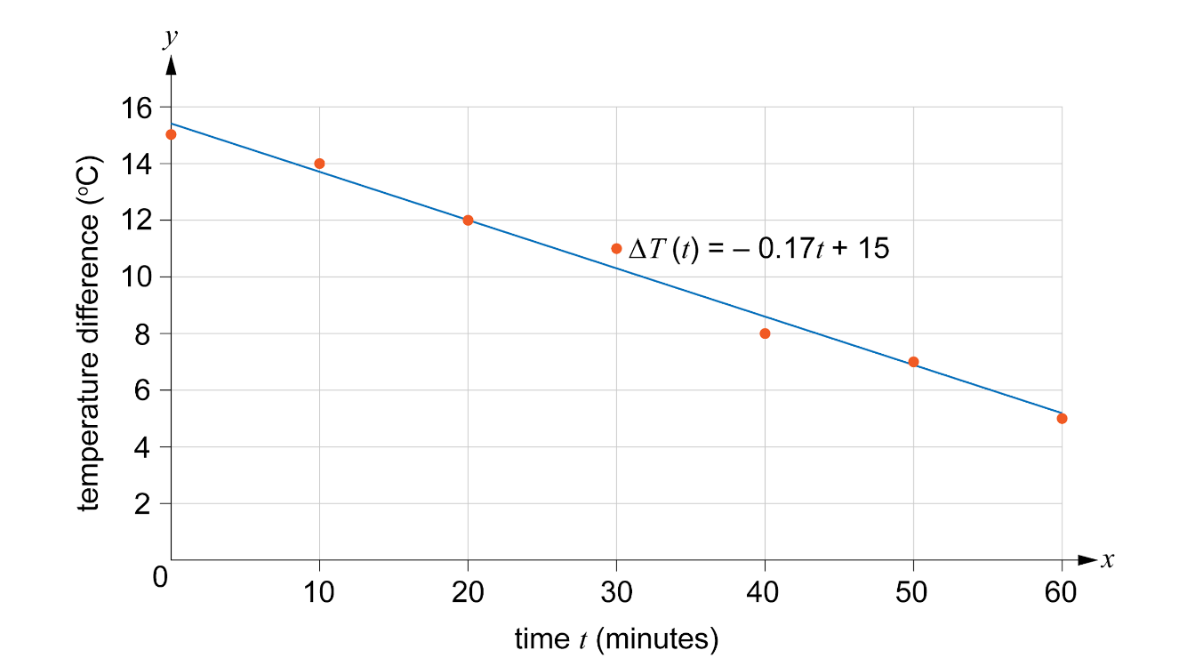
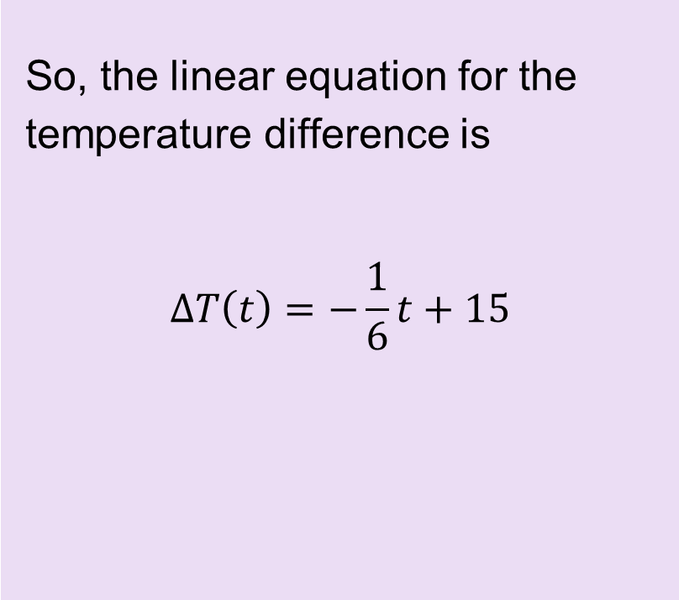
Analysing heat loss through a wall: worked example
Activity 2
So, the linear equation for the temperature difference is
Lesson 4: Using integration in construction

Slide 19
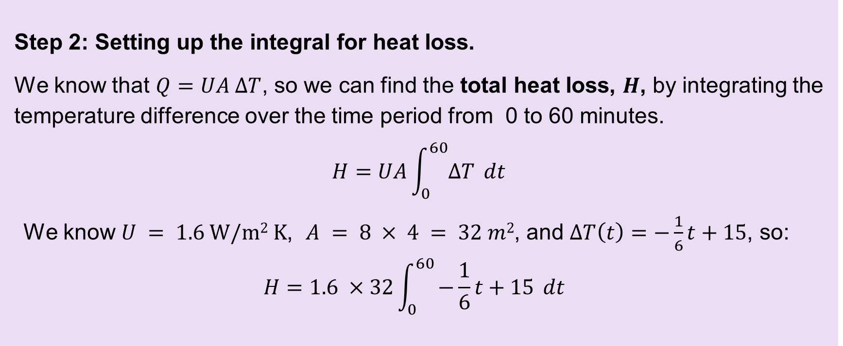
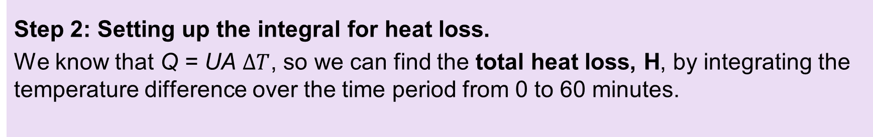
Analysing heat loss through a wall: worked example
Activity 2
Step 2: Setting up the integral for heat loss.
We know that Q = UA $∆T$, so we can find the total heat loss, H, by integrating the temperature difference over the time period from 0 to 60 minutes.
Lesson 4: Using integration in construction

Slide 20
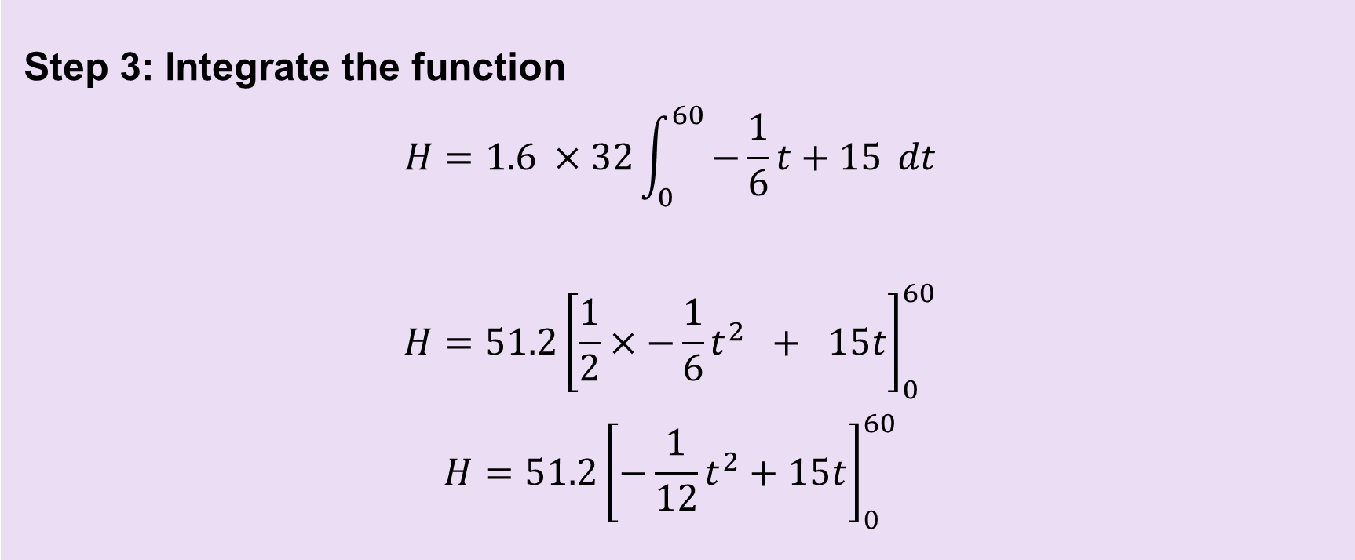
Analysing heat loss through a wall: worked example
Activity 2
Step 3: Integrate the function.
Lesson 4: Using integration in construction

Slide 21
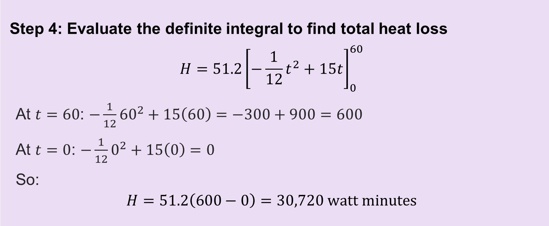
Analysing heat loss through a wall: worked example
Activity 2
Step 4: Evaluate the definite integral to find total heat loss.
Lesson 4: Using integration in construction

Slide 22

Analysing heat loss through a wall: worked example
Activity 2
Convert to watt hours (by dividing by 60):
H = 30,720 watt minutes
H = $\frac{30,720}{60}$ watt hours
H = 512 watt hours
Lesson 4: Using integration in construction

Slide 23
Multiple-choice questions
Plenary
In which scenario is integration most useful in construction?
calculating the area of a square room
estimating the total volume of earth to be removed from an excavation site
finding the length of a single straight beam
determining the number of bricks needed for a straight square wall
Lesson 4: Using integration in construction

Slide 24
Multiple-choice questions
Plenary
In which scenario is integration most useful in construction?
calculating the area of a square room
estimating the total volume of earth to be removed from an excavation site
finding the length of a single straight beam
determining the number of bricks needed for a straight square wall
Answer
B. estimating the total volume of earth to be removed from an excavation site
Lesson 4: Using integration in construction

Slide 25
Multiple-choice questions
Plenary
In which of the following situations would integration be most useful in construction?
calculating the number of roof tiles needed
estimating the total material required for a curved roof structure
determining the height of a single building column
finding the number of doors in a building
Lesson 4: Using integration in construction

Slide 26
Multiple-choice questions
Plenary
In which of the following situations would integration be most useful in construction?
calculating the number of roof tiles needed
estimating the total material required for a curved roof structure
determining the height of a single building column
finding the number of doors in a building
Answer
B. estimating the total material required for a curved roof structure
Lesson 4: Using integration in construction

Slide 27
In this lesson, we have:
Plenary
General competencies
English:
E2 Present information and ideas
E5 Synthesise information
Maths:
M2 Estimate, calculate and spot errors
M3 Proportion
M4 Use rules and formulae
M5 Process data
M8 Communicate using maths
Digital:
D3 Communicate and collaborate
used integration to determine the area under a curve in various construction situations;
measured and analysed heat loss through a wall;
used integration to calculate the amount of heat lost through a wall in a specific time period.
Lesson 4: Using integration in construction

Slide 28
Consolidation
Consolidation
Complete a report of your practical activity.
Practise some more calculations involving integration using the Consolidation Worksheet.
Then swap with a partner and use the worksheet answers to give your partner feedback.
Resources needed
Consolidation Worksheet
Consolidation Worksheet answers
Lesson 4: Using integration in construction

