Slide 1
Construction
Route: Construction
Topic: Practical construction calculus
Lesson 3: Using differentiation in construction
Notes:
Image © Shutterstock/Freedomz

Slide 2
In this lesson, we will:
Introduction
General competencies
English:
E2 Present information and ideas
E5 Synthesise information
Maths:
M2 Estimate, calculate and spot errors
M3 Proportion
M4 Use rules and formulae
M5 Process data
M8 Communicate using maths
Digital:
D3 Communicate and collaborate
explain how heat is lost from a building and ways in which this can be minimised;
calculate U-values and heat loss through a structure;
use differential calculus to plan the construction of a house which minimises heat loss.
Lesson 3: Using differentiation in construction

Slide 3
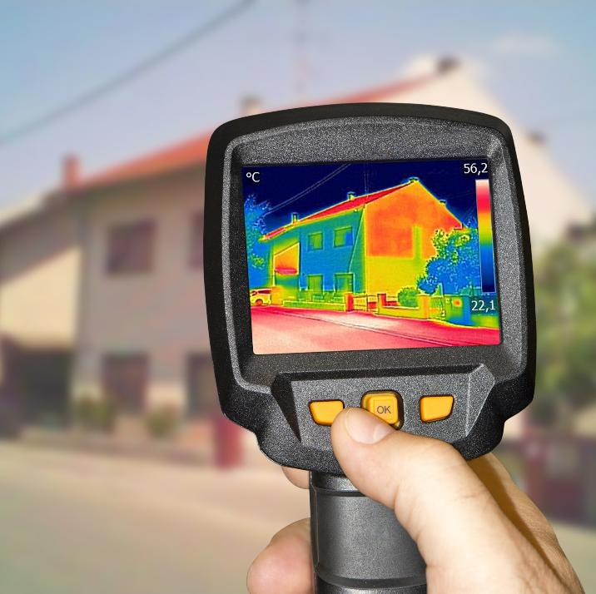
Where is heat lost from a building?
Introduction
Heat loss through a building happens when warm air inside escapes to the cooler air outside. It also occurs because of conduction through the walls and other solid materials.
Where are the main places heat is lost from a building?
How can we prevent or reduce heat loss?
Why is preventing heat loss important?
Lesson 3: Using differentiation in construction
Notes:
Image © Shutterstock/Ivan Smuk

Slide 4
How can heat be lost?
Introduction
Heat can be lost through walls in the following ways:
  Conduction: Heat moves through solid materials, like the bricks or wood in the wall. If the material is not a good insulator, the heat can easily pass through.
  Draughts: Warm air can leak out through air gaps or cracks in the wall.
  Radiation: Heat is given off by walls when not properly insulated.
Lesson 3: Using differentiation in construction

Slide 5
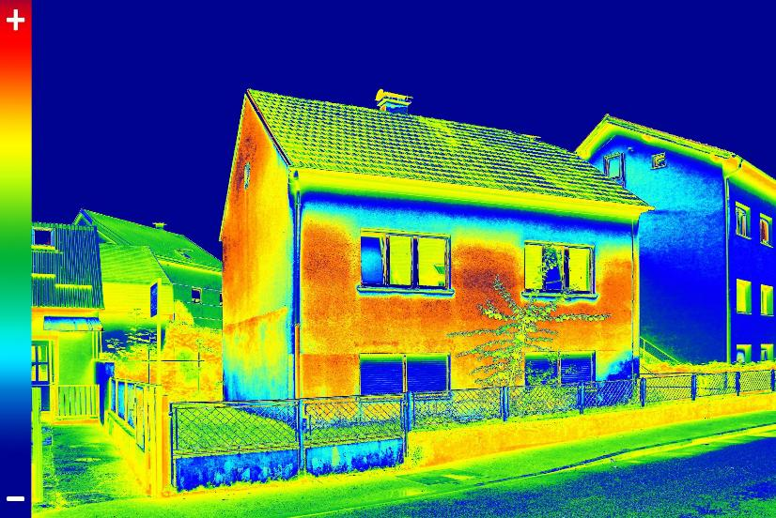
Where is heat lost from a building?
Introduction
Thermal imaging camera key:
red
orange hottest or heat loss areas
yellow
green – intermediate temperatures
blue
purple
Where do you think the most heat is escaping?
coolest or well-insulated spots
Lesson 3: Using differentiation in construction
Notes:
Image © Shutterstock/Ivan Smuk

Slide 6
Calculating heat loss
Activity 1
Area of contact
Which factors could increase and decrease the rate of heat loss across a material?
Rate of heat loss factors
Thickness of material
Temperature differential
Insulation
Lesson 3: Using differentiation in construction

Slide 7
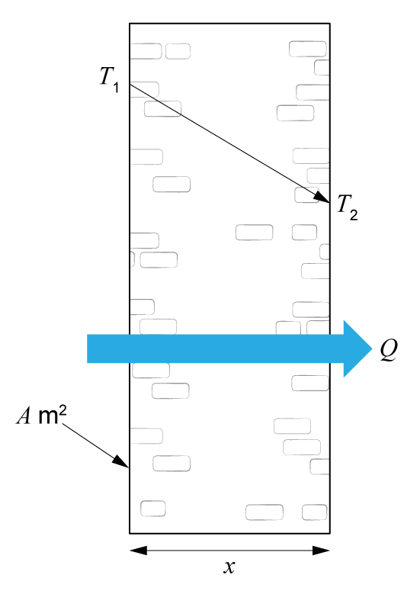
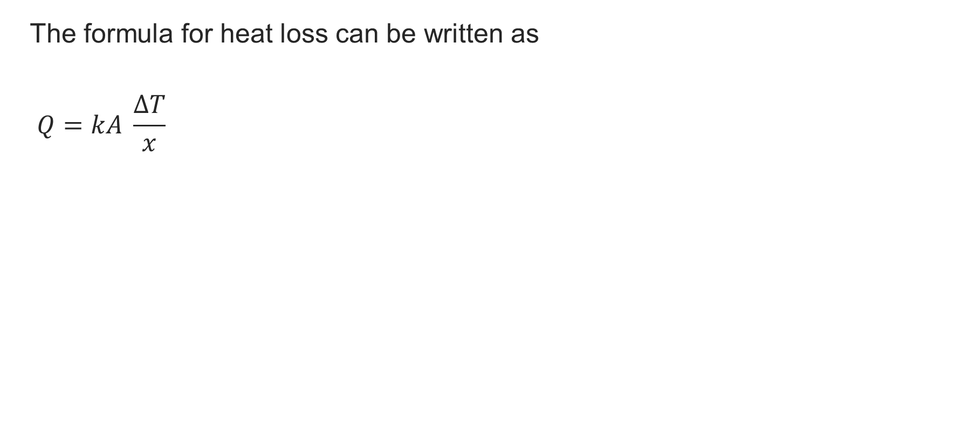
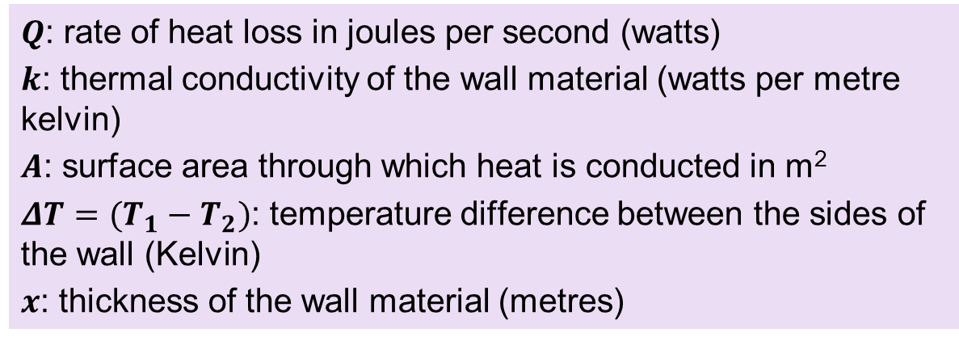
Heat loss formula
Activity 1
Lesson 3: Using differentiation in construction

Slide 8
Thermal resistance
Activity 1
Thermal resistance is how well a material can stop heat from passing through it.
The higher the thermal resistance, the better the material is at keeping heat inside or outside.
The thermal resistance of a surface depends on the conduction, convection and radiation at that surface.
Lesson 3: Using differentiation in construction

Slide 9
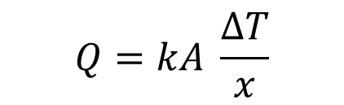
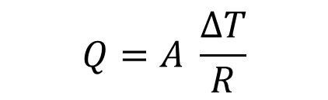
Thermal resistance and heat loss formula
Activity 1
The thermal resistance, R, is related to the thermal conductivity, k, and the wall thickness, x.
In fact, we can rewrite the formula for heat loss:
The rate of heat loss, Q, is inversely proportional to the thermal resistance, R.
Lesson 3: Using differentiation in construction

Slide 10
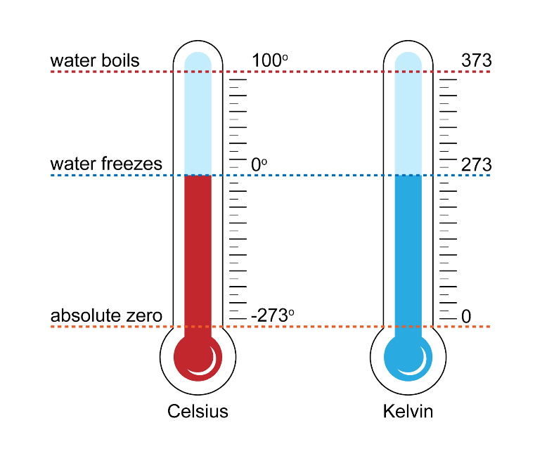
Temperature scales
Activity 1
This diagram shows how
the Celsius and Kelvin scales
compare.
Although the same temperature
is represented by a different value
on each scale, a change of 1°C
is equivalent to a change of 1 K.
Lesson 3: Using differentiation in construction

Slide 11
U-values
Activity 1
A U-value measures how well a material allows heat to pass through it.
It is the amount of heat which passes through 1 m² of a building for a 1 K (1 Kelvin) temperature difference between the air on one side and the air on the other side.
The units of U-values are watts per metre squared Kelvin (W/m²K).
Lesson 3: Using differentiation in construction

Slide 12
U-values
Activity 1
High U-value
The material lets heat through easily, causing more heat loss.
Low U-value
The material is better at stopping heat from escaping, which makes it a good insulator.
Lesson 3: Using differentiation in construction

Slide 13
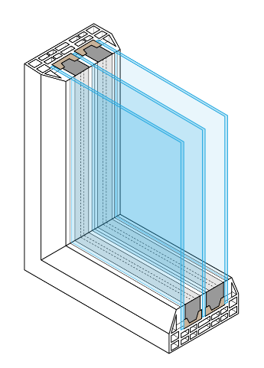
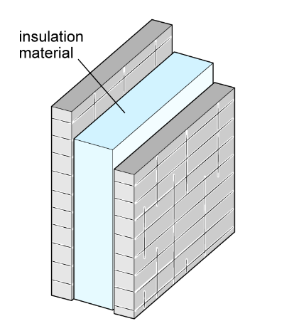
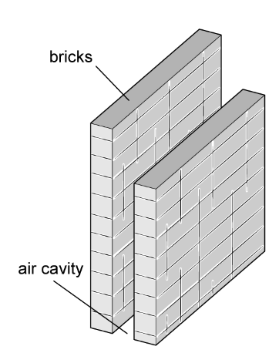
Range of typical U-values
Activity 1
Material | U-value (W/m²K)
Single-glazing | 4.8 – 5.8
Solid timber door | 3
Solid brick wall | 2
Double-glazing | 1.2 – 3.7
Cavity wall with no insulation | 1.5
Triple-glazing | 0.6 – 0.8
Insulated wall | 0.18
Triple-glazing
U-value = 0.6 – 0.8 W/m²K
Cavity wall with insulation
Cavity wall with no insulation
U-value = 0.8 W/m²K
U-value = 1.5 W/m²K
Lesson 3: Using differentiation in construction

Slide 14
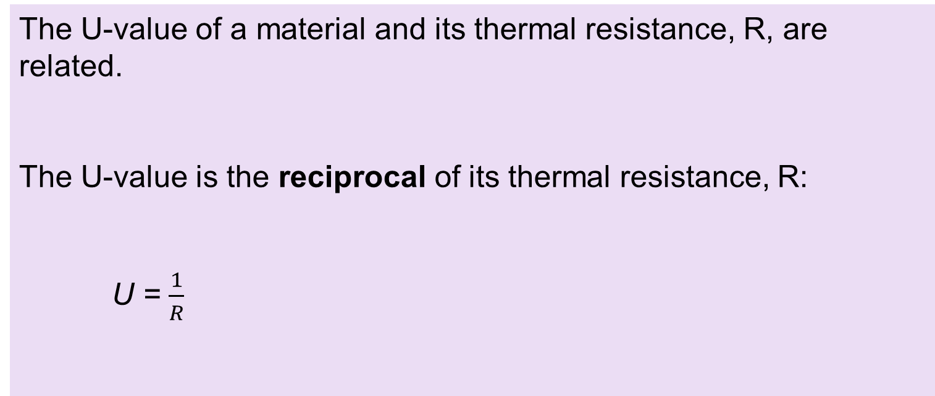
Thermal resistance and U-values
Activity 1
The U-value of a material and its thermal resistance, R, are related.
The U-value is the reciprocal of its thermal resistance, R:
U = $\frac{1}{R}$
Lesson 3: Using differentiation in construction

Slide 15
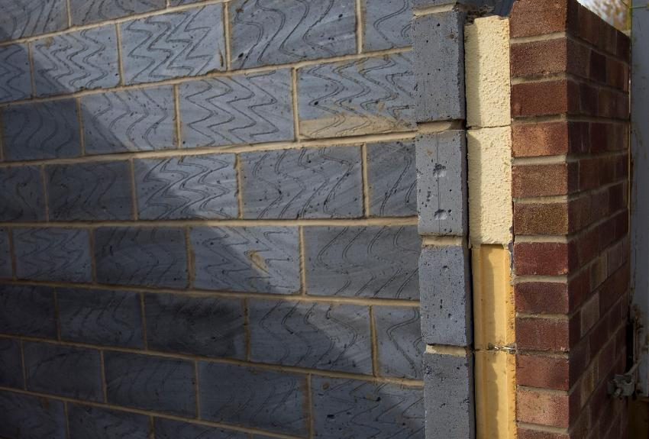
Calculating U-values
Activity 1
Many features of a building are made of different layers, for example a composite door or insulated cavity walls.
To find the thermal resistance, R, of such a feature, sum all the separate thermal resistances of each material.
Then calculate the reciprocal of the total to find the U-value.
Lesson 3: Using differentiation in construction
Notes:
Image © Shutterstock/Mark I Walker

Slide 16
Building choices
Activity 1
The U-value isn’t the only factor to be considered when deciding which building materials to use.
For example, RAAC is a bubble-filled concrete that was widely used as it was cheap, lightweight and a good thermal insulator. However, it was only designed to last 25–30 years, after which it no longer works, as cracks begin appearing in the material.
Factors to consider
Use of the material
Cost
Appearance/ design
Building standards
Durability
U-value
Lesson 3: Using differentiation in construction

Slide 17
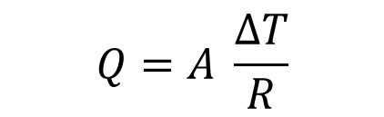

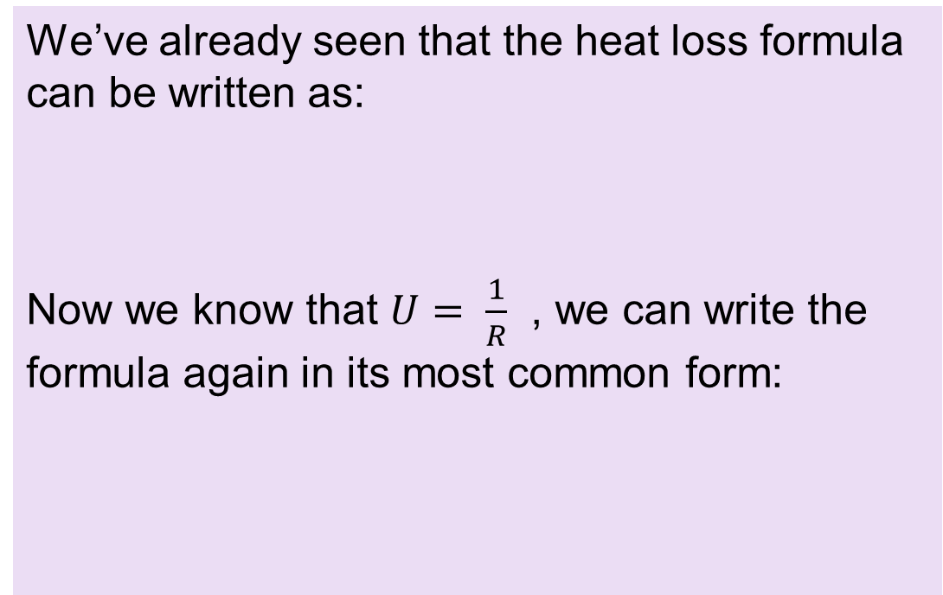
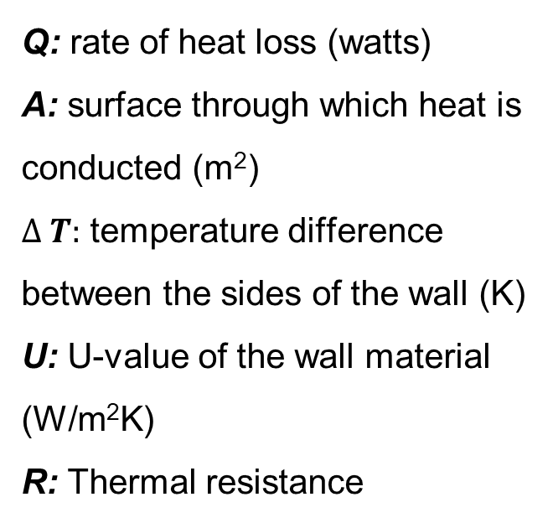
Calculating heat loss
Activity 1
We’ve already seen that the heat loss formula can be written as:
Now we know that $U= \frac{1}{R}$ , we can write the formula again in its most common form:
Q: rate of heat loss (watts)
A: surface through which heat is conducted (m²)
$∆ T:$ temperature difference between the sides of the wall (K)
U: U-value of the wall material (W/m²K)
R: Thermal resistance
Lesson 3: Using differentiation in construction

Slide 18

Heat loss and U-values: worked example
Activity 1
Worked example – Follow along using the Activity 1 Worked example.
Calculate the heat loss by 1 m² of this cavity wall when the temperature difference either side of the wall is 10°C.
The makeup of the cavity wall consists of:
Material | R
100 mm clay brick | 0.18
50 mm air gap | 0.18
50 mm expanded polystyrene board | 1.25
100 mm concrete block | 0.15
Outside surface resistance | 0.06
Inside surface resistance | 0.12
The cavity wall has R equal to the sum of the R values of each of its parts.
Lesson 3: Using differentiation in construction

Slide 19
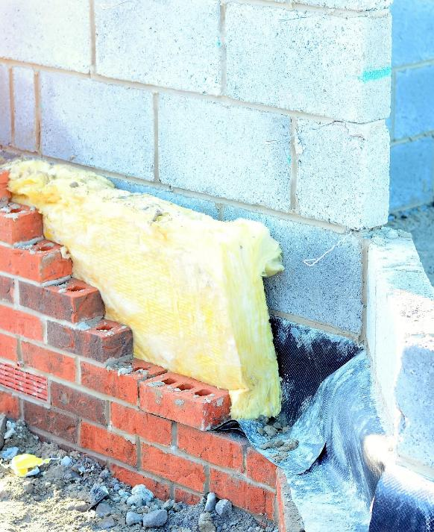
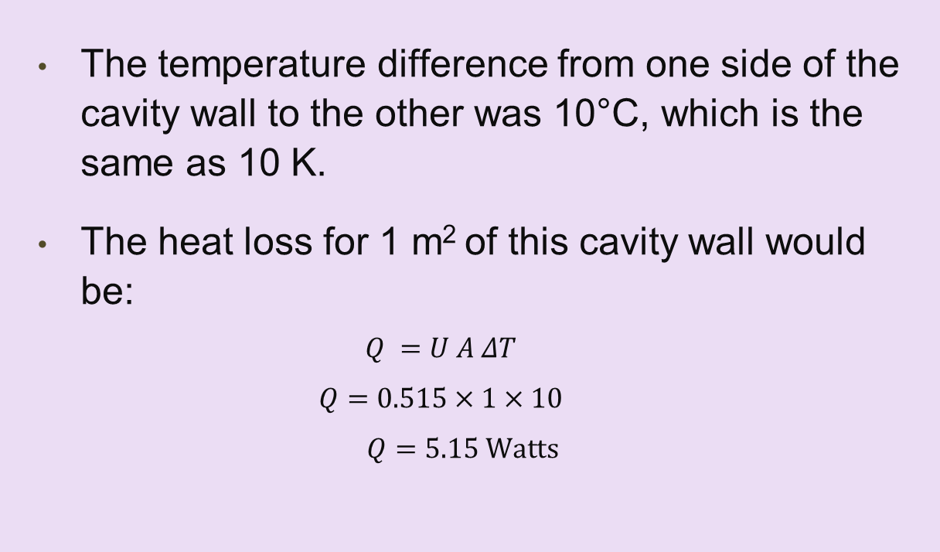
Heat loss and U-values: worked example
Activity 1
The temperature difference from one side of the cavity wall to the other was 10°C, which is the same as 10 K.
The heat loss for 1 m2 of this cavity wall would be:
Lesson 3: Using differentiation in construction
Notes:
Image © Shutterstock/Irene Miller

Slide 20
Calculating heat loss: practice
Activity 1
Complete the practice questions on the worksheet.
Resources needed
L3 Activity 1 worksheet 1
Calculator
Lesson 3: Using differentiation in construction

Slide 21
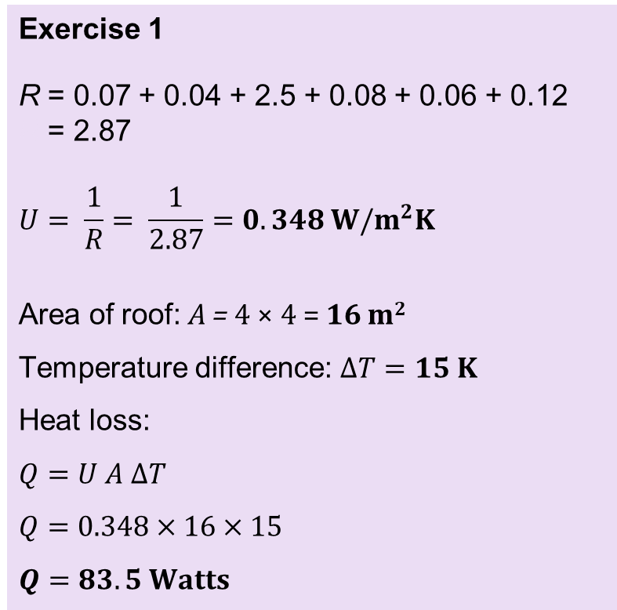
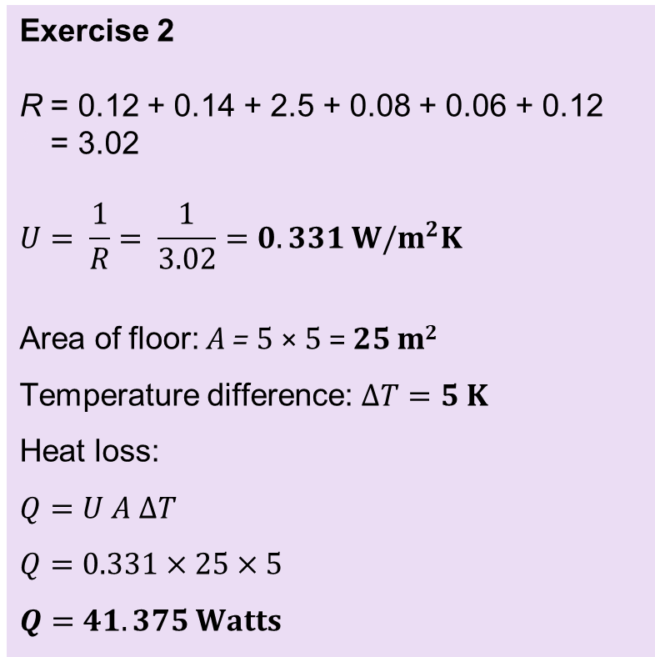
Heat loss practice question answers
Activity 1
Lesson 3: Using differentiation in construction

Slide 22
Minimising heat loss: practice
Activity 2
We can use differential calculus to optimise the dimensions of a building so that as little heat is lost as possible.
Read through the Activity 2 Worked example handout.
Complete the practice questions on the worksheet.
Resources needed
L3 Activity 2 Worked example
L3 Activity 2 worksheet
L3 Activity 2 worksheet answers
Calculator
Lesson 3: Using differentiation in construction

Slide 23
Discussion task
Plenary
Why is it important to calculate heat loss and U-values?
How are these calculations used in the construction industry?
Lesson 3: Using differentiation in construction

Slide 24
Multiple-choice questions
Plenary
Which of the following statements are correct?
The rate of heat transfer through a wall is:
proportional to the temperature difference between the inside and outside surface.
inversely proportional to the temperature difference between the inside and outside surface.
proportional to the thermal resistance of the material through which the heat is conducted.
inversely proportional to the thermal resistance of the material through which the heat is conducted.
Lesson 3: Using differentiation in construction

Slide 25
Multiple-choice questions
Plenary
Which of the following statements are correct?
The rate of heat transfer through a wall is:
proportional to the temperature difference between the inside and outside surface.
inversely proportional to the temperature difference between the inside and outside surface.
proportional to the thermal resistance of the material through which the heat is conducted.
inversely proportional to the thermal resistance of the material through which the heat is conducted.
Answers
The rate of heat transfer through a wall is:
A. proportional to the temperature difference between the inside and outside surface.
D. inversely proportional to the thermal resistance of the material through which the heat is conducted.
Lesson 3: Using differentiation in construction

Slide 26
Multiple-choice questions
Plenary
Which one of the following materials will have the lowest U-value?
double-glazed window pane
solid timber door
insulated cavity wall
solid brick wall
Lesson 3: Using differentiation in construction

Slide 27
Multiple-choice questions
Plenary
Which one of the following materials will have the lowest U-value?
double-glazed window pane
solid timber door
insulated cavity wall
solid brick wall
Answer
C. insulated cavity wall
Lesson 3: Using differentiation in construction

Slide 28
In this lesson, we have:
Plenary
General competencies
English:
E2 Present information and ideas
E5 Synthesise information
Maths:
M2 Estimate, calculate and spot errors
M3 Proportion
M4 Use rules and formulae
M5 Process data
M8 Communicate using maths
Digital:
D3 Communicate and collaborate
explained how heat is lost from a building and ways in which this can be minimised;
calculated U-values and heat loss through a structure;
used differential calculus to plan the construction of a house which minimises heat loss.
Lesson 3: Using differentiation in construction

Slide 29
Before next lesson:
Plenary
we will take some temperature measurements for use in a heat loss activity;
we will measure the temperature inside and outside a wall every 20 minutes over a period of 1–2 hours;
the data we collect will be used to calculate the total heat loss using integration.
Lesson 3: Using differentiation in construction

Slide 30
Consolidation
Consolidation
Using Consolidation worksheet 1, carry out some research into three different insulation materials.
Compare the materials based on their U-value, cost and environmental impact.
Summarise your findings in a table and then explain your findings.
Alternatively, complete the additional practice exercises in Consolidation worksheet 2 and check your answers using the answer sheet provided.
Resources needed
L3 Consolidation worksheet 1
L3 Consolidation worksheet 2
Calculator
L3 Consolidation worksheet 2 answers
Lesson 3: Using differentiation in construction

