Slide 1
Health
Route: Health & Science
Topic: Skin integrity
Resource 2: Pressure ulcer categories
Notes:
Image © Shutterstock/Pormezz

Slide 2
In this lesson, we will:
Introduction
Define evidence-based practice (EBP) in the context of pressure ulcer risk assessing
Consider the purpose of the National Wound Care Strategy Programme (NWCSP) in assessments
Identify NWCSP pressure ulcers categories 1 to 4
Skills:
CS1.2 Provide person-centred care
CS4.1 Undertake reflective practice and record reflections and experiences
General competencies:
English:
GEC2 Present information and ideas
GEC4 Summarise information/ideas
GEC5 Synthesise information
Mathematics:
GMC3 Working with proportion
Digital:
GDC1 Use digital technology and media effectively
Resource 2: Pressure ulcer categories

Slide 3

Evidence-based practice (EBP) in healthcare
Introduction
Evidence-based practice (EBP) is a systematic approach that combines clinical expertise, patient values and the best available research evidence in the decision-making process for patient care.
Why is EBP important in healthcare?
How do you think it applies to skin integrity?
Resource 2: Pressure ulcer categories
Notes:
Image © Shutterstock/FOTO Eak

Slide 4
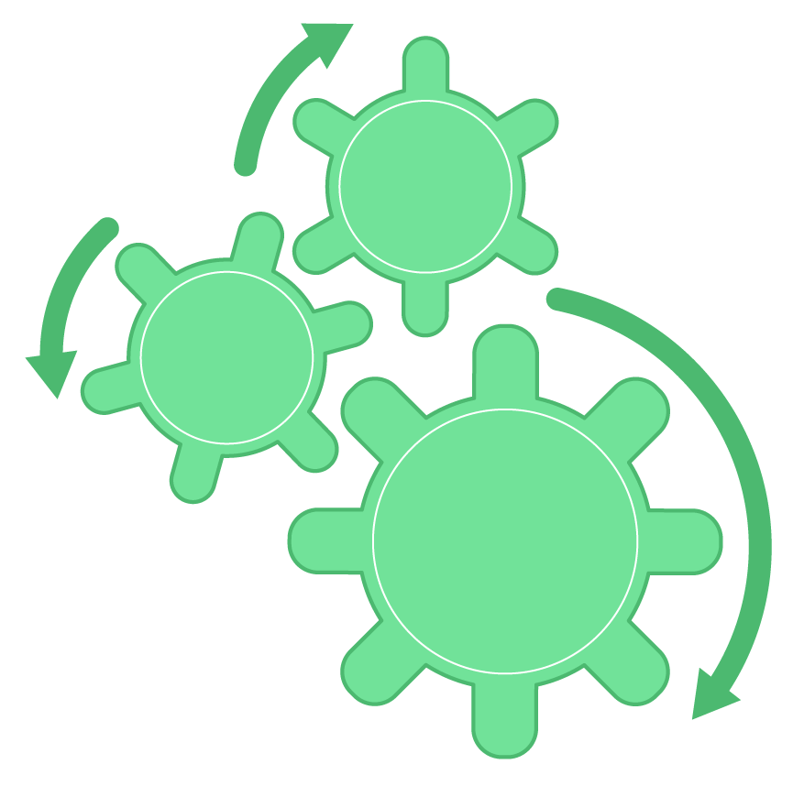
Using systematic approaches with skin integrity
Introduction
EBP is used to prevent and identify appropriate treatment of pressure injuries.
The same approaches are used across hospitals to:
categorise the risk of a person developing pressure injuries (Braden scale/Waterlow score);
assess the severity of pressure injuries, e.g. by using the National Wound Care Strategy Programme (NWCSP) categorisation tool.
This ensures consistency, reliability and efficiency in reducing the impact for patients. It also reduces costs to the NHS.
Risk factors
Prevention actions
Consistency with identification and level severity
Resource 2: Pressure ulcer categories
Notes:
Image © Gatsby Technical Education Networks

Slide 5

The National Wound Care Strategy Programme (NWCSP)
Introduction
The NWCSP has been commissioned by NHS England to improve the prevention and care of pressure ulcers.
They have developed standardised assessments for a consistent approach to categorising injuries depending on their severity.
Resource 2: Pressure ulcer categories
Notes:
Image © Shutterstock/Pormezz

Slide 6
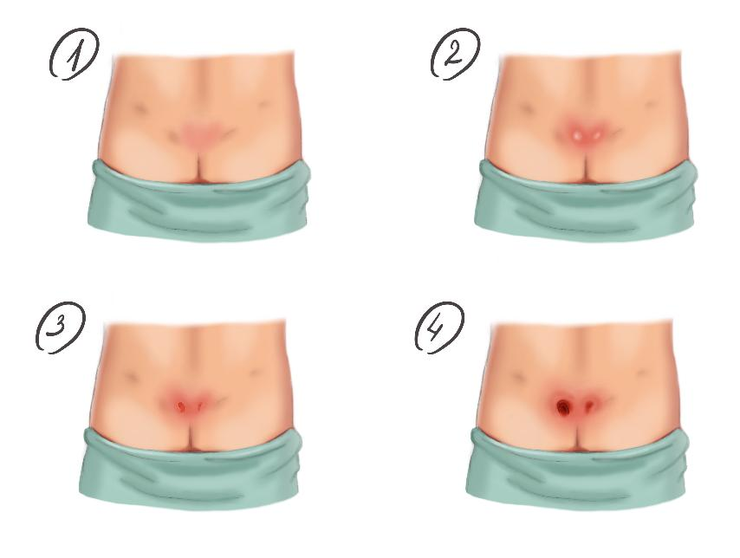
NWCSP categories
Introduction
The NWCSP system classifies pressure ulcers into four main categories:
  Non-blanchable erythema.
  Partial thickness skin loss.
  Full-thickness skin loss.
  Full-thickness tissue loss.
Resource 2: Pressure ulcer categories
Notes:
Image © Shutterstock/Artemida-psy

Slide 7
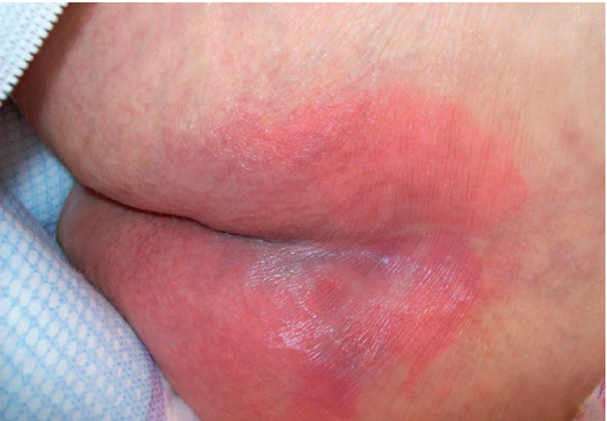

Non-blanchable erythema
Introduction
Erythema is an abnormal redness of the skin; this is more difficult to observe in darker skin tones. It is often accompanied by some level of swelling which can be accompanied by heat. It is an early warning sign of a pressure injury.
A non-blanchable erythema is discolouration of the skin that does not turn white when pressed. This is a Category 1 pressure injury.
Resource 2: Pressure ulcer categories
Notes:
(from top) Image 1 © DHG Healthcare
Image 2 © Talley Group Limited

Slide 8
Use the NWCSP categories
Activity
Your task:
Work with a partner.
View the images of pressure injuries.
Identify the category.
For any you are unsure of, discuss why.
Suggest what area of the body they are from and why they may have formed.
Be prepared to feedback your assessment and categories to the whole class.
Resource 2: Pressure ulcer categories

Slide 9
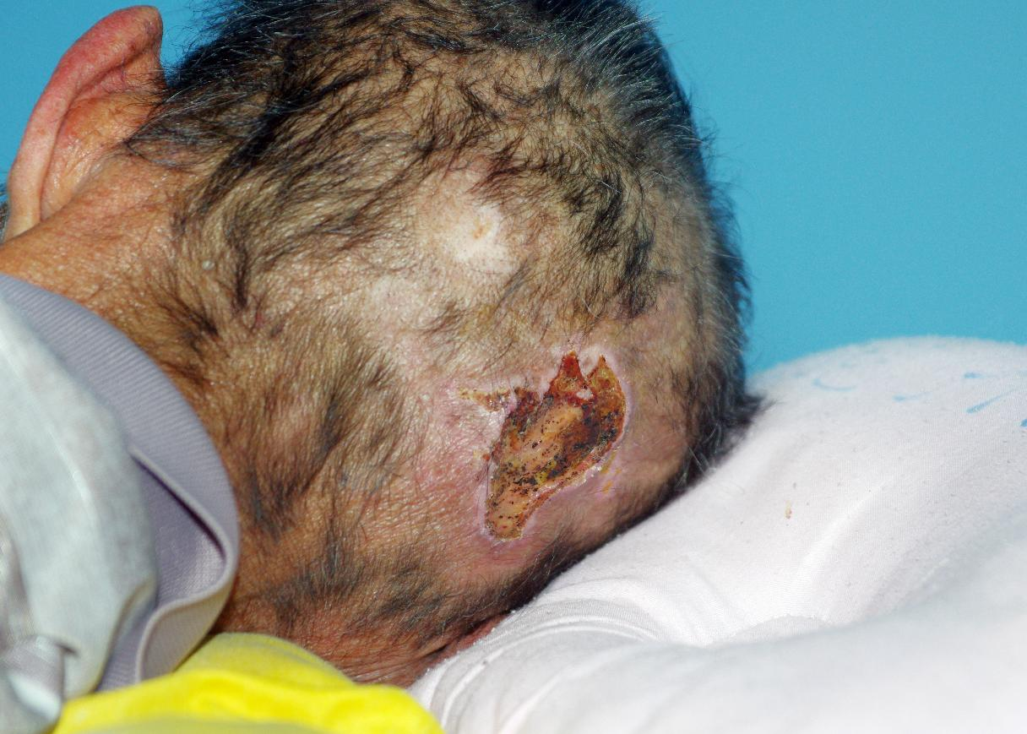
Image 1
Activity
Resource 2: Pressure ulcer categories
Notes:
Image © Shutterstock/phichet chaiyabin

Slide 10
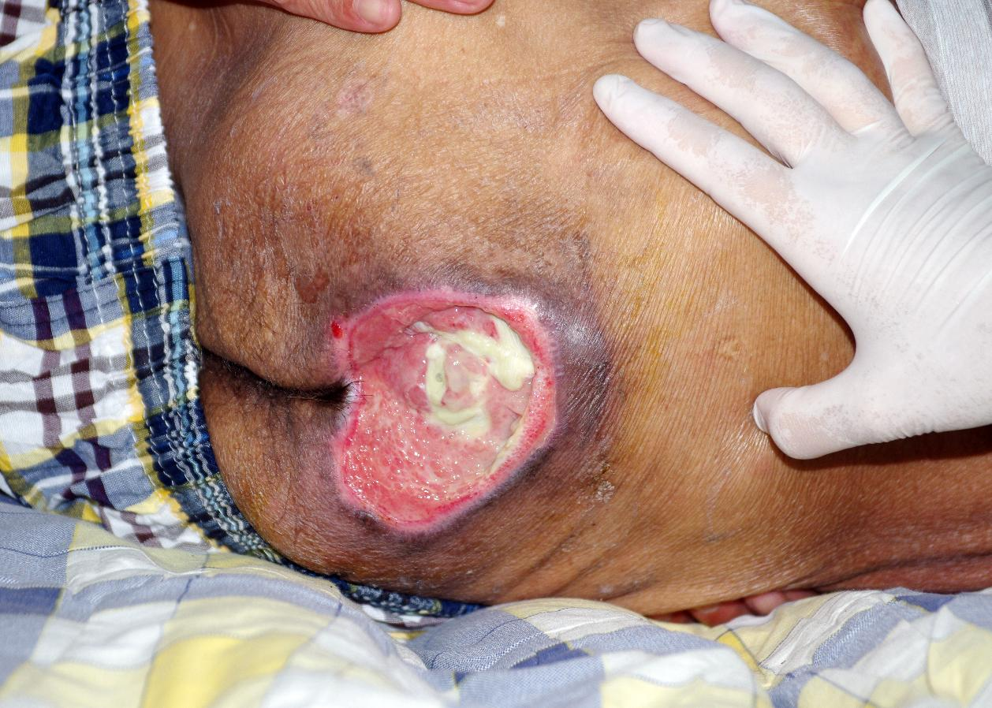
Image 2
Activity
Resource 2: Pressure ulcer categories
Notes:
Image © Shutterstock/phichet chaiyabin

Slide 11
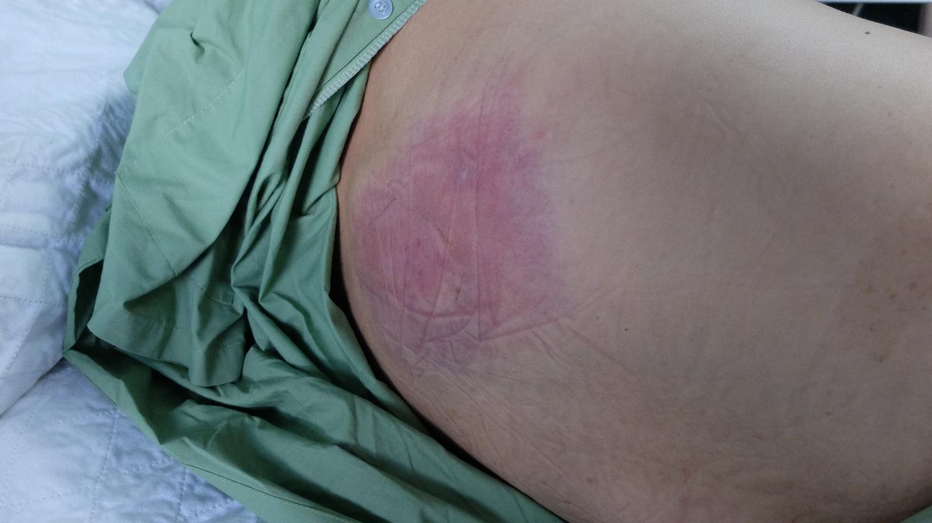
Image 3
Activity
Resource 2: Pressure ulcer categories
Notes:
Image © Shutterstock/Casa nayafana

Slide 12
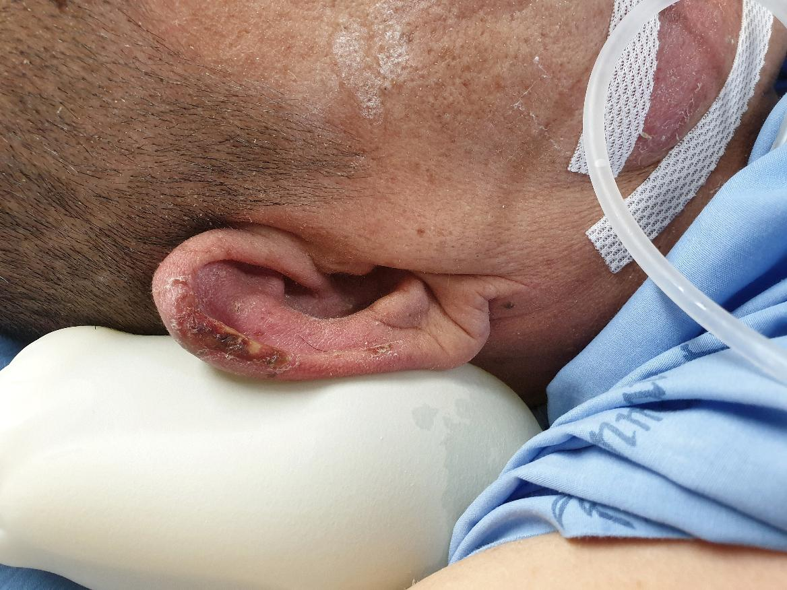
Image 4
Activity
Resource 2: Pressure ulcer categories
Notes:
Image © Shutterstock/Rojchana Loonrasri

Slide 13
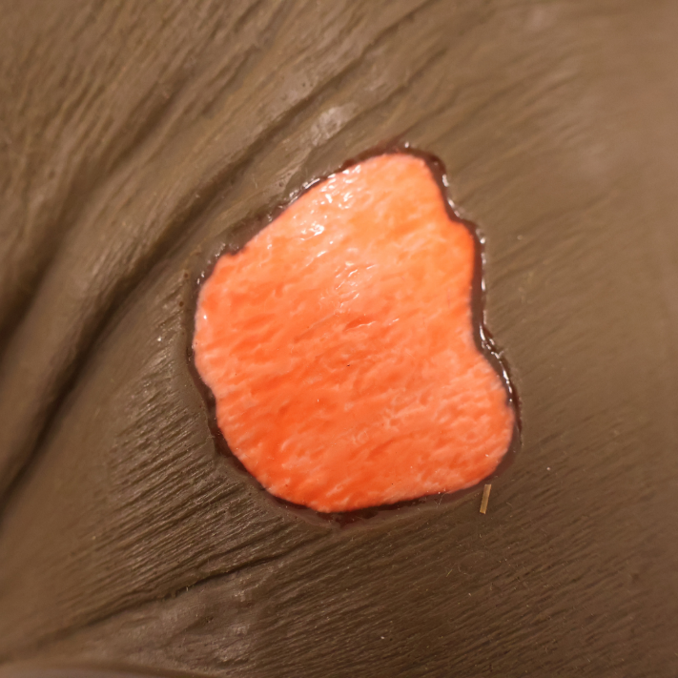
Image 5
Activity
Resource 2: Pressure ulcer categories
Notes:
Image © Sims & Skills Ltd

Slide 14
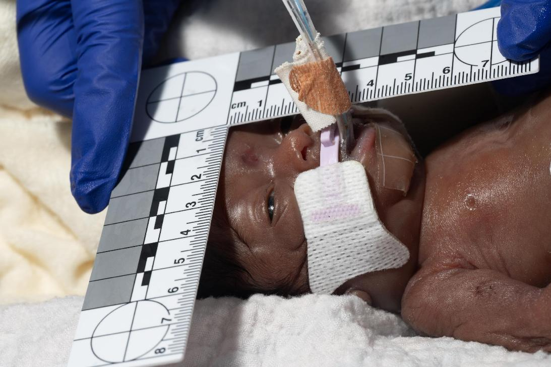
Image 6
Activity
Resource 2: Pressure ulcer categories
Notes:
Image © University Hospitals Bristol and Weston NHS Foundation Trust, Reframe Image Library

Slide 15
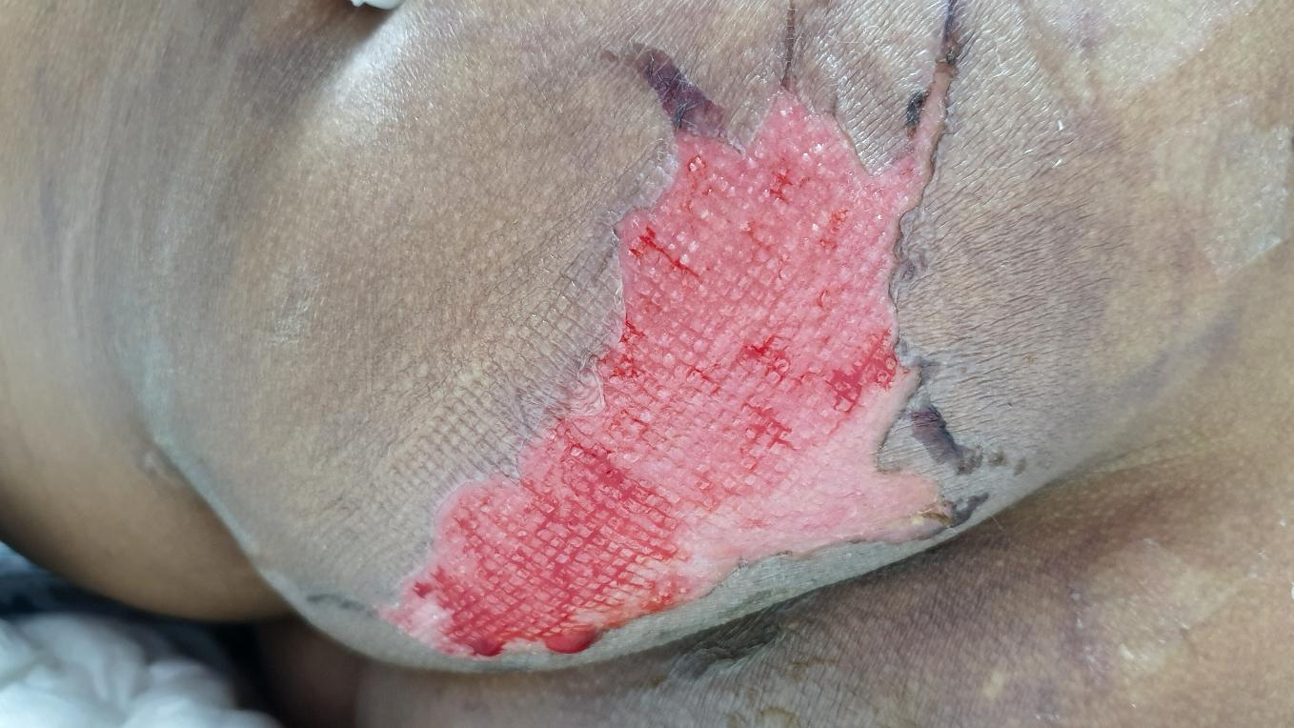
Image 7
Activity
Resource 2: Pressure ulcer categories
Notes:
Image © Shutterstock/RJ22

Slide 16
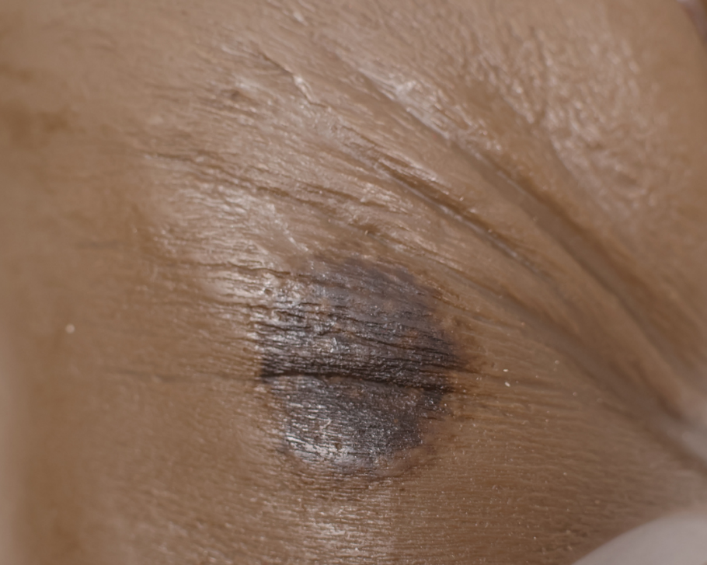
Image 8
Activity
Resource 2: Pressure ulcer categories
Notes:
Image © Sims & Skills Ltd

Slide 17
In this lesson, we have:
Plenary
Defined evidence-based practice (EBP) in the context of pressure ulcer risk assessing
Considered the purpose of the National Wound Care Strategy Programme (NWCSP) in assessments
Identified NWCSP pressure ulcers categories 1 to 4
Skills:
CS1.2 Provide person-centred care
CS4.1 Undertake reflective practice and record reflections and experiences
General competencies:
English:
GEC2 Present information and ideas
GEC4 Summarise information/ideas
GEC5 Synthesise information
Mathematics:
GMC3 Working with proportion
Digital:
GDC1 Use digital technology and media effectively
Resource 2: Pressure ulcer categories

