Slide 1
Health
Route: Health & Science
Topic: Skin integrity
Introductory lesson: Pressure injuries
Notes:
Image © Shutterstock/Pormezz

Slide 2
In this lesson, we will:
Introduction
Summarise the function and structure of the skin
Define skin integrity and pressure injury
Explain how ageing changes the structure of the skin
Explain risk factors for pressure injuries
Skills:
CS5.1. Apply research skills
General competencies:
English:
GEC2 Present information and ideas
GEC4 Summarise information/ideas
GEC5 Synthesise information
Digital:
GDC1 Use digital technology and media effectively
Introductory lesson: Pressure injuries

Slide 3
Glossary
Introduction
Use the glossary document provided as a revision resource. Note down the key terms and their definitions as you come across them throughout the topic.
Think about the source of the information and use only credible/official sources.
The glossary contains two terms from this lesson as examples.
Resource needed:
Glossary
Introductory lesson: Pressure injuries

Slide 4
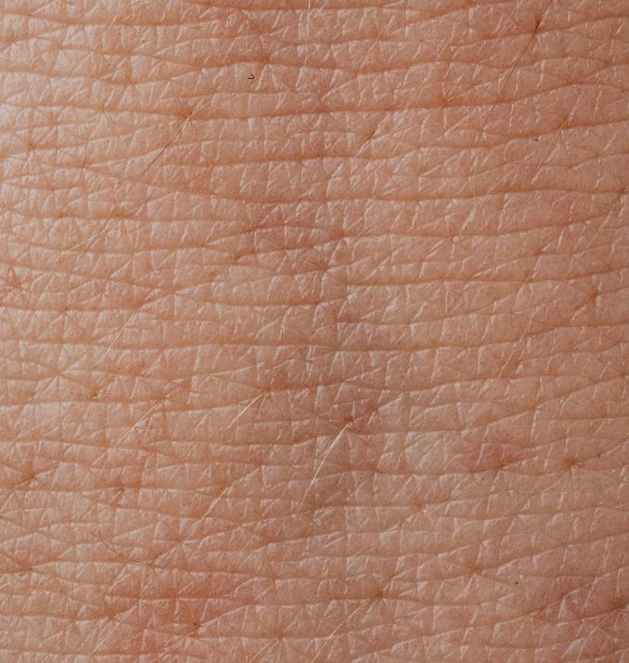
Skin quiz
Introduction
1. The skin is part of which body system?
A Circulatory
B Integumentary
C Endocrine
D Nervous
Introductory lesson: Pressure injuries
Notes:
Image © Pexels/Kaboompics.com

Slide 5
Skin quiz
Introduction
1. The skin is part of which body system?
A Circulatory
B Integumentary
C Endocrine
D Nervous
The skin is part of the integumentary system, along with the hair, nails and exocrine glands (glands that make and release substances through ducts onto your body surfaces).
Introductory lesson: Pressure injuries

Slide 6

Skin quiz
Introduction
2. Which vitamin is produced by the skin when exposed to UV radiation?
A A
B B
C C
D D
Introductory lesson: Pressure injuries
Notes:
Image © Unsplash/Chuttersnap

Slide 7
Skin quiz
Introduction
2. Which vitamin is produced by the skin when exposed to UV radiation?
A A
B B
C C
D D
UV radiation from the sun penetrates the skin and triggers the synthesis of vitamin D.
Vitamin D has many roles in the body, including bone health. It can also be found in some foods.
Introductory lesson: Pressure injuries

Slide 8
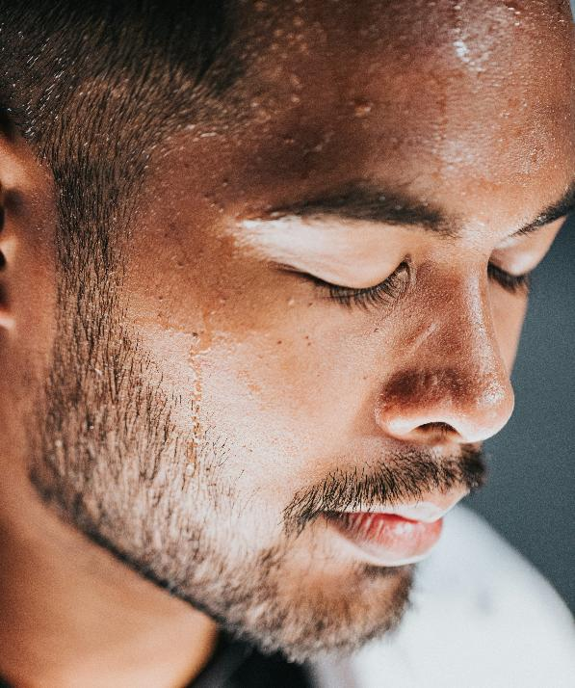
Skin quiz
Introduction
3. What are the functions of sweating?
A Temperature regulation, excretion and protection
B Temperature regulation and excretion
C Protection and temperature regulation
D Excretion and protection
Introductory lesson: Pressure injuries
Notes:
Image © Unsplash/Nathan Dumlao

Slide 9
Skin quiz
Introduction
3. What are the functions of sweating?
A Temperature regulation, excretion and protection
B Temperature regulation and excretion
C Protection and temperature regulation
D Excretion and protection
Temperature regulation: Sweating is the body's primary way to cool down and regulate body temperature.
Excretion: Sweating is a mechanism used to remove some toxic waste products.
Protection: Sweat contains antimicrobial substances that help the immune system fight off bacteria and fungi.
Introductory lesson: Pressure injuries

Slide 10
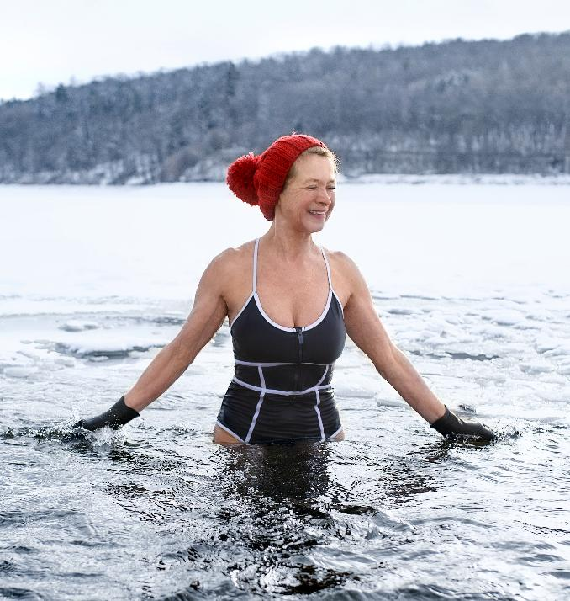
Skin quiz
Introduction
4. Which of these happens when the body gets too cold?
A Sweating and vasoconstriction
B Shivering and vasodilation
C Sweating and vasodilation
D Shivering and vasoconstriction
Introductory lesson: Pressure injuries
Notes:
Image © Shutterstock/Ground Picture

Slide 11
Skin quiz
Introduction
4. Which happens when the body gets too cold?
A Sweating and vasoconstriction
B Shivering and vasodilation
C Sweating and vasodilation
D Shivering and vasoconstriction
Shivering involves rapid, involuntary muscle contractions that generate heat as a by-product of energy use (thermogenesis), helping warm the body.
Vasoconstriction narrows blood vessels near the skin, reducing blood flow to the surface. This minimises heat loss and redirects warm blood to the core, protecting vital organs.
Introductory lesson: Pressure injuries

Slide 12
Functions of the skin
Activity 1
Forms a protective barrier against microbes.
Regulates body temperature.
Prevents the loss of vital body fluids.
Shields the body from mechanical, physical and hazardous substances.
Protects against harmful sun exposure and radiation.
Removes toxins through sweat.
Detects sensations like touch, heat and cold.
Facilitates vitamin D production.
Resources needed:
Activity 1 Worksheet
Introductory lesson: Pressure injuries

Slide 13
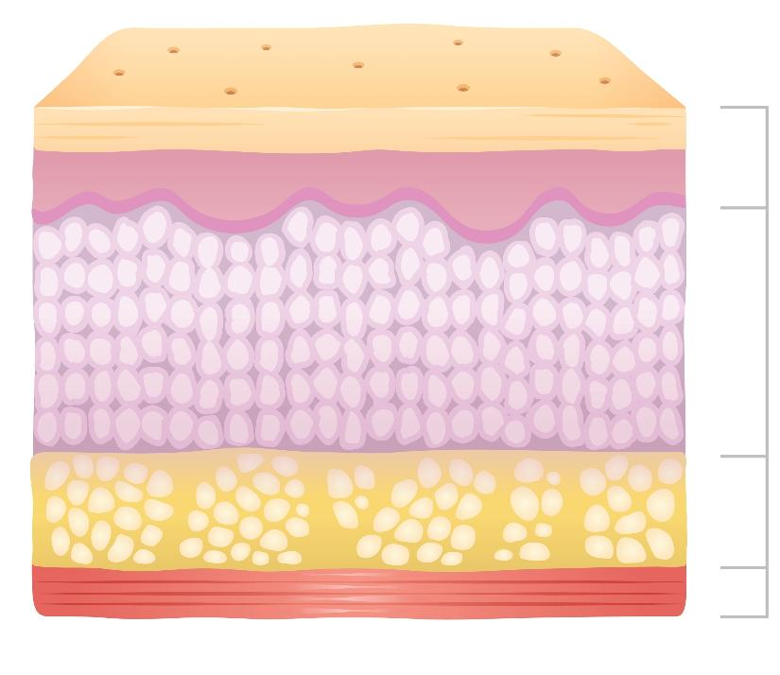
Skin layers
Activity 1
There are three layers of tissue that make up the skin:
  Epidermis
  Dermis
  Hypodermis/
  subcutaneous layer
Underneath these skin layers is muscle.
Epidermis
Dermis
Hypodermis/
subcutaneous layer
Muscle
Introductory lesson: Pressure injuries
Notes:
Image © Shutterstock/About time

Slide 14
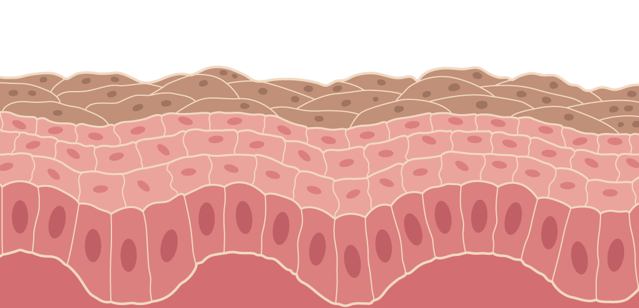
Epidermis
Activity 1
The epidermis contains dead cells.
It is avascular – it contains no blood vessels.
It provides a waterproof barrier.
It contains the pigment melanin, which creates the skin tone.
Top layer of dead cells continuously shed
Bottom layer of epidermis where the healthy cells are made
Introductory lesson: Pressure injuries
Notes:
Image © Gatsby Technical Education Networks

Slide 15
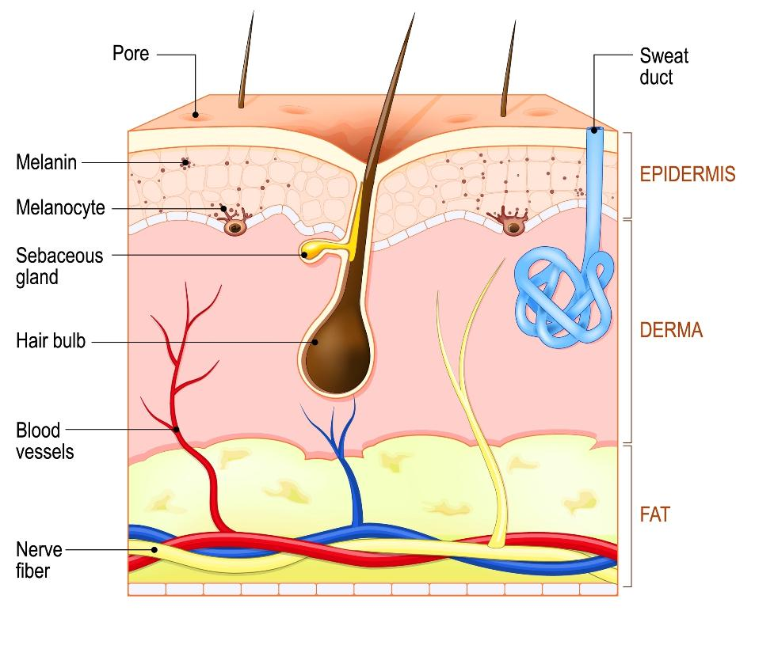
Dermis
Activity 1
The dermis is vascular. It contains blood vessels that nourish the epidermis and regulate body temperature.
It contains collagen and elastin fibres, which provide structural support, elasticity and strength to the skin.
It also contains hair follicles, sweat glands and nerve endings.
Epidermis
Dermis
Hypodermis/ subcutaneous layer
Introductory lesson: Pressure injuries
Notes:
Image © Shutterstock/Designua

Slide 16
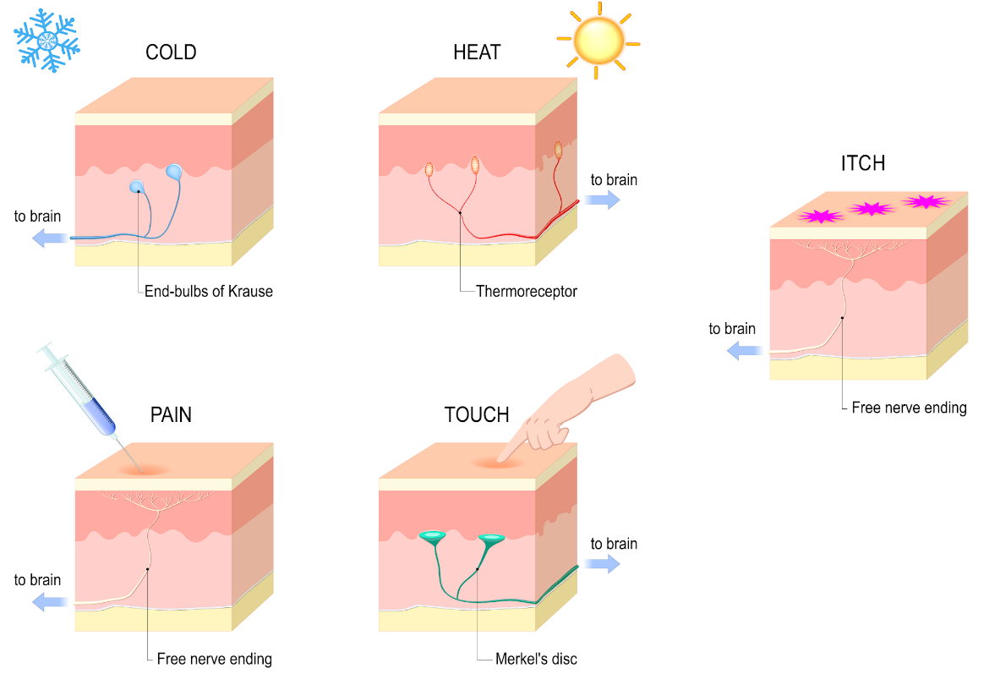
Cutaneous sensations
Activity 1
The dermis has nerve endings responsible for detecting cutaneous sensation.
Introductory lesson: Pressure injuries
Notes:
Image © Gatsby Technical Education Networks

Slide 17

Hypodermis/subcutaneous layer
Activity 1
Is responsible for fat storage.
It provides insulation, cushioning and a protective layer.
It contains larger blood vessels that serve those in the dermis. It also plays a role in temperature regulation by adjusting blood flow to the skin.
Epidermis
Dermis
Hypodermis/ subcutaneous layer
Introductory lesson: Pressure injuries
Notes:
Image © Shutterstock/Designua

Slide 18
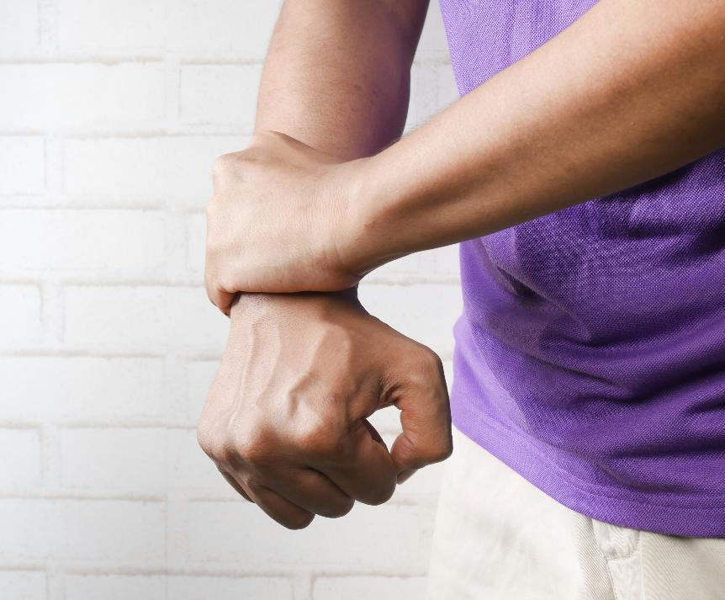
Skin scenarios
Activity 2
Multiple Sclerosis (MS) can cause a person to have altered sensations (pins and needles, burning or crawling sensations, numbness or tightness).
What causes this?
Introductory lesson: Pressure injuries
Notes:
Image © Unsplash/Towfiqu barbhuiya

Slide 19
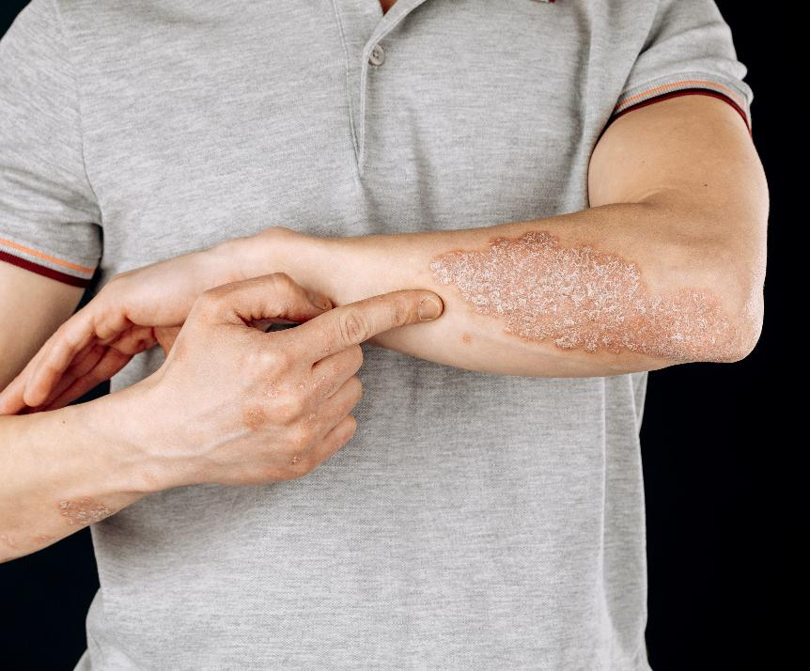
Skin scenarios
Activity 2
Psoriasis is a chronic condition where epidermal skin cells multiply too quickly.
What is the main symptom it causes?
Introductory lesson: Pressure injuries
Notes:
Image © Shutterstock/Fuss Sergey

Slide 20
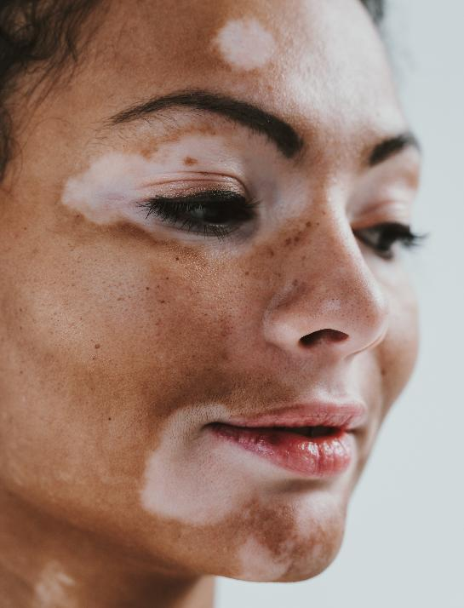
Skin scenarios
Activity 2
Vitiligo is an autoimmune disorder that causes loss of skin colour in patches.
What cells in the epidermis are being attacked by the immune system?
Introductory lesson: Pressure injuries
Notes:
Image © Shutterstock/oneinchpunch

Slide 21
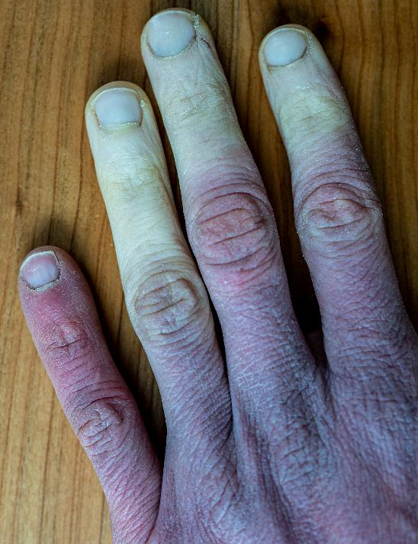
Skin scenarios
Activity 2
Raynaud's disease primarily affects the small blood vessels in the fingers and toes, causing them to constrict in response to cold or stress.
Why can this lead to tissue damage?
Introductory lesson: Pressure injuries
Notes:
Image © Shutterstock/bieszczady_wildlife

Slide 22
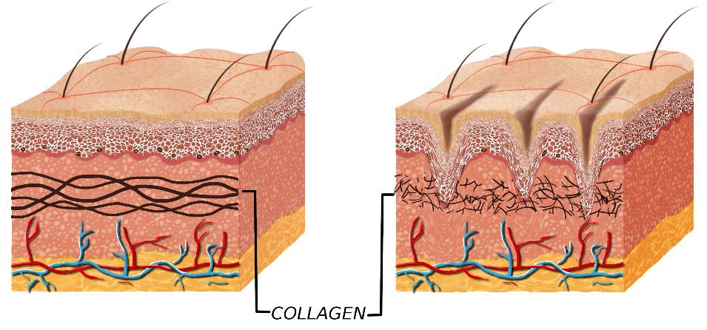
Ageing skin: Collagen production
Activity 3
As we age, the body produces less collagen (the main structural protein in the dermis, which gives the skin firmness, strength and elasticity).
What are the effects?
Younger skin
Older skin
Reduction in epidermis skin cells size causing wrinkles, sagging, thinning and moisture loss.
Reduced blood flow leading to a slower healing rate.
Introductory lesson: Pressure injuries
Notes:
Image © Shutterstock/Cessna152

Slide 23
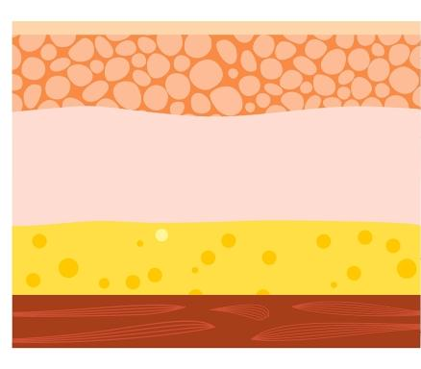
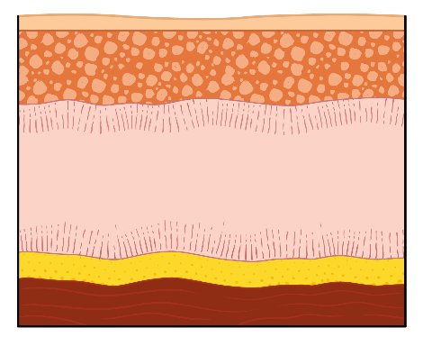
Ageing skin: Subcutaneous fat
Activity 3
epidermis
dermis
hypodermis/ subcutaneous
layer
Younger skin
Older skin
Subcutaneous fat just under the skin in the hypodermis layer makes up about 90% of our body fat. As we age, our subcutaneous fat layer gets thinner.
What are the effects?
Less protection against bumps and knocks.
Less insulation – older people are more affected by cold temperatures.
Introductory lesson: Pressure injuries
Notes:
Image © Shutterstock/Pikovit
Image © Gatsby Technical Education Networks

Slide 24
Ageing skin: Cutaneous sensations
Activity 3
Reduced nerve function: Ageing decreases the number and sensitivity of nerve endings in the skin.
Decline in blood flow: Reduced blood circulation in ageing skin affects nerve health.
Slower response to stimuli: Ageing nerves transmit signals more slowly.
What are the effects?
Reduction in the ability to detect touch, pressure, temperature and pain.
Delayed reactions to temperature changes, pain or tactile stimuli.
Introductory lesson: Pressure injuries

Slide 25
Ageing skin: Reduced nutrient absorption
Activity 3
As people age, their bodies become less efficient at absorbing nutrients from food.
This is due to several factors including reduced acid stomach production and less active digestive enzymes.
What are the effects on the skin?
Weakens the skin and reduces its ability to repair itself.
Introductory lesson: Pressure injuries

Slide 26
Skin integrity
Activity 3
Skin integrity is defined as the skin being ‘whole, intact and undamaged’.
Impaired skin integrity means there is structural damage or changes to the skin layers which means it is more vulnerable to injury.
A clinical task is to assess skin integrity, and there are tissue viability teams who work within hospitals. They are a group of specialist professionals who carry out assessments and treatment for patients who have complex skin damage and factors affecting the healing process.
Introductory lesson: Pressure injuries

Slide 27
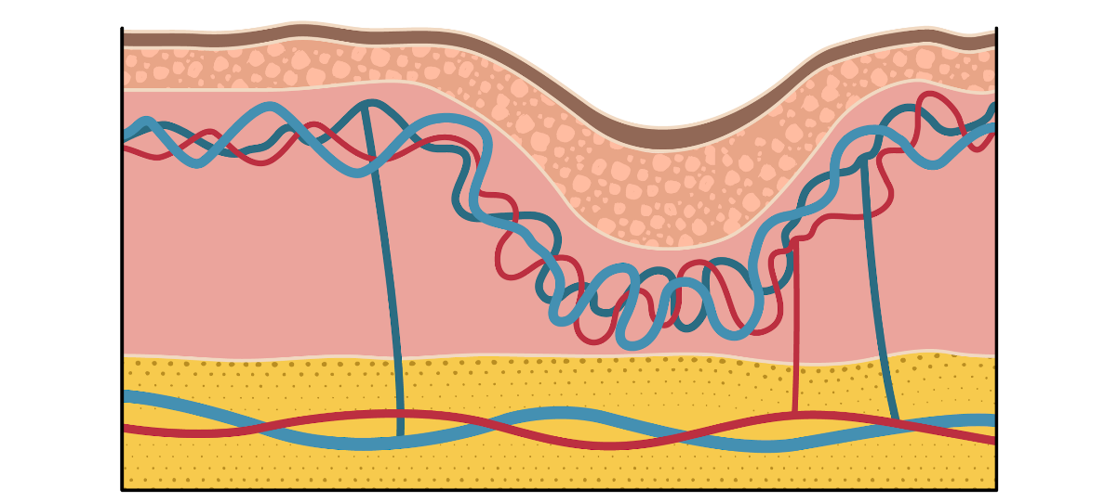
Pressure damages to skin
Activity 3
pressure
epidermis
dermis
plexus capillary network
hypodermis/ subcutaneous layer
Pressure on the top skin surface reduces blood flow in plexus capillaries under the skin in the epidermis and dermis skin layer. The blood flow to the site of new skin cells is reduced or stopped, and they start to die off without the nutrients and oxygen to function as they should.
Introductory lesson: Pressure injuries
Notes:
Image © Gatsby Technical Education Networks

Slide 28
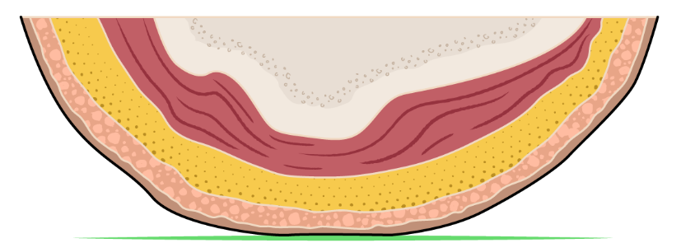
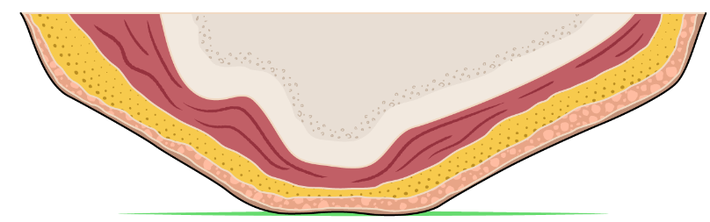
Skin integrity
Activity 3
Healthy skin
Fragile skin
Introductory lesson: Pressure injuries
Notes:
Image © Gatsby Technical Education Networks

Slide 29
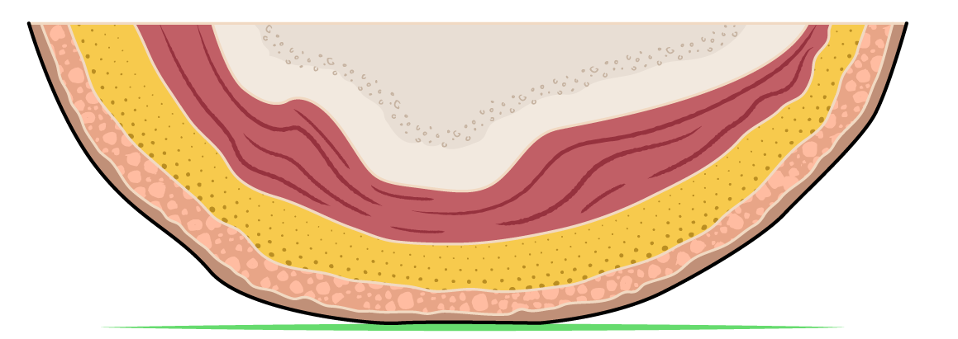
Skin integrity
Activity 3
Body-weight pressure
Healthy skin
The subcutaneous layer contains blood vessels and cushioning fat
Bone
Sweat glands lubricate the skin
The epidermis is where new cells are made
The epidermis is the outer protective layer
Surface pressure
Introductory lesson: Pressure injuries
Notes:
Image © Gatsby Technical Education Networks

Slide 30
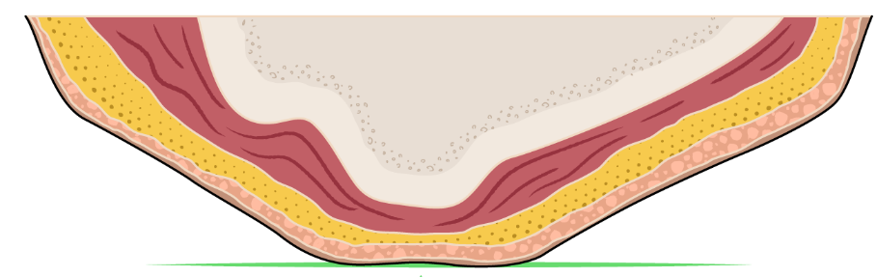
Skin integrity
Activity 3
Body-weight pressure
Fragile skin
The subcutaneous layer has fewer and flatter fat cells
Bones protrude
Fewer sweat glands make less lubrication
The epidermis produces cells more slowly
The epidermis is dry and loses cell layers
Surface pressure
Introductory lesson: Pressure injuries
Introductory lesson: Pressure injuries
Notes:
Image © Gatsby Technical Education Networks

Slide 31
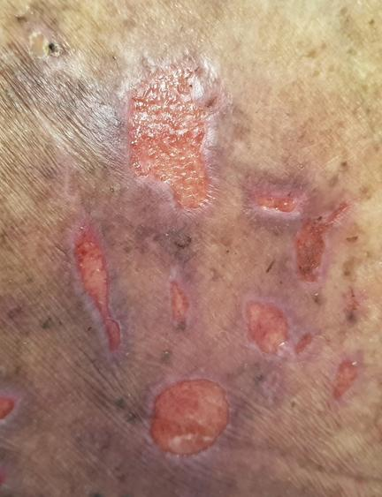
Pressure injuries
Activity 3
A pressure injury, also known as a pressure ulcer or bedsore, is an injury that occurs when the skin has been under pressure from body weight distribution or medical equipment/devices.
Blood flow is reduced in the dermis over a period of time, and the underlying tissue breaks down.
Introductory lesson: Pressure injuries
Notes:
Image © Shutterstock/RJ22

Slide 32
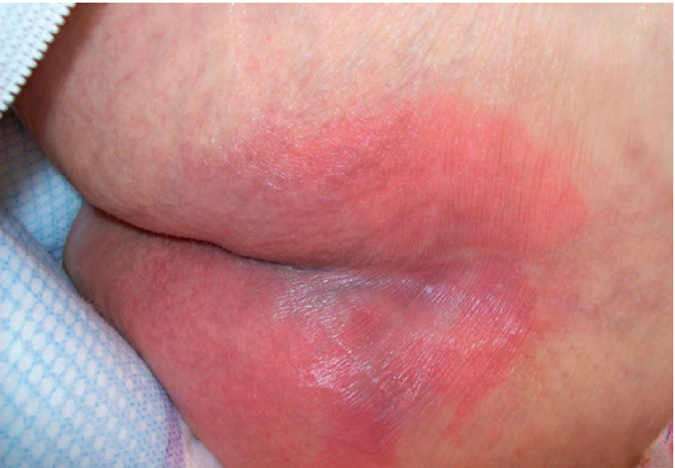
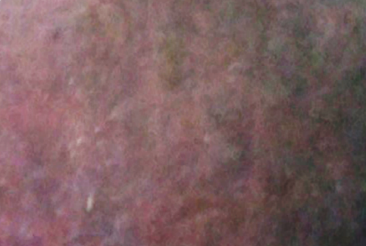
Pressure injuries
Activity 3
Early symptoms of pressure injuries include:
Changes to the colour of the skin (redness in paler skin tones, blue/purple on darker skin tones).
Pain or itchiness in the area.
Patches of skin feeling warmer or cooler than other areas.
Introductory lesson: Pressure injuries
Notes:
(from top) Image 1 © DHG Healthcare
Image 2 © Talley Group Limited

Slide 33
Risk factors for pressure injuries
Activity 3
Being obese (high BMI)
Incontinence
Smoking
Old age
Poor nutrition
Immobility
Poor circulation
Your task:
For each of these risk factors, discuss in pairs why you think it increases the risk of developing pressure injuries.
Check your ideas by researching online.
Introductory lesson: Pressure injuries

Slide 34
Obesity
Activity 3
With an increase in weight, the risk of developing a pressure ulcer increases.
A high BMI indicates a diet that lacks the nutrition needed for healthy skin.
A person who is obese is more likely to have comorbidities, such as diabetes.
Keeping skin clean is more difficult for someone who is morbidly obese, and skin folds are constantly moist with sweat. (Baumgarten et al, 2006 in Hyun et al, 2014)
Increased weight may make it harder to mobilise due to the increase in cardiac and respiratory demands on the body. This may contribute to a more sedentary lifestyle.
Introductory lesson: Pressure injuries
Notes:
https://oska.uk.com/busting-myths-what-is-the-impact-of-body-weight-on-pressure-ulcer-risk/#:~:text=Obese%20and%20extremely%20obese%20people,for%20those%20caring%20for%20them. (Baumgarten et al, 2006 in Hyun et al, 2014)

Slide 35
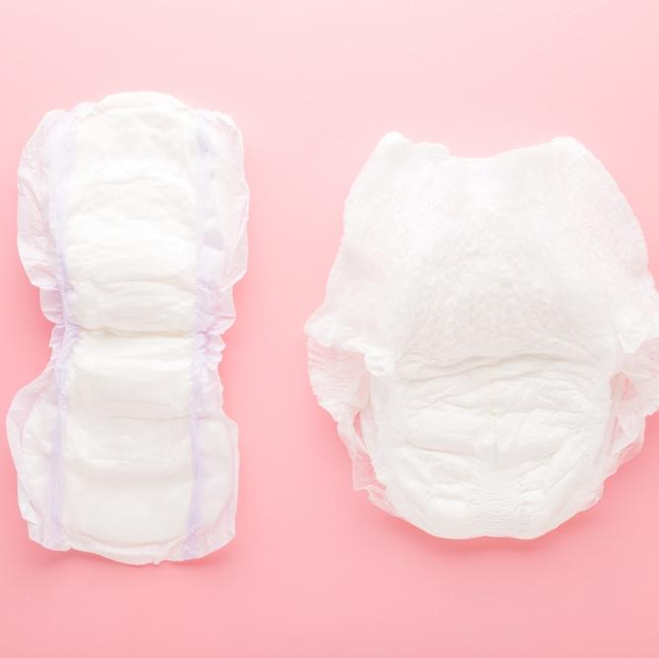
Incontinence
Activity 3
Repeated or prolonged exposure to urine and faeces can cause moisture lesions, breaking the skin integrity.
This could increase the susceptibility to pressure injuries.
With urine/faeces present, there is the added complication of infections.
Introductory lesson: Pressure injuries
Notes:
Image © Shutterstock/FotoDuets

Slide 36
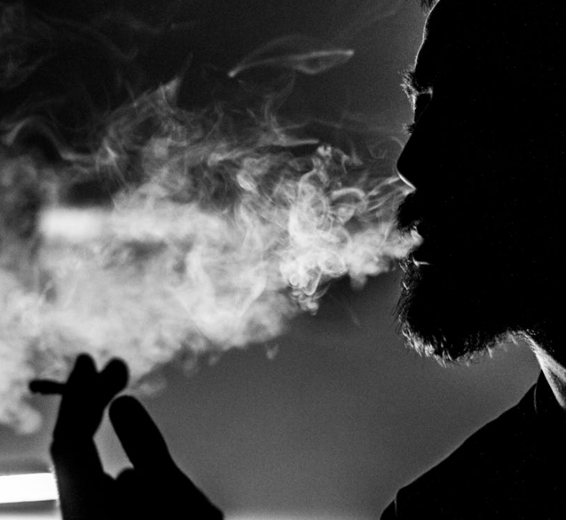
Smoking
Activity 3
  Smoking damages blood vessels, reducing blood flow and oxygen delivery to the skin and underlying tissues. This hampers the skin's ability to heal and increases the likelihood of tissue damage from prolonged pressure.
  Smoking impairs collagen production, which weakens the skin's structure and elasticity. Collagen is critical for the skin’s ability to resist pressure and heal from damage.
Introductory lesson: Pressure injuries
Notes:
Image © Pexels/Petar Starčević

Slide 37
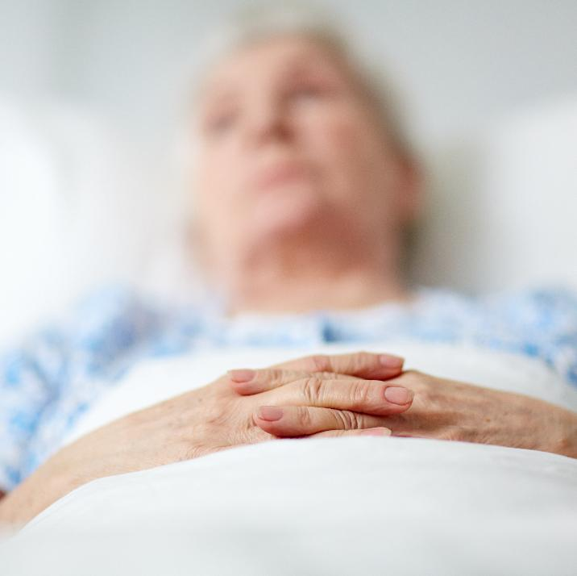
Ageing
Activity 3
Over 60% of pressure injuries occur in people over 70 years of age.
This is due to:
thinner, fragile skin;
reduced muscle and fat;
mobility issues;
poor circulation.
Introductory lesson: Pressure injuries
Notes:
Image © Shutterstock/Pressmaster

Slide 38
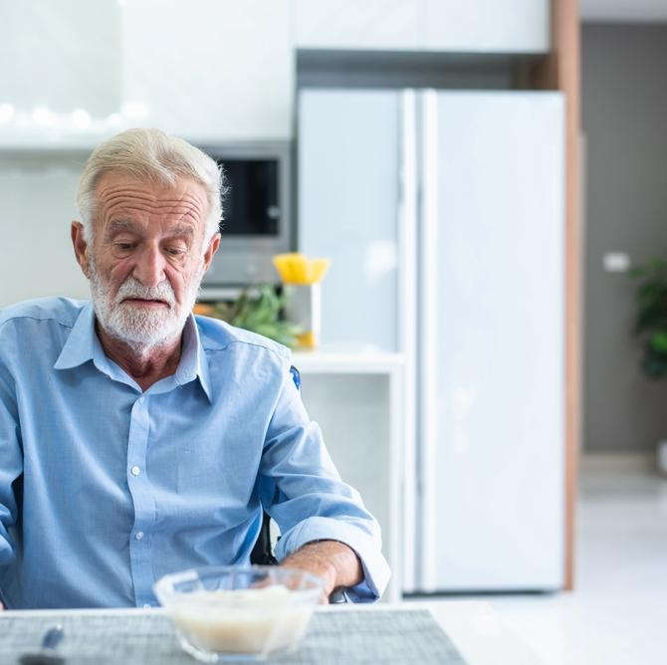
Poor nutrition
Activity 3
Insufficient intake of calories, protein and other essential nutrients weakens the skin, and reduces its ability to repair itself.
Also, dehydration can make the skin dry and less resilient, increasing the risk of breakdown from sustained pressure.
Introductory lesson: Pressure injuries
Notes:
Image © Shutterstock/CC7

Slide 39
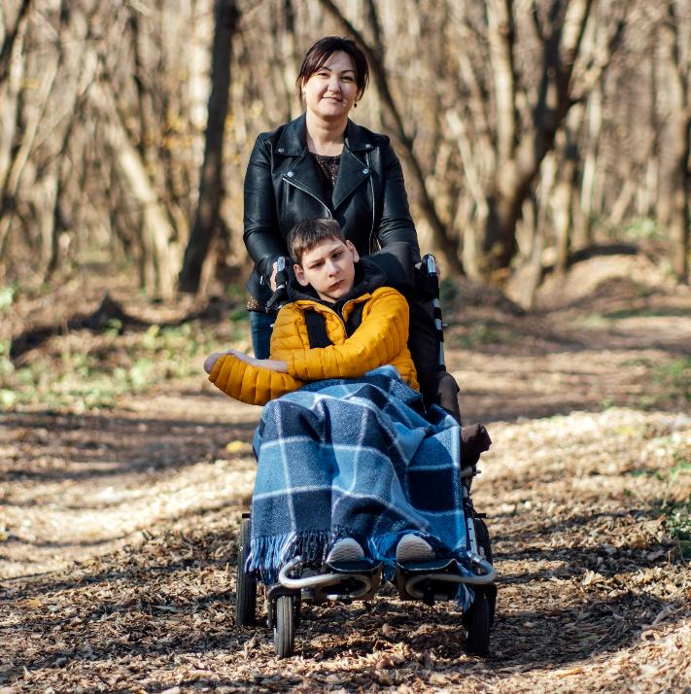
Immobility
Activity 3
A person who is unable to reposition themselves either lying down or sitting is vulnerable to developing a pressure ulcer.
Areas which are a bony prominence are at a higher risk resulting from sustained pressure by weight distribution.
They are also at a higher risk of pressure injury from shear and friction.
Introductory lesson: Pressure injuries
Notes:
Image © Shutterstock/Iryna Imago

Slide 40
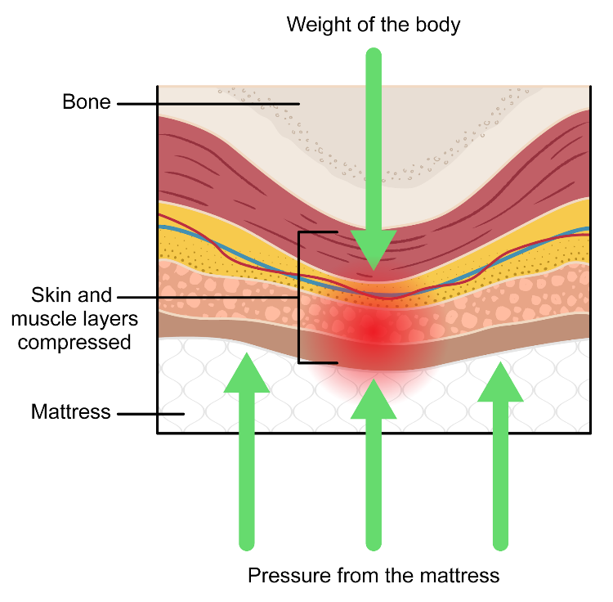
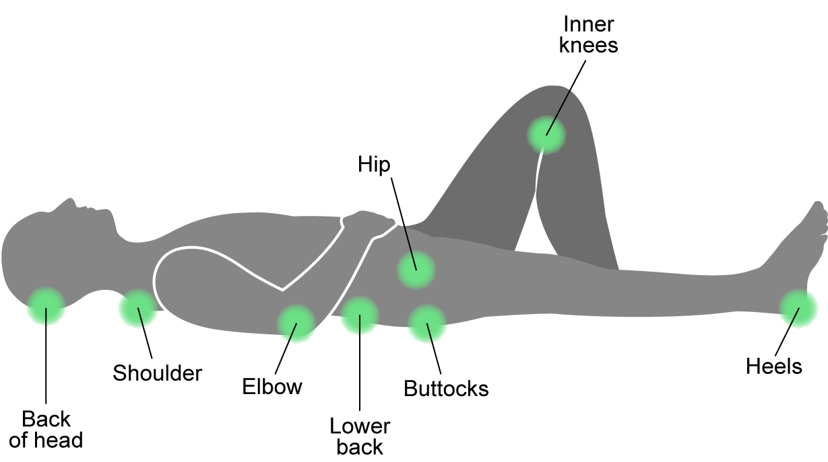
Immobility
Activity 3
Bony prominence areas when lying
Introductory lesson: Pressure injuries
Notes:
Image © Gatsby Technical Education Networks

Slide 41
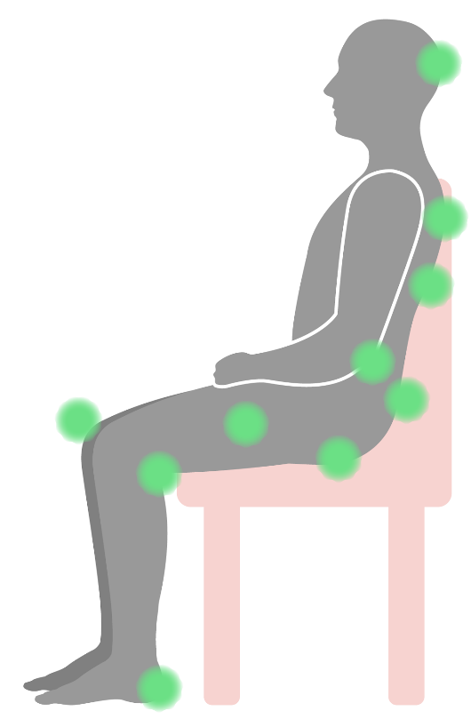
Immobility
Activity 3
Bony prominence areas when seated
Back of head
Shoulder blades
Between the knees
Bones of spine close to surface of skin
Elbows
Area at top of buttock crease
Back of knees
Bony part of the buttocks
Heels
Widest part of the
thighs when seated
Introductory lesson: Pressure injuries
Notes:
Image © Gatsby Technical Education Networks

Slide 42
Immobility
Activity 3
Immobility also increases the risk of pressure injury from shear and friction.
Shear occurs when the skin remains in place but the underlying tissues (like muscles and blood vessels) slide in opposite directions, often due to gravity or movement, e.g. sliding down in a bed or a wheelchair or reclining in a chair without proper support.
Friction occurs when the skin rubs against a surface, such as a bed, chair or clothing, causing mechanical damage to the epidermis. It can be caused by dragging a person across a bed or chair without lifting them, or by medical devices rubbing against the skin.
Introductory lesson: Pressure injuries

Slide 43
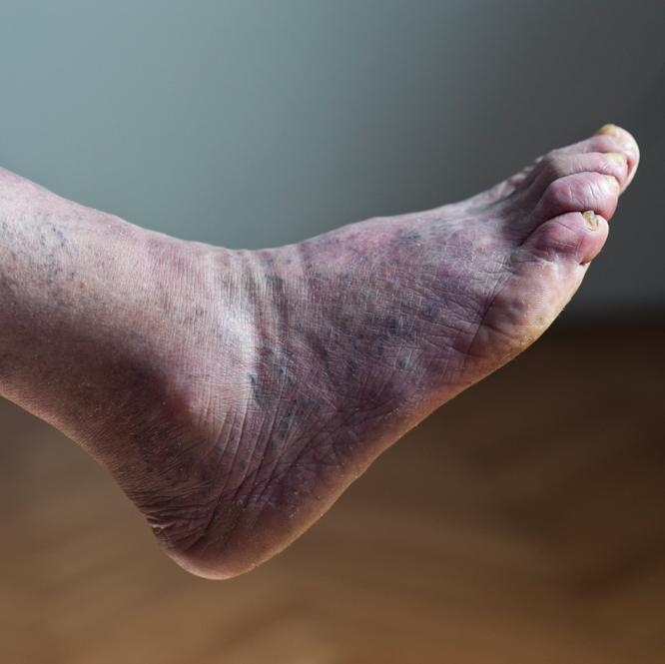
Poor circulation
Activity 3
Reduced blood flow, due to conditions like diabetes and vascular disease, limits the skin’s ability to receive the nutrients and oxygen needed for healing.
Introductory lesson: Pressure injuries
Notes:
Image © Shutterstock/MilosMomcilovic

Slide 44
Activity 4: Case studies task
Activity 4
Each group should complete one case study task, using Activity 4 worksheet.
Jim case study task:
Research how having diabetes affects the risk of developing pressure injuries.
Explain how high Jim’s risks of developing pressure injuries were during his recovery. Explain why.
Suggest how the risks could be lowered.
Bhavin case study task:
Research the symptoms of advanced MND.
Analyse the impact MND may have on Bhavin’s skin and pressure risk.
Explain how the risks could be lowered.
Introductory lesson: Pressure injuries

Slide 45
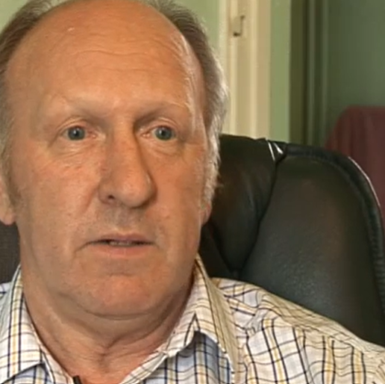
Case study: Jim
Activity 4
At age 56, Jim had a stroke.
He is diabetic.
After the stroke, he had a left-sided weakness and was not able to move the limbs on his left side unassisted. Physiotherapy sessions helped him to slowly regain movement.
He had difficulty swallowing.
Watch the video where Jim talks about his recovery.
Introductory lesson: Pressure injuries
Notes:
Image © NHS
Jim’s story – NHS https://www.nhs.uk/conditions/stroke/recovery/

Slide 46
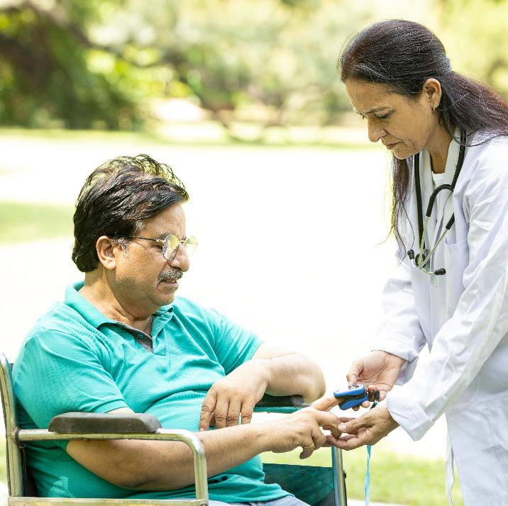
Case study: Bhavin
Activity 4
Bhavin is 71. He was diagnosed with Motor Neuron Disease (MND) almost three years ago.
His condition has deteriorated, and he is doubly incontinent. He is unable to move unaided, using a powered wheelchair which supports his head. His Body Mass Index (BMI) is 17.
Bhavin has moved into a nursing home for round the clock specialist care. A hoist is used to move Bhavin into his wheelchair from his bed.
Introductory lesson: Pressure injuries
Notes:
Image © Shutterstock/stockpexel

Slide 47
In this lesson, we have:
Plenary
Summarised the structure and functions of the skin
Defined skin integrity and pressure injury
Explained how ageing changes the structure of the skin
Explained risk factors for pressure injuries
Skills:
CS5.1. Apply research skills
General competencies:
English:
GEC2 Present information and ideas
GEC4 Summarise information/ideas
GEC5 Synthesise information
Digital:
GDC1 Use digital technology and media effectively
Introductory lesson: Pressure injuries

Slide 48
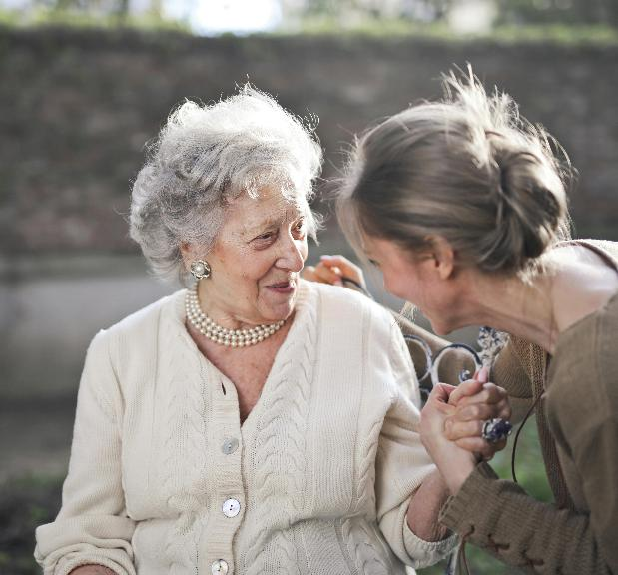
Consolidation: Case study – Delilah
Consolidation
Delilah is an 81-year-old patient living with dementia.
Your task:
Research symptoms associated with dementia.
Identify the factors that raises the risk of Delilah developing pressure ulcers.
In as much detail as possible, explain why each factor is a risk.
Resource: Consolidation worksheet
Introductory lesson: Pressure injuries
Notes:
Image © Pexels/Andrea Piacquadio

