Slide 1
Construction
Route: Construction
Topic: Calculating construction costs
Lesson 1: Calculating unit rates
Notes:
Image © Shutterstock/Dragon Images

Slide 2
In this lesson, we will:
Introduction
Identify the different costs involved in a construction project
Outline the roles of a quantity surveyor and an estimator
Calculate material and labour costs
Calculate unit rates
Skills:
CS3 Follow standard processes to produce unit rates, bills of quantities and their costing documentation
General competencies:
English:
E2 Present information and ideas
E5 Synthesise information
Maths:
M2 Estimate, calculate and spot errors
M3 Work with proportion
M4 Use rules and formulae
M5 Process data
M8 Communicate using mathematics
M9 Cost a project
Digital:
D3 Communicate and collaborate
Lesson 1: Calculating unit rates

Slide 3

What do you know about costs?
Introduction
Lesson 1: Calculating unit rates
Notes:
Image © Shutterstock/Dragon Images

Slide 4
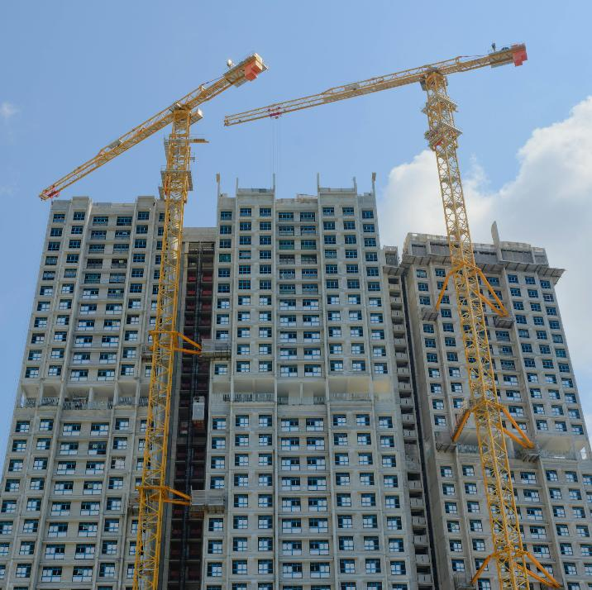
What construction costs can you think of?
Introduction
List the costs that you think a building site might generate.
In small groups, collate your lists and categorise them into different types of costs.
Lesson 1: Calculating unit rates
Notes:
Image © Pexels/CK Seng

Slide 5
Different construction costs
Introduction
Material costs: expenses associated with purchasing and delivering to site. For example, bricks, concrete, steel and insulation.
Labour costs: rates paid to construction workers and tradespeople plus any additional costs of employment.
Plant costs: the use of machinery and equipment needed on a construction site, including hire/purchase of items such as excavators, cranes and tools.
Preliminary costs: costs that are not covered in the measured work section of a Bill of Quantities (BoQ). Includes things before, during and after the project. For example, site setup, site fencing, site accommodation, site supervision, scaffolding, final cleaning, commissioning and handover.
Lesson 1: Calculating unit rates

Slide 6
Cost management and NRM 2
Introduction
Component | Included | Unit | Pricing method | Excluded
1 Testing and commissioning plan. | Costs associated with the following shall be deemed to be included in section 1.2.1: Management and staff costs: 1 Preparation of Commissioning Plan. | item | 1 Fixed charge 2 Time-related charge | 1 Testing and commissioning of services.
Handover. | Unless otherwise indicated, costs associated with the following shall be deemed to be included in section 1.2.1: Management and staff costs: 1 Preparation of Handover Plan.
 | 2 Training of building user’s staff in the operation and maintenance of the building engineering services systems.
 | 3 Provision of spare parts for maintenance of building and engineering services.
 | 4 Provision of spare parts and portable indicating instruments for the operation and maintenance of building engineering services systems.
 | 5 Pre-completion inspections.
 | 6 Final inspections.
This is an extract from the New Rules of Measurement 2 (NRM 2). NRM provide a standard set of measurement rules that can be applied to any project.
Preliminary costs are extensive and are detailed in the NRM.
Lesson 1: Calculating unit rates
Notes:
Extract from RICS New Rules of Measurement NRM 2 ISBN 9781842197165

Slide 7
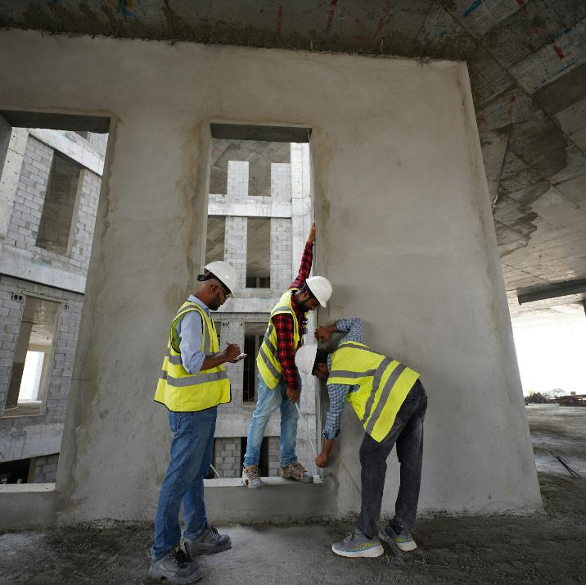
How and why are costs monitored?
Introduction
Valuations are carried out monthly.
These valuations help determine interim payments.
The BoQ can be used to complete a valuation.
Variations are included in the valuation.
A retention percentage can be deducted and retained, by the client, until the project is completed.
Lesson 1: Calculating unit rates
Notes:
Image © Unsplash/Glenov Brankovic

Slide 8
What if the scope of work changes?
Introduction
A variation is a change to the original scope of work. These can be modifications to design, materials, construction methods or project timelines.
It is important that changes are documented and agreed upon to manage costs and project quality effectively.
The architect or supervising officer usually give instructions about variations to the contracted works.
Reasons for a variation:
changes to design
unforeseen conditions, e.g. unexpected ground conditions
client requests
change in nominated subcontractors
adjustments needed to meet building control requirements.
changes in the law
inflation.
Lesson 1: Calculating unit rates

Slide 9

Why do we need to monitor costs?
Introduction
Understanding costs is essential for estimating and controlling budgets.
Controlling costs is important to ensure a project stays on budget and meets its financial objectives.
Mismanagement of resources can lead to delays, increased expenses, and financial strain on the contractor and the client.
Lesson 1: Calculating unit rates
Notes:
Image © Pexels/Pixabay

Slide 10
What factors can impact costs and profits?
Introduction
Think about the construction of a new residential building or commercial space.
Challenges
Increased cost of materials, labour, energy.
Harder to find skilled workers.
Biodiversity Net Gain (BNG) and the Building Safety Act (BSA) add more responsibilities.
Outcomes of challenges
Building residential and commercial property is more expensive and harder to manage.
Rules add cost but do not increase value of homes being built, making it difficult to make a good profit.
Lesson 1: Calculating unit rates

Slide 11

How can we manage these challenges?
Introduction
Planning ahead and using accurate data can help keep projects on track, even when costs and rules are changing.
A careful approach can help ensure projects end successfully and stay profitable.
An estimator, buyer and quantity surveyor all play a role in the estimation and control of costs on construction projects.
The contract will set out whether the client or the contractor is responsible when costs are changing.
Watch this video about estimating construction costs and make notes using the Introduction worksheet.
Lesson 1: Calculating unit rates
Notes:
Image © Pexels/Mohamed Hamdi
Estimating construction costs video: https://vimeo.com/1104064715/e1cf2c67fc

Slide 12

Quantity surveyor interview
Activity 1
Watch this video about the role of a quantity surveyor and make notes using the Activity 1 worksheet.
Lesson 1: Calculating unit rates
Notes:
Role of a quantity surveyor video: https://vimeo.com/1104064839/4c215420ba

Slide 13

What does a QS do?
Activity 1
The QS plays an important role in managing both the financial and contractual aspects of a construction project, ensuring smooth progress from start to finish.
The QS can work for clients or contractors.
Lesson 1: Calculating unit rates
Notes:
Image © Pexels/Thirdman

Slide 14
Responsibilities of a QS
Activity 1
The role of a QS begins at the planning stage. They help develop a detailed budget based on estimates detailed in the scope of work. They ensure that the costs are realistic and align with the overall objectives of the project.
Once construction begins, the QS monitors ongoing expenses through valuations.
They keep track of the variations and advise the client on potential financial risks or opportunities.
Lesson 1: Calculating unit rates

Slide 15

What does an estimator do?
Activity 1
The estimator is a key member of the team. They are responsible for calculating the cost estimate and price before construction begins.
They need to include all direct costs (e.g. labour, plant, materials) and indirect costs (e.g. supervision, office facilities, insurance, overheads and profit).
Lesson 1: Calculating unit rates
Notes:
Image © Unsplash/Jakub Zerdzicki

Slide 16
Labour costs
Activity 2
Many trades work together on a construction site.
The cost of using each trade varies.
Costs are dependent on the required
skill level, and whether professional qualifications are needed.
Make a list of all the trades that may be involved in a building project.
Rank your list from those which you think cost the most, to the least.
Lesson 1: Calculating unit rates

Slide 17
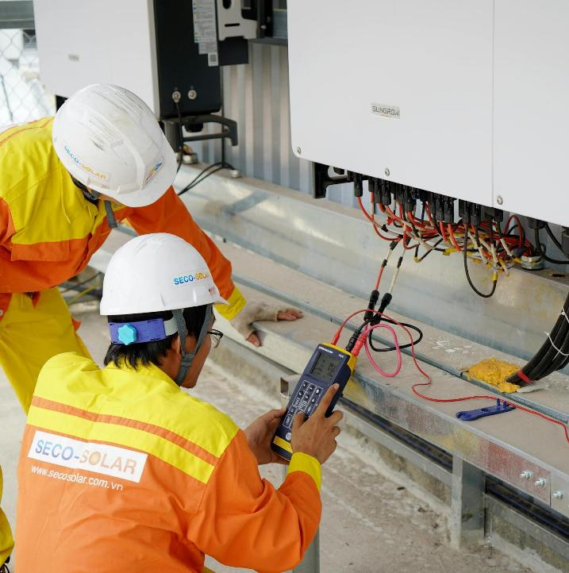
Labour costs
Activity 2
Trade | Hourly rate
Electrician | £40–70
Plumber | £40–60
Gas engineer | £40–50
Joiner/Carpenter | £30–45
Painter/Decorator | £30–45
Plasterer | £37–50
Roofer | £35–40
Bricklayer | £30–40
Labourer | £14–45
Plant operator | £14–20
Lesson 1: Calculating unit rates
Notes:
Image © Pexels/Trinh Tran
Please note, the rates shown are taken from: www.checkatrade.com/blog/cost-guides/how-much-do-tradespeople-cost/ and: www.jobsite.co.uk/jobs/plant-operator
Rates (as of April 2025) from:
https://www.checkatrade.com/blog/cost-guides/how-much-do-tradespeople-cost/
https://www.jobsite.co.uk/jobs/plant-operator

Slide 18
All-in labour rates
Activity 2
All-in labour rates cover all the incidental costs of employing a construction operative, not just the pay that the operative receives.
All-in labour rates are calculated each year when pay agreements are settled.
The Construction Industry Joint Council (CIJC) Working Rule Agreement (WRA) sets out standard rates for the construction industry.
The National Agreement for the Engineering Construction Industry (NAECI) sets terms and conditions of employment throughout the UK.
Incidental costs include:
inclement weather allowance
non-productive overtime costs
employers’ National Insurance Contributions (NIC)
sick pay allowance
Construction Industry Training Board (CITB) levy contributions
holiday credits
pension contributions
other allowances.
Lesson 1: Calculating unit rates

Slide 19
All-in labour rate: Calculation example
Activity 2
This table shows an example of the calculation of an
all-in labour rate.
It covers all the incidental costs of employing a construction operative.
Guaranteed minimum wages Contractor’s bonus allowance Inclement weather allowance (included via adjustment to working hours) Non-productive overtime costs Sick pay allowance Trade supervision Working Rule Agreement allowances (generally for labourers not craft operatives) Sub-total | £28,920 £3,219 – £1,007 £203 £1,740 – £35,089
CITB training contributions (0.35% on annual payroll £35,089) National Insurance Contributions (15% of average earnings £675 × 52wks) Holiday credits Tool allowances Sub-total | £123 £5,265 £4,172 £225 £44,874
Severance payments (2% of labour costs) Sub-total | £897 £45,771
Employer’s liability insurance (2% of labour costs) Annual cost per craft operative Number of productive hours worked All-in hourly rate (n ÷ o) | £915 £46,686 1834 £25.46
Lesson 1: Calculating unit rates
Notes:
Table from The Chartered Institute of Building Code of Estimating Practice 7th Edition (2009) ISBN 9781405129718 (modified to reflect increases in labour costs up to February 2025)

Slide 20
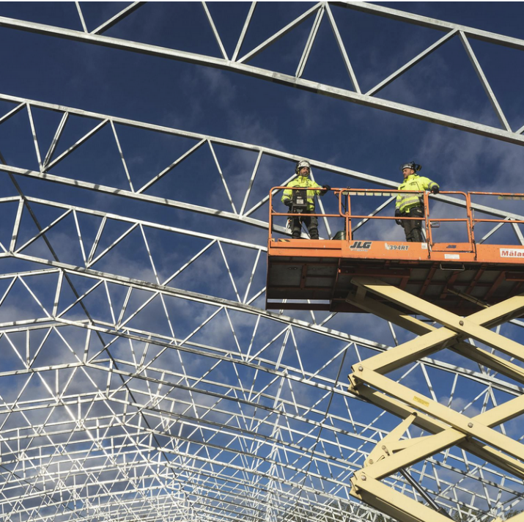
Examples of construction plant machinery
Activity 2
Excavator: for excavating foundations.
Concrete mixer: for mixing concrete and mortars.
Scaffolding: fixed access for working at height.
Scissor lift: mobile access to high areas.
Mobile crane: lifting heavy loads on large projects.
Plate compactor: for compacting soil or gravel for sub-bases.
Mobile generator: temporary power supply on site.
Lesson 1: Calculating unit rates
Notes:
Image © Pexels/Jimmy Nilsson Masth

Slide 21
Plant costs
Activity 2
What are these different types of machine used for?
Plant and equipment | Daily hire cost (£) | Weekly hire cost (£)
Excavator (mini) | £150 | £675
Concrete mixer | £50 | £225
Scaffolding | £100 | £450
Scissor lift | £120 | £540
Mobile crane | £300 | £1,350
Plate compactor | £45 | £180
Mobile generator | £50 | £225
Lesson 1: Calculating unit rates
Notes:
Please note, the rates shown are taken from: www.checkatrade.com/blog/cost-guides/how-much-do-tradespeople-cost/ and: www.jobsite.co.uk/jobs/plant-operator

Slide 22
Materials costs
Activity 2
Material type | Unit | Cost per unit | Coverage rate | Waste percentage
Paint | 1 litre | £15 | 10 m² per litre | 10%
Render (25 mm thick) | 1 m³ | £200 | 0.025 m³ per square metre | 5%
Bricks | 1000 bricks | £450 | 16 m² per metre | 2%
Blocks | 1 m² | £15 | 98 m² per 1000 | 5%
Paving slabs (600 mm × 600 mm) | 1 slab | £12 | 2.78 slabs per square metre | 5%
Cavity wall ties | 250 ties | £100 | 4 ties per square metre | 2%
Cement mortar (for a one brick wall) | 1 m³ | £5 | 0.054 m³ per square metre | 5%
Lesson 1: Calculating unit rates
Notes:
Please note, the rates shown are taken from: www.checkatrade.com/blog/cost-guides/how-much-do-tradespeople-cost/ and: www.jobsite.co.uk/jobs/plant-operator

Slide 23

Unit rate
Activity 3
A unit rate refers to the cost per unit of measurement (for example £ per m³ of concrete).
The unit rate calculation includes material costs, wastage, labour and sometimes overhead or plant costs.
It helps contractors and quantity surveyors estimate costs efficiently and compare prices for different construction elements.
Lesson 1: Calculating unit rates
Notes:
Image © Unsplash/Microsoft 365

Slide 24
Coverage and wastage
Activity 3
When calculating unit rates, coverage and wastage must be considered.
Coverage
This is the amount of material needed to cover a specific area or complete a given task.
For instance, 60 bricks are required to build 1 m² of half brick wall.
Wastage
This refers to the extra materials accounted for in calculations due to losses during transportation, laps, cutting, theft or accidental damage on-site.
Typically, a percentage is added to the required materials to account for this.
Lesson 1: Calculating unit rates

Slide 25
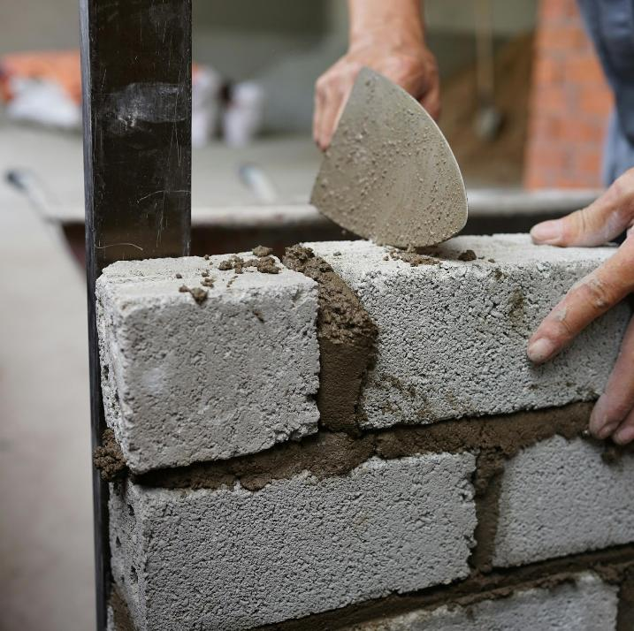
Labour constants
Activity 3
A labour constant is the time needed for a construction operative to complete the work required for one unit of measurement, e.g. 1 m² of brickwork. They are used to estimate unit rates.
Labour constants remain the same, but costs per hour can change.
In computer estimating systems, labour constants are embedded. The hourly cost to employ can be input by the estimator.
Lesson 1: Calculating unit rates
Notes:
Image © Unsplash/Solomen

Slide 26
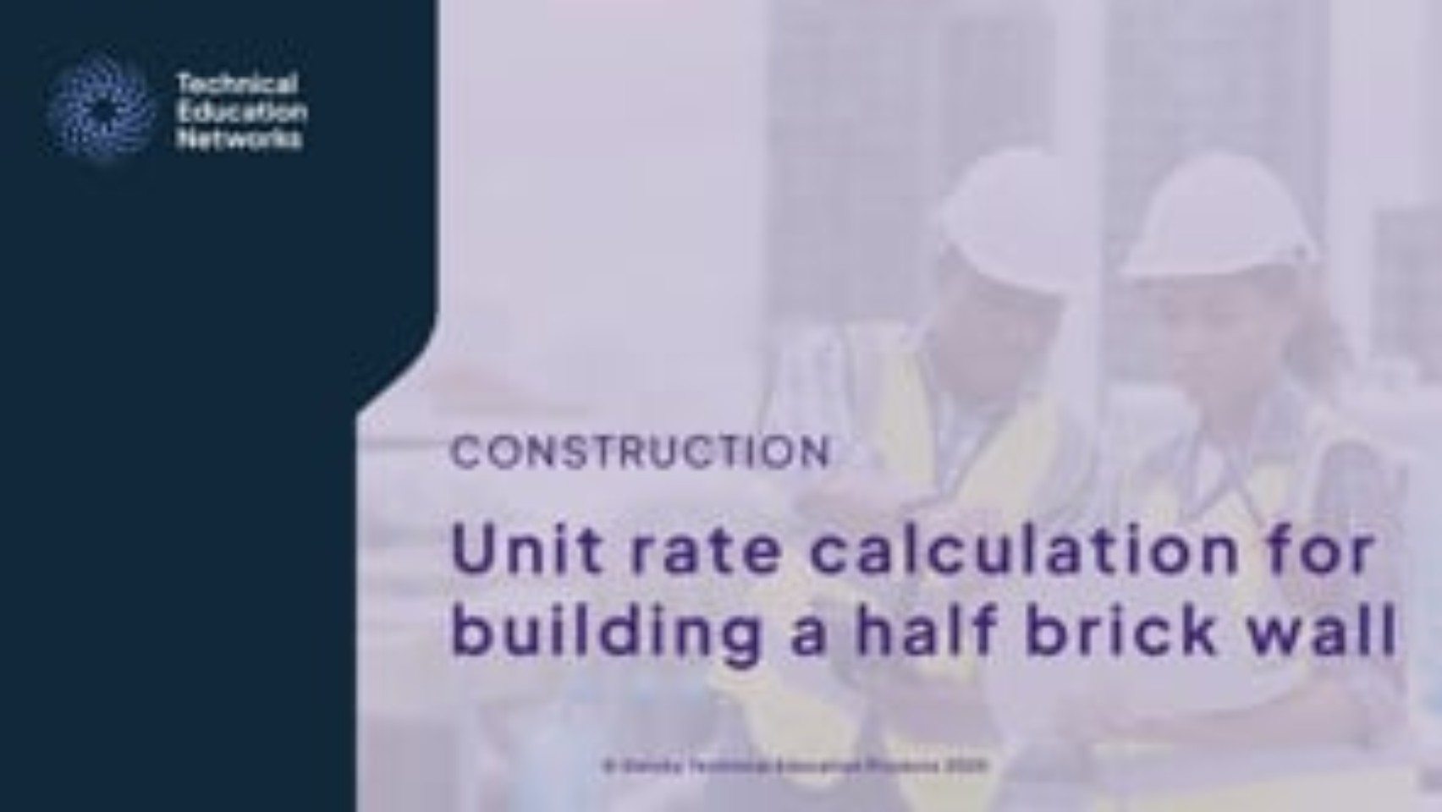
Calculating a unit rate
Activity 3
Lesson 1: Calculating unit rates
Notes:
Unit rate calculation explainer video: https://vimeo.com/1103437896

Slide 27

Calculating a unit rate: Brickwork
Activity 3
This is an extract from a BoQ which is a document used for pricing and tendering.
We will see how to ‘build up’ a unit rate for this item.
Item | Description | Quantity | Unit | Unit rate | Total
a | Half a brick wall in type A facings, in coloured mortar, in skins of hollow walls, pointed one side as the work proceeds | 1251 | m²
Lesson 1: Calculating unit rates
Notes:
Image © Pexels/Mike Bird

Slide 28
Worked example: Brickwork unit rate
Activity 3
Materials
Bricks | 60 No × £0.64 = | £38.40
Mortar | 0.027 × £150 = | £ 4.05
Subtotal |  | £42.45
Waste (+ 5%) | £42.45 × 0.05 = | £ 2.12
Subtotal (materials) |  | £44.57
Labour
Bricklayer | 1.4 hours × £28.75 = | £40.25
Labourer | 0.7 hours × £19.50 = | £13.65
Total |  | £98.47 per m²
Hint
To calculate waste, multiply the total cost of your materials by the wastage factor, in this example it is 5%.
This is then added to the total cost.
Lesson 1: Calculating unit rates

Slide 29
Calculating the total cost
Activity 3
The unit rate we calculated is the cost of completing 1 m² of the brickwork.
This rate (£98.47 per m²) can be inserted into the BoQ and multiplied by the quantity to produce a total.
Item | Description | Quantity | Unit | Unit rate | Total
a | Half a brick wall in type A facings, in coloured mortar, in skins of hollow walls, pointed one side as the work proceeds | 1251 | m² | £98.47 | £123,185.97
Lesson 1: Calculating unit rates
Notes:
Image © Pexels/Mike Bird

Slide 30
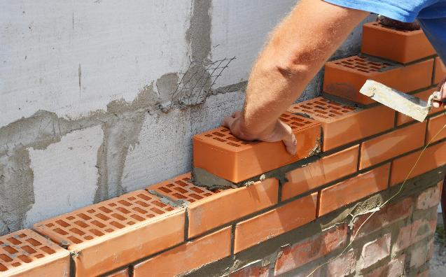
Calculating a unit rate: Forming cavities
Activity 3
This is an extract from a BoQ.
We will see how to ‘build up’ a unit rate for this item.
Item | Description | Quantity | Unit | Unit rate | Total
b | Forming 100 mm cavity in hollow walls, 4 No type A stainless steel wall ties per m² | 1245 | m²
Lesson 1: Calculating unit rates
Notes:
Image © Shutterstock/Radovan1

Slide 31
Worked example: Forming cavities
Activity 3
Materials
Wall ties | 4 No × £1.75 = | £7.00
Waste (+ 2.5%) | £7.00 × 0.025 = | £0.18
Subtotal (materials) |  | £7.18
Labour
Bricklayer | 0.1 hours × £28.75 = | £2.88
Labourer | 0.05 hours × £19.50 = | £0.98
Total |  | £11.04 per m²
Remember, when calculating, round results to the nearest penny (2 decimal places).
Lesson 1: Calculating unit rates

Slide 32

Computerised estimating systems
Activity 3
Technology has revolutionised construction estimating and now digital BoQ are commonly used.
Computerised estimating systems calculate the unit rates, but the estimator will:
input material prices and plant hire rates;
fine-tune waste percentages;
review embedded labour constants;
input all-in labour rates;
add a percentage to each item for overheads and profit.
Lesson 1: Calculating unit rates
Notes:
Image © Unsplash/Glenn Carstens-Peters

Slide 33
Calculating unit rates: Practice
Activity 3
Working as a pair/team complete the questions on the worksheet.
Resources:
L1 Activity 3 Reference sheet
L1 Activity 3 Worksheet
Calculator
Lesson 1: Calculating unit rates

Slide 34
Calculating unit rates: Answers
Activity 3
Practice exercise unit rate (a)
£16.28 per m³
Practice exercise unit rate (b)
£11.63 per m²
Practice exercise unit rate (c)
£207.16 per m²
Resources:
L1 Activity 3 Worked solutions
Lesson 1: Calculating unit rates

Slide 35

How can a contractor reduce project costs?
Activity 3
By minimising waste and using materials wisely, a contractor will make a project more sustainable which will support the environment.
Adopt modern methods of construction: Using prefabricated, modular construction and off-site manufacturing helps reduce build time, reducing site costs, minimising waste and reducing labour costs.
Value engineering: The design and the materials selected are evaluated to identify cost-effective alternatives without compromising on quality or performance.
Value engineering prioritises the essential features of a project and eliminates unnecessary expenses.
Lesson 1: Calculating unit rates
Notes:
Image © Pexels/Kaboompics.com

Slide 36
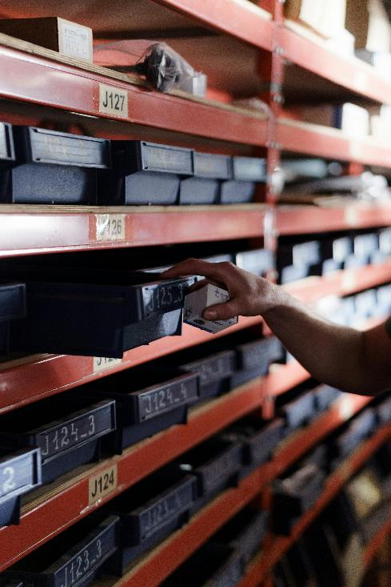
How can a contractor reduce project costs?
Activity 3
Bulk buying materials negotiating better terms with suppliers.
Source materials locally reducing transportation costs.
Using skilled and fully trained labour reduces waste associated with mistakes and errors. Skilled labour may be able to complete work more quickly.
Using digital tools such as Building Information Modelling (BIM) to plan the construction sequence and identify potential clashes. For example, between the building’s structural frame and services, reducing errors on site which ultimately saves time and therefore cost.
Lesson 1: Calculating unit rates
Notes:
Image © Pexels/cottonbro studio

Slide 37
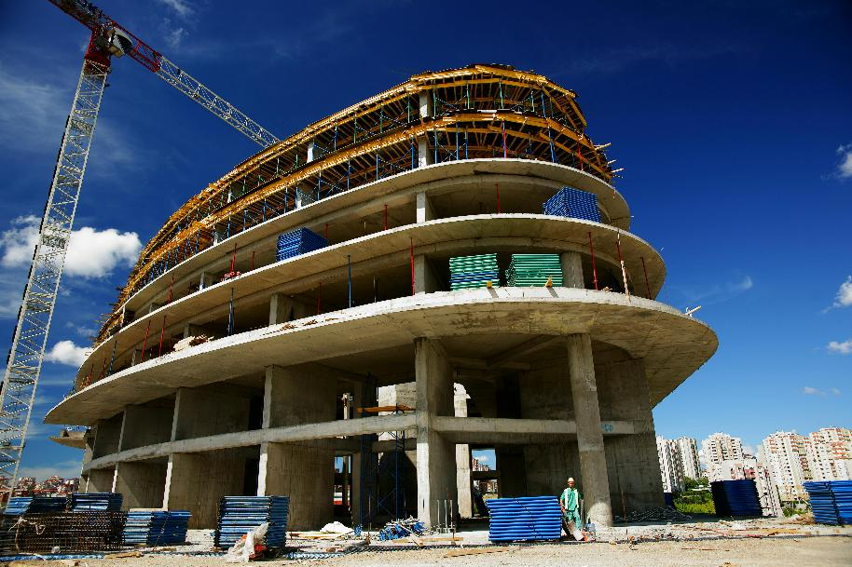
Plenary
Plenary
What challenges did you face in calculating costs?
Write down three top tips you should remember when performing a unit rate calculation.
Share your tips with a partner. Together, create a final list of three to five tips that includes the most important points from each of your notes.
Lesson 1: Calculating unit rates
Notes:
Image © Pexels/Engin Akyurt

Slide 38
In this lesson, we have:
Plenary
Identified the different costs involved in a construction project
Outlined the roles of a quantity surveyor and an estimator
Calculated material and labour costs
Calculated unit rates
Skills:
CS3 Follow standard processes to produce unit rates, bills of quantities and their costing documentation
General competencies:
English:
E2 Present information and ideas
E5 Synthesise information
Maths:
M2 Estimate, calculate and spot errors
M3 Work with proportion
M4 Use rules and formulae
M5 Process data
M8 Communicate using mathematics
M9 Cost a project
Digital:
D3 Communicate and collaborate
Lesson 1: Calculating unit rates

Slide 39

Consolidation
Consolidation
You and your partner have been assigned the task of calculating the cost of raking out and repointing a section of brick wall.
The consolidation worksheet gives the area of repointing and the labour constants, labour rates, materials cost and coverage.
Example of mortar joints requiring repointing
Lesson 1: Calculating unit rates
Notes:
Image © Shutterstock/Nigel Burley

