Slide 1
Digital
Route: Digital
Topic: The business environment and technical change management
Resource 3: Technical change management
Notes:
Image © Shutterstock Gorodenkoff

Slide 2
In this resource, we will:
Introduction
Skills
1 Be able to reflectively evaluate
2 Communicate information clearly to a technical and non-technical audience
3 Work with others in a collaborative manner to allow for/encourage faster, better and more efficient achievement of goals
General competencies
English:
E1 Convey technical information to different audiences
E2 Present information and ideas
E3 Create texts for different purposes and audiences
E4 Summarise information/ideas
E5 Synthesise information
E6 Take part in/leading discussions
Digital:
D1 Use digital technology and media effectively
D3 Communicate and collaborate
consider the importance of technical change management in any organisation;
watch and make notes about a video featuring examples of technical change management;
discuss the opportunities and potential pitfalls for any organisation making a similar change.
Resource 3: Technical change management

Slide 3
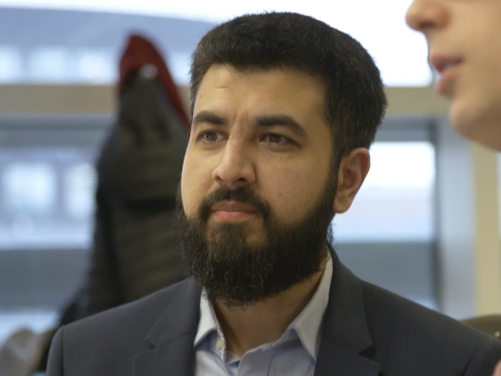
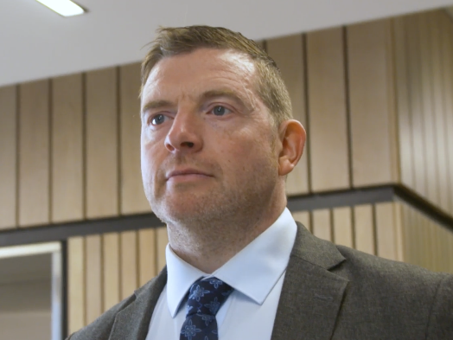
Change management − Case study contributors
Introduction
Ovais
Zack
Steve
Lead Delivery Manager
Senior Learning Design Engineer
Research, Design and Development Officer
National Highways Government road network management for England
Google American technology company
Peak Demand Small independent estate agents based in Manchester, UK
Resource 3: Technical change management
Notes:
Images © Gatsby Technical Education Projects

Slide 4
Case study videos
Activity 1
In the videos each person describes their role and an example of technical change management as part of a digital project.
Use Activity 1 Worksheet to help you make notes on:
digital technologies involved;
reasons, or triggers, for change;
how change was delivered;
examples of change difficulties.
Also note any keywords mentioned that you are not familiar with, to discuss afterwards.
Available videos:
National Highways
Ovais Idris: Lead Delivery Manager https://vimeo.com/1095536543/4f2c2e4101
Google
Zack Akil: Senior Learning Design Engineer https://vimeo.com/1095536783/0844d320b4
Peak Demand Estate Agents
Steve: Research, Design and Development Manager https://vimeo.com/1095535784/7e4a34beff
Resource 3: Technical change management
Notes:
National Highways
Ovais Idris: Lead Delivery Manager https://vimeo.com/1095536543/4f2c2e4101
Google
Zack Akil: Senior Learning Design Engineer https://vimeo.com/1095536783/0844d320b4
Peak Demand Estate Agents
Steve: Research, Design and Development Manager https://vimeo.com/1095535784/7e4a34beff

Slide 5
Case study discussion
Activity 2
You should have notes on:
digital technologies involved;
reasons for change;
how the change was delivered;
examples of change difficulties.
Class discussion points:
What is technical change management?
What could be the reason(s) for a technical change?
What internal and/or external factors could influence the need for a technical change?
What are the problems to look out for and how can these be mitigated?
What are the potential benefits to the organisation?
What are the potential benefits to the customer?
Why is staff training so important?
Why is it so important staff or involved throughout the process?
Could any of the change examples in the videos be done differently?
Resource 3: Technical change management

Slide 6
Internal factors that can trigger change
Activity 2
Changes within the organisation
Change in department/staffing structures
Expansion or downsizing
Meeting the training needs of staff
Having too many incompatible or legacy systems
Large-scale software/hardware failure
Strategic objectives
Diversifying into new products and services
Rebranding or changing the nature of the organisation
Embracing new technology opportunities
Changes to working practices (remote/flexible)
Resource 3: Technical change management
Notes:
Image © Pexels/Kindel Media

Slide 7
External factors that can trigger change
Activity 2
Political – Changes in national government, and their national and international priorities.
Economic – The state of the country, interest rates, market pressures and new products and services.
Social – Demographic and cultural changes, impact of social media and new working practices.
Technological – New and obsolete technology, the rise of AI and potential dangers from internet attacks.
Legal – New and updated legislation related to working practices and the rights of employees.
Environmental – Building a sustainable organisation that reflects world priorities, green technology and increased risk of natural disasters.
A video explanation of PESTLE can be found here: https://youtu.be/GFVKKTwkANY
Resource 3: Technical change management
Notes:
Image © Pexels/Polina Tankilevitch
Video explanation of PESTLE: https://youtu.be/GFVKKTwkANY

Slide 8
In this resource, we have:
Plenary
Skills
1 Be able to reflectively evaluate
2 Communicate information clearly to a technical and non-technical audience
3 Work with others in a collaborative manner to allow for/encourage faster, better and more efficient achievement of goals
General competencies
English:
E1 Convey technical information to different audiences
E2 Present information and ideas
E3 Create texts for different purposes and audiences
E4 Summarise information/ideas
E5 Synthesise information
E6 Take part in/leading discussions
Digital:
D1 Use digital technology and media effectively
D3 Communicate and collaborate
considered the importance of technical change management in any organisation;
watched and made notes about a video featuring examples of technical change management;
discussed the opportunities and potential pitfalls for any organisation making a similar change.
Resource 3: Technical change management

Slide 9
Discussion
Plenary
Why do some organisations try to avoid technical change?
Can you think of any existing organisations, including from your placements, that you believe would benefit from a technical change? Give reasons.
Discuss the differences between technical change between a large and a small organisation.
Resource 3: Technical change management
Notes:
Image © Pexels/RDNE Stock project

Slide 10
Consolidation
Follow-up
Write a short blog post that offers advice or tips on technical change management. This could be for a specific organisation you are familiar with or a general blog post for a digital-oriented organisation. It might include:
What is technical change management?
What planning should be put in place?
An evaluation of technical change for any organisation, including its benefits and potential problems to be overcome.
Research recent examples of technical change that have gone wrong and had to be reversed or quickly changed.
Resource 3: Technical change management

