Slide 1
Construction
Route: Construction
Topic: Law and contracts in construction
Lesson 6: What are the legalities of a contract?
Notes:
Image © Shutterstock/CrizzyStudio

Slide 2
In this lesson, we will:
Introduction
Skills:
Develop ability to appraise and form valid arguments from information given in a case study.
Improve communication skills by creating reports and presentations for different audiences.
Build teamwork and discussion skills by participating in group and class discussion to explore ideas.
General competencies:
English:
E2 Present information and ideas.
E5 Synthesise information.
E6 Take part in/lead discussions.
Digital:
D3 Communicate and collaborate.
explain the basic elements needed to make a legal contract;
describe typical conditions of contract found in a construction contract.
Lesson 6: What are the legalities of a contract?

Slide 3
Knowledge recap
Introduction
Think back to the previous lesson and answer the following questions:
What are the main types of construction contract?
Why is precision in a construction contract so important?
Lesson 6: What are the legalities of a contract?
Notes:
Image © Pexels/ThisIsEngineering

Slide 4
Starter activity
Introduction
Spend a few minutes in your table groups discussing the following questions:
Why do you think contracts are essential in construction projects?
What could happen if contracts were unclear or missing critical elements?
Can you identify the elements of a contract?
Lesson 6: What are the legalities of a contract?

Slide 5
Extended starter activity
Introduction
Consider the following scenarios. In your table groups, try to identify some of the issues relating to the agreement between the parties.
Scenario 1
A contractor sends a quote for a building project but doesn’t specify the materials or timeline. The client verbally agrees to proceed. What issues could arise if this project moved forward without clarification?
Scenario 2
A developer proposes a contract for a housing project. The contractor sends back a modified version with different terms, but no formal response is received. What issues could arise from this lack of clarity?
Lesson 6: What are the legalities of a contract?

Slide 6
Extended starter activity
Introduction
Consider the following scenarios. In your table groups, try to identify some of the issues relating to the agreement between the parties.
Scenario 3
A subcontractor agrees to provide additional work at no extra charge, hoping it will lead to future contracts with the main contractor. Why is consideration essential in contract law?
Scenario 4
A contractor and client informally agree to project terms in a coffee shop, with no written agreement or formal acknowledgment. Identify the missing element. What could happen if one party later disagrees with the terms discussed?
Lesson 6: What are the legalities of a contract?

Slide 7
Rights and obligations under contract law
Activity 1
Watch the video and answer questions on Lesson 6 Activity 1 Worksheet.
Lesson 6: What are the legalities of a contract?
Notes:
Elements of a construction contract video: https://vimeo.com/1095612170/f63009c6a5

Slide 8
Elements of a contract
Activity 1
What are the four main elements that make a contract legally binding?
How can a contract help manage changes during a project, such as when a homeowner requests a change to an ongoing renovation?
What should a builder and a client check before signing a construction contract?
How does a contract outline what happens if there is a delay or if the work is substandard?
Lesson 6: What are the legalities of a contract?

Slide 9
Answers
Activity 1
1. What are the four main elements that make a contract legally binding?
Offer: A clear proposal by one party to another, such as a builder offering to complete specific work for a set price.
Acceptance: The unqualified agreement to the terms of the offer by the other party, such as the homeowner agreeing to the proposed price and scope of work.
Intention to create legal relations: Both parties must intend for the agreement to be legally enforceable.
Consideration: The exchange of something of value between the parties, like the homeowner providing payment and the builder delivering the work.
Lesson 6: What are the legalities of a contract?

Slide 10
Answers
Activity 1
2. How can a contract help manage changes during a project, such as when a homeowner requests a change to an ongoing renovation?
A contract provides a framework to document and manage any changes during the project. If a homeowner requests changes, like upgrading materials or adding extra features, both parties can amend the contract to reflect the new terms, including additional costs or an adjusted timeline.
This ensures that both parties agree to the changes and avoid disputes later. When a change is made to a contract, it is often termed a ‘variation’.
Lesson 6: What are the legalities of a contract?

Slide 11
Answers
Activity 1
3. What should a builder and client check before signing a construction contract?
Before signing, both the builder and client should carefully review key terms such as the scope of the work – what exactly is being built or renovated.
Timeline: Deadlines for starting and completing the project.
Payment schedule: When and how payment will be made.
Dispute resolution: Clauses in the contract explain how conflict will be handled.
Lesson 6: What are the legalities of a contract?

Slide 12
Answers
Activity 1
4. How does a contract outline what happens if there is a delay or if the work is substandard?
A well-written contract will include clauses covering delays and substandard work. For example, it might allow the client to withhold final payment until issues are resolved or specify penalties for delays. It may also outline procedures for resolving disputes, such as mediation or arbitration, in case the parties cannot agree on how to proceed. This ensures that both parties are protected and know their rights if problems arise during the project.
Lesson 6: What are the legalities of a contract?

Slide 13
Test your understanding
Activity 2
Now it’s time to test your knowledge.
Your group will be given some scenarios in Activity 2 Worksheet to consider. Discuss the elements of a valid contract and decide what word(s) are missing.
Be prepared to feed back to the rest of the class.
Lesson 6: What are the legalities of a contract?
Notes:
Image © Unsplash/Scott Graham

Slide 14
Answers
Activity 2
Scenario
intention
consideration, consideration
consent
contract
acceptance, counter-offer
counter-offer
acceptance, consideration, intention, offer
offer, acceptance, intention, consideration
Lesson 6: What are the legalities of a contract?
Notes:
Image © Unsplash/Scott Graham

Slide 15
Review questions
Activity 2
What is an offer in the context of a construction contract?
Why is it important for both parties to accept the terms of a contract without making changes?
How does ‘intention to create legal relations’ ensure that a contract is legally enforceable?
Give an example of consideration in a construction project.
What is the difference between an offer and a counter-offer?
Lesson 6: What are the legalities of a contract?

Slide 16
Review answers
Activity 2
An offer in a construction contract is a clear statement of the terms under which one party (such as a construction company) is prepared to be bound. For example, a construction company offers to build a house for a specific price, including details of what the project entails.
It is important because acceptance must exactly match the offer for a valid contract to exist. Any changes or conditions create a counter-offer rather than acceptance, which means a contract has not yet been formed.
The intention to create legal relations ensures that both parties agree their contract is legally binding. In business agreements, it is presumed that both parties want to enter into a legal relationship, the contract to be enforceable by contract law, allowing them to take legal action if one party fails to meet their obligations.
Lesson 6: What are the legalities of a contract?

Slide 17
Review answers
Activity 2
Consideration is something of value exchanged between the parties. For example, in a construction project, the homeowner’s consideration is the payment they provide for the work, and the builder’s consideration is the completion of the construction.
An offer is a proposal made by one party, which the other party can accept to form a contract. A counter-offer is a response that modifies the terms of the original offer, meaning the original offer is no longer valid and has been replaced with new terms.
Lesson 6: What are the legalities of a contract?

Slide 18
Matching exercise
Activity 3
Scope of work
Details the project's timeline, including start and completion dates. It also specifies important milestones that need to be achieved.
Time and schedule
Outlines the amount the client agrees to pay the contractor for completing the project. It also explains when and how payments will be made, such as upon reaching specific milestones or after the project is fully completed.
Payment
Guarantees that the contractor will fix any defects or problems that arise after the project is completed within a specified period. It ensures that the work is free from defects in materials and workmanship.
Quality
Defines the specific tasks and responsibilities the contractor is expected to complete as part of the construction project. It outlines what work will be done.
Insurance and indemnifications
Covers extraordinary events or circumstances beyond the contractor's control (e.g. natural disasters, strikes) that could prevent the project from being completed on time. It allows for adjustments to the schedule in such cases.
Liquidated damages
Outlines the conditions under which either party can end the contract. It explains how the contract can be terminated for various reasons, such as a breach of contract, failure to meet the project’s requirements or financial insolvency.
Force majeure
Explains the types of insurance the contractor must carry (e.g. liability insurance) and how they will protect both parties from financial losses due to accidents, damages or other unforeseen events.
Warranties
If the project is not completed on time, this clause sets a fixed penalty the contractor must pay the client for each day the project is delayed. It helps compensate the client for losses caused by late completion.
Termination
Sets the standards for the quality of the work that must be maintained throughout the project. It ensures that the construction meets the specified requirements and any relevant building codes or regulations.
Lesson 6: What are the legalities of a contract?

Slide 19
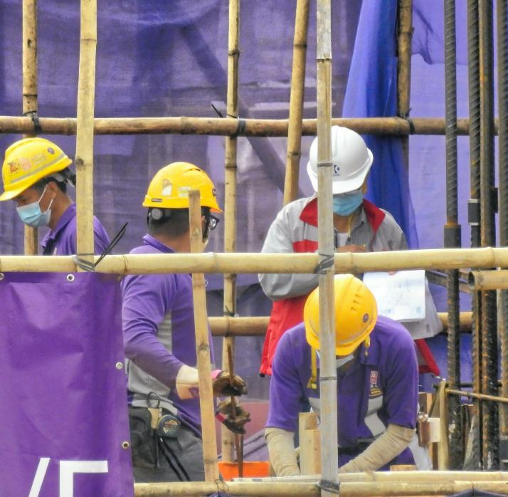
Questions
Plenary
Why is important to clearly define the scope of work in a contract?
What could happen if the contract doesn’t specify how delays will be handled?
How do terms like payment and quality protect both the contractor and the client?
What elements are needed to form a contract?
Lesson 6: What are the legalities of a contract?
Notes:
Image © Unsplash/Thomas Kinto

Slide 20
Answers
Plenary
Why is it important to clearly define the scope of work in a contract?
Defining the scope of work clearly ensures that both the contractor and the client know exactly what is expected. It prevents misunderstandings or disputes about the work to be done, the materials to be used or the project's scale. Detailing this sets clear boundaries and expectations for both parties.
2. What could happen if the contract doesn’t specify how delays will be handled?
If the contract doesn’t specify how delays will be handled, disputes may arise about responsibility for the delay or how to compensate for it. Without clear terms, the client may refuse to pay for incomplete work, or the contractor may be left financially vulnerable. The project might also be significantly delayed without a clear solution, which could lead to legal conflicts.
Lesson 6: What are the legalities of a contract?

Slide 21
Answers
Plenary
3. How do terms like payment and quality protect both the contractor and the client?
Payment terms ensure that the contractor is compensated fairly and on time, and they help the client by setting clear expectations for when and how much payment is due. Quality terms protect the client by ensuring that the work meets agreed-upon standards, while protecting the contractor from unrealistic quality expectations or demands for changes outside of the agreed scope.
4. What elements are needed to form a contract?
Offer: a clear proposal, such as a builder offering to complete work for a specified price
Acceptance: the other party agreeing to the proposal without changes
Intention: to create legal relations; both parties must understand that the agreement is legally binding
Consideration: the exchange of value between the parties, such as payment for services rendered
Lesson 6: What are the legalities of a contract?

Slide 22
In this lesson, we have:
Plenary
Skills:
Develop ability to appraise and form valid arguments from information given in a case study.
Improve communication skills by creating reports and presentations for different audiences.
Build teamwork and discussion skills by participating in group and class discussion to explore ideas.
General competencies:
English:
E2 Present information and ideas.
E5 Synthesise information.
E6 Take part in/lead discussions.
Digital:
D3 Communicate and collaborate.
explained the basic elements needed to make a legal contract;
described typical conditions of contract found in a construction contract.
Lesson 6: What are the legalities of a contract?

Slide 23
Consolidation
Consolidation
Complete the Follow-up Worksheet which consolidates knowledge of Lesson 6.
Complete the Assessment Worksheet and submit to your teacher for marking.
Lesson 6: What are the legalities of a contract?

