Slide 1
Science
Route: Health & Science
Topic: Refluxing
Lesson 2: Refluxing practical
Notes:
Image © Shutterstock/BalanceFormCreative

Slide 2
In this lesson, we will:
Introduction
Explain the use and application of glassware, thermometers, and balances when undertaking scientific techniques
Identify the appropriate equipment and explain the correct setup for a reflux reaction
Demonstrate practical technical competence in the use of equipment when performing a reflux
Safely perform a reflux using appropriate personal protective equipment (PPE)
Skills:
S1.73 Apply scientific knowledge when undertaking scientific techniques
S1.79 Use the following practical scientific techniques to prepare, isolate and separate materials: Refluxing
S1.84 Select appropriate equipment to complete practical scientific techniques
S1.85 Demonstrate practical technical competence in the use of equipment
General competencies:
English:
GEC2 Present information and ideas
GEC4 Summarise information/ideas
Maths:
GMC1 Measuring with precision
GMC10 Optimising work processes
Lesson 2: Refluxing practical

Slide 3
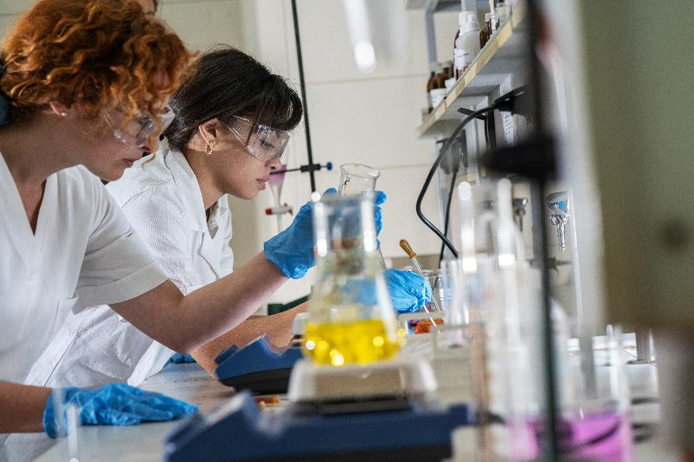
Error spotting
Introduction
Your teacher will show you a demonstration reflux setup to evaluate. Work through the following questions:
Study the reflux equipment setup.
Identify and correct any errors.
Explain any consequent issues they might cause
Be prepared to share with the class.
Lesson 2: Refluxing practical
Notes:
Image © Shutterstock/BalanceFormCreative

Slide 4
Refluxing practical
Activity 1
Option 1:
You are going to perform a reflux to produce biodiesel by following the method provided.
Option 2:
You are going to perform a reflux to hydrolyse an ester to produce a carboxylic acid by following the method provided.
Option 3:
You are going to perform a microscale reflux by following the method provided.
Lesson 2: Refluxing practical

Slide 5
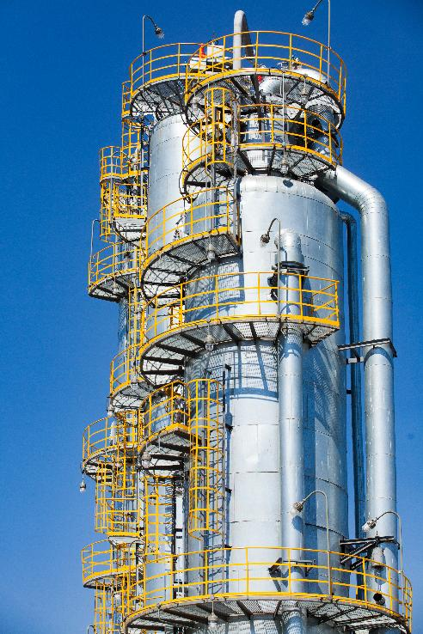
Plenary – Scenario-based question
Plenary
A chemical plant produces compound X in a batch process using an esterification reaction between an alcohol and an acid, and reflux is used in its synthesis. In a recent batch, they noticed a decrease in product yield and on investigation the production team recognised the decrease was due to an issue in the reflux step.
Suggest two potential reasons for this decrease in product yield. Explain any changes/modifications to the setup that might be necessary and how they would improve the efficiency of the reflux process.
Lesson 2: Refluxing practical
Notes:
Image © Shutterstock/Alexey Rezvykh

Slide 6
In this lesson, we have:
Plenary
Skills:
S1.73 Apply scientific knowledge when undertaking scientific techniques
S1.79 Use the following practical scientific techniques to prepare, isolate and separate materials: Refluxing
S1.84 Select appropriate equipment to complete practical scientific techniques
S1.85 Demonstrate practical technical competence in the use of equipment
General competencies:
English:
GEC2 Present information and ideas
GEC4 Summarise information/ideas
Maths:
GMC1 Measuring with precision
GMC10 Optimising work processes
Explained the use and application of glassware, thermometers, and balances when undertaking scientific techniques
Identified the appropriate equipment and explain the correct setup for a reflux reaction
Demonstrated practical technical competence in the use of equipment when performing a reflux
Safely performed a reflux using appropriate personal protective equipment (PPE)
Lesson 2: Refluxing practical

Slide 7
Consolidation
Consolidation
You are tasked with improving the environmental impact of a reflux process for a large-scale chemical production plant.
Identify three factors that impact the sustainability and environmental impact of a reflux reaction.
Suggest one improvement for each factor that could improve the process’s environmental footprint.
Lesson 2: Refluxing practical

