Slide 1
Science
Route: Health & Science
Topic: Calibration
Notes:
Image © Pexels/ThisIsEngineering

Slide 2
In this lesson, we will:
Introduction
Skills
S1.76 Use the following practical scientific techniques to measure a range of physical properties: conductivity meter to measure conductivity of a solution
S1.86 Calibrate scientific equipment and check it is fit for use: pH meters, balances, mechanical (variable-volume) pipette
S3.7 Resolve issues with a range of scientific equipment
S3.9 Recognise when a piece of equipment is producing inaccurate data.
S3.10 Recognise when equipment is likely to be damaged or cause injury due to malfunction.
S3.11 Report faults and source expert help when required.
General competencies
English:
GEC1 Convery technical information to different audiences
GEC2 Present information and ideas
GEC3 Create texts for different purposes and audiences
GEC4 Summarise information/ideas
GEC5 Synthesise information
GEC6 Take part in/lead discussions
Digital:
GDC3 Communicate and collaborate
Maths:
GMC1 Measuring with precision
GMC2 Estimating, calculating and error spotting
GMC3 Working with proportion
explain why it is important to calibrate and test equipment
perform a calibration of a pH meter, a balance and a mechanical pipette
write Standard Operating Procedures (SOPs) for the calibration of a pH meter, a balance, a mechanical pipette and a conductivity meter
use a conductivity meter to measure the conductivity of a solution
describe the difference between precision and accuracy.
Calibration

Slide 3
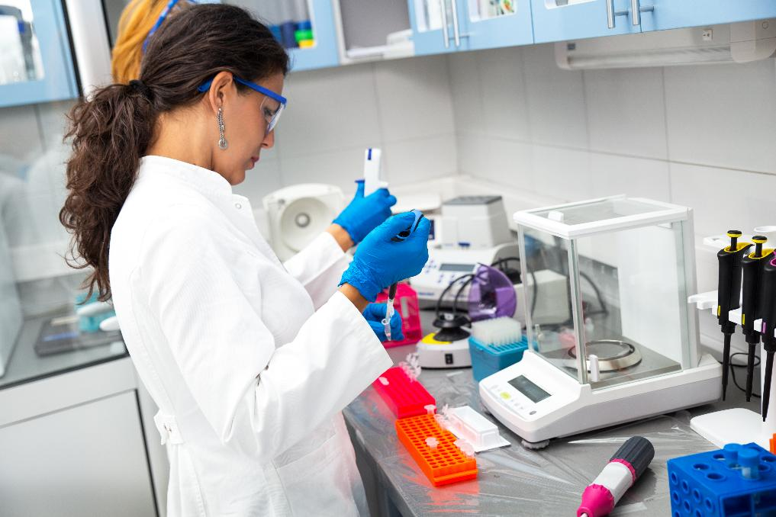
Calibration
Introduction
What is calibration?
Why is it important?
Calibration
Notes:
Image © Shutterstock/Zoran Zeremski

Slide 4
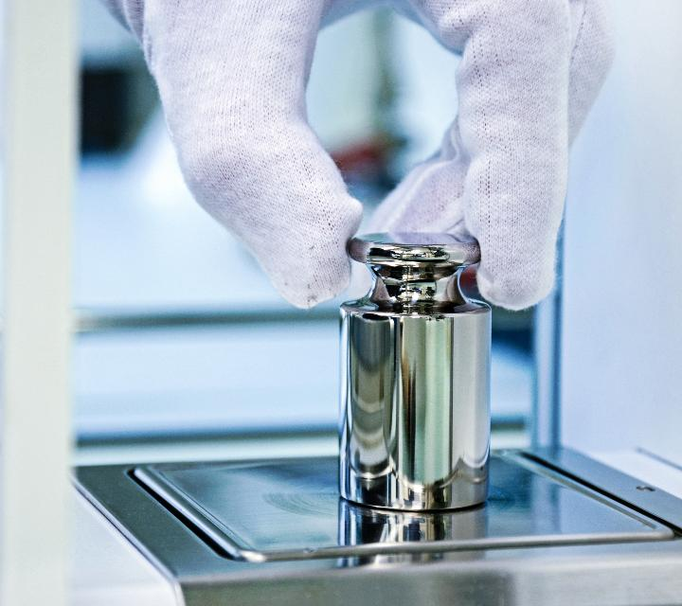
Calibration
Introduction
Calibration refers to the process of verifying and adjusting the accuracy of measuring instruments and equipment to ensure they provide correct results.
Calibration ensures that instruments produce reliable and accurate data, which is crucial for scientific research, experiments and industrial processes.
Calibration
Notes:
Image © Shutterstock/Markus Thoenen

Slide 5
Activity 1: Investigating calibration
Activity 1
Using Worksheet 1, imagine that the lab you work for has just been given some pipettes from another department.
Using the equipment you’ve been given, suggest, as a group, how you might determine which pipettes, if any, are not working correctly.
Suggest any possible consequences
of using pipettes that do not work correctly.
Explain why calibration is important.
Additional task
Determine the uncertainty and therefore calculate the percentage error associated with measuring a mass of 0.05 g on your balance.
Calibration

Slide 6
Types of error
Activity 1
Human error: mistakes made by a person performing a task, such as misreading a measurement, incorrectly recording data, or not following a procedure correctly.
Mechanical error: errors from device malfunctions, like faulty parts or broken tools.
Instrumental error: inaccuracies caused by the measuring instrument itself, such as poor calibration.
Random error: unpredictable measurement fluctuations due to environmental changes, or slight variations in technique.
Calibration

Slide 7

Activity 2: The importance of calibration video
Activity 2
Watch the video and complete questions 1–4 on the worksheet.
Calibration
Notes:
The importance of calibration video: https://vimeo.com/1060451809

Slide 8

Activity 2: Precision versus accuracy video
Activity 2
Watch the video and complete question 5 on the worksheet.
Calibration
Notes:
Precision versus accuracy video: https://vimeo.com/1060452102

Slide 9
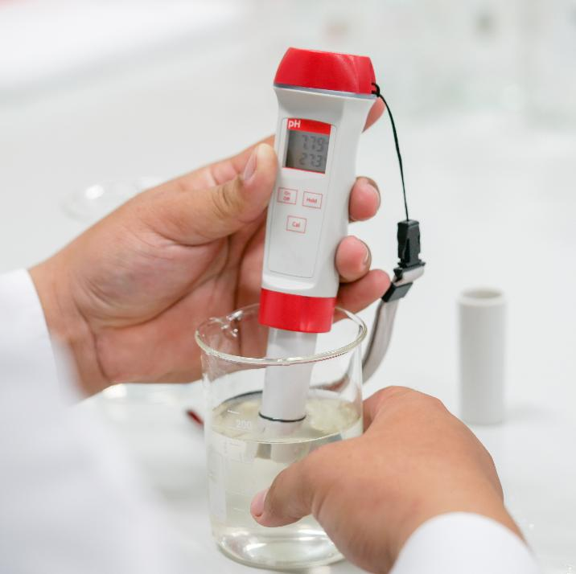
Activity 3: Calibration practical
Activity 3
Rotate around the four stations and use the worksheet to calibrate four pieces of standard lab equipment:
  a balance
  a pH meter
  a mechanical pipette
  a conductivity meter.
Calibration
Notes:
Image © Shutterstock/Choksawatdikorn

Slide 10
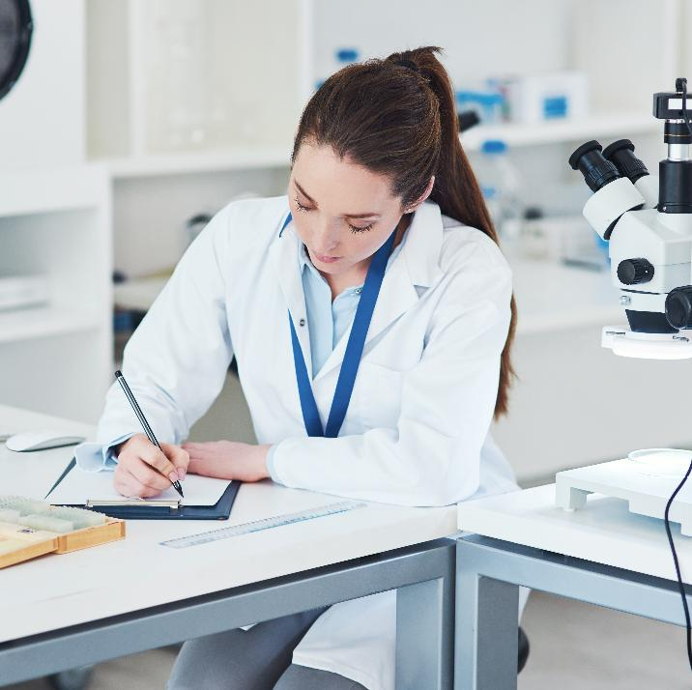
Activity 4: Writing SOPs
Activity 4
Write an SOP (Standard Operating Procedure) for the calibration process you are given.
The worksheet from Activity 3 can be used as a support sheet if needed, and a template for writing an SOP can also be provided.
Calibration
Notes:
Image © Shutterstock/PeopleImages.com - Yuri A

Slide 11
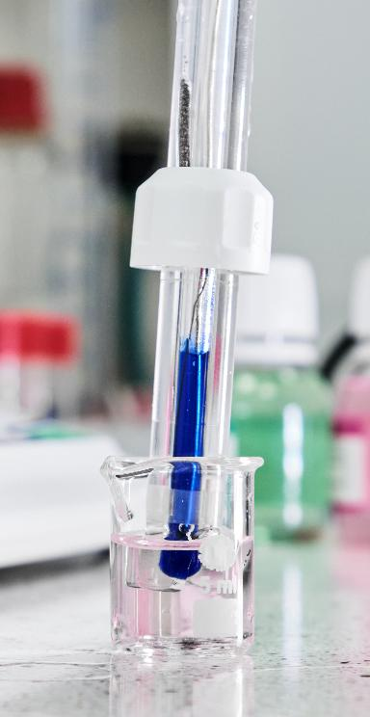
Scenario-based question 1
Plenary
Imagine you are a laboratory technician working in a medical laboratory. You are tasked with adjusting the pH of a new drug formulation to 7.4.
You have unknowingly been using an uncalibrated pH meter.
Explain two potential consequences to the medical laboratory of using an uncalibrated pH meter in this process.
[4 marks]
Calibration
Notes:
Image © Shutterstock/Vladimka production

Slide 12
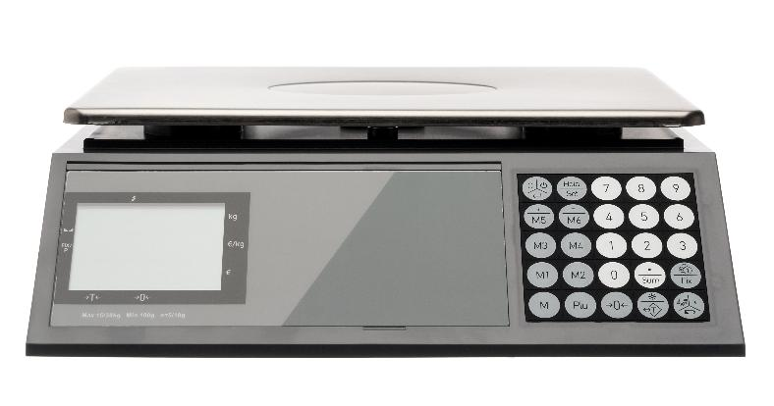
Scenario-based question 2
Plenary
During the third step of the production cycle, a balance is used to measure out six portions of 75 kg of a chemical feedstock, which costs the company £13.55 per kilogram.
If this balance is under-reading the mass by 1.25%, how much money is being wasted per production cycle?
[3 marks]
Calibration
Notes:
Image © Shutterstock/Serhiy Stakhnyk

Slide 13
Scenario-based question 3
Plenary
A new anticancer drug needs to be prepared by being vaporised and then adsorbed onto nanoparticle surfaces, which act as carriers.
1500 μL of a 0.001 g/μL solution (per gram of nanoparticle) needs to be transferred into the vaporiser using 100 μL aliquots. The threshold of delivery for the drug to be effective is a minimum of 1.4 g of drug (per gram of nanoparticle).
A research lab is using a mechanical pipette to create the solution. The pipette has not been recently calibrated and when used to deliver 100 μL, it delivers only 93 μL per aliquot.
Explain why there will not be enough drug loaded (per gram of nanoparticles) to meet the threshold. [3 marks]
If there is time, calculate the percentage error in the measurement of one aliquot of
100 μL using this uncalibrated pipette.
Calibration

Slide 14
In this lesson, we have:
Plenary
Skills
S1.76 Use the following practical scientific techniques to measure a range of physical properties: conductivity meter to measure conductivity of a solution
S1.86 Calibrate scientific equipment and check it is fit for use: pH meters, balances, mechanical (variable-volume) pipette
S3.7 Resolve issues with a range of scientific equipment
S3.9 Recognise when a piece of equipment is producing inaccurate data.
S3.10 Recognise when equipment is likely to be damaged or cause injury due to malfunction.
S3.11 Report faults and source expert help when required.
General competencies
English:
GEC1 Convery technical information to different audiences
GEC2 Present information and ideas
GEC3 Create texts for different purposes and audiences
GEC4 Summarise information/ideas
GEC5 Synthesise information
GEC6 Take part in/lead discussions
Digital:
GDC3 Communicate and collaborate
Maths:
GMC1 Measuring with precision
GMC2 Estimating, calculating and error spotting
GMC3 Working with proportion
explained why it is important to calibrate and test equipment
performed a calibration of a pH meter, a balance and a mechanical pipette
written Standard Operating Procedures (SOPs) for the calibration of a pH meter, a balance, a mechanical pipette and a conductivity meter
used a conductivity meter to measure the conductivity of a solution
described the difference between precision and accuracy.
Calibration

Slide 15
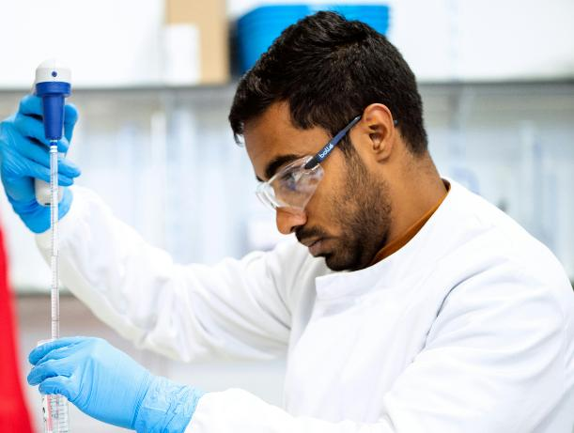
Consolidation
Consolidation
Pick one of the four scenarios on the worksheet.
Take the role of a calibration expert working in this industry.
Research and write a presentation to explain
why calibration is necessary in the given
context. Include any financial, health and
safety, legal or other implications that may
arise if regular and correct calibration does
not take place.
The presentation should be written for colleagues
in the same industry who are not experts in calibration.
Calibration
Notes:
Image © Pexels/ThisIsEngineering

