Slide 1
Health
Route: Health & Science
Topic: An introduction to social care (Health)
Lesson 2: Integrated care, multidisciplinary and multi-agency teamwork
Notes:
Image © Shutterstock/Fizkes

Slide 2
In this lesson, we will:
Introduction
Define multidisciplinary teamwork, a multi-agency approach and integrated care
Recognise the differences between Integrated Care Systems (ICSs), Integrated Care Boards (ICBs) and Integrated Care Partnerships (ICPs) in England
Explain the relationship between integrated care and care planning
Skills:
CS1.1 Plan and develop person-centred care
CS3.2 Undertake collaborative work demonstrating
CS4.1 Undertake reflective practice and record reflections and experiences
CS4.2 Make improvements to own practice
General competencies:
English:
GEC2 Present information
GEC5 Synthesise information and ideas
Digital:
GDC1 Use digital technology and media effectively
Lesson 2: Integrated care, multidisciplinary and multi-agency teamwork

Slide 3
Multidisciplinary teamwork
Introduction
Social care plays a vital role in preventing health issues occurring, maintaining good health and supporting the recovery of people who are leaving a healthcare setting.
Integrated care is delivered by professionals working in multidisciplinary teams.
Lesson 2: Integrated care, multidisciplinary and multi-agency teamwork
Notes:
Image © Shutterstock/Pattern Paper Print

Slide 4
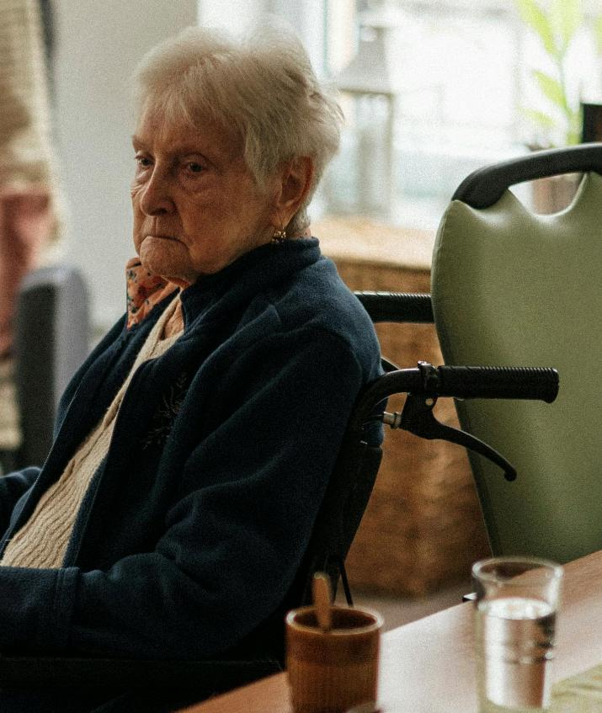
Case study – Dora
Activity 1
Read through Dora’s case study.
In pairs, discuss the questions.
Lesson 2: Integrated care, multidisciplinary and multi-agency teamwork
Notes:
Image © Pexels/Jsme MILA

Slide 5
Case study – Dora
Activity 1
Lesson 2: Integrated care, multidisciplinary and multi-agency teamwork
Notes:
Discharge planning meeting: Dora video: https://vimeo.com/1077657858

Slide 6
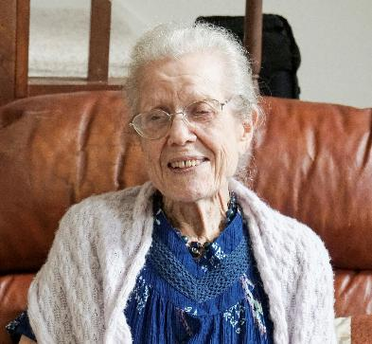
Health issues
Activity 2
Coronary heart disease
Smoking
Dementia
How do these health issues affect an individual?
Why might affected individuals require social care?
Lesson 2: Integrated care, multidisciplinary and multi-agency teamwork
Notes:
Image © Pexels/Towfiqu barbhuiya
Image © Unsplash/Jonathan Kemper
Image © Unsplash/Izzy Park

Slide 7
Joined up healthcare and social care
Activity 2
Continuous research, statistics: what is working, what needs improving?
Start early: health education and citizenship in schools
Social prescribing: funding for activities and community support, e.g. free gym membership
Support from charities and community volunteers
Government initiatives, e.g. sugar tax
Lesson 2: Integrated care, multidisciplinary and multi-agency teamwork

Slide 8
Question 1
Activity 2
What is the government’s role in preventing and treating ill health and disease within the population?
Lesson 2: Integrated care, multidisciplinary and multi-agency teamwork

Slide 9
Question 1
Activity 2
What is the government’s role in preventing and treating ill health and disease within the population?
The government aims to prevent disease through public health initiatives and regulations, while also ensuring treatment is free and accessible through the NHS and supported care via local authority social services.
Lesson 2: Integrated care, multidisciplinary and multi-agency teamwork

Slide 10
Question 2
Activity 2
Which statement do you feel is most accurate?
An individual’s health is 100% their responsibility.
An individual’s health is 100% the responsibility of government through health and social care services.
An individual’s health is 50% their responsibility and 50% the responsibility of government through health and social care services.
Lesson 2: Integrated care, multidisciplinary and multi-agency teamwork

Slide 11
Question 2
Activity 2
Which statement do you feel is most accurate?
An individual’s health is 100% their responsibility.
An individual’s health is 100% the responsibility of government through health and social care services.
An individual’s health is 50% their responsibility and 50% the responsibility of government through health and social care services.
Answer: 3
The government empowers individuals with health information and care services to encourage self-management.
An individual has choices to act on guidance and utilise support outside of conventional medical care.
Lesson 2: Integrated care, multidisciplinary and multi-agency teamwork

Slide 12
Question 3
Activity 2
What role does social care have in preventing ill health?
Lesson 2: Integrated care, multidisciplinary and multi-agency teamwork

Slide 13
Question 3
Activity 2
What role does social care have in preventing ill health?
Social care supports vulnerable people, promoting independence and early intervention initiatives e.g. domiciliary care infection control, and the treatment of ill health, e.g. ensuring prescribed medication is taken as advised, or support with daily physiotherapy exercises.
Lesson 2: Integrated care, multidisciplinary and multi-agency teamwork

Slide 14
The Health and Social Care Act (2022)
Activity 3
The Health and Care Act 2022 is legislation that aims to improve and support health and care services in England recover from the pandemic. It is intended to:
Improve care coordination and health outcomes
Reduce health inequalities, making it easier for health and care organisations to work together to provide care for people who need access to multiple services
Improve safeguarding
Transfer legal responsibilities for safeguarding adults from Clinical Commissioning Groups (CCG) to Integrated Care Boards (ICBs)
Improve quality and safety
Make the health and care system less bureaucratic and more accountable
Lesson 2: Integrated care, multidisciplinary and multi-agency teamwork

Slide 15
Integrated care
Activity 3
GP
The coordinated delivery of health, social and community services to meet individuals' comprehensive needs.
Specialist doctor
Nurse
Patient and family/ caregivers
What professionals are involved in integrated care?
Social worker
Pharmacist
Lesson 2: Integrated care, multidisciplinary and multi-agency teamwork

Slide 16
Key terms
Activity 3
Multidisciplinary teams (MDTs)
A diverse group of professionals collaborating to undertake the appropriate medical treatment, care and/or support for an individual.
(source: NCFE)
Multi-agency approach
The collaborative approach of separate agencies coming together to discuss and plan care for individuals, e.g. health sector, social care sector, community and charity/volunteers.
(source: NCFE)
Lesson 2: Integrated care, multidisciplinary and multi-agency teamwork

Slide 17
Organisation of integrated care
Activity 3
Integrated Care Systems (ICSs)
Regional structures that oversee health and social care, setting priorities and managing resources
Integrated Care Boards (ICBs)
Integrated Care Partnerships (ICPs)
Within each ICS, ICBs plan and coordinate services, ensuring they meet local needs
Alliances of local health, social care and community organisations that deliver targeted, community-based care
Primary care, social care, community services, secondary care providers
Lesson 2: Integrated care, multidisciplinary and multi-agency teamwork

Slide 18
Making Every Contact Count
Activity 3
A health initiative encouraging professionals to use everyday interactions to promote healthier lifestyles.
By offering brief advice or guidance during routine appointments, MECC aims to increase awareness of health risks and encourage small, positive behaviour changes, supporting overall well-being in communities.
Lesson 2: Integrated care, multidisciplinary and multi-agency teamwork
Notes:
Image © Pexels/Valentin Antonucci

Slide 19
What would you do?
Activity 4
After oxygen starvation at birth, Marium is now 31 and is given round the clock care by her mother, Aisha. They live alone and after a fall Aisha is unable to lift Marium or carry out all the care task she needs. They live in a flat where the lift is often broken, and Marium does not have a suitable wheelchair. Aisha needs to attend physiotherapy appointments.
What are Marium’s needs?
How could these be met?
Lesson 2: Integrated care, multidisciplinary and multi-agency teamwork

Slide 20
Plenary
Plenary
Free healthcare and free social care provision were originally viewed as separate entities.
In four or five sentences, describe the importance of social care knowledge for professionals who work in healthcare. In other words, why is social care information relevant to you in your future career?
Lesson 2: Integrated care, multidisciplinary and multi-agency teamwork

Slide 21
In this lesson, we have:
Plenary
Defined multidisciplinary teamwork, a multi-agency approach and integrated care
Recognised the differences between Integrated Care Systems (ICSs), Integrated Care Boards (ICBs) and Integrated Care Partnerships (ICPs) in England
Explained the relationship between integrated care and care planning
Skills:
CS1.1 Plan and develop person-centred care
CS3.2 Undertake collaborative work demonstrating
CS4.1 Undertake reflective practice and record reflections and experiences
CS4.2 Make improvements to own practice
General competencies:
English:
GEC2 Present information
GEC5 Synthesise information and ideas
Digital:
GDC1 Use digital technology and media effectively
Lesson 2: Integrated care, multidisciplinary and multi-agency teamwork

Slide 22
Consolidation
Consolidation
Sandy, age 82, is recovering from a hip fracture following a fall at home. He has been in a nursing home for eight weeks to ensure he received medical care. His health on admission was further complicated by malnourishment and unmanaged diabetes.
It has been decided that he is well enough to move to residential care, where support can be tailored to semi-independent living.
Discuss ways in which Sandy can be supported in the care home.
Lesson 2: Integrated care, multidisciplinary and multi-agency teamwork

