Slide 1
Health
Route: Health & Science
Topic: An introduction to social care (Health)
Lesson 3: Integrated care in action
Notes:
Image © Shutterstock/Fizkes

Slide 2
In this lesson, we will:
Introduction
Determine the planning, process and outcomes of integrated care planning meetings
Apply knowledge of an individual’s needs to provision, services and professionals
Apply a person-centred care approach
Skills:
CS1.1 Plan and develop person-centred care
CS2.1 Communicate clearly and effectively with a variety of stakeholders
CS3.2 Undertake collaborative work
CS4.2 Make improvements to own practice
General competencies:
English:
GEC2 Present information and ideas
GEC4 Summarise information/ideas
GEC5 Synthesise information
Lesson 3: Integrated care in action

Slide 3
Skills and qualities
Introduction
What skills and qualities are important in a social care professional?
Make a list of each.
Lesson 3: Integrated care in action
Notes:
Image © Pexels/Mizuno K

Slide 4
The six Cs
Introduction
C
C
C
C
C
C
are
ourage
ompassion
ommitment
ommunication
ompetence
Lesson 3: Integrated care in action

Slide 5
Care planning
Activity 1
In your group, put together a care plan for an individual.
You will:
identify the individual’s needs;
decide how could these needs could be met;
say who should be involved;
summarise how services and professionals could work in partnership.
Lesson 3: Integrated care in action
Notes:
Image © Pexels/William Fortunato

Slide 6
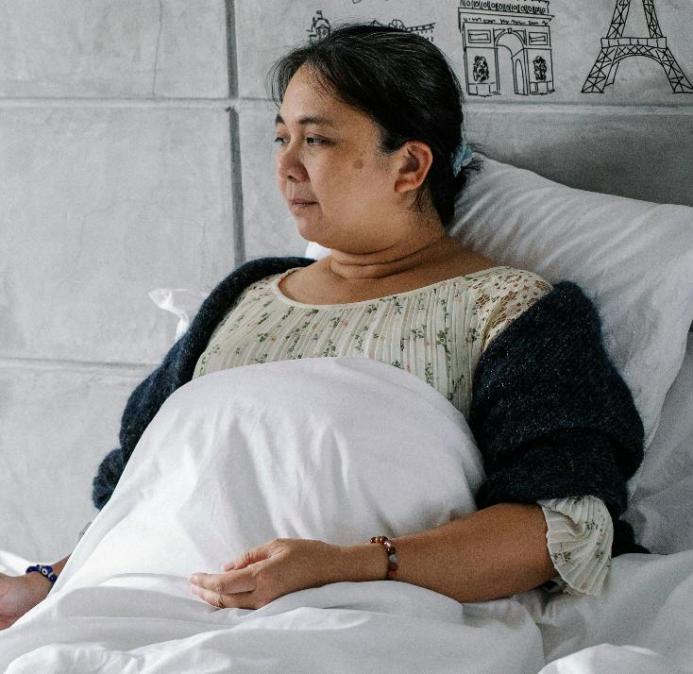
Case study – Jacynda
Activity 1
Jacynda lives on her own and has a mild learning disability. She is in debt. She was not registered with a GP until she had chest pains at age 57. She has a BMI of 34, is pre-diabetic, has high cholesterol and poor liver function.
When asked, Jacynda said she didn’t know what a healthy diet was and had never looked at food labels. She thought she had an intake of 28 units of alcohol per week. She said she was not in contact with her family and had not got any friends.
Lesson 3: Integrated care in action
Notes:
Image © Pexels/Alex Green

Slide 7
Case study – Jagesh
Activity 1
Jagesh is 27, homeless and addicted to heroin. He lost his job because he was caught smoking cannabis. Jagesh’s parents kicked him out of the family home. He found a group of people who bought shoplifted goods and began using heroin with the money he made.
He also sells drugs for a gang. He begs for money in the town centre and the police often move him on. He is underweight, shares needles and feels hopeless. He stays at a crisis night shelter when there is room.
Lesson 3: Integrated care in action
Notes:
Image © Pexels/Ron Lach

Slide 8
Case study – Dianna
Activity 1
Dianna is 83 and experiencing cognitive decline. She is being discharged from hospital after fracturing her hip. She has problems with balance and mobility and needs more support for her own safety. During recovery she will need assistance with all daily activities, as she is frail and incontinent.
She lives in a two-storey house with her husband, Robert, who is 90. He is not capable of meeting her care needs. He disagrees with this assessment, but their children agree.
Lesson 3: Integrated care in action
Notes:
Image © Pexels/Jsme MILA

Slide 9
Case study – Bartek
Activity 1
Bartek is 20 and has a learning disability and type 1 diabetes. He must monitor his blood sugar levels and inject himself with insulin. He would like to live more independently and thinks he can cope alone in a flat. He refuses to negotiate and has stopped engaging.
He does not have a job. His parents ensure his diabetes is managed, as Bartek does not understand measurements and dosage. They have found local supported living specialist accommodation which is staffed 24/7.
Lesson 3: Integrated care in action
Notes:
Image © Pexels/MART PRODUCTION

Slide 10
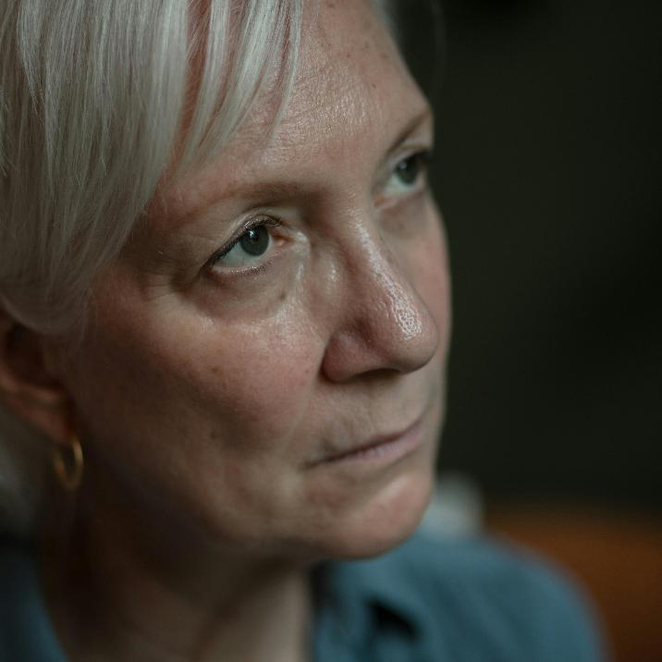
Case study – Sadie
Activity 1
Sadie is 56 and moved to England to study three years ago while her children remained with their grandparents. She experienced a sudden mild ischaemic stroke and was hospitalised.
Her speech has improved, and she has been working with a physiotherapist, but she has become withdrawn and has been diagnosed with depression. She is fit enough to be discharged with follow-up appointments and daily physio exercises, but she is anxious and believes she will not manage on her own.
Lesson 3: Integrated care in action
Notes:
Image © Pexels/RDNE Stock project

Slide 11
Case study – Brad
Activity 2
Read through Brad’s case study.
Think about:
Brad’s care needs when he leaves hospital.
Brad’s own emotions about leaving his home.
Who will be at the care meeting.
Lesson 3: Integrated care in action
Notes:
Image © Shutterstock/ViDI Studio

Slide 12
Care meeting role play
Activity 3
You are going to apply a person-centred care approach by role playing Brad’s care meeting.
Lesson 3: Integrated care in action
Notes:
Image © Pexels/Ivan Samkov

Slide 13
Reflection
Plenary
Carry out reflective practice on your performance in the role play:
What did you learn about care planning from this activity?
How might this role play help you in real-life situations involving teamwork or decision-making?
If you could do the activity again, what would you do differently to improve your performance or the group’s outcome?
Lesson 3: Integrated care in action

Slide 14
In this lesson, we have:
Plenary
Determined the planning, process and outcomes of integrated care planning meetings
Applied knowledge of an individual’s needs to provision, services and professionals
Applied a person-centred care approach
Skills:
CS1.1 Plan and develop person-centred care
CS2.1 Communicate clearly and effectively with a variety of stakeholders
CS3.2 Undertake collaborative work
CS4.2 Make improvements to own practice
General competencies:
English:
GEC2 Present information and ideas
GEC4 Summarise information/ideas
GEC5 Synthesise information
Lesson 3: Integrated care in action

Slide 15
Consolidation: Brad’s care setting
Consolidation
Think about the different care settings in Brad’s case study:
Blackbird Road supported living house, with four rooms
Describe what you think the ideal social care settings should be like for Brad and their family.
Explain (give reasons) why you choose these.
Consider:
Type of building and facilities
Health and safety
Physical needs
Specialist equipment and adaptations
Intellectual and cognitive needs
Emotional and mental health needs
Social needs
Barriers
Informal carer’s support
Lesson 3: Integrated care in action

