Slide 1
Science
Route: Health & Science
Topic: Health, safety and environmental regulations and practice
Lesson 1: How to assess risk
Notes:
Image © Istockphoto/sanjeri

Slide 2
In this lesson we will:
Introduction
Identify the difference between hazards and risks, and how to determine each appropriately.
Assess hazards and risks in new and familiar environments.
Introduce writing a risk assessment using the HSE’s Five Steps to Risk Assessment for a variety of new and familiar contexts.
Establish individual accountability and expertise in order to initiate evaluation of risk assesments.
Skills:
CS1.1: Independently produce a high-level project plan, taking into account the document’s purpose, including: a completed risk assessment; details of how risks will be mitigated
CS3.1: Identifying their own role in relation to the wider team, including: establishing own accountability for tasks and deliverables; own and others’ area of expertise
CS3.2: Meet their responsibilities when working in a wider team by ensuring that project is compliant with relevant health and safety requirements (for example, if storing and handling hazardous substances)
CS5.1: Solve a problem within a science context, by evaluating the impact and continuing to monitor any changes and making recommendations for further improvement
General competencies:
English:
GEC2: Present information and ideas
GEC3: Create texts for different purposes and audiences
GEC4: Summarise information/ideas
GEC6: Take part in/lead discussions
Maths:
GMC6: Understanding data and risk
Lesson 1: How to assess risk

Slide 3
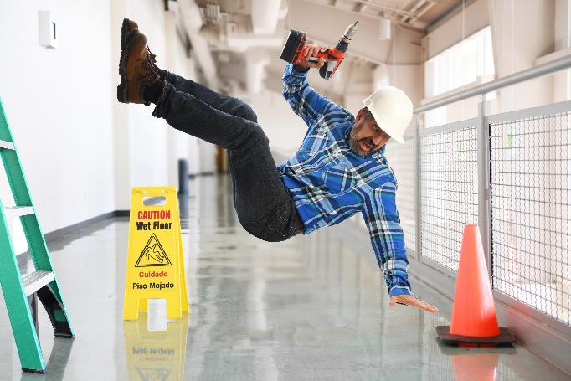


Accidents at work
Introduction
Lesson 1: How to assess risk
Notes:
Image: spilled test tube © Shutterstock/adriaticfoto
Image: man with trapped arm © Shutterstock/Zoriana Zaitseva
Image: man falling over © Shutterstock/Andre Marcelo Santa Maria

Slide 4
HSE case study 1
Introduction
Solderer develops asthma at large manufacturers in Gloucester
Summary
An employee developed occupational asthma after working for a large multi-national company in Gloucester. He was employed between 1995 and 2004 as a solderer and was exposed to rosin based (colophony) solder fume during his career.
His health was deteriorating from 1999 onwards, and he was taking time off work due to breathing difficulties.
HSE investigation
The company did not have adequate control measures in place and failed to install fume extraction equipment to remove rosin based fumes from the workroom air or from the breathing zones of its solderers.
The company did not substitute the rosin based solder with rosin free solder until December 2003, despite an assessment having identified the need to in 1999.
Employees, including the asthma sufferer were not placed under a health surveillance scheme at any time.
This case study can be found on the HSE website here: https://www.hse.gov.uk/coshh/casestudies/index.htm
Lesson 1: How to assess risk
Notes:
This case study is available at: https://www.hse.gov.uk/coshh/casestudies/index.htm
Case study contains public sector information published by the Health and Safety Executive and licensed under the https://www.nationalarchives.gov.uk/doc/open-government-licence/version/3/

Slide 5
HSE case study 2
Introduction
Food manufacturer fined after two workers injured
11 Feb 2019 | News
A food manufacturer has been sentenced following two separate incidents where workers became trapped in moving machinery.
Colchester Magistrates’ Court heard how, on 26 March 2016, whilst working for 2 Sisters Food Group Ltd at its poultry site in Flixton, Norfolk, Mr Romas Ciurlionis trapped his thumb in a moving shackle shortly after being shown how to remove chicken intestines. As the line was running, he was pulled away from the emergency stop cord and when it moved past a fixed gate his thumb was severed.
Lesson 1: How to assess risk
Notes:
This case study is available at: https://www.hsmsearch.com/Food-manufacturer-fined-after-two-workers-injured with content from HSE (https://www.hse.gov.uk).
Case study contains public sector information published by the Health and Safety Executive and licensed under the https://www.nationalarchives.gov.uk/doc/open-government-licence/version/3/

Slide 6
HSE case study 3
Introduction
School cook can hardly walk
Summary
A 46-year-old school cook developed breathing problems after working with flour in the school kitchen. The room was small with poor ventilation.
Her breathing problems became so severe that she could hardly walk. She had to sleep sitting up.
Her daily job included dough making in a large mixer. There were no controls for the flour dust.
HSE investigation
The cook contacted her union, which supported her with a compensation claim on the basis that decent working conditions were not provided.
The council admitted that it had not taken sufficient action over the problem despite repeated complaints. HSE was not involved.
This case study can be found on the HSE website here: https://www.hse.gov.uk/coshh/casestudies/index.htm
Lesson 1: How to assess risk
Notes:
This case study is available at: https://www.hse.gov.uk/coshh/casestudies/index.htm
Case study contains public sector information published by the Health and Safety Executive and licensed under thehttps://www.nationalarchives.gov.uk/doc/open-government-licence/version/3/

Slide 7
HSE case study 4
Introduction
Company fined after employees suffer from dermatitis
Summary
Workers at a company premises in Bristol were exposed to hazardous chemicals over a four-year period leading to the onset of a disease called 'allergic contact dermatitis’. One employee suffered four years of his skin blistering, cracking, splitting and weeping because of this allergic dermatitis.
Two other employees also suffered the symptoms of allergic dermatitis, including fingers and hands becoming so badly swollen and blistered that one could not do up his shirt buttons without his fingers splitting open. All three employees had been working with photographic chemicals.
Effects
The company was fined a total of £100,000 and ordered to pay £30,000 costs. They were fined £30,000 for breaching The Health and Safety at Work Act 1974, and £10,000 for 6 separate breaches of the Control of Substances Hazardous to Health (COSHH) Regulations for not making adequate risk assessments, not preventing or controlling exposure of employees to chemicals, and for not providing any 'health surveillance' of employees at-risk. They were also fined £10,000 for not reporting a case of allergic contact dermatitis.
This case study can be found on the HSE website here: https://www.hse.gov.uk/coshh/casestudies/index.htm
Lesson 1: How to assess risk
Notes:
This case study is available at: https://www.hse.gov.uk/coshh/casestudies/index.htm
Case study contains public sector information published by the Health and Safety Executive and licensed under thehttps://www.nationalarchives.gov.uk/doc/open-government-licence/version/3/

Slide 8
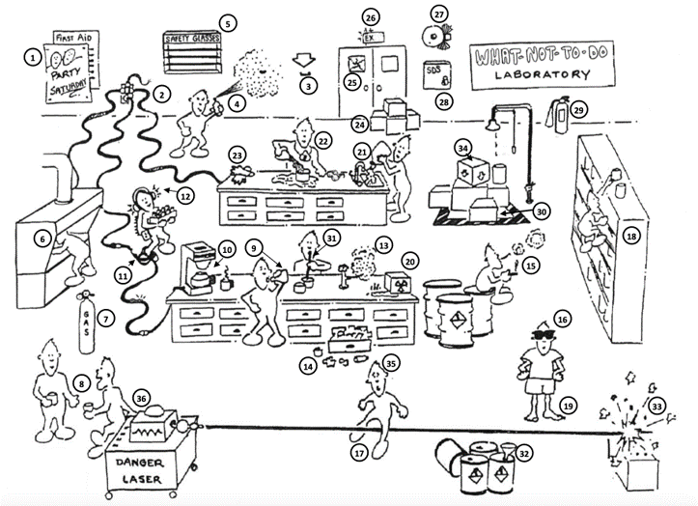
Hazards in the workplace
Activity 1
Identify the hazards in the image on your worksheet.
Write a description of each hazard in the table.
Resources needed
L1 A1 Worksheet 1
Lesson 1: How to assess risk
Notes:
Image: The Laboratory Safety Institute (LSI)

Slide 9

Hazards in the workplace
Activity 1
When completing your worksheet, for each hazard think about:
What is the hazard?
What harm could it cause?
Who could be harmed?
How likely is it that this event will occur?
What is the consequence and severity of the
harm it could cause?
How could the risk be reduced/controlled/prevented?
How would you deal with the hazard if it is present?
Lesson 1: How to assess risk

Slide 10
Risks and hazards
Activity 1
What is the difference between a risk and
a hazard?
Here are two definitions. Identify the definition of a risk and the definition of a hazard.
Something that has the potential to cause injury or harm.
How likely it is that something will cause harm, and how severe that harm would be (the consequence).
Lesson 1: How to assess risk

Slide 11
Risks and hazards
Activity 1
What is the difference between a risk and
a hazard?
Here are two definitions. Identify the definition of a risk and the definition of a hazard.
Something that has the potential to cause injury or harm.
How likely it is that something will cause harm, and how severe that harm would be (the consequence).
Answers
Hazard
Risk
Lesson 1: How to assess risk

Slide 12
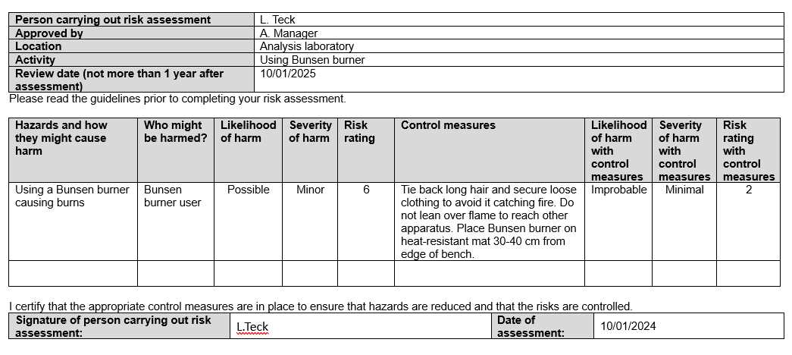
Introduction to risk assessments
Activity 2
A pro-forma risk assessment
Lesson 1: How to assess risk
Notes:
See also risk assessment (pages 11–12): https://www.ncfe.org.uk/media/xeyo35n4/sci-gsem-01-tq-science-osa-laboratory-sciences-assignment-1-distinction-guide-standard-exemplification-materials.pdf

Slide 13
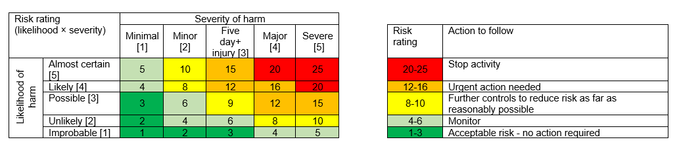
Introduction to risk assessments
Activity 2
A risk matrix
Lesson 1: How to assess risk
Notes:
See also Risk matrix (page 10): https://www.ncfe.org.uk/media/xeyo35n4/sci-gsem-01-tq-science-osa-laboratory-sciences-assignment-1-distinction-guide-standard-exemplification-materials.pdf

Slide 14

The main purposes of a risk assessment
Activity 2
The main purposes of a risk assessment are:
to identify hazards to health, safety and wellbeing in a workplace
to determine the risks involved with each of those hazards
to evaluate existing safety and control measures and determine if further measures are required to eliminate a hazard, or where this is not possible, to minimise risk
to put safety measures in place to ensure that any residual risk is as low as possible.
Lesson 1: How to assess risk
Notes:
Image © iStockphoto/JohnnyGrieg

Slide 15
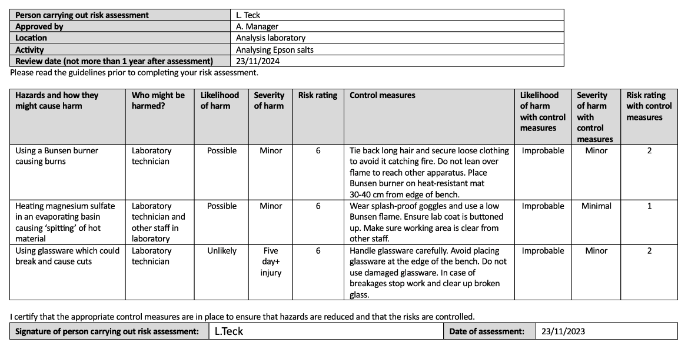
Considering risk assessments
Activity 2
THINK, PAIR, SHARE
Why are risk assessments important?
What information is needed in a risk assessment?
How does this relate to the activity we have just performed?
Lesson 1: How to assess risk
Notes:
See also risk assessment from (pages 11–12): https://www.ncfe.org.uk/media/xeyo35n4/sci-gsem-01-tq-science-osa-laboratory-sciences-assignment-1-distinction-guide-standard-exemplification-materials.pdf

Slide 16

The HSE’s Five Steps to Risk Assessment
Activity 3
Step 1: Identifying the hazards
Step 2: Deciding who might be harmed and how
Step 3: Evaluating the risks and deciding on precautions
Step 4: Recording findings and implementing them, including completing risk assessment documentation
Step 5: Reviewing your assessment and updating if necessary
Lesson 1: How to assess risk
Notes:
Contains public sector information published by the Health and Safety Executive and licensed under the https://www.nationalarchives.gov.uk/doc/open-government-licence/version/3/

Slide 17
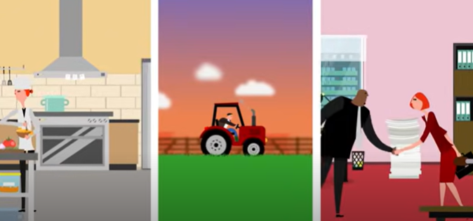
Preparing to write risk assessments
Activity 3
Watch the video about the HSE’s Five Steps to Risk Assessment.
Add notes to Worksheet 2, which will help you to follow these five steps yourself.
You should include prompts or questions that you could ask yourself during each step.
Resources needed
L1 A3 Example risk assessment
L1 A3 Worksheet 2
HSE: Health and safety risk assessment and management
Lesson 1: How to assess risk
Notes:
This video ’Health and safety risk assessment and management’ from the HSE is available on YouTube at: https://www.youtube.com/watch?v=xyANahuhGs0.
Video contains public sector information published by the Health and Safety Executive and licensed under the https://www.nationalarchives.gov.uk/doc/open-government-licence/version/3/

Slide 18

Considerations when writing risk assessments
Activity 3
Step 1: Identifying the hazards
  How do we do this? What could we use to help?
  How much detail is needed?
  Consider long term health hazards (e.g. high levels of noise)
  and non-routine activities (e.g. spring cleaning).
Step 2: Deciding who might be harmed and how
  Consider visitors, as well as regular members of staff/employees/students.
Step 3: Evaluating the risks and deciding on precautions
  How do we determine the risk level?
  Are all hazards the same?
  Consider what can be done to minimise/
  reduce/remove the risk.
Add notes to your activity sheet during your class discussion.
Lesson 1: How to assess risk

Slide 19
Considerations when writing risk assessments
Activity 3
Step 4: Recording findings and implementing them,
including completing risk assessment documentation
    What do we need to record here? How?
Step 5: Reviewing your assessment and updating if necessary
    When should this take place?
    Why is this an important step?
  Add notes to your activity sheet during your class discussion.
Lesson 1: How to assess risk

Slide 20
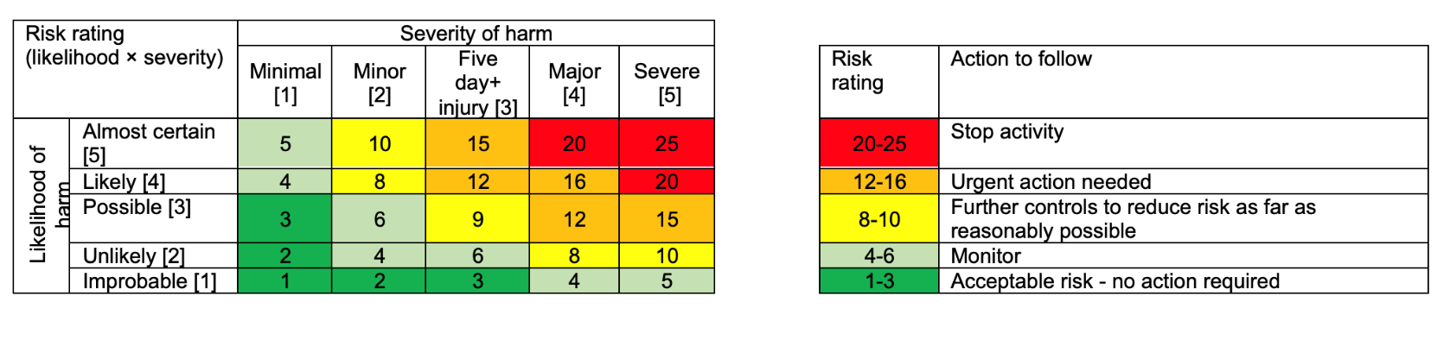
Using a risk matrix
Activity 3
A risk matrix
Lesson 1: How to assess risk
Notes:
See also risk matrix: https://www.ncfe.org.uk/media/votpjuvh/sci-0007-01-tq-science-osa-laboratory-sciences-assignment-1-assignment-brief.pdf

Slide 21
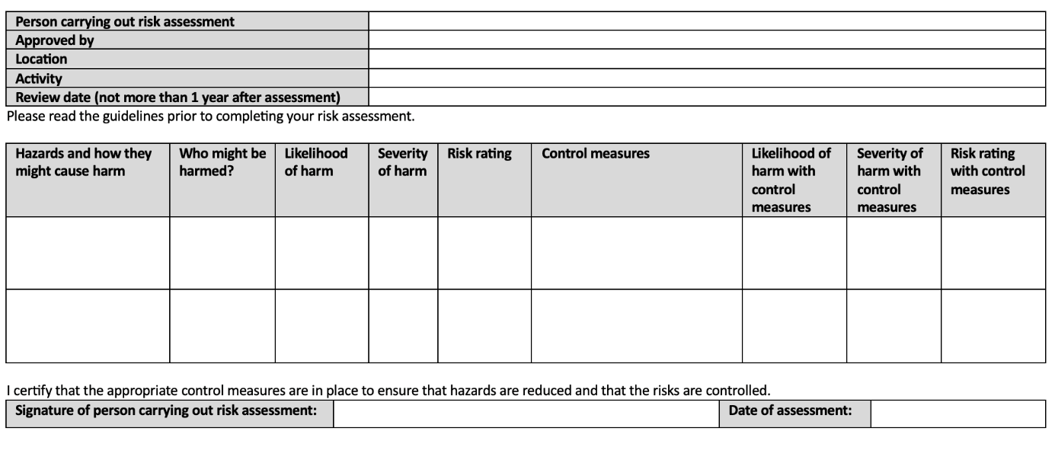
Writing risk assessments
Activity 3
This is the risk level (LxS) once the control measures have been applied – again, use the risk matrix to determine if further action is needed.
In these first ’Likelihood’ and ‘Severity’ columns, determine the likelihood of this hazard occurring, and the severity of the consequences if it does. Mark these out of 5 – you can use the risk matrix to help.
Here we need to write each hazard and a brief description of it, and then who might be harmed by it.
Use the risk matrix to determine the total risk level (before any control measures are put in place) – this gives you an idea of what further action is appropriate.
These second ‘Likelihood’ and
‘Severity’ columns give values (1 – 5) which reflect the likelihood and severity after the control measures have been applied.
Here, detail any control measures necessary to minimize the hazard – these control measures should leave your residual risk level at 10 or below where possible.
Lesson 1: How to assess risk
Notes:
See also risk assessment (pages 9–10): https://www.ncfe.org.uk/media/votpjuvh/sci-0007-01-tq-science-osa-laboratory-sciences-assignment-1-assignment-brief.pdf

Slide 22
Write your own risk assessment
Activity 3
It’s your turn!
Complete a risk assessment for one of the five tasks using the HSE’s Five Steps to Risk Assessment.
Then, in groups, compare and improve your risk assessments.
Tasks
Moving a large, high pressure gas cylinder
Manual handling of large items around a room
Working in an office space
Working in a wet lab
Boiling a beaker of water
Lesson 1: How to assess risk

Slide 23
Improving a risk assessment
Plenary
THINK, PAIR, SHARE
Read through the risk assessment in front of you and evaluate it:
How could the risk assessment be improved?
What information is missing?
Does it fulfil enough of the five steps?
Resources needed
L1 Plenary Risk Assessment 1
L1 Plenary Risk Assessment 2
Lesson 1: How to assess risk

Slide 24
In this lesson we have:
Plenary
Identified the difference between hazards and risks, and how to determine each appropriately.
Assessed hazards and risks in new and familiar environments.
Introduced writing a risk assessment using the HSE’s Five Steps to Risk Assessment for a variety of new and familiar contexts.
Established individual accountability and expertise in order to initiate evaluation of risk assessments.
Skills:
CS1.1: Independently produce a high-level project plan, taking into account the document’s purpose, including: a completed risk assessment; details of how risks will be mitigated
CS3.1: Identifying their own role in relation to the wider team, including: establishing own accountability for tasks and deliverables; own and others’ area of expertise
CS3.2: Meet their responsibilities when working in a wider team by ensuring that project is compliant with relevant health and safety requirements (for example, if storing and handling hazardous substances)
CS5.1: Solve a problem within a science context, by evaluating the impact and continuing to monitor any changes and making recommendations for further improvement
General competencies:
English:
GEC2: Present information and ideas
GEC3: Create texts for different purposes and audiences
GEC4: Summarise information/ideas
GEC6: Take part in/lead discussions
Maths:
GMC6: Understanding data and risk
Lesson 1: How to assess risk

Slide 25
Next lesson we will:
Plenary
Recall and recognise the different COSHH hazard symbols and the actions needed to control the associated risks.
Identify hazards associated with different substances.
Practice writing risk assessments using the HSE’s Five Steps to Risk Assessment for a variety of new and familiar contexts, which include hazardous substances and detailing appropriate control measures for each.
Evaluate Risk Assessments, including making recommendations for further improvements where appropriate.
Lesson 1: How to assess risk

