Slide 1
Science
Route: Health & Science
Topic: Good scientific and clinical practice
Lesson 2: Using a SOP
Notes:
Image © Shutterstock/Gorodenkoff

Slide 2
In this lesson, we will:
Introduction
Follow a standard operating procedure (SOP).
Perform a search to locate a specific SOP for a given activity.
Identify missing statutory requirements on a SOP.
Skills:
CS3.2 Meet their responsibilities when working in a wider team by ensuring that the project is compliant with relevant SOPs specific to the lab in which they are working
CS2 Researching
General competencies:
English:
GEC5 Synthesise information
GEC6 Take part in/lead discussions
Maths:
GMC1 Measuring with precision
GMC6 Understanding data and risk
Digital:
GDC1 Use digital technology and media effectively
Lesson 2: Using a SOP

Slide 3

What are some main principles of good practice in scientific and clinical settings?
Introduction
Store materials and chemicals appropriately
Calibrate and maintain equipment
Maintain work areas
Effectively manage stock levels
Use standard operating procedures (SOPs)
Lesson 2: Using a SOP

Slide 4
Following a SOP
Activity 1
Follow a SOP on the worksheet to manufacture Drug X.
Once complete, test the pH of your solution. It should be in the range 4.5–4.6.
If the pH matches the expected pH, you have followed the SOP correctly. Answer the questions on the next slide.
If it doesn’t match, follow the instructions on the CLEAPSS guide using water in your burette.
Resources needed
L2 Activity 1 Worksheet
CLEAPSS guide to filling and using a burette
Equipment to make Drug X
Lesson 2: Using a SOP
Notes:
Websites linked in this slide:
https://science.cleapss.org.uk/Resource-Info/GL320-Filling-and-using-a-burette.aspx

Slide 5
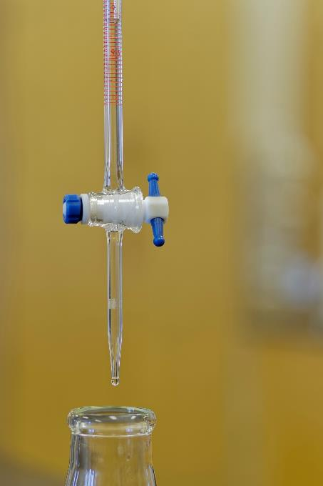
Following a SOP
Activity 1
Were any steps of the procedure unclear?
What do you think the beaker was for?
Did you have any difficulties reading the scale?
What could happen if a drug with the wrong pH was used on a patient?
What procedures are in place to prevent this kind of error happening in an industry placement or a workplace?
Lesson 2: Using a SOP
Notes:
Image © Shutterstock/ggw

Slide 6
Finding and comparing SOPs
Activity 2
The following slides contain some scenarios that require SOPs.
Decide what key points should be in the SOP.
Look up a relevant SOP for the scenario.
  How many of the key points listed in the SOP had you suggested?
  Identify which points in the SOP are critical (i.e., could have disastrous outcomes if done wrongly). Did you include these?
Then compare some of the SOPs you’ve looked at. What features of the SOPs are the same? How are they different?
Lesson 2: Using a SOP

Slide 7
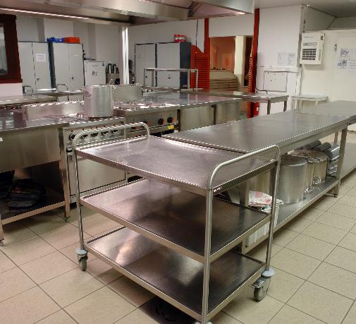
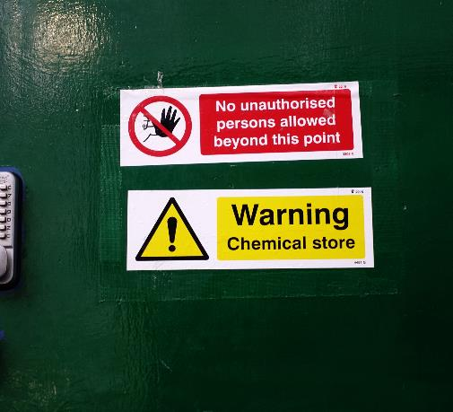
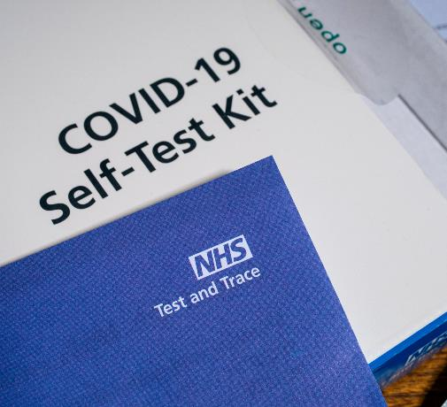
Finding and comparing SOPs
Activity 2
Scenario 1: You are asked to prepare a meal in a school kitchen for students.
Scenario 2: You have been asked to move the contents of an old hazardous chemical store into a new one.
Scenario 3: A new strain of COVID has emerged. You need to explain to how to use a test.
Lesson 2: Using a SOP
Notes:
Scenario 1: A SOP that outlines procedures to keep catering staff safe when working in a kitchen
Image © Shutterstock/Kris Vandereycken
Scenario 2: A SOP that outlines storage, handling and disposal of waste chemicals and solvents
Image © Shutterstock/RogerMechan
Scenario 3: A SOP that outlines the correct procedure to use a COVID-19 lateral flow test
Image © Shutterstock/chrisdorney

Slide 8
Finding and comparing SOPs
Activity 2
Within organisations, SOPs are often contained on an intranet/online training manual and can be located through index searches.
This ensures that:
all staff can easily locate the relevant SOP
everyone uses the most up-to-date version of the SOP
a digital record is kept of who has used a particular SOP and when they have used it
staff induction and ongoing training is kept up-to-date and refresher training carried out where relevant.
Lesson 2: Using a SOP

Slide 9
Successful SOPs
Plenary
Good SOPs should:
be updated regularly (and the most up-to-date version used)
be reviewed, authorised, signed and dated
clearly outline the scope (what the SOP covers) and purpose of the SOP
clearly detail any required procedure.
Lesson 2: Using a SOP

Slide 10
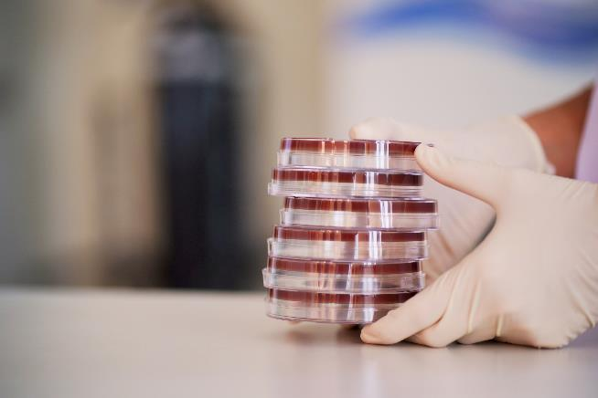
Spot the SOP errors
Plenary
The worksheet is a SOP on making agar plates.
How many errors can you spot?
Resources needed
L2 Plenary Worksheet
Lesson 2: Using a SOP
Notes:
Image © Shutterstock/enuengneng

Slide 11
Spot the SOP errors
Plenary
The SOP has not been reviewed or authorised.
The users have not dated when they read the policy.
The scope and the purpose have been muddled up and placed in the wrong boxes.
The temperature is missing at step 2 in the procedure.
The final step in the procedure is missing where students should disinfect the area they worked in with ethanol.
Lesson 2: Using a SOP

Slide 12
In this lesson, we have:
Plenary
Plenary
Followed a standard operating procedure (SOP).
Performed a search to locate a specific SOP for a given activity.
Identified missing statutory requirements on a SOP.
Skills:
CS3.2 Meet their responsibilities when working in a wider team by ensuring that the project is compliant with relevant SOPs specific to the lab in which they are working
CS2 Researching
General competencies:
English:
GEC5 Synthesise information
GEC6 Take part in/lead discussions
Maths:
GMC1 Measuring with precision
GMC6 Understanding data and risk
Digital:
GDC1 Use digital technology and media effectively
Lesson 2: Using a SOP

Slide 13
Compare SOPs
Consolidation
Search for two SOPs online for the same piece of equipment.
Compare them using the table on the worksheet.
Resources needed
L2 Consolidation Worksheet
Lesson 2: Using a SOP

