Slide 1
Science
Route: Health & Science
Topic: Good scientific and clinical practice
Lesson 2: Use of equipment
Notes:
Image © Shutterstock/Gorodenkoff

Slide 2
In this lesson, we will:
Introduction
Explain why it is important to calibrate and test equipment so it is fit for use.
Describe the potential impacts of not maintaining, cleaning and servicing equipment.
Outline how to escalate concerns over faulty or unsuitable equipment.
Skills:
CS3.2: Working with others
CS6: Communication
CS7.1 Evaluate the project’s processes and outcomes
General competencies:
English:
GEC5 Synthesise information
GEC6 Take part in/lead discussions
Maths:
GMC1 Measuring with precision
GMC2 Estimating, calculating and error spotting
Lesson 3: Use of equipment

Slide 3

Look at the image
Introduction
What different things do scientists measure in the world around us?
Lesson 3: Use of equipment
Notes:
Image © Unsplash/Pedro Ramos

Slide 4
Look at the image
Introduction
Which measurements did you think of?
What else did you come up with?
What measurements are critically important?
Temperature & humidity
% transparency
Number of office workers
Light intensity
Height of pole
Building material strength
Mobile speed data
Blood pressure
Steps taken
Mass of bus
Number of cars per hour
Speed
Heart rate
Lesson 3: Use of equipment
Notes:
Image © Unsplash/Pedro Ramos

Slide 5
Why is it important to regularly test equipment?
Activity 1
You will be given some pieces of equipment to take a range of measurements. Your teacher will tell you which measurements to take.
Once all groups have collected their data, compare your readings.
  Which group(s) had the correct readings? How do you know?
  Which piece(s) of equipment is/are faulty? How do you know?
  Why is it important to regularly test equipment to check it is not faulty?
Resources needed
A range of equipment
Lesson 3: Use of equipment

Slide 6
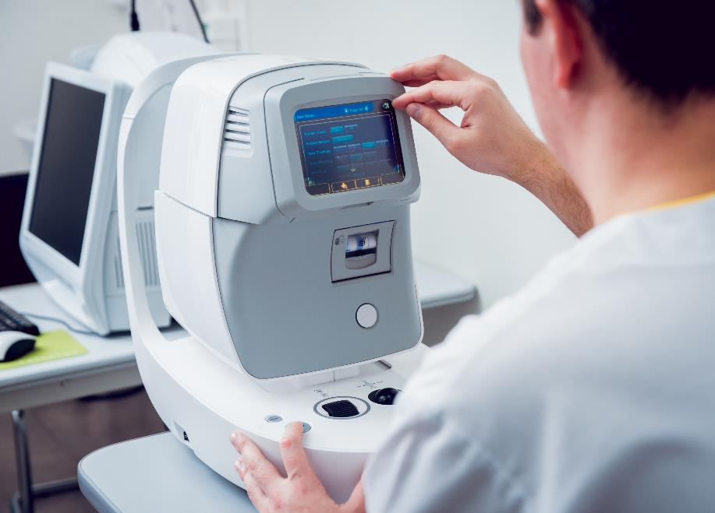
Why is it important to regularly test equipment?
Activity 1
Regularly testing equipment:
ensures the accuracy of measurements
prolongs the life of equipment
is often required to meet legal requirements.
Lesson 3: Use of equipment
Notes:
Image © Shutterstock/Roman Zaiets

Slide 7
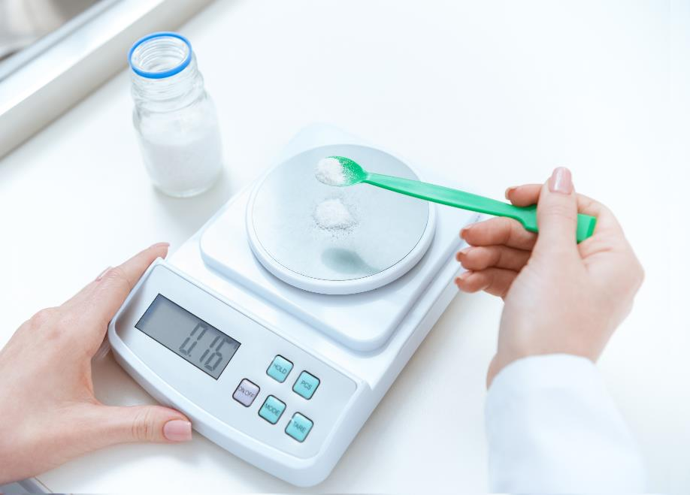
Calibrating equipment
Activity 2
Calibrating weighing scales
Why might laboratory scales need calibrating in a scientific workplace?
Is it sufficient just to set the zero reading?
Is a single calibration mass enough to calibrate laboratory scales?
Lesson 3: Use of equipment
Notes:
Image © Shutterstock/LightField Studios

Slide 8
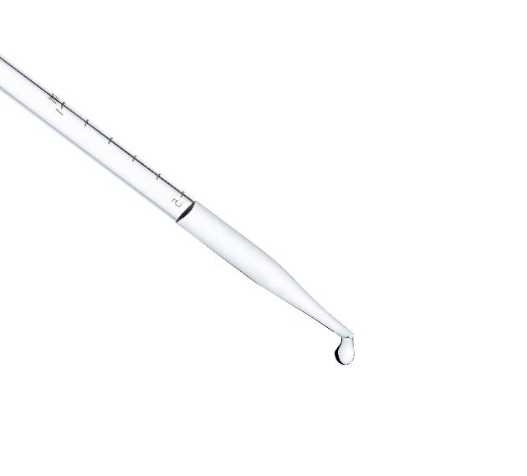
Why is it important to regularly test equipment?
Activity 2
Follow the steps provided on your worksheet to calibrate a micropipette.
Resources needed
L3 Activity 2 Worksheet
P1000 micropipette
Pipette tips
Distilled water
A beaker
Digital thermometer or temperature probe
Digital balance, resolution ±0.0001g
Balance draught shield
Weighing boats
Lesson 3: Use of equipment
Notes:
Image © Shutterstock/stciel

Slide 9
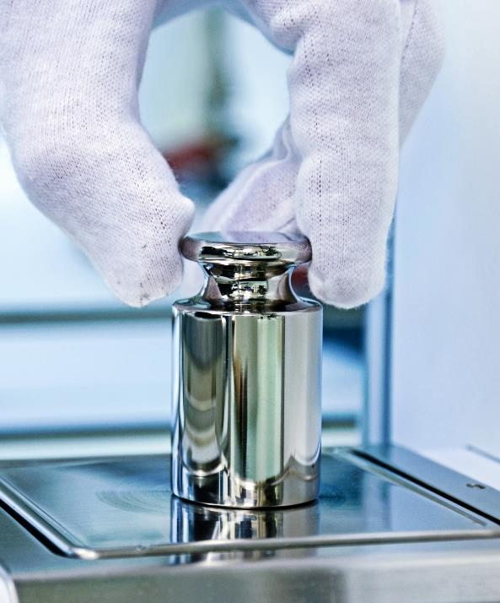
Calibrating equipment
Activity 2
Calibration ensures that a scientific process or piece of equipment will produce accurate results every time.
Over time, instruments can 'drift' due to normal wear and tear, resulting in inaccurate results. Therefore, it is important that pieces of equipment are properly calibrated before use.
Calibration involves comparing measurement
values obtained by a piece of equipment under test, with those of known accuracy. (If found to be incorrect the piece of equipment is then adjusted.)
Lesson 3: Use of equipment
Notes:
Image © Shutterstock/Markus Thoenen

Slide 10
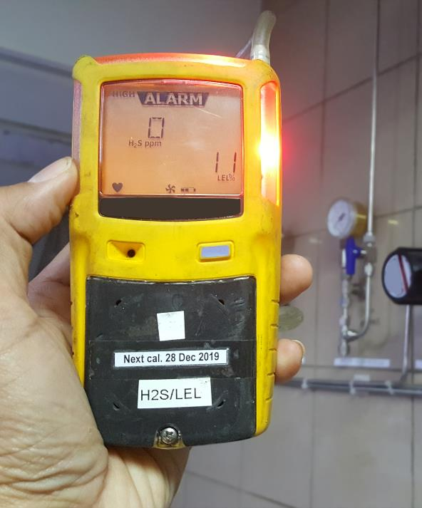
Calibrating equipment
Activity 2
As well as ensuring an instrument provides an accurate reading, calibration extends the life of a piece of equipment.
The calibration lifecycle of a piece of equipment varies by instrument. It is also determined by manufacturers’ recommendations, usage and environment of the instrument.
It is a legal requirement to calibrate some instruments, for example, gas detectors. This is to ensure safety standards are met.
Lesson 3: Use of equipment
Notes:
Image © Shutterstock/petroleum man

Slide 11
Identifying mistakes
Activity 3
For each scenario (1–4), read how a student made a measurement.
Decide where they went wrong.
Repeat the procedure correctly using the equipment supplied.
Resources needed
Cards cut from L3 Activity 3 Worksheet
Balance
4 x 50cm³ beakers
Salt
Measuring cylinder
Water
Thermometer
Bunsen burner
Gauze
Tripod
Mat
Safety glasses
Pipette/syringe
Lesson 3: Use of equipment

Slide 12
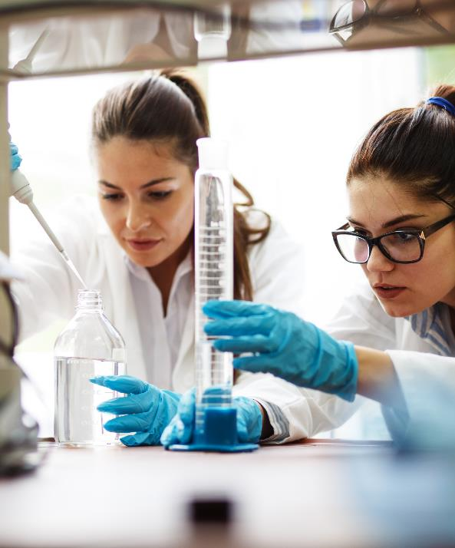
Identifying mistakes – correct procedures
Activity 3
Scenario 1 – Place the empty beaker on the balance, press tare, then remeasure the mass of the beaker with the salt added.
Scenario 2 – Place the measuring cylinder on a table whilst filling the cylinder and reading the volume. To determine the correct volume of liquid, line up the eye to the level of where the liquid sits on the scale before taking the reading. (This avoids parallax error.)
Scenario 3 – The thermometer should be held in the liquid away from the beaker sides when measuring the temperature. The liquid should be stirred before a measurement is taken.
Scenario 4 – Use a pipette/syringe to accurately measure out the volume of liquid and transfer to the beaker. Beakers are not suitable for accurate volume measurements due to their larger graduations.
Lesson 3: Use of equipment
Notes:
Image © Shutterstock/BalanceFormCreative

Slide 13
Escalating concerns
Activity 4
When on placement, a trainee nurse had concerns that a fridge, which was being used to store drugs, was not registering the correct temperature. The fridge temperature display showed fluctuations, even when the door had been closed for a period of time.
Discuss with a partner which of the following steps the student should take:
Switch the appliance off at the wall, wait for five minutes, and switch on again. Check the fridge display resets correctly.
Remove all the drugs from the fridge and store in an alternative fridge.
Place a note on the equipment stating that it is faulty and cannot be used and complete a report form.
Tell a more senior member of staff about the issue.
Lesson 3: Use of equipment

Slide 14
Escalating concerns
Activity 4
If a piece of equipment is unsuitable for intended use, due to a fault or not being correctly calibrated, you should:
  not use the piece of equipment
  label the piece of equipment as unfit for use
  tell your supervisor/line manager
  fill in any organisational documentation if required.
Lesson 3: Use of equipment

Slide 15
Plenary
Plenary
Write down three reasons why it is important to calibrate equipment.
Lesson 3: Use of equipment

Slide 16
In this lesson, we have:
Plenary
Skills:
CS3.2: Working with others
CS6: Communication
CS7.1 Evaluate the project’s processes and outcomes
General competencies:
English:
GEC5 Synthesise information
GEC6 Take part in/lead discussions
Maths:
GMC1 Measuring with precision
GMC2 Estimating, calculating and error spotting
Explained why it is important to calibrate and test equipment so it is fit for use.
Described the potential impacts of not maintaining, cleaning and servicing equipment.
Outlined how to escalate concerns over faulty or unsuitable equipment.
Lesson 3: Use of equipment

Slide 17
Consolidation
Consolidation
Make a video of either correct, or subtly incorrect, procedures to show to the rest of the group in a later session.
Look at online animations to help develop practical skills you lack confidence in, for example, how to make a solution. Suitable examples can be found here: www.labxchange.org/library
Join in with a measurement challenge courtesy of the National Physical Laboratory (NPL), using your measurement skills: www.npl.co.uk/measurement-at-home
Lesson 3: Use of equipment
Notes:
www.labxchange.org/library
www.npl.co.uk/measurement-at-home (with permission)

