Slide 1

Lesson 7: Virtual environments
Digital environments
Notes:
Version 1, June 2024

Slide 2
Communication over networks
Retrieval activity
Question .
At which layer of the TCP/IP model would you expect to see the IP protocol?
Application layer
Transport layer
Network or internet layer
Link or data link layer
Question .
At which layer of the TCP/IP model would you expect to see the UDP protocol?
Application layer
Transport layer
Network or internet layer
Link or data link layer
Question .
At which layer of the TCP/IP model would you expect to see the Ethernet protocol?
Application layer
Transport layer
Network or internet layer
Link or data link layer
Question .
At which layer of the TCP/IP model would you expect to see the FTP protocol?
Application layer
Transport layer
Network or internet layer
Link or data link layer

Slide 3
Communication over networks
Retrieval activity
Question .
At which layer of the TCP/IP model would you expect to see the IP protocol?
Application layer
Transport layer
Network or internet layer
Link or data link layer
Question .
At which layer of the TCP/IP model would you expect to see the UDP protocol?
Application layer
Transport layer
Network or internet layer
Link or data link layer
Question .
At which layer of the TCP/IP model would you expect to see the Ethernet protocol?
Application layer
Transport layer
Network or internet layer
Link or data link layer
Question .
At which layer of the TCP/IP model would you expect to see the FTP protocol?
Application layer
Transport layer
Network or internet layer
Link or data link layer
Notes:
Answers: IP protocol – C; Ethernet protocol – D; UDP protocol – B; FTP protocol - A

Slide 4
Lesson 7: Virtual environments
Objectives
In this lesson you will:
Examine the key features of virtual environments:
  Increased security
  Sharing
  Aggregation
  Emulation
  Isolation
  Portability
Analyse the benefits and drawbacks of the use of virtual environments in a range of contexts
General competencies:
E1 - convey technical information
E2 - present information and ideas
E3 - create texts
E4 - summarise information
E5 - synthesise information
D1 - use digital technology
D6 - code and program

Slide 5
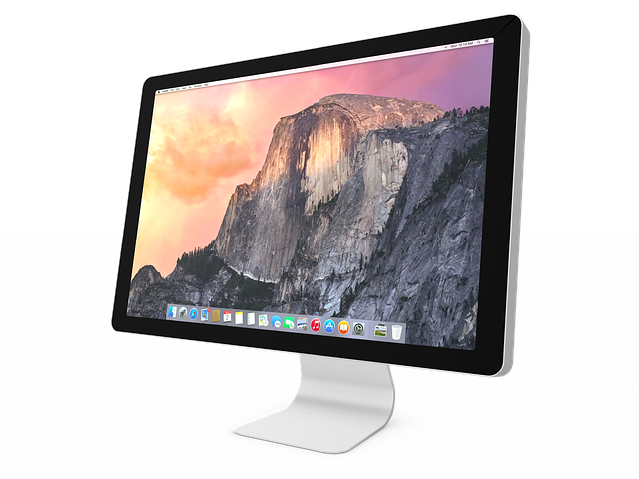
Virtual machines
Activity 1
A computer system is usually configured to have a single environment in which you work. We can refer to this as a physical machine.
This physical machine will have an Operating System (OS), such as Windows 10, and an amount of main memory and secondary storage.
Notes:
Personal computer image by SharaniRamli from Pixabay: https://pixabay.com/photos/imac-pc-personal-computer-computer-2493287/

Slide 6
Virtual machines
Activity 1
Open and complete Part A of ‘A1 Activity sheet – Virtual machines’
What operating system (and which version) is installed on the computer system you are using now?
How much main memory do you have?
How much disk storage do you have?
What other operating systems are you aware of?
Why might you want to use a different operating system?
Activity 1 - Virtual machines
Part A
A computer system is usually configured to have a single environment in which you work. We can refer to this as a physical machine. This physical machine will have an operating system, such as Windows 10, and an amount of main memory and secondary storage.
Investigate the attributes of the computer system you are currently using and complete the table below.
If you are using a Windows computer you can use Windows > System Information.
If you are using MacOS you can specify Apple menu > System Settings, then click General in the sidebar. Click About in the right-hand window, then click System Report.

Slide 7
Virtual machines
Activity 1
You don’t need a new physical machine in order to install and use a different operating system
You can set up one or more virtual machines (VMs) on a single physical computer system
Each virtual machine will have its own operating system and an allocation of the physical system resources
To create a VM you must install a ‘type-2’ hypervisor such as VirtualBox
This will allow you to share the resources of the physical machine between two or more virtual machines
Guest operating system
Guest operating system
Hypervisor (type-2)
Host operating system
Computer hardware
A hypervisor (sometimes also known as a Virtual Machine Monitor – VMM) is a piece of software which creates and runs virtual machines.

Slide 8
Virtual machines
Activity 1
Look at the VirtualBox documentation and find out which guest operating systems can be installed on which host operating systems
https://www.virtualbox.org/wiki/End-user_documentation
Open and complete Part B of ‘A1 Activity sheet – Virtual machines’
Activity 1 - Virtual machines
Part B
For this activity, you are going to look at the documentation for VirtualBox (or an alternative type-2 hypervisor product if preferred):
https://www.virtualbox.org/wiki/End-user_documentation
Find out which guest operating systems can be installed on which host operating systems and complete the table below.
Host operating system | Guest operating system(s)
Notes:
https://www.virtualbox.org/wiki/End-user_documentation

Slide 9
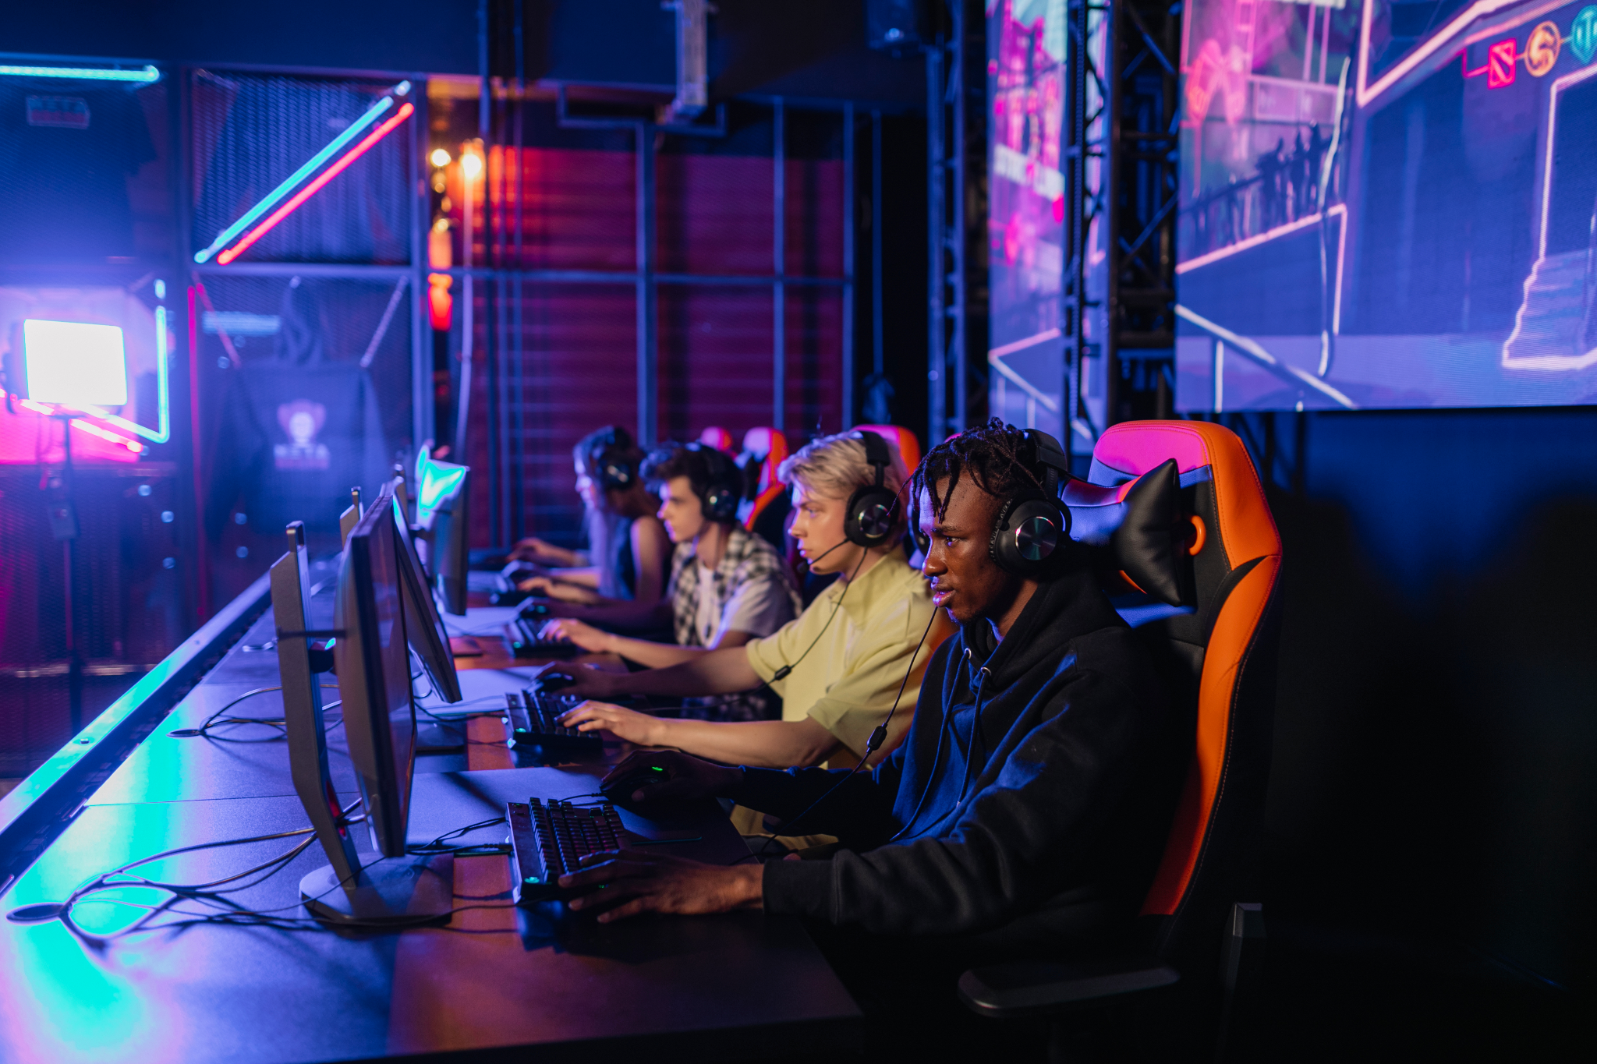
Emulators
Activity 1
An emulator attempts to make one computer system behave like a completely different computer system (i.e. with different physical characteristics)
For example, you might want to use an emulator to make your personal computer behave like your favourite games console
When you use an emulator, you cannot access computer hardware directly; it is done through the emulator
If the hardware does not exist on the physical computer system, the required functionality will be created in the software
Notes:
Photo by Alena Darmel from Pexels: https://www.pexels.com/photo/a-group-of-friends-gaming-together-7862657/

Slide 10
Emulators
Activity 1
Use the internet to research emulators for several games consoles:
Open and complete Part C of ‘A1 Activity sheet – Virtual machines’
Activity 1 - Virtual machines
Part C
Use the internet to research emulators for several games consoles:
Make a bullet point list in the table below of any notable issues (with an emulator) that have been reported by users.
Console | Emulator(s) | Issues

Slide 11
Server virtualisation
Activity 2
The techniques used to create virtual machines on a personal computer can also be deployed on large powerful servers.
These physical servers can be split up to create multiple virtual servers using a “type-1” hypervisor, such as VMWare.
A type-1 hypervisor does not require a host operating system to be installed. The hypervisor manages the hardware resources directly.
Virtual server
Virtual server
Hypervisor (type-1)
Computer hardware
The resources of the physical server are shared between all of the virtual servers.

Slide 12
Server virtualisation
Activity 2
The virtual server is created as a “VM image” which includes the operating system, configuration settings, and files.
It is straightforward to backup the server by taking an image copy (because the image is treated as a single file) and straightforward to redeploy if the server fails.
All of the servers can be managed from a central point of control, and this does not have to be in the same location as the servers. This allows multiple servers to be managed remotely from a single point of expertise.
The virtual server is portable — it could easily be redeployed to a different physical server. This means that if more capacity is needed, it is relatively straightforward to bring the server up on a new, larger platform. If the physical server space is leased or rented, an alternative provider could be used with little disruption or risk to service.

Slide 13
Server virtualisation
Activity 2
Access the customer stories on the VMware website and select one story to read
Open and complete ‘A2 Activity sheet – Server virtualisation’ by summarising:
  The name of the organisation
  The nature of the organisation (i.e. what they do)
  What they hoped to achieve by virtualisation
  The benefits of the solution
At the end of the activity, share your findings with your fellow classmates
Activity 2 - Server virtualisation
Access the customer stories on the VMware website:
https://www.vmware.com/uk/company/customers.html#
Select one story to read. Use this activity sheet to summarise:
The name of the organisation
The nature of the organisation (i.e. what they do)
What they hoped to achieve by virtualisation
The benefits of the solution
At the end of the activity, share your findings with your fellow classmates.
Name of the organisation
Nature of the organisation (i.e. what they do)
Notes:
https://www.vmware.com/uk/company/customers.html#

Slide 14
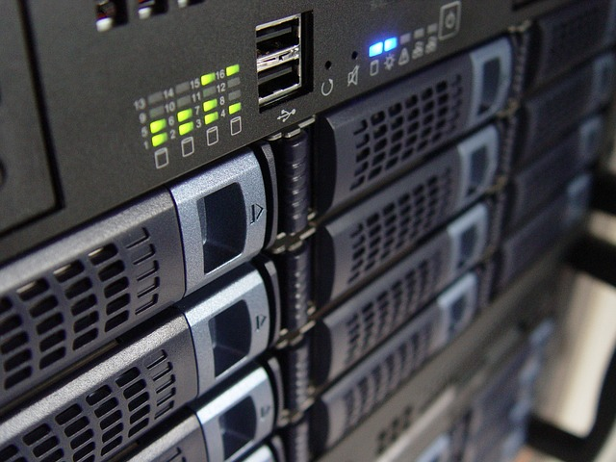
Server virtualisation
Activity 2
As well as partitioning a single physical server to support one or more virtual servers, computing resources can be aggregated.
This is very useful for systems to support areas such as research departments, where a huge amount of processing power may be needed for specific projects.
Big Data projects are very often too large for a single server. Tools such as Hadoop make it possible to process massive volumes of data on clusters of computer systems.
Aggregation is combining physical servers and their memory and CPU power to create a single, large virtual machine
Notes:
Photo by heladodementa from Pixabay: https://pixabay.com/photos/technology-servers-server-1587673/

Slide 15
Virtual development environments
Activity 3
As a software developer, you can set up a virtual environment in which to develop and test your computer programs.
Whenever you are working on a project that has external dependencies (such as modules written by another person or company), it is good practice to create a virtual environment.
This means that any modules you install and use for the project are isolated within the environment and will not affect other programs that might have different dependencies.
The way you do this will depend on the programming language. For example, if you use Python, you can use the Python venv module (built into the core library).

Slide 16
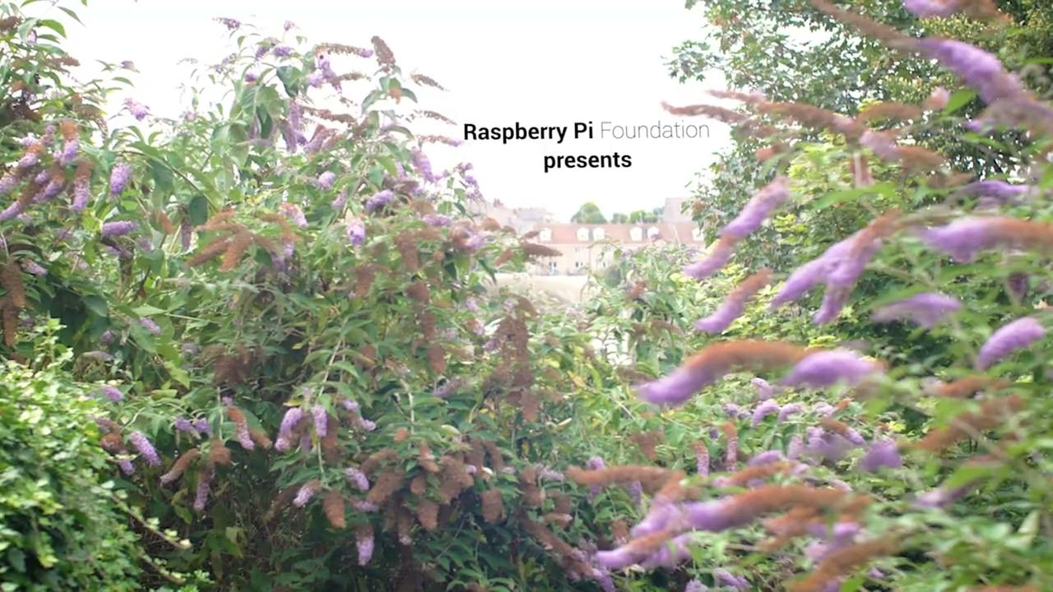

Activity 3
What encouraged Cian to become a software engineer? What skills do you think he has had to develop?
Notes:
A3 Software engineer film: https://vimeo.com/883953763

Slide 17
Virtual development environments
Activity 3
When someone wants to run a program, their machine must have a suitable interpreter or the program code must have been compiled to run on their machine
The Java programming language uses a different approach:
  A Java Virtual Machine must be set up on the machine that will run the Java program
  The program must be translated into intermediate or byte code
  This code will run on the Java VM. The Java VM will communicate with the physical computer system
  This approach means that Java applications (and others that take a similar approach) are more portable than other applications

Slide 18
Virtual development environments
Activity 3
Using a programming language of your choice, identify a software module that you might use in a development project
For your chosen module, investigate to determine:
  Will the module work with all versions of your chosen programming language?
  Are there any other software dependencies?
  Is there anything else you would need to consider before you decide whether you should use it?
Activity 3 – Virtual development environments
Using a programming language of your choice, identify a software module/package that you might use in a development project.
For example, if you use Python, you might use Pillow which is a Python Imaging Library that provides powerful image processing capabilities.
For your chosen module/package, investigate to determine:
Will the module/package work with all versions of your chosen programming language?
Are there any other software dependencies?
Is there anything else you would need to consider before you decide whether you should use it?
Document your findings in the table provided below.
Name of the module/package

Slide 19
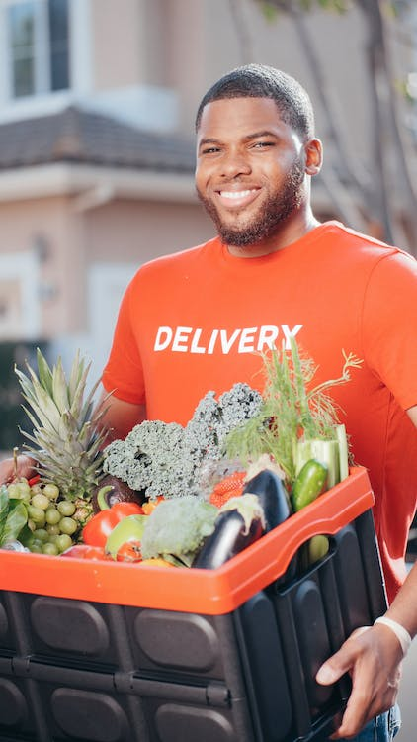
Apply it – activity
Apply it
Delivereaze is a grocery delivery business. It has a fleet of vehicles that operate across the country making deliveries of groceries that have been ordered online.
The company currently has a number of standalone servers that support business operations. For example, they have a web server, a mail server, a database server and a print server.
They have been advised that they could make better use of their hardware by virtualising their servers.
Create a short presentation for the company covering the following points:
  What is meant by server virtualisation
  The benefits of server virtualisation to the business
Notes:
Photo by Kindel Media from Pexels: https://www.pexels.com/photo/man-in-orange-shirt-holding-black-and-orange-plastic-box-with-fresh-vegetables-6868797/

Slide 20
Apply it – activity answers
Apply it
What is meant by server virtualisation:
Server virtualisation means splitting a physical server up into two or more virtual servers. For Delivereaze, one physical server could be configured to provide the web server, the mail server, the database server and the print server.
A type-1 hypervisor would be used to configure the physical server. This would allow each virtual server to directly access the hardware resources of the physical server.
Each virtual server would be self-contained and would operate independently of the others.

Slide 21
Apply it – activity answers
Apply it
The benefits of server virtualisation for Deliverease:
Deliverease would be able to invest in a single high-performance server and its resources would be shared between the virtual servers.
A single physical machine would be easier to backup because each virtual server is a file “image” which can be handled as a single file.
If Deliverease wanted to move their operations to a new physical server or to a cloud service provider, the image copies could be easily deployed to the new server. This means it is relatively easy for the business to upscale when they need more capacity or to achieve better performance.

Slide 22
Next lesson
Summary
In this lesson, you…
Examined key features of virtual environments
Analysed the benefits and drawbacks of the use of virtual environments in a range of contexts
Next lesson, you will…
Define what cloud storage is
Describe how organisations use cloud environments
Examine the different models of cloud deployment
Explore how the responsibility of ownership is distributed between subscriber and service provider
Distinguish between cloud service models

