Slide 1
Lesson 4: Networks
Digital environments
Notes:
Version 1, June 2024

Slide 2
Secondary storage — retrieval activity
Starter activity
Question .
Which three of the following statements about optical storage are true?
Optical media have a limited amount of storage capacity compared to other types of storage
Optical media are not easily portable due to internal moving parts
A CD-ROM is a type of optical media
Optical media are organised in groups of circular discs called platters
Optical media are always used as a form of read-only memory
A laser beam burns tiny pits onto the disc
Question .
Which three of the following statements about optical storage are true?
Optical media have a limited amount of storage capacity compared to other types of storage
Optical media are not easily portable due to internal moving parts
A CD-ROM is a type of optical media
Optical media are organised in groups of circular discs called platters
Optical media are always used as a form of read-only memory
A laser beam burns tiny pits onto the disc
Notes:
Answers: A, C, F
Photo by Mati Mango from Pexels: https://www.pexels.com/photo/compact-discs-in-close-up-view-4734714/

Slide 3
Lesson 4: Networks
Objectives
In this lesson, you will:
Explain why devices are connected to networks
Describe what a network is
Compare common network types
Recognise the characteristics of different network topologies
General competencies:
E1 - convey technical information
E2 - present information and ideas
E3 - create texts
E4 - summarise information
E5 - synthesise information
E6 - take part in discussions
D2 - design digital media
D3 - communicate and collaborate

Slide 4
Starter activity
What is a network? Is this internet a network?
Notes:
A0 Introduction: Networks

Slide 5
What is a network?
Starter activity
Businesses and organisations use networks to connect together digital devices, wirelessly or using cables, so that they can communicate with each other and share resources.
Notes:
Photo by Pixabay from Pexels: https://www.pexels.com/photo/close-up-photography-of-yellow-green-red-and-brown-plastic-cones-on-white-lined-surface-163064/

Slide 6
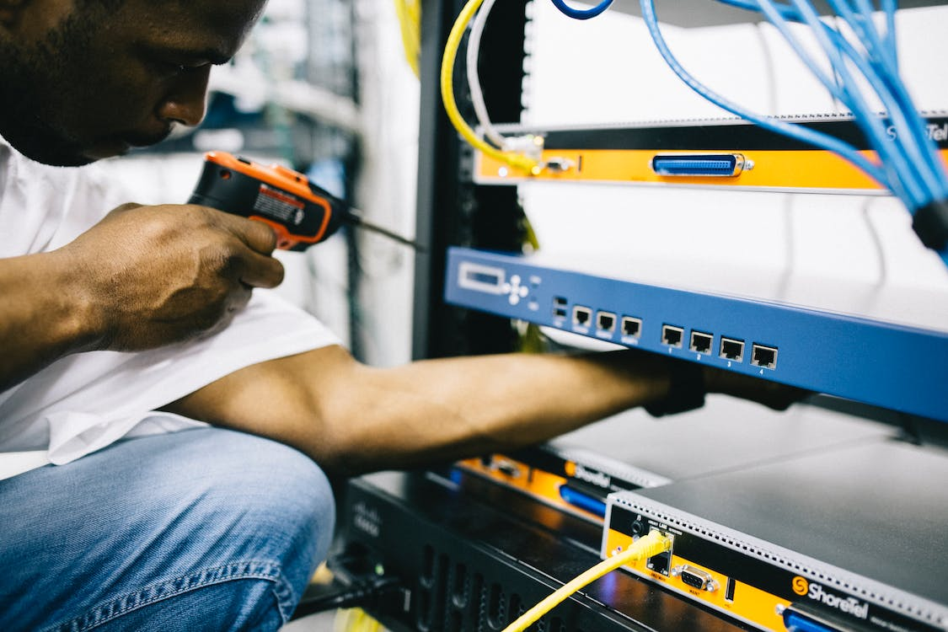
Why use a network?
Starter activity
Networks have revolutionised our ability to communicate. There are many different communication systems, for example:
Text (SMS) message
Email
Instant messaging
Internet telephony
All of these systems require networks.
Notes:
Photo by Field Engineer from Pexels: https://www.pexels.com/photo/professional-crop-black-technician-working-with-hardware-442154/

Slide 7
Networking case study
Starter activity
Networks have become a fundamental part of our lives, and many of us use them daily, often without really considering the infrastructure or technology that sits behind them.
However, the infrastructure to support these networks is not available everywhere.
For example, in Sarawak, Malaysia, there was a lack of computing facilities in primary schools, and the Ministry of Education, Innovation and Talent Development wanted to find a solution. Some of these primary schools are in rural locations and do not have reliable internet access.
What could be a solution?
Notes:
Photo by Iqwan Alif from Pexels: https://www.pexels.com/photo/laughing-children-in-between-woman-and-man-at-daytime-1206101/
Further information from: https://www.raspberrypi.com/success-stories/sarawak-malaysia-primary-schools/

Slide 8
Networking case study
Starter activity
What solution did you discuss?
What was the actual solution?
Kits containing Raspberry Pi 4 computers were sent out to schools. These computers were affordable and powerful, and could be set up quickly
To ensure they worked in rural areas, some of the Raspberry Pis were set up to function as internet-in-a-box offline servers that allowed educational content to be preloaded. This meant the schools did not have to rely on connection to the internet.
Notes:
Photo by Iqwan Alif from Pexels: https://www.pexels.com/photo/laughing-children-in-between-woman-and-man-at-daytime-1206101/
Further information from: https://www.raspberrypi.com/success-stories/sarawak-malaysia-primary-schools/

Slide 9
Why use a network?
Activity 1
Advantages to networking include the ability to:
Share expensive hardware devices between multiple users
Share files and resources — this could be globally
Have multiuser systems
Track what users are doing
Back up files centrally — this improves reliability
Deploy and upgrade software centrally
Control security centrally

Slide 10
Why use a network?
Activity 1
Disadvantages to networking include:
Additional hardware costs — cabling and connection devices
The cost of having to employ someone to look after the network (depending on the size of the network)
Reliance on servers — if the server fails, the entire network can fail
Greater security risks
Costs and benefits
There are extra costs involved in setting up a network. There is often a significant investment in cabling and communication systems, and ongoing costs to make sure that the network is well managed. However, the benefits of networking are significant and will outweigh the costs over a given period of time.

Slide 11
Transmission media
Activity 1
You are now going to take a look at the media used to transmit data from one device to another.
These are called transmission media and fit into two main categories:
Wired
Wireless
Wired transmission media
Wireless transmission media
Notes:
Images:
Laptop image by FiveFlowersForFamilyFirst from Pixabay: https://pixabay.com/vectors/laptop-pc-computer-computer-science-2243898/
Wireless access point image by jallen_RTR from Pixabay: https://pixabay.com/vectors/router-internet-icon-technology-6933520/
Wireless symbol image by Samuel1983 from Pixabay: https://pixabay.com/vectors/wireless-signal-icon-image-vector-1119306/

Slide 12
Transmission media
Activity 1
Wired transmission media are physical cables that connect one device to another.
A wired connection is often shown as a solid or a long-dashed line in a diagram.
Wireless transmission media do not require a physical cable. Wireless signals are sent through the air using electromagnetic waves.
A wireless connection is often shown using a dotted line or a wave symbol.

Slide 13
Wired and wireless networks (think, write, pair, share)
Activity 1
List examples of wired or wireless networks that you might have seen or use in your day-to-day lives.
Free Wi-Fi on public transport
Supermarket checkout system
The college/ school network
Home wireless network
Touchscreen ordering system for fast food
A network at work
Free Wi-Fi in a cafe

Slide 14
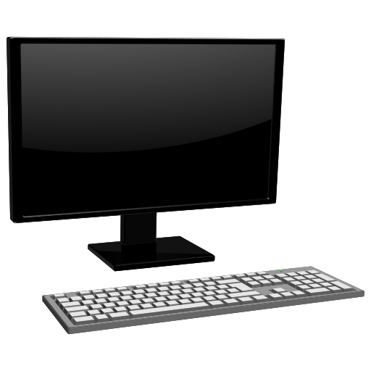
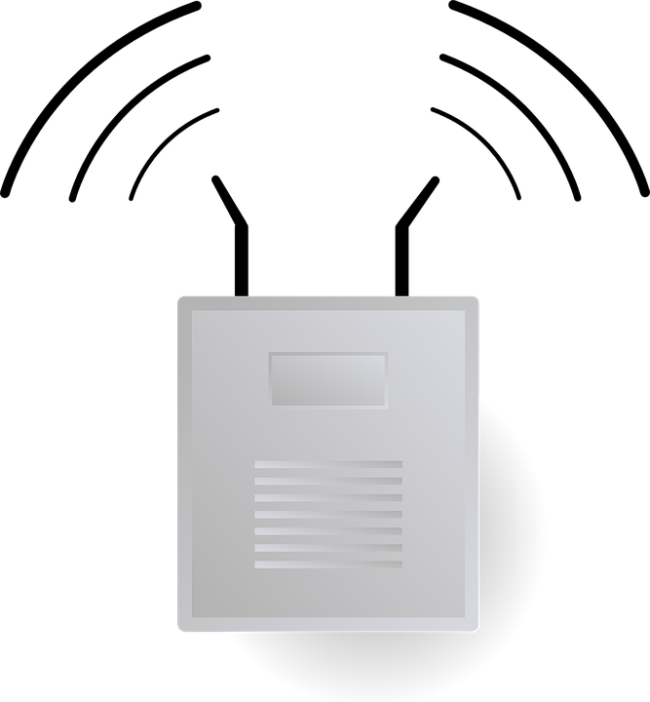
Wired and wireless
Activity 1
A network can include both wired and wireless transmission media.
For example, a college might use wired connections in a computer room that has desktop computers.
The college might also have a wireless access point for students to connect mobile devices to during study periods.
Notes:
Image sources:
Tablet image by janjf93 from Pixabay: https://pixabay.com/vectors/tablet-ipad-homebutton-app-1717178/
Tablet image by monstreh from Pixabay: https://pixabay.com/vectors/board-pc-screen-vector-background-1362851/
Laptop image by Clker-Free-Vector-Images from Pixabay: https://pixabay.com/vectors/laptop-computer-business-technology-312499/
Desktop computer image by OpenClipart-Vectors from Pixabay: https://pixabay.com/vectors/computer-hardware-keyboard-monitor-1295125/
Wireless access point image by Clker-Free-Vector-Images from Pixabay: https://pixabay.com/vectors/router-wifi-wireless-connector-23240/
Wireless symbol image by Samuel1983 from Pixabay: https://pixabay.com/vectors/wireless-signal-icon-image-vector-1119306/

Slide 15
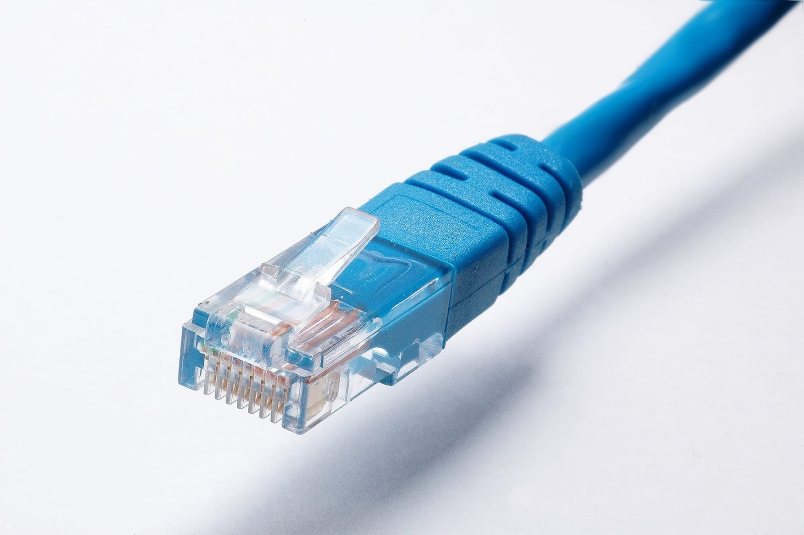
Wired vs wireless
Activity 1
Advantages and limitations of transmission media
Complete the ‘A1 Activity sheet – Advantages and limitations of transmission media’
Research the advantages and limitations of the transmission media and then decide which is the most suitable medium for the scenarios provided
Transmission medium | Description | Cost | Speed | Distance | Considerations
Copper cable/Ethernet cable | Wired transmission medium. It uses electrical signals to transmit data. | Cheaper to buy and install than a fibre-optic cable. | Data transfer is slower compared to a fibre-optic cable, but speeds are generally faster than via Wi-Fi. | The signals in copper cables degenerate over long distances, such as 100m for Cat 5. | More prone to signal disturbances than a fibre-optic cable. Typically more stable than wireless connections. More time-consuming to expand compared to wireless connections.

Slide 16
Network types and models
Activity 2
Networks can be created in different ways depending on the requirements and needs of users. Some common network types include:
Local Area Network (LAN)
Wide Area Network (WAN)
Personal Area Network (PAN)
A network model describes the architecture of the network. Common models include:
Client-server
Peer-to-peer
Thin client
Notes:
Photo by Field Engineer from Pexels: https://www.pexels.com/photo/serious-ethnic-field-engineer-examining-hardware-and-working-on-laptop-442152/

Slide 17
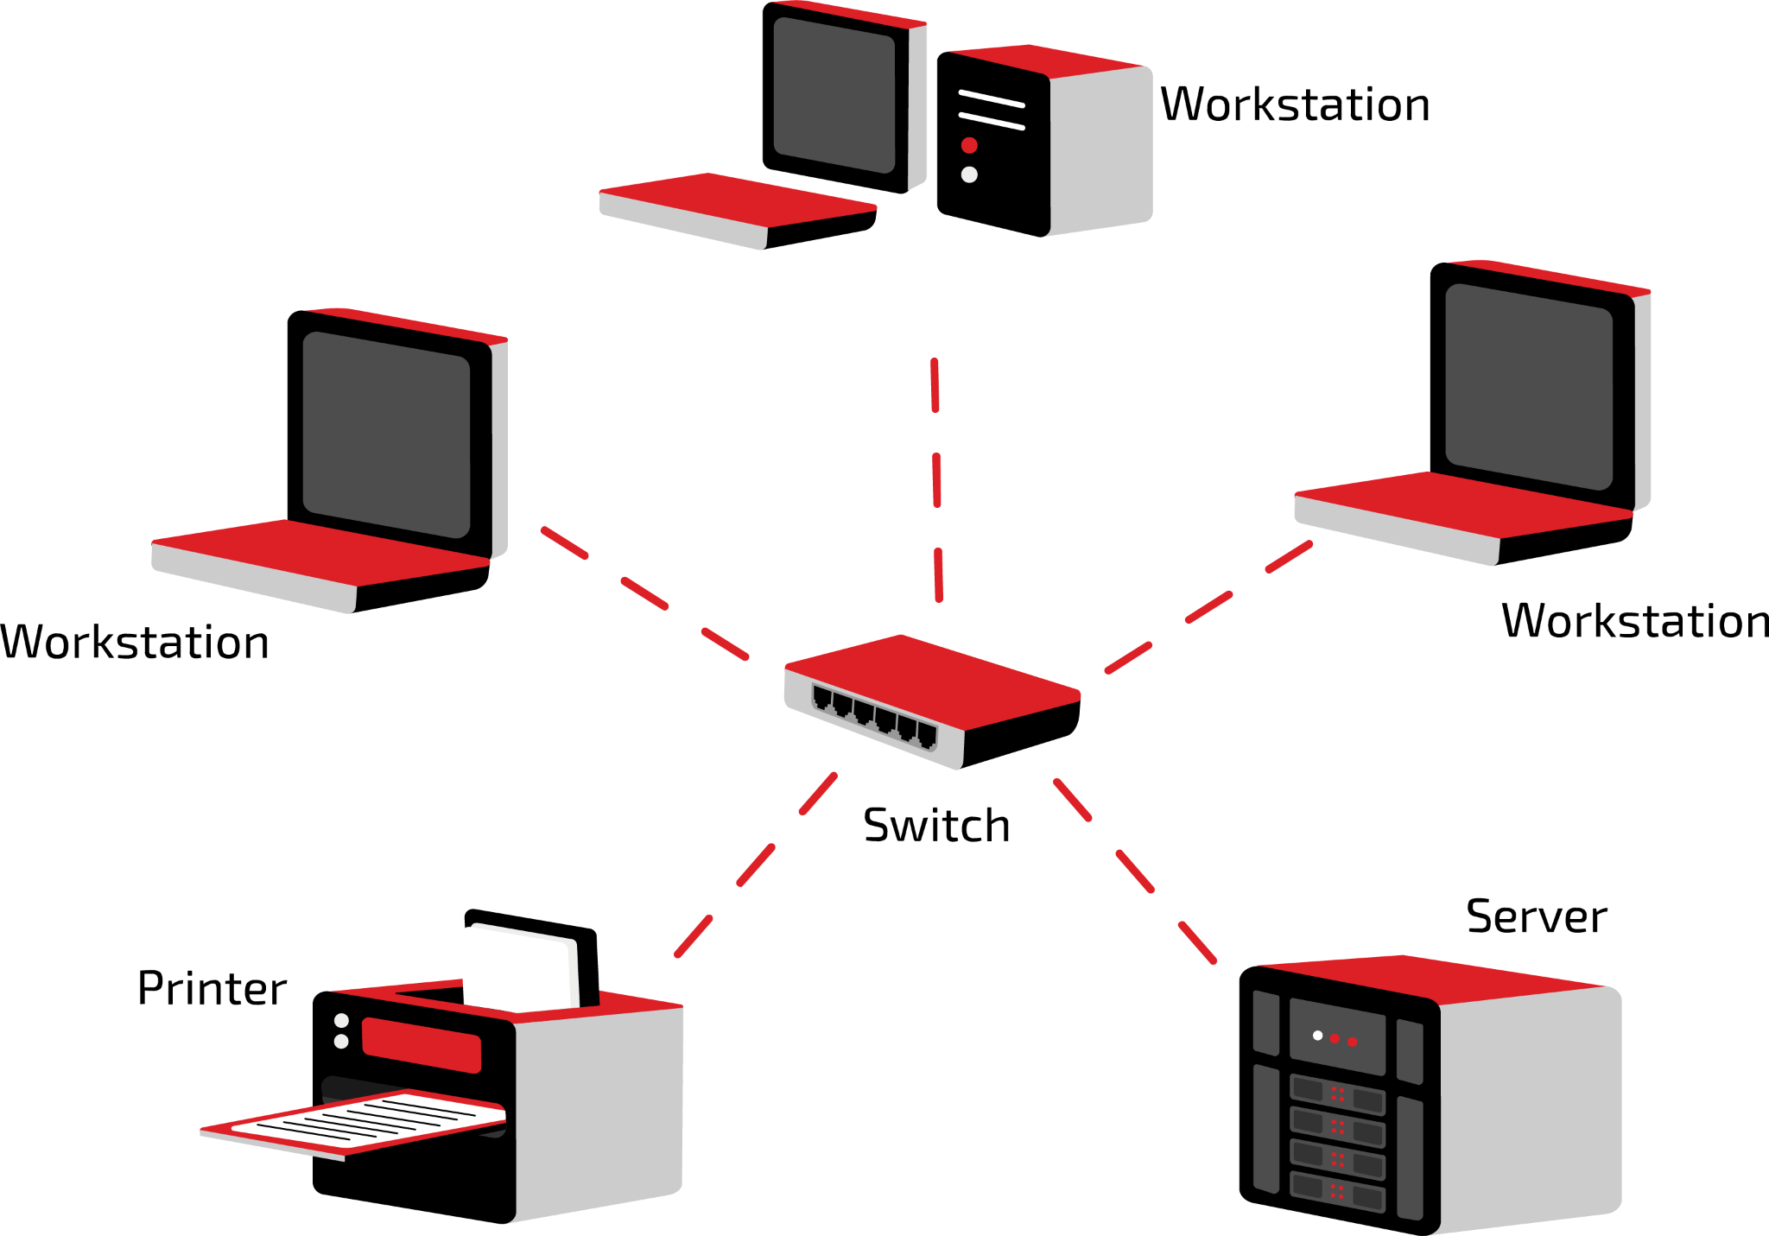
Network performance
Activity 2
Network types and models
There are lots of different ways that a network can be created. Read the sections below to learn more about the different types of network and network models.
Network types .
Local Area Network (LAN)
A local area network (LAN) refers
to a network that is formed when
devices in the same building or on
a single site are connected. A network
in your home, workplace, or school/
college will be a LAN.
One characteristic of a local area
network is that the infrastructure
(cabling and network communication
devices) will be owned and maintained
by the organisation (or the organisation
may employ someone to do this for them).
You have been tasked with setting up a small network for a charity that has moved to a new office.
Open the ‘A2 Activity sheet – Network types and models’ to learn more about different types of network and network models.
Then, research the effects of bandwidth and latency on networks and the impact this may have on the employees’ work at the charity.

Slide 18
Network topologies
Activity 3
You are now going to look at how devices and components in a network can be arranged.
There are many different arrangements. These arrangements are called topologies.

Slide 19
Network topologies
Activity 3
There are two categories of network topology:
The physical topology describes how the devices are physically laid out and connected
The logical topology describes how the devices behave when they communicate
You will generally consider the physical topology of a network. The logical topology will be determined by the components that are used to build the network. For example, standard Ethernet uses a logical bus topology but will rarely be implemented using a physical bus topology.

Slide 20
Network topologies
Activity 3
Diagrams (or graphs) are sometimes used to represent the different network topologies.
The nodes (dots) represent a component in the network and the edges (lines) represent how they are connected to each other.
Remember that networks can be wired or wireless or, more likely, built from a combination of wired and wireless components.

Slide 21
Network topologies
Activity 3
This is a graph for a star topology.
The arrangement has one central node with all of the other nodes connected to it.
The central node would typically be a hub or a switch that could transfer data between nodes.
Note: You might see network diagrams where the server is the central node. These are not accurate. The server would be attached to the central node.

Slide 22
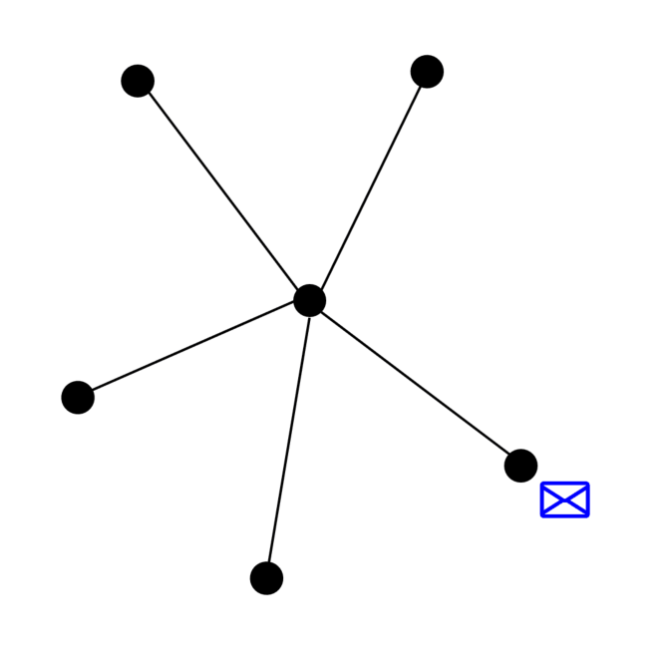
Network topologies
Activity 3
If a hub is the central node, then data will be broadcast to all nodes connected to it.
Broadcast is a term used to describe the message being transmitted to all connected nodes.
Notes:
Animated GIF: Raspberry Pi Foundation
The red crosses indicate that the message has been ignored because it was not addressed to that location.

Slide 23
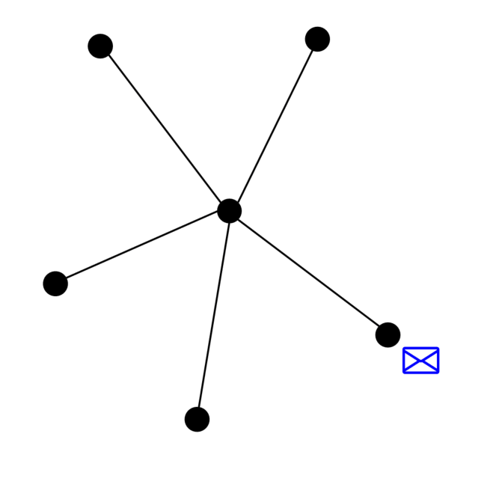
Network topologies
Activity 3
If a switch is the central node, then it will transfer the data only to the node to which it is addressed.
Notes:
Animated GIF: Raspberry Pi Foundation

Slide 24
Network topologies
Activity 3
This is a graph for a mesh topology.
In this arrangement, there are multiple ways for data to transfer from one node to another.
In a mesh network, each node is connected to at least one other node. It is more common for them to be connected to more than one node.

Slide 25
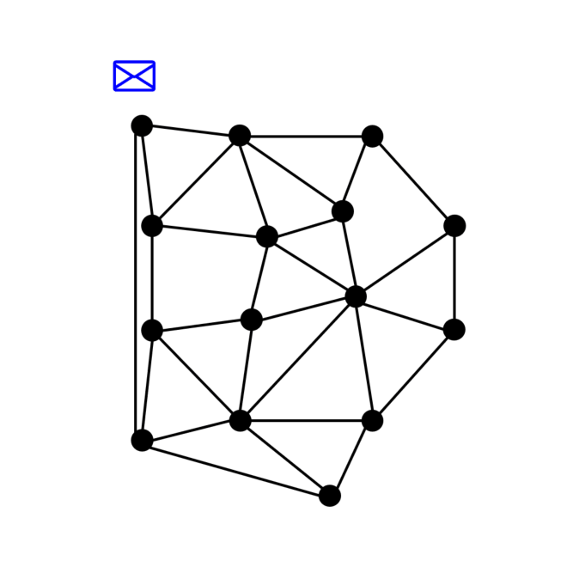
Network topologies
Activity 3
In a mesh network, typically the most efficient route is calculated before the required data is transferred.
Notes:
Animated GIF: Raspberry Pi Foundation

Slide 26
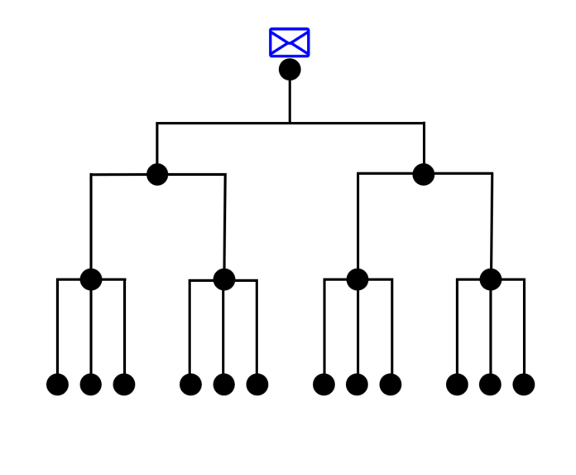
Network topologies
Activity 3
This is a graph for a tree network. This topology is a mixture of a star and bus topology.
Groups of nodes are connected together to a linear bus backbone topology.
Notes:
Animated GIF: Raspberry Pi Foundation

Slide 27
Virtual local area network
Activity 3
A virtual local area network (VLAN) is a technique that is used to split one LAN into several smaller LANs or segments
For example, if you have a large site with many buildings, you may split the individual buildings into several VLANs
This helps to improve the efficiency of very large LANs
Advantages of VLANs | Disadvantages of VLANs
Latency is decreased as data is transmitted across a smaller network Security is improved as different VLANs can have different access levels | Planning, implementation, and maintenance of a VLAN could be complicated and may require specialist expertise Can be more expensive due to the need for additional hardware in some large networks

Slide 28
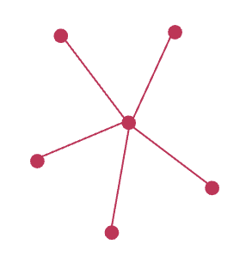
Exploring the advantages and disadvantages
Activity 3
Open and complete the ‘A3 Activity sheet – Topologies’
Read through the advantages and disadvantages of the different topologies and then determine the most suitable topology for the scenarios given
Topologies
Star topology .
A star topology has one central node with all of the other nodes connected to it. The central node would typically be a hub or a switch that could transfer data between nodes.
If a hub is the central node, then it will broadcast the data to all nodes connected to it. If a switch is the central node, then it will transfer the data to the required location.
Advantages | Disadvantages
A damaged link only affects the attached node You can easily add new devices (so long as there are sufficient free ports on the central device) It works well under heavy load if using a switch for the central node | The central node is a single point of failure It requires a central device such as a hub or a switch

Slide 29
Can you remember the names of all three topologies?
Retrieval activity
A
B
C
Star
Mesh
Tree

Slide 30
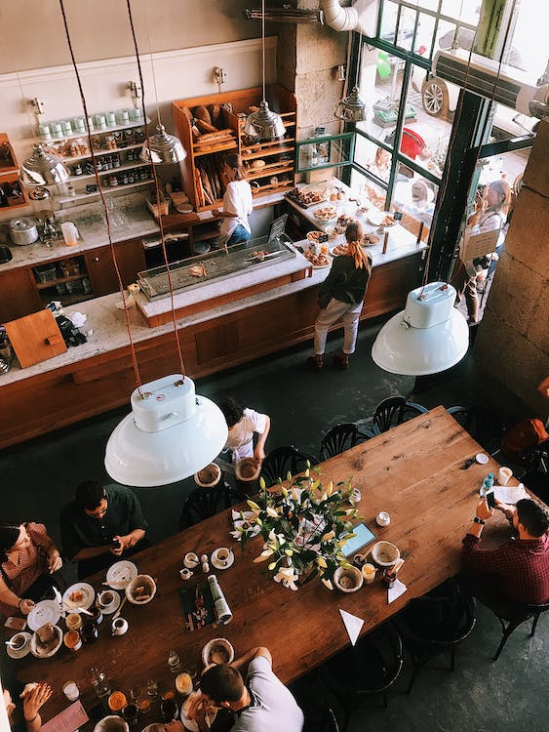
Apply it - activity
Apply it
Beanz is an independent coffee retailer and has four outlets in a large city. The owner of the business places orders centrally for the supplies for all four outlets based on each outlet’s sales information.
The business is currently in the process of upgrading their IT systems so that each coffee shop will have:
An Electronic Point of Sale (EPOS) system
A link to head office (based at the business owner’s home) for the sales data to be uploaded at the end of each day
A tablet that will display orders that have been entered into the till for the barista to fulfil
Wireless internet access for customers
Task
Carry out research into EPOS systems and produce a summary of the features and benefits of suitable devices.
Produce a simple network diagram for either a single coffee shop or the whole business.
Notes:
Photo by Dmitry Zvolskiy from Pexels: https://www.pexels.com/photo/top-view-photo-of-restaurant-2253643/

Slide 31
Apply it – answers
Apply it
EPOS system
Feature | Benefits
Touchscreen interface | Allows operator to select goods (for sale) by icon
Customer-facing display screen | Customer can see items as they are being added to order
Barista-facing display screen | Barista can see items in the order that have been taken at the point of sale
Card payment terminal | To allow card payments
Print receipts | Customer has proof of purchase
Inventory Management / Stock control | Produces information for ordering stock and also for analysing sales

Slide 32
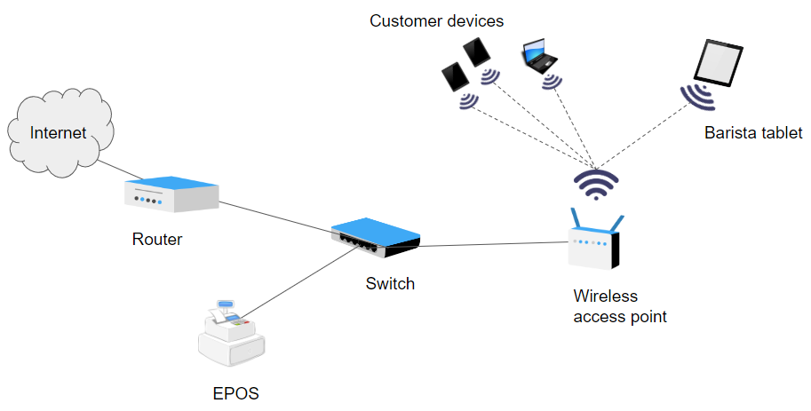
Apply it – answers
Apply it
Network set-up for each coffee shop
Notes:
Cash register image: https://pixabay.com/vectors/register-cash-register-modern-23666/

Slide 33
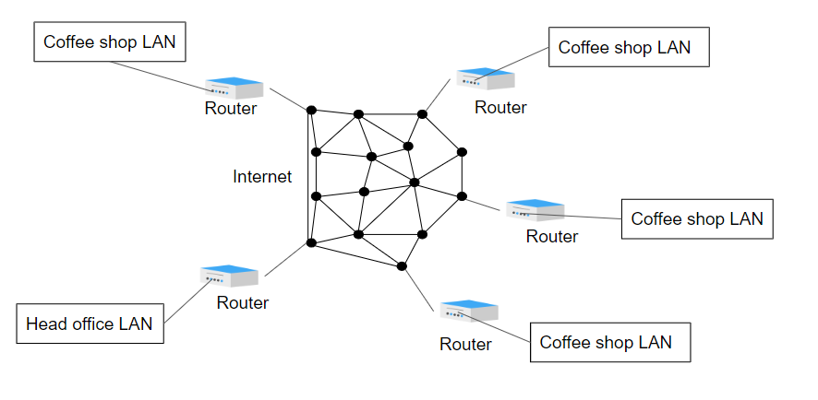
Apply it – answers
Apply it
Network overview for the organisation as a whole
Each coffee shop will be connected to the head office over the Internet.
This could make use of a VPN to make communication more secure.

Slide 34
Next lesson
Summary
In this lesson, you…
Explained why devices are connected to networks
Described what a network is
Compared common network types
Recognised the characteristics of different network topologies
Next lesson, you will…
Discover how communication takes place over a network
Recognise some common components of a network and their purpose
Describe the role of protocols in network communication
Identify the contents and purpose of a packet in transmitting data across a network

