Slide 1
Lesson 3: Memory and storage
Digital environments
Notes:
Version 1, June 2024

Slide 2
Software - study question
Retrieval activity
A software developer uses an Integrated Development Environment (IDE) when writing and debugging a new program.
Describe two features of an IDE that would help the developer with this task.
Code editing tool allows software developer to enter and edit code
Editing features such as colour coded text, auto indentation would allow developer to quickly read code
Syntax checking would highlight syntax errors to developer
Debugging tools would find runtime and logical errors for the developer

Slide 3
Lesson 3: Memory and storage
Objectives
In this lesson you will:
Identify the features of physical storage systems
Describe the role of main memory and its key characteristics
Recognise the need for secondary storage
Compare the different types of of physical storage and recovery systems
General competencies:
E1 - convey technical information
E2 - present information and ideas
E4 - summarise information
E6 - take part in discussions
M6 - understand data and risk
D2 - design digital media
D3 - communicate and collaborate

Slide 4
Starter activity
Why do we need to store data?
Notes:
A0 Introduction: Memory and storage film: https://vimeo.com/883954135

Slide 5
Why is data storage important?
Starter activity
Consider your education provider.
What data do they store?
Why do they need to store this data?
How long do they have to store that data for?
Is it important that the data is kept secure?
How important is it that the data can be retrieved quickly?
What issues need to be considered when storing the data?
Notes:
Photo by Ivan Samkov from Pexels: https://www.pexels.com/photo/group-of-people-studying-together-5676744/

Slide 6
Main memory
Activity 1
Main memory is memory that can be accessed directly by the processor. It consists of memory locations that store instructions or data while the data is being processed.
There are two types of main memory:
Random Access Memory (RAM)
Read Only Memory (ROM)
Notes:
Photo by Ali Arapoğlu from Pexels: https://www.pexels.com/photo/desktop-motherboard-with-connectors-and-microchips-at-home-4432037/

Slide 7
Main memory
Activity 1
In order for any program to be executed, it must first be loaded into the RAM from secondary storage.
This is because RAM has quicker read and write speeds than secondary storage devices. The processor will fetch instructions (and any necessary data) from the RAM directly before decoding and executing them.
ROM is typically used to store the boot sequence (BIOS) for a computer. Unlike RAM, it is non-volatile and will not lose its data when the power is switched off.
Notes:
Photo by Ali Arapoğlu from Pexels: https://www.pexels.com/photo/desktop-motherboard-with-connectors-and-microchips-at-home-4432037/

Slide 8
RAM or ROM?
Activity 1
RAM or ROM?
Main memory is memory that can be accessed directly by the processor. It consists of memory locations that store instructions or data.There are two types of main memory, RAM and ROM.
Place the statements provided into the correct position in the table.
Research the main differences between RAM and ROM and their uses.
Open and complete the ‘A1 Activity sheet – RAM or ROM’ to investigate the characteristics and uses of RAM and ROM.
RAM | ROM
R A Memory | R O Memory

Slide 9
Cache
Activity 1
Whilst a program is being executed, the processor stores and retrieves data from the main memory repeatedly, and although main memory is quick to access, there is another type of memory designed to make access to frequently used data much faster: cache.
This improves the performance of the processor.
Main
Memory
(RAM)
Processor
Cache

Slide 10
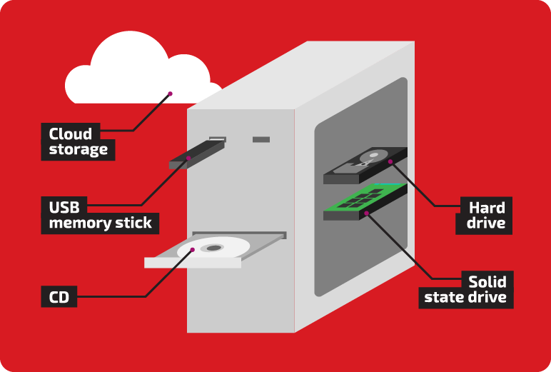
Main memory isn’t enough
Activity 2
Secondary storage is necessary because it is persistent.
This means it is designed to store data even when the computer system is not in use.
Notes:
Image source: Raspberry Pi FutureLearn courses

Slide 11
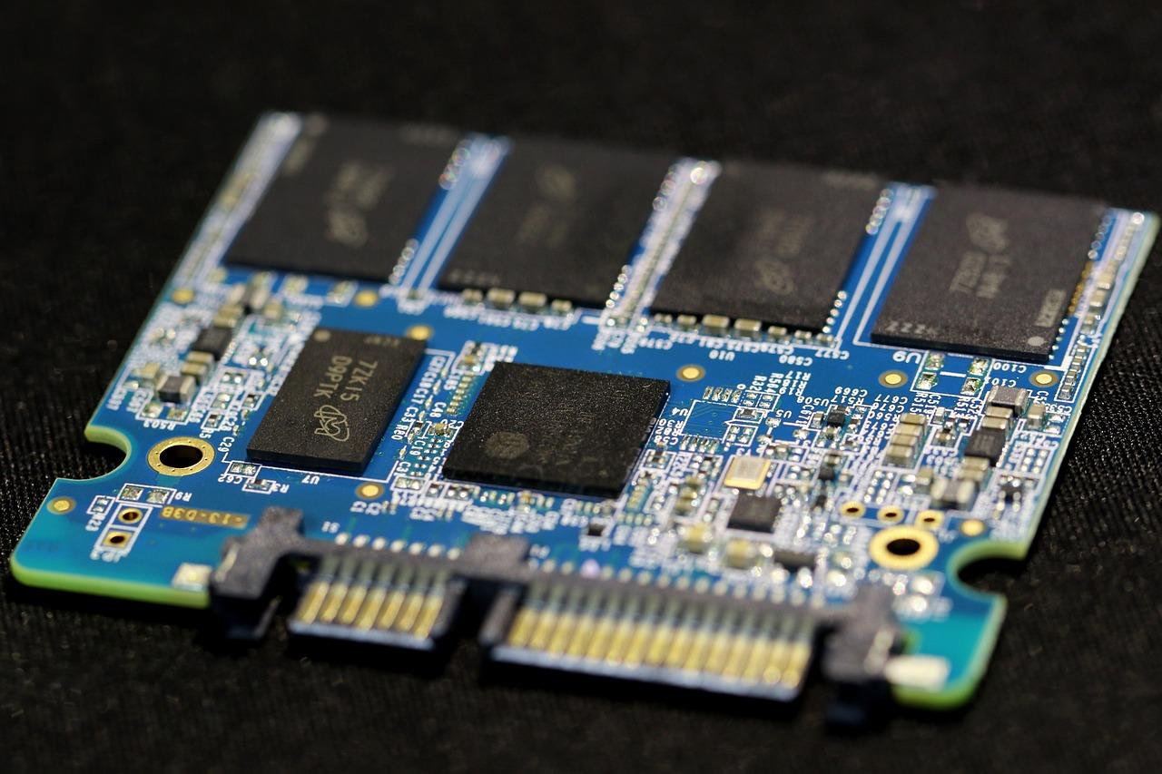
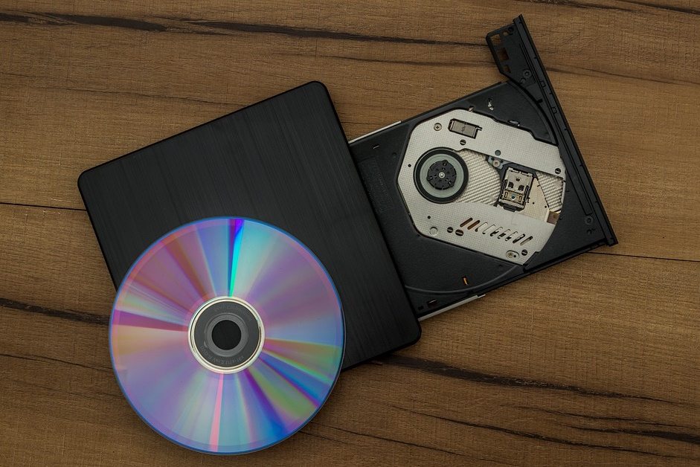
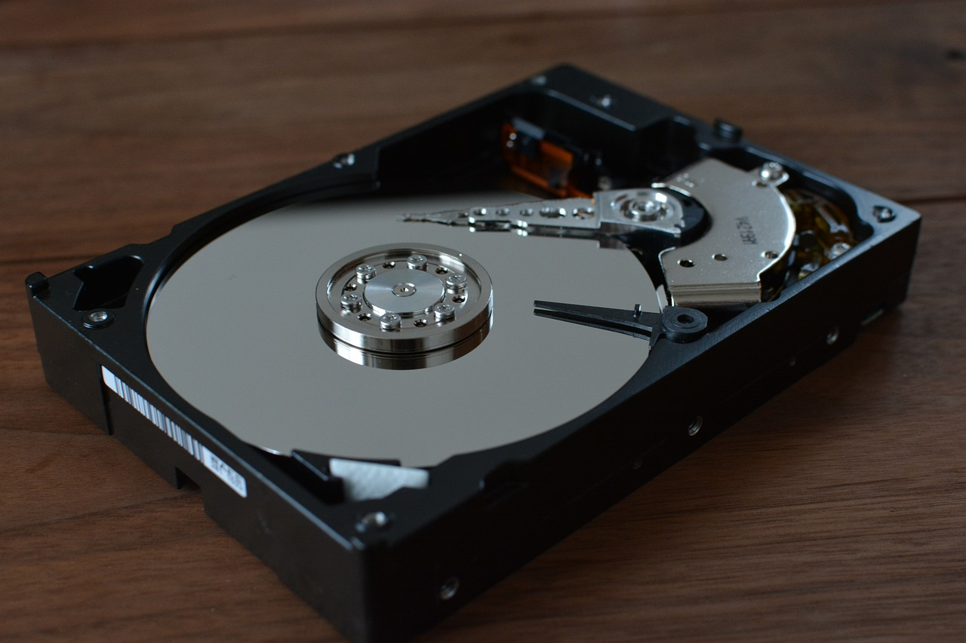
Secondary storage
Activity 2
Secondary storage
Solid-state
Optical
Magnetic
Three types of secondary storage are:
Notes:
Images:
SSD photo by manseok_Kim from Pixabay: https://pixabay.com/photos/solid-state-drive-storage-device-6158470/
CD photo by ReadyElements from Pixabay: https://pixabay.com/photos/burn-cd-cd-rom-compact-disc-disk-3509504/
HDD photo by IT-STUDIO from Pixabay: https://pixabay.com/photos/hdd-hard-disk-pc-parts-1273984/

Slide 12
Secondary storage
Activity 2
Solid-state (SSDs)
Solid-state drives (SSDs) and solid-state devices like USB sticks and SD cards have no moving parts, which means they are more robust and are suitable for devices that move around a lot.
It is becoming increasingly common for computer systems to have both magnetic and solid-state drives.
An advantage is that SSDs can read and write data much quicker than both magnetic and optical storage devices.
A disadvantage is that SSDs have a limited number of read/write cycles which means they are not suitable for long-term archiving of data.
Capacity | 🔷🔷🔷🔷🔷
Cost | 🔷🔷
Durability | 🔷🔷🔷🔷🔷
Portability | 🔷🔷🔷🔷🔷
Notes:
Photo by manseok_Kim from Pixabay: https://pixabay.com/photos/solid-state-drive-storage-device-6158470/

Slide 13
Secondary storage
Activity 2
Optical
Optical storage covers CDs, DVDs, and other types of disc that are read by lasers. Discs can be read only, write once, or read/write.
They have been traditionally used to distribute media such as music, film and games.
An advantage is that they are portable and can be easily shared.
A disadvantage is that the computer system needs to have a suitable drive. Optical discs can be damaged or deteriorate if not stored correctly.
Capacity | 🔷🔷
Cost | 🔷🔷🔷🔷🔷
Durability | 🔷🔷🔷
Portability | 🔷🔷🔷🔷🔷
Notes:
Photo by ReadyElements from Pixabay: https://pixabay.com/photos/burn-cd-cd-rom-compact-disc-disk-3509504/

Slide 14
Secondary storage
Activity 2
Magnetic
Magnetic storage covers magnetic disk drives which are often referred to as hard disk drives (HDDs).
Magnetic disk drives are typically used in desktop and laptop devices.
An advantage is that magnetic disk drives offer greater capacity at a much lower unit cost than SSDs.
A disadvantage is they are not designed to be portable and can be fragile.
Capacity | 🔷🔷🔷🔷🔷
Cost | 🔷🔷🔷🔷
Durability | 🔷🔷🔷🔷
Portability | 🔷
Notes:
Photo by IT-STUDIO from Pixabay: https://pixabay.com/photos/hdd-hard-disk-pc-parts-1273984/

Slide 15
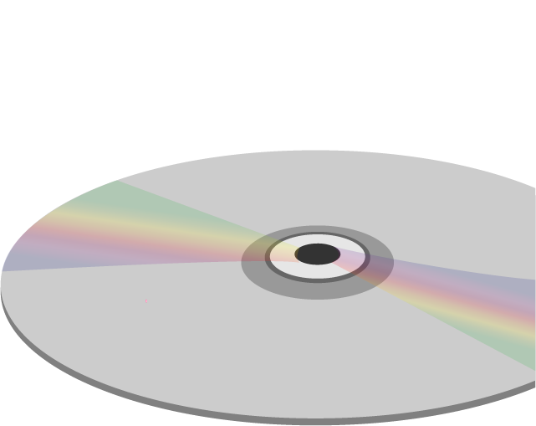
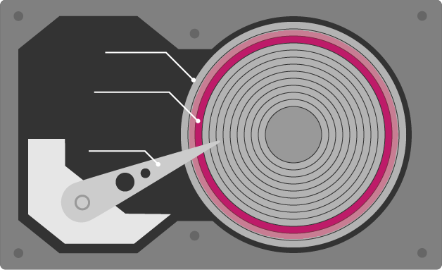
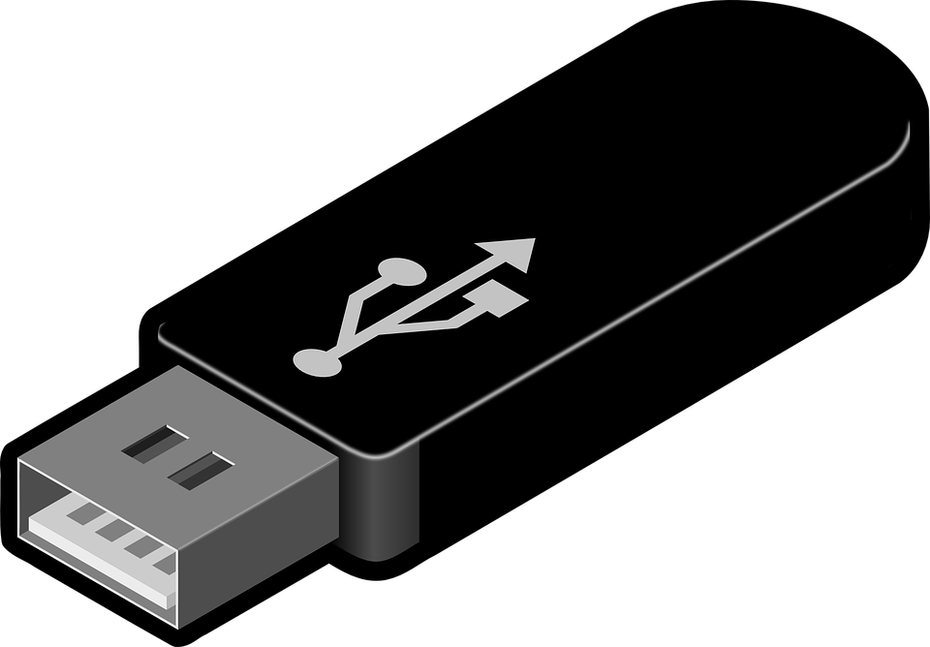
Secondary storage
Retrieval activity
What category of secondary storage are these devices?
Magnetic
Solid-state
Optical
Notes:
Images:
USB stick image by Clker-Free-Vector-Images from Pixabay: https://pixabay.com/vectors/usb-disk-disc-storage-technology-47552/
Other images: Raspberry Pi Foundation

Slide 16
Industry spotlight
Activity 2
Hammad is an Impact Analyst at the Raspberry Pi Foundation, a UK-based educational charity with the mission to enable young people to realise their full potential through the power of computing and digital technologies.
Hammad is responsible for managing the impact evaluation process for various programmes within the Foundation. This means he collects data and uses this data to make recommendations and judgements about the success of a particular product or programme.
What data does the impact team store?
Why do they need to store this data?
How long do they have to store that data for?
Is it important that the data is kept secure?
How important is it that the data can be retrieved quickly?
What issues need to be considered when storing the data?

Slide 17
Cloud storage
Activity 2
More recently the use of traditional secondary storage devices is being replaced with cloud storage.
Cloud storage is a way to store and access files through the internet.
The data is stored on servers owned by a service provider. Cloud storage providers have warehouses full of these servers, called server farms.
You will explore cloud storage in more detail in subsequent lessons.
Notes:
Photo by bsdrouin from Pixabay: https://pixabay.com/photos/network-server-system-2402637/

Slide 18
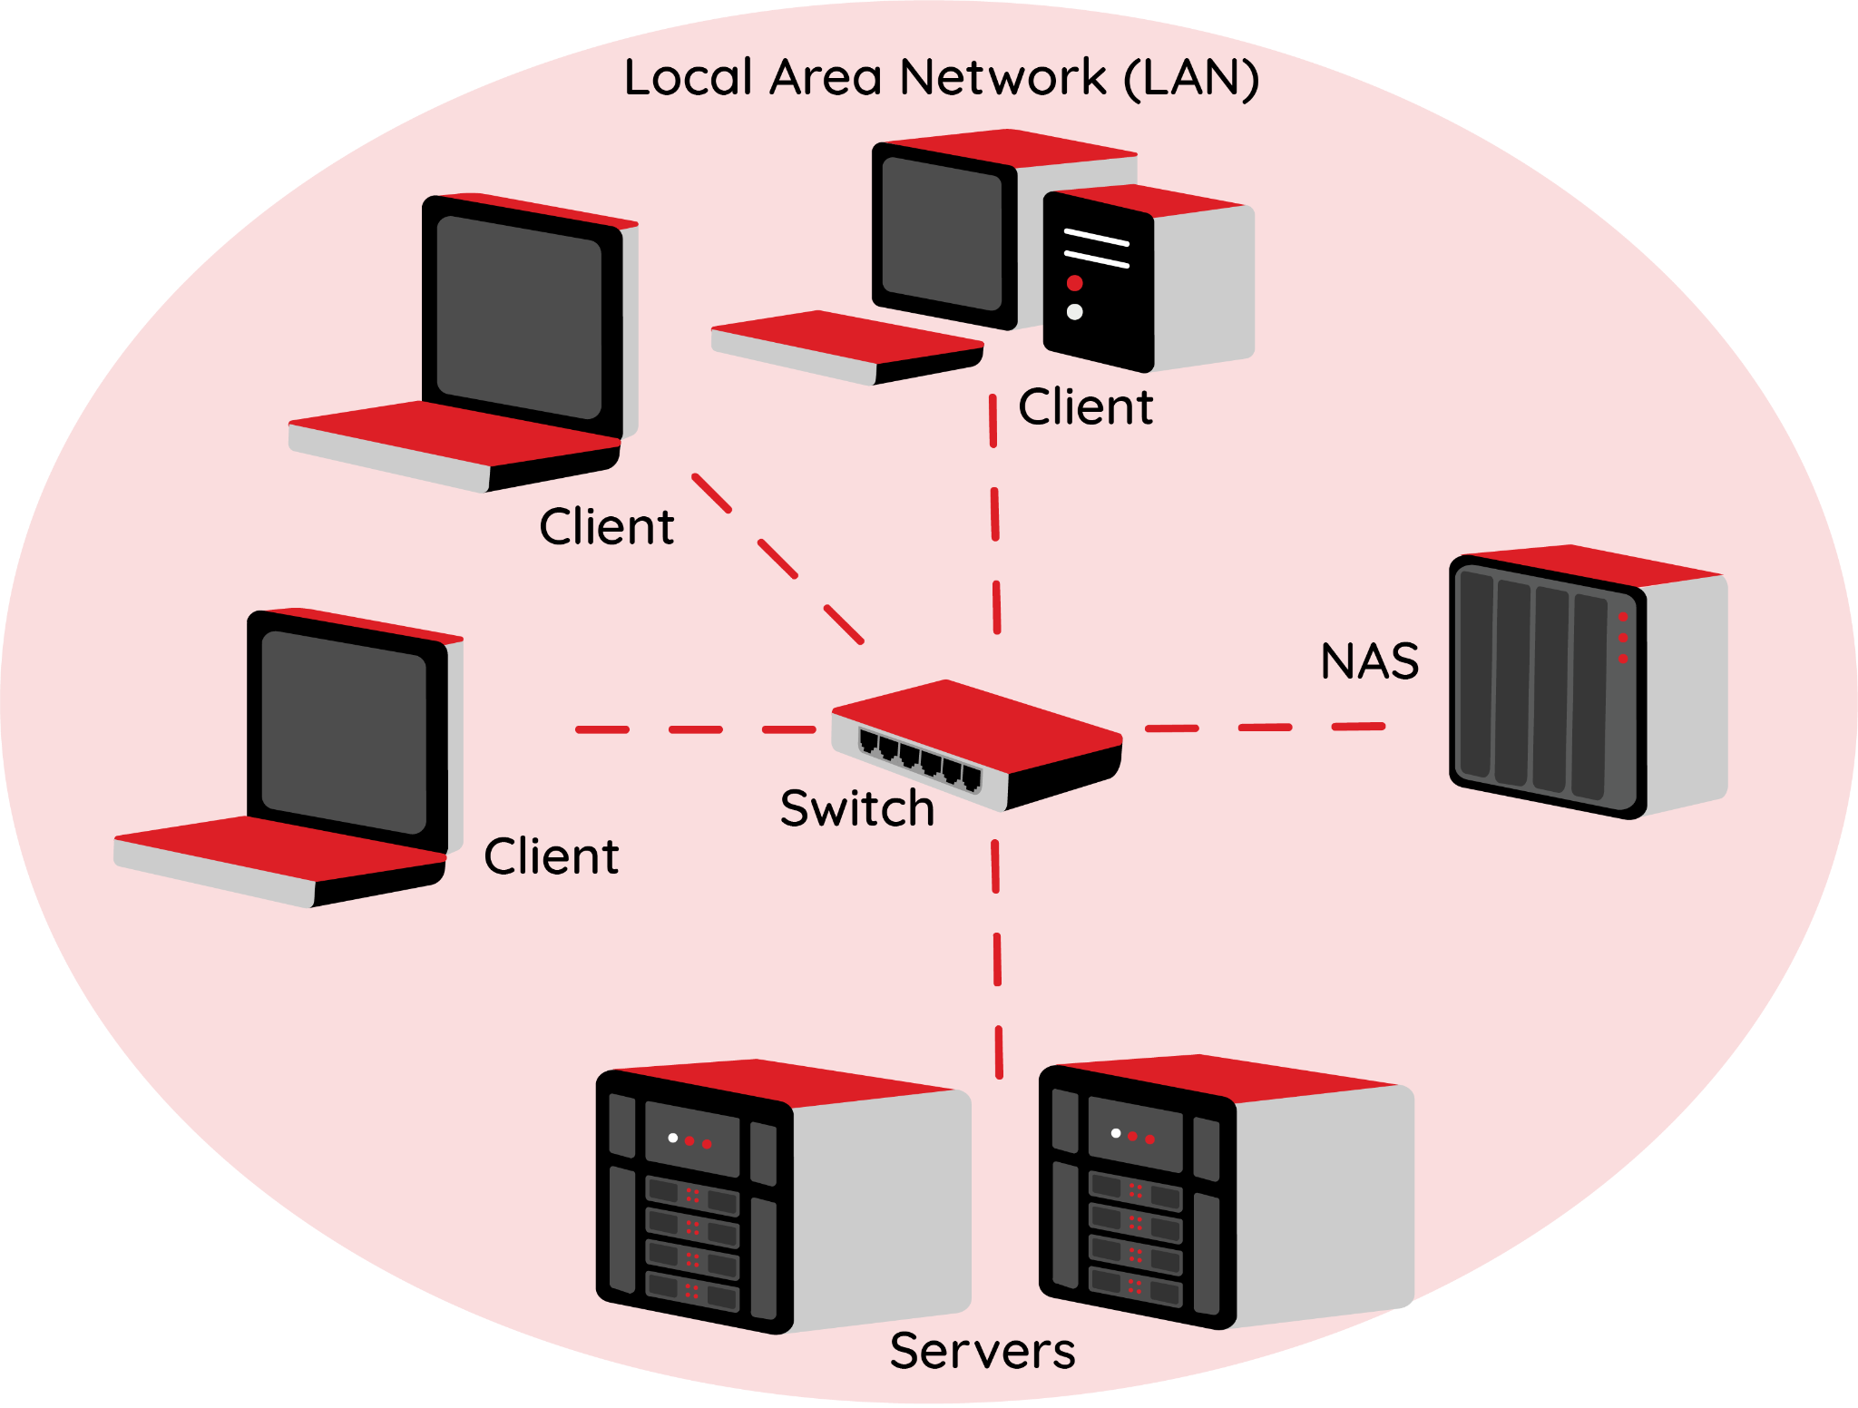
Network Attached Storage (NAS)
Activity 3
A data storage device that connects to and is accessed through a network
Can only be accessed by authorised network devices and users
Typically ties into the network through a standard Ethernet connection
There is a cost benefit as storage is central for all devices
If the NAS fails, all devices will lose access to the data, as it has a single point of failure
Because it is an essential shared resource, it is important that data is secure from external threats and a suitable backup and recovery system is in place
Typically uses RAID to backup data

Slide 19
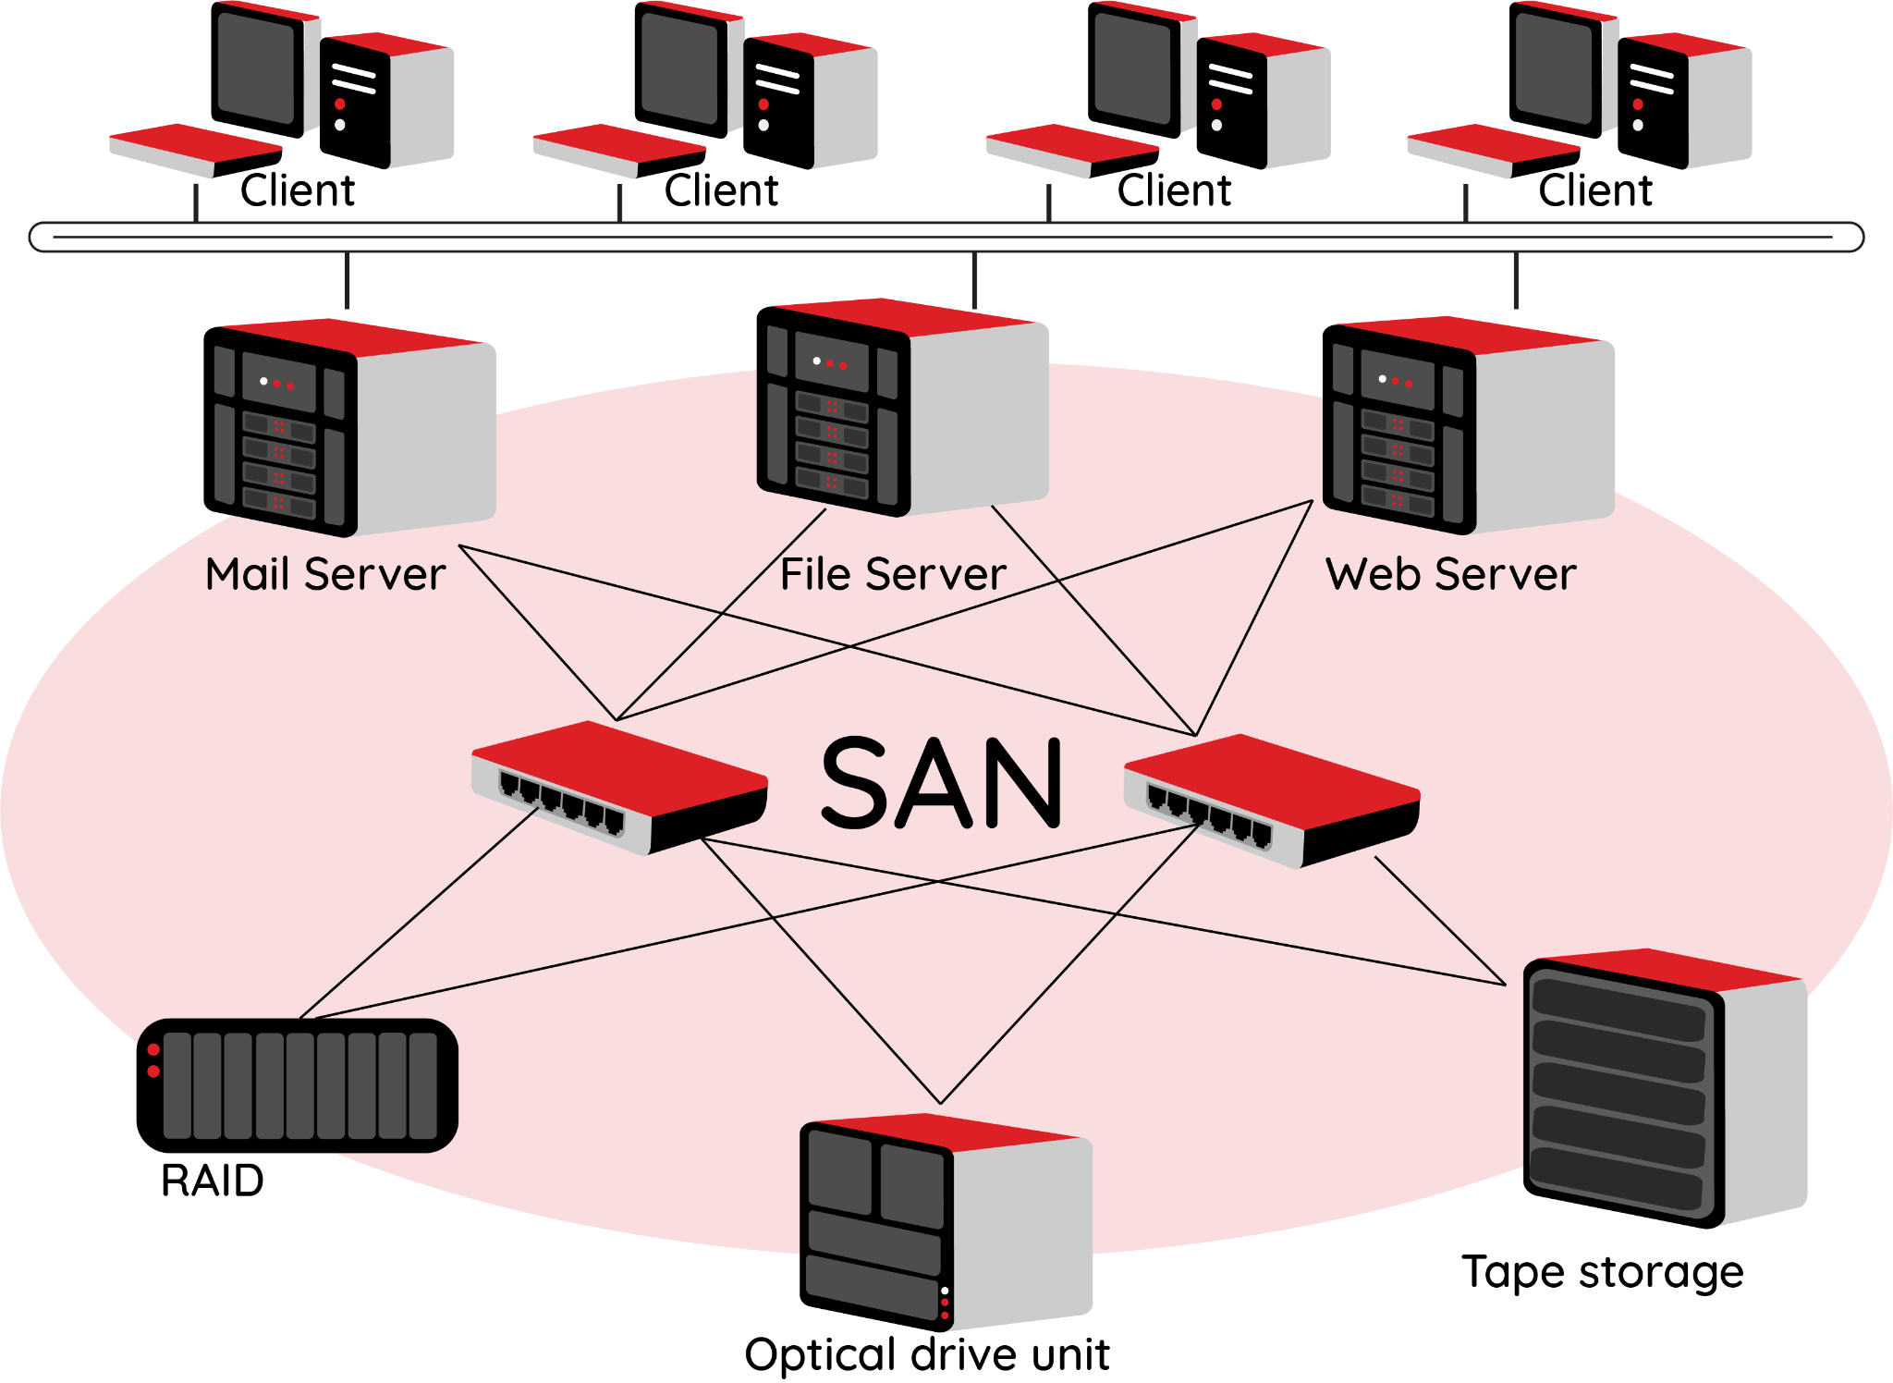
Storage Area Network (SAN)
Activity 3
Specialised high-speed network of storage devices
Normally connected together using fibre-optic cabling
Storage appears as a local device to users
Uses block storage where storage is broken down into blocks
Multiple points of failure, so a SAN is far more fault-tolerant than a NAS that has a single point of failure.
High upfront costs — typically needs a specialist to design and configure, and a skilled network manager to maintain

Slide 20
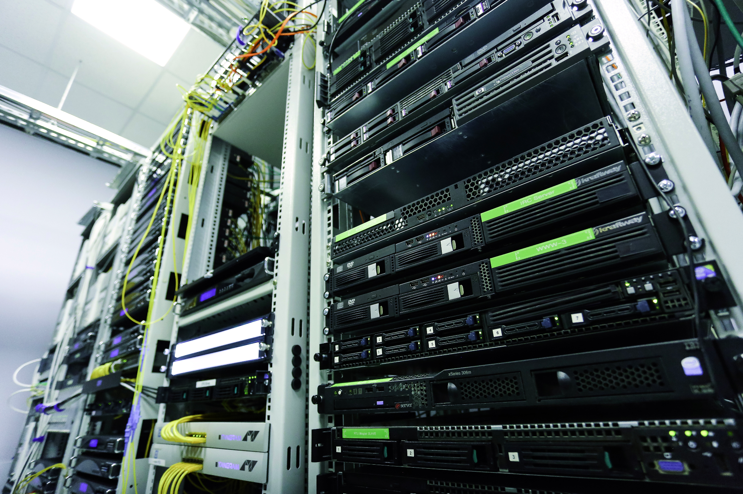
Physical data storage and recovery systems
Activity 3
Secondary storage devices are designed to be persistent storage.
However, they can fail or degrade over time. Data can also accidentally be overwritten.
This is why many organisations adopt physical storage and recovery systems.
Notes:
Photo by Sergei Starostin from Pexels: https://www.pexels.com/photo/network-servers-on-an-enclosure-6466141/

Slide 21
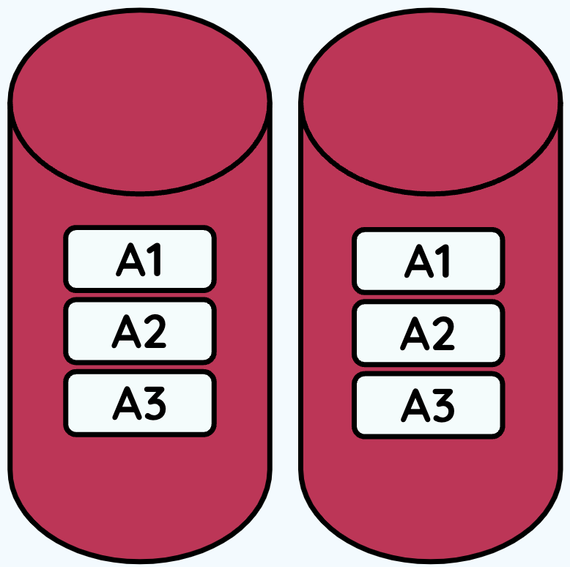
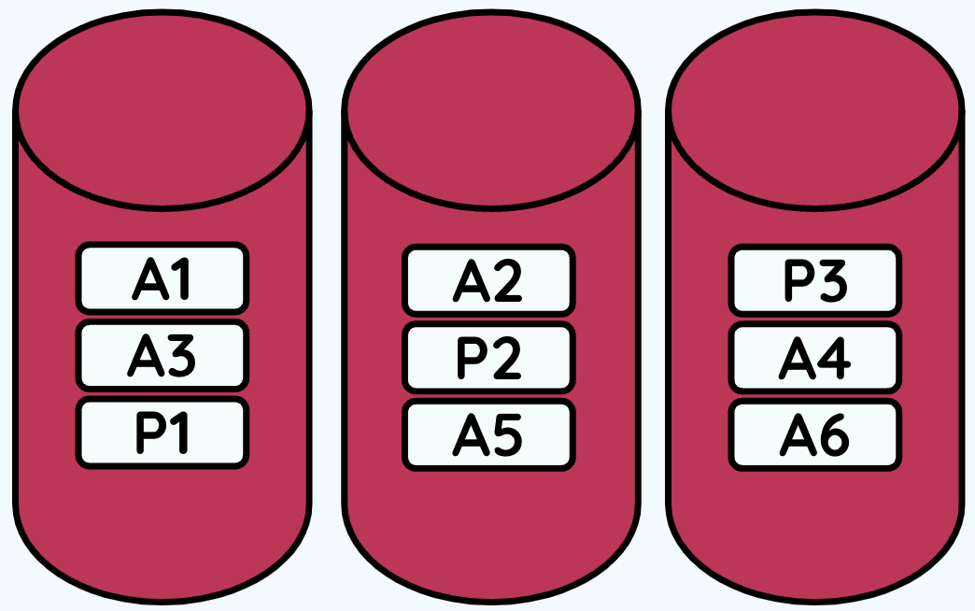
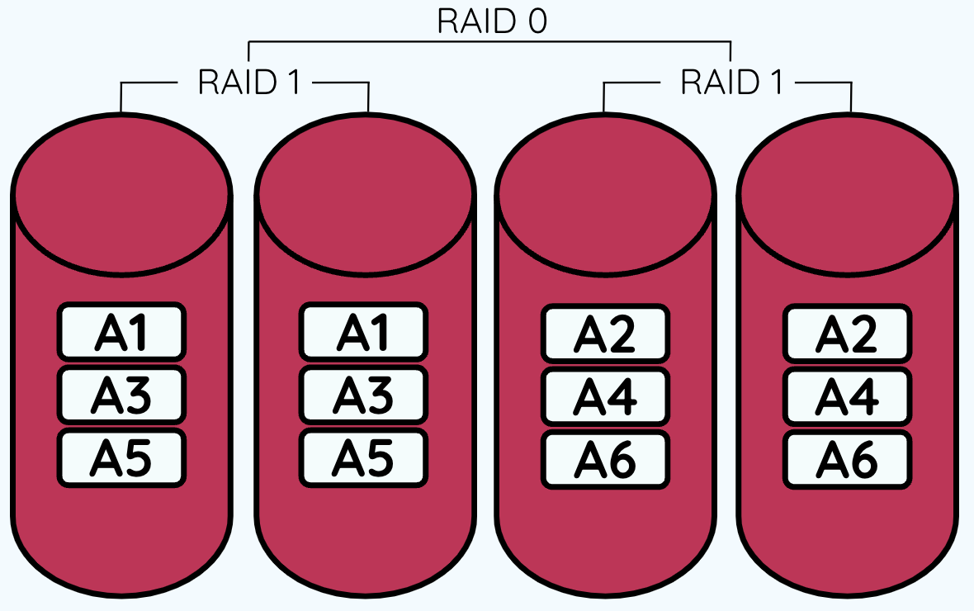
RAID
Activity 3
RAID
Redundant Array of Independent Disks (RAID) is a physical storage and recovery system. It is a type of storage that writes across multiple hard drives within the same system. Use this worksheet to make notes on the different types of RAID implementation.
RAID stands for Redundant Array of Independent Disks
This is implemented by having multiple hard drives, normally all the same model, size, and with the same capacity, grouped together through either software or hardware
This provides drive redundancy, meaning that if one drive fails or degrades data is not lost
Open and complete ‘A3 Activity sheet - RAID’ as your teacher goes through the next few slides
 | RAID 1 | RAID 5 | RAID 10
Number of disks required
Mirrored | (Y/N) | (Y/N) | (Y/N)
Redundancy
Read performance: Time taken to read data from storage
Write performance: Time taken to write data to storage

Slide 22
RAID 1
Activity 3
Identical disks and data are stored identically on both sets of disks (mirrored)
Minimum two disks required
Redundancy is excellent, because if one disk fails, the other has a copy of the entire data
Good read performance
Slightly lower write performance as data must be written to both drives
A1
A1
A2
A2
A3
A3

Slide 23
RAID 5
Activity 3
Minimum three disks required
Good redundancy
Distributed parity
Good performance as blocks are striped
Can only withstand one disk failure due to how the parity is distributed
A1
A2
P3
A3
P2
A4
P1
A5
A6
Striping: A process of breaking the data into segments and then spreading it across all of the drives. This helps to access data faster because multiple drives work together to read, write, and store data.
Parity: This is a type of extra data that is calculated and stored alongside the data the user wants to write. This extra data can be used to detect errors in transmission or storage. Some RAID groups use one or more disk drives that contain parity information to enable them to rebuild data in case of a drive failure.

Slide 24
RAID 10 (RAID 1 + 0)
Activity 3
Minimum four disks required
Blocks are striped and mirrored
Excellent redundancy as blocks are mirrored
Excellent performance as blocks are striped.
Higher cost than RAID 1 and RAID 5
RAID 0
RAID 1
RAID 1
A1
A1
A2
A2
A3
A3
A4
A4
A5
A5
A6
A6

Slide 25
Retrieval practice
Retrieval activity
Question .
Select two of the following statements about memory that are true:
RAM stores data and instructions during processing
ROM has larger capacity than RAM
ROM is read only memory
Question .
The term redundancy in storage systems means:
Data is broken down into segments and spread across drives
Extra data created and used to calculate if data has been lost
The time taken to open a file from storage
Writing data in two places, so if one disks fails, the data is not lost
Question .
Select two of the following statements about memory that are true:
RAM stores data and instructions during processing
ROM has larger capacity than RAM
ROM is read only memory
Question .
The term redundancy in storage systems means:
Data is broken down into segments and spread across drives
Extra data created and used to calculate if data has been lost
The time taken to open a file from storage
Writing data in two places, so if one disks fails, the data is not lost
Question .
Which of the RAID systems requires a minimum of three disks?
RAID 1
RAID 5
RAID 10
Question .
Which of the RAID systems requires a minimum of three disks?
RAID 1
RAID 5
RAID 10
Notes:
Answers:
redundancy – D;
memory statements – A and C;
RAID systems with min three disks - B

Slide 26
Apply it – activity
Apply it
Hills Road Surgery, a doctors practice (GP), holds lots of sensitive personal information about patients
This information includes contact details, personal medical history, and details of medication prescribed
What type of physical storage and recovery system should they consider and why?
What will they need to consider when storing this sensitive personal information?
Be prepared to feedback your recommendation to the rest of the class and justify your choices
Notes:
Photo by Antoni Shkraba from Pexels: https://www.pexels.com/photo/doctor-checking-the-back-of-a-patient-5215013/

Slide 27
Apply it – possible solutions
Apply it
The sensitive personal information will need to be kept confidential and stored securely in order for the surgery to comply with the law. They will also have to ensure data is kept up-to-date and not kept for longer than necessary.
RAID 1 - would be the cheapest solution and would ensure the GP had a copy of the entire data. The rate latency may cause delays writing patient information.
RAID 5 - improved performance from RAID 1 but can only withstand one disk failure. May result in downtime at the surgery.
RAID 10 - increased cost due to minimum requirement of four disks. Time to rebuild from failure is reduced due to mirroring, and would reduce impact on patients.
NAS - connected to network so will only allow authorised access. Should not be the only backup system due to inability to recover deleted files.
SAN - usually a fibre-optic network so data can be accessed quickly, would require a skilled network manager — would the GP surgery have this?

Slide 28
Next lesson
Summary
In this lesson, you…
Identified the features of physical storage systems
Described the role of main memory and its key characteristics
Recognised the need for secondary storage
Compared the different types of physical storage and recovery systems
Next lesson, you will…
Explain why devices are connected to networks
Describe what a network is
Compare common network types
Recognise the characteristics of different network topologies

