Slide 1

Lesson 5: Communication over networks
Digital environments
Notes:
Version 1, June 2024

Slide 2
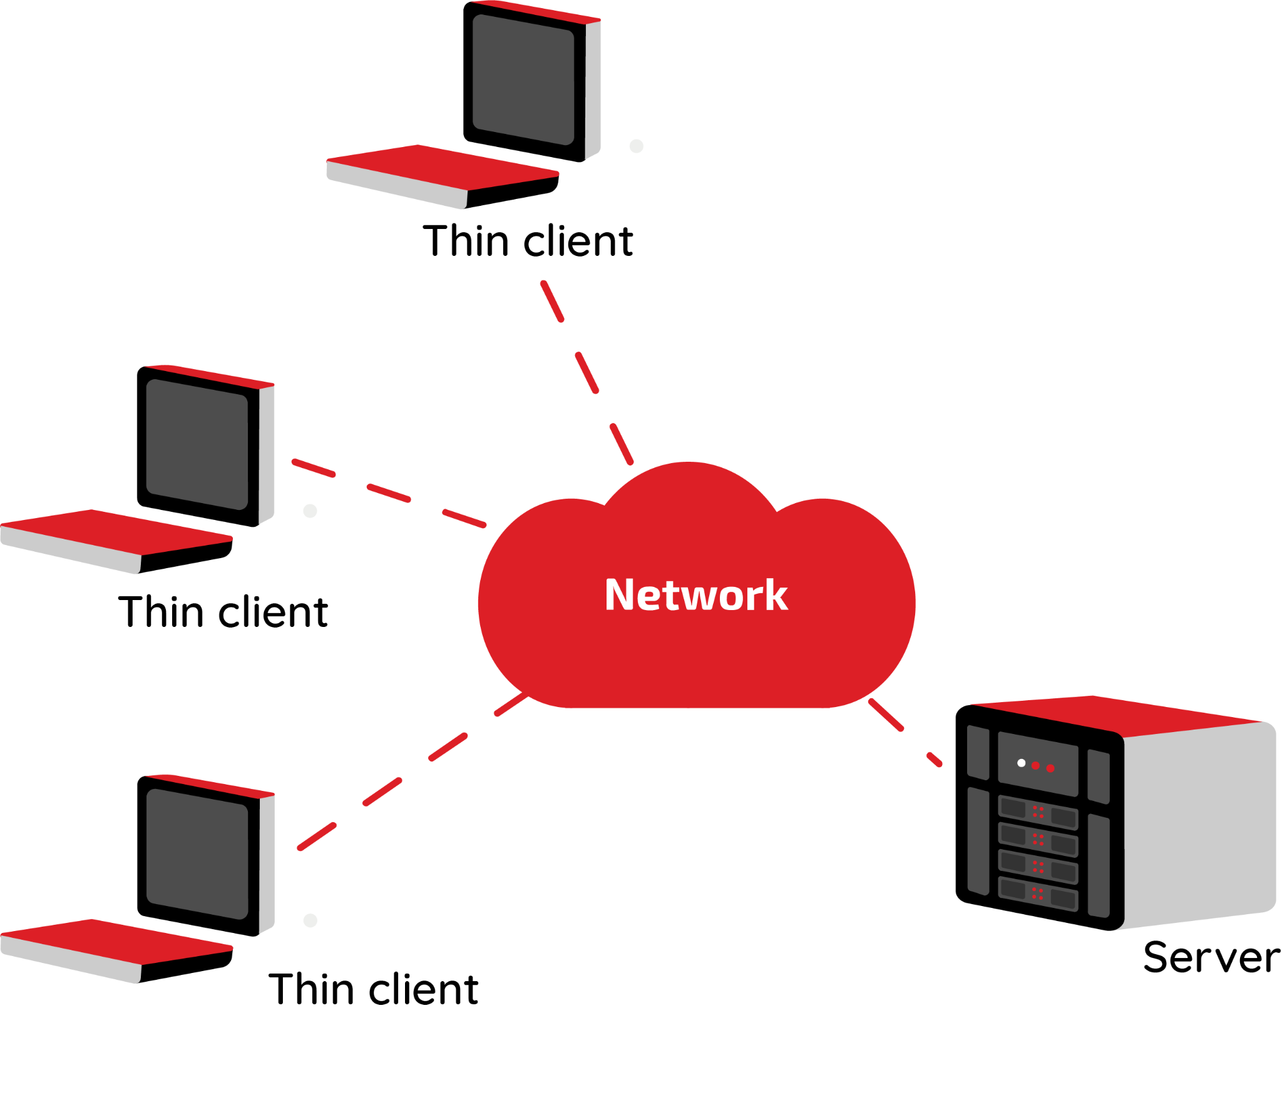
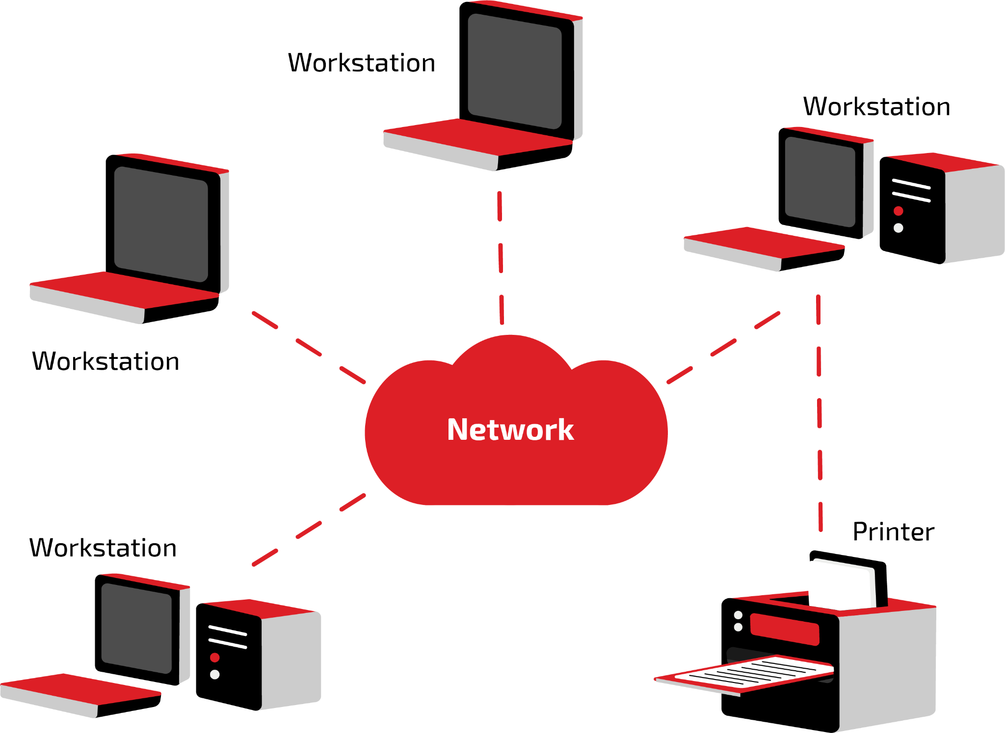
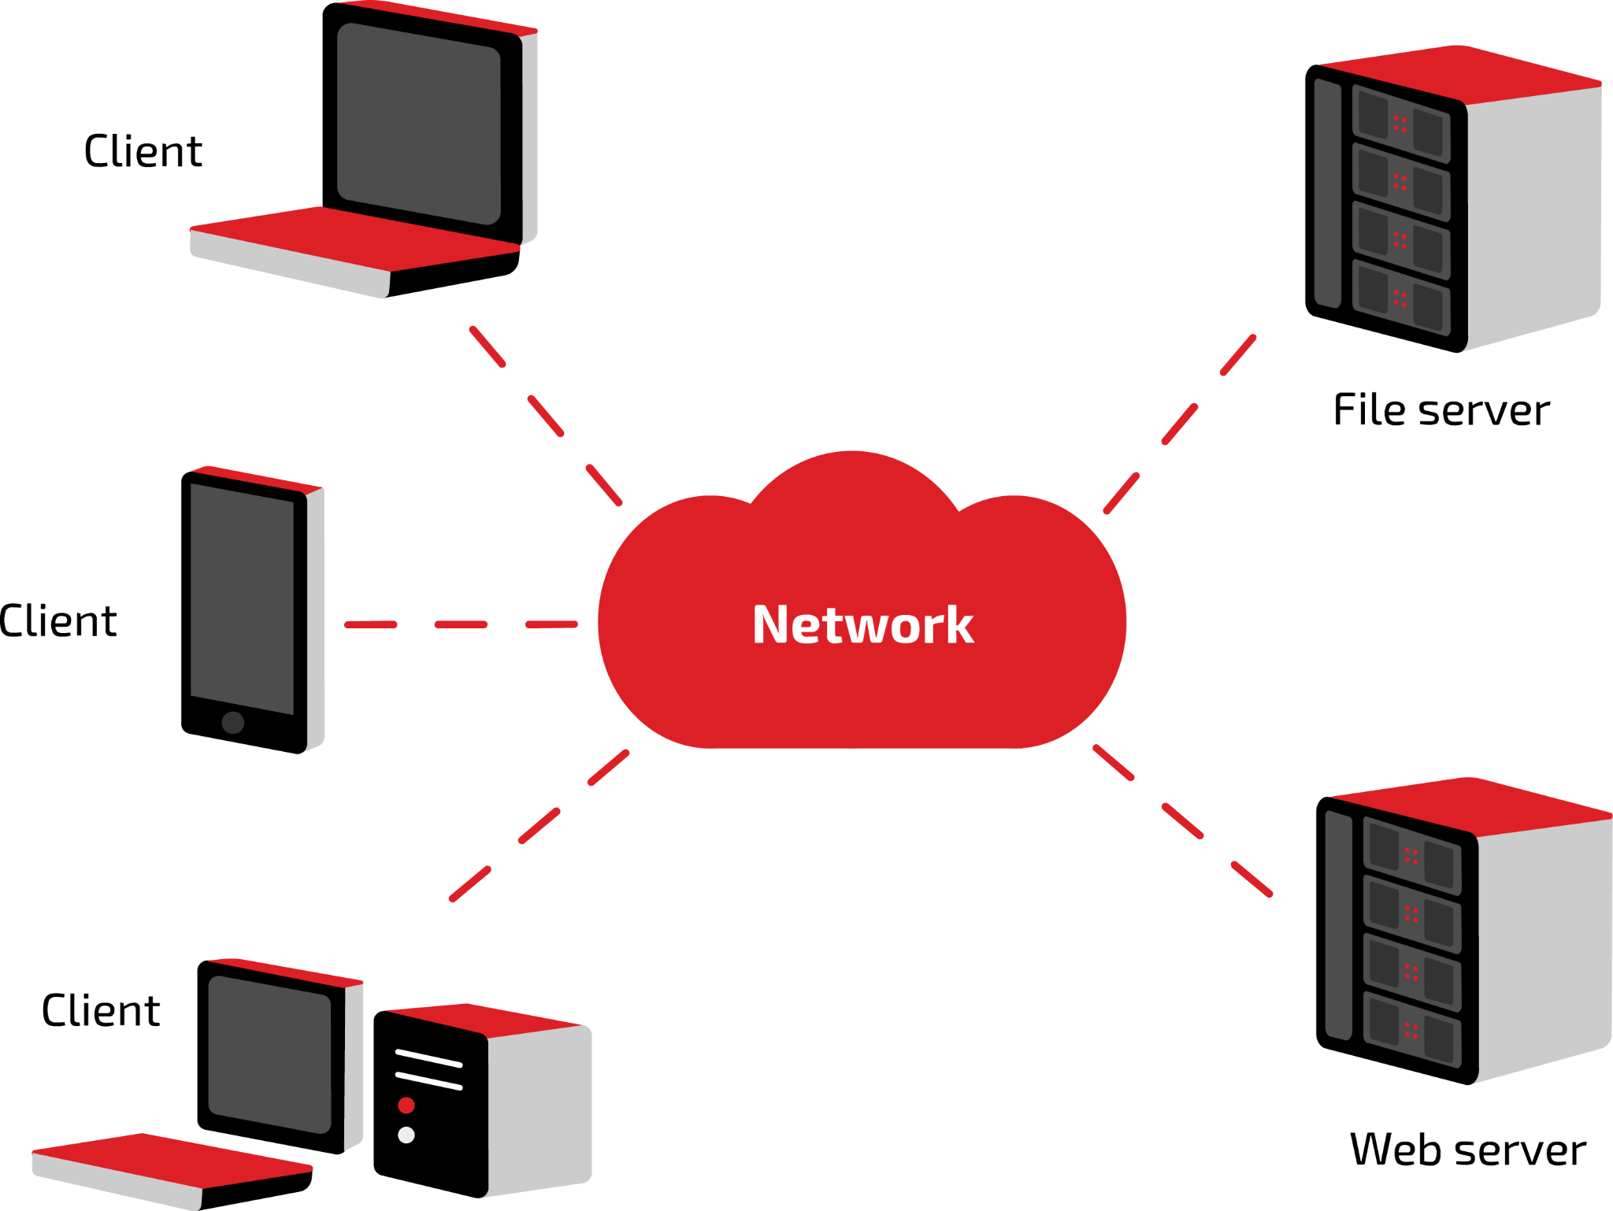
Network models – retrieval activity
Starter activity
Correctly name each network model.
Client–server
Thin client
Peer-to-peer

Slide 3
Starter activity
How will devices on different networks communicate with each other?
How the devices will be connected (wired, wireless)?
What do we need to consider when networking devices together?
How the network will be arranged (topologies)?
What hardware will be needed?
What will affect the performance of the network?
How will information be transmitted across the network?

Slide 4
Lesson 5: Communication over networks
Objectives
In this lesson, you will:
Discover how communication takes place over a network
Recognise some common components of a network and their purpose
Describe the role of protocols in network communication
Identify the contents and purpose of a packet in transmitting data across a network
General competencies:
E2 - present information and ideas
E4 - summarise information
E5 - synthesise information
E6 - take part in discussions
D1 - use digital technology
D2 - design digital media
D3 - communicate and collaborate
D6 - code and program

Slide 5
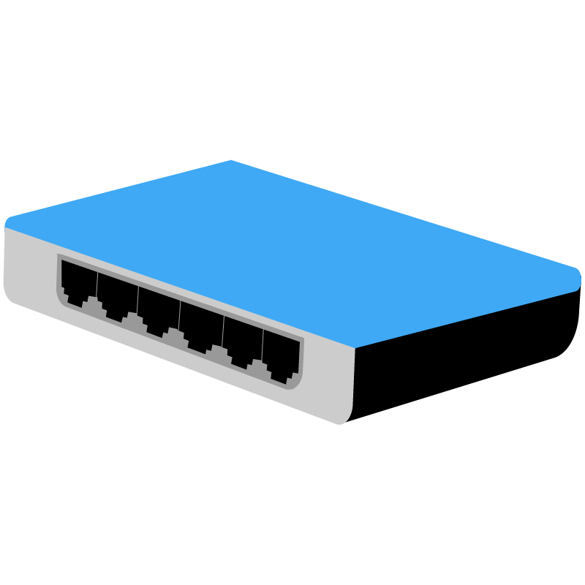
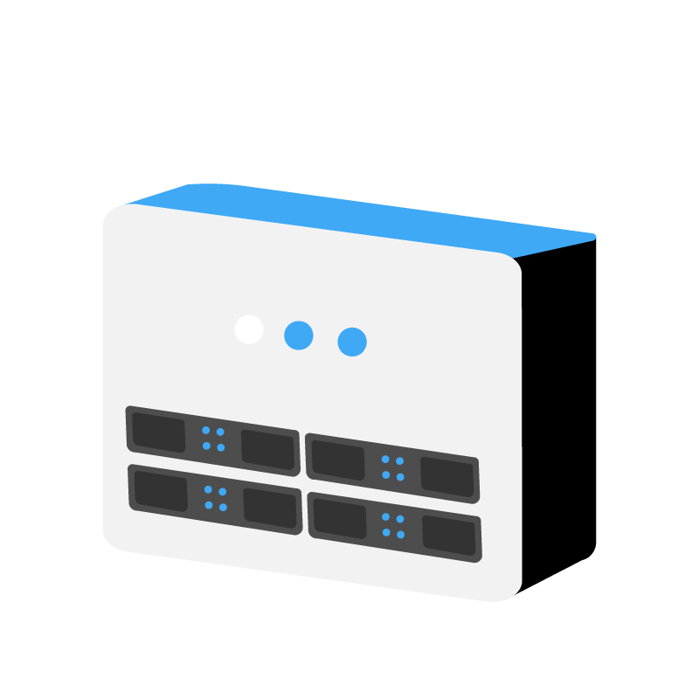


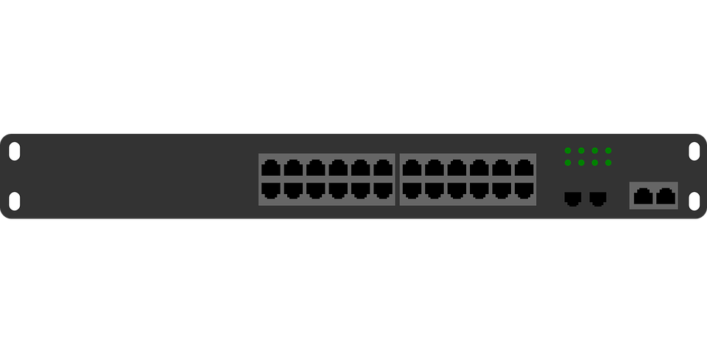
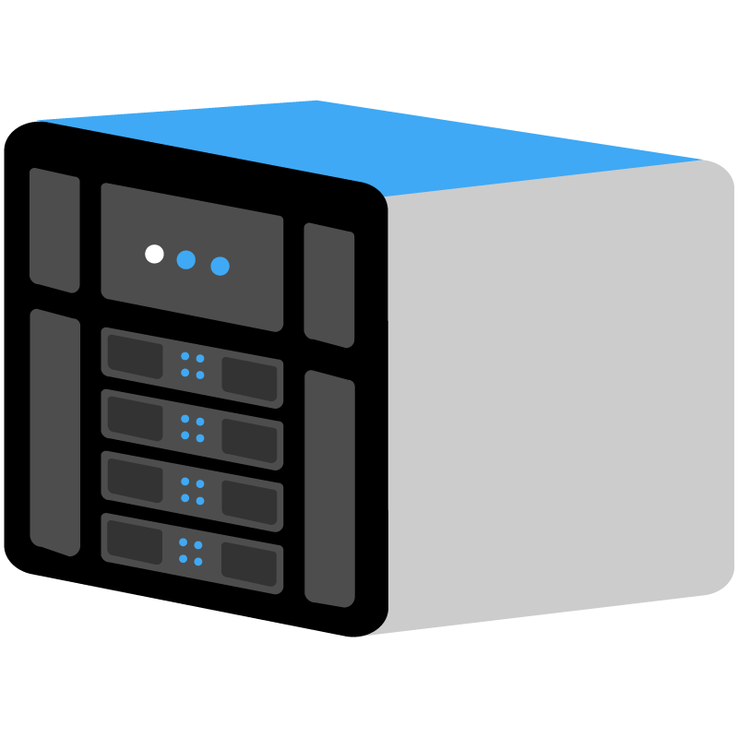
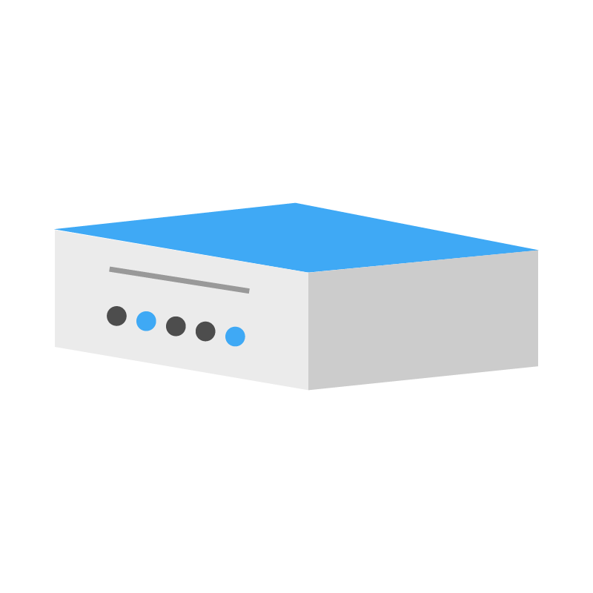
Common network components
Activity 1
 | Switch – can be used to connect multiple wired devices together. A switch will receive any incoming data and transmit it to the specific device to which it is addressed.
 | Hub – can be used to connect multiple wired devices together. A hub will receive any incoming data and broadcast (copy and transmit) it to all other devices connected to the hub.
 | Wireless access point (WAP) – connects to a wired network and provides a central point for wireless devices to connect to. The WAP allows wireless access to the network.
 | Network interface card (NIC) – allows a device to connect to a network. It is used to receive data from the network and to transmit data onto the network.
 | Bridge – is used to connect a network segment to another network segment.
 | Server – a centralised device that manages access to resources across a network. The server fulfils requests from the clients on the network.
 | Router – responsible for moving data from one network to another. A common use for a router is to connect a network to the internet (which is also a network).
Notes:
Images: Raspberry Pi Foundation

Slide 6

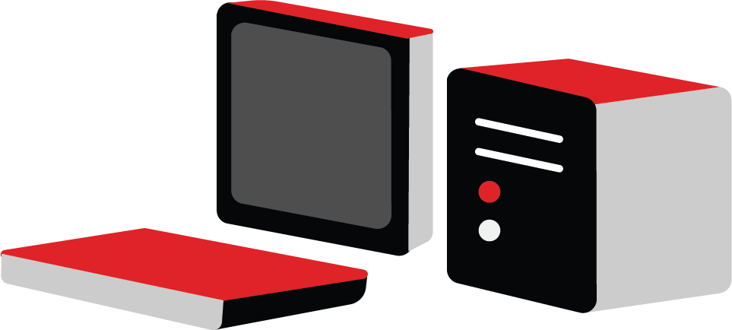
Selecting hardware for a network
Activity 1
Different networks need to meet different network requirements and will be implemented using different network components.
Open and complete the ‘A1 Activity sheet – Selecting hardware for a network’.
Scenario 1
An apprentice wants to test their networking skills and set up a wired network using three devices. They have a laptop and two PCs that they want to connect together. Each device already has a standard network interface card. The network will not be connected to the internet. Label the network hardware item that you think is missing from the diagram.

Slide 7


Activity 2
What is a server? How many types of server are discussed in the video?
Notes:
A2 Servers film: https://vimeo.com/883954087

Slide 8
Examples of types of servers
Activity 2
Types of servers and their purpose
Match each type of server with the correct description of its purpose.
There are different types of servers and each has a specific purpose.
Open and complete the ‘A2 Activity sheet – Types of servers and their purpose’.
Type of server |  | Purpose
Application server |  | Used for hosting a database so that it can be accessed by users over a network.
Database server |  | Used for sending and receiving email communications.
File server |  | Used for receiving and processing printing requests to networked printers.
Web server |  | Used for hosting webpages. Web content is delivered to end users over the internet via a web browser.
Domain Name Server (DNS) |  | Used to convert domain names to the IP addresses needed to locate resources on the internet.
Mail server |  | Used to replicate the functionality of a physical server. There can be many such servers running on the same physical server, which allows for separation of services without the need for multiple pieces of hardware.
Virtual server |  | Used for sharing files over a network.
Print server |  | Used for hosting web applications. It allows users to access applications without having to install them on their computers.

Slide 9
Examples of types of servers – Answers
Activity 2
Application server
Used for hosting web applications. It allows users to access applications without having to install them on their computers.
Database server
Used for hosting a database so that it can be accessed by users over a network.
File server
Used for sharing files over a network.
Web server
Used for hosting webpages. Web content is delivered to end users over the internet via a web browser.
Domain Name Server (DNS)
Used to convert domain names to the IP addresses needed to locate resources on the internet.
Mail server
Used for sending and receiving email communications.
Virtual server
Used to replicate the functionality of a physical server. There can be many such servers running on the same physical server, which allows for separation of services without the need for multiple pieces of hardware.
Print server
Used for receiving and processing printing requests to networked printers.

Slide 10

Rules for communication
Activity 3
Question
Can you think of any rules for communication that we use in our daily lives?
Explorer task
What would happen if we did not have rules for communication?
Notes:
Image by truthseeker08 from Pixabay: https://pixabay.com/photos/hands-thumb-promise-finger-gesture-1923185/

Slide 11
Rules for communication
Activity 3
Saying hello and goodbye
Shaking hands
Waiting for someone to finish talking before you talk
Waving hello and goodbye
Using “Dear” etc. in letters and emails
Speaking the same language or one that both parties understand

Slide 12
What if we did not have rules for communication?
Activity 3
Exchanges might be awkward if one person waves hello and the other person does not
You would not know how to politely end a conversation
Several people might talk at once
People might be offended
People would not be able to understand each other
We use rules for communication in our daily lives.

Slide 13

Protocols
Activity 3
Computers also need to have rules for communication.
These are known as protocols.
Protocols are the reason why billions of devices all over the world can communicate with each other.
Computers that need to communicate with each other will use the same protocols.
Notes:
Image by geralt from Pixabay: https://pixabay.com/illustrations/earth-network-blockchain-globe-3537401/

Slide 14
Protocols
Activity 3
Common protocols used in networking are:
DHCP
DNS
HTTP/HTTPS
FTP
NTP
POP/SMTP/IMAP
TCP/IP
The P at the end of most of these acronyms stands for Protocol.
Notes:
Image by geralt from Pixabay: https://pixabay.com/illustrations/earth-network-blockchain-globe-3537401/

Slide 15


Activity 3
Which protocols are mentioned during the video? Do you recognise any of them?
Notes:
A3 Network protocols film: https://vimeo.com/883954069

Slide 16


Protocols
Activity 3
Different protocols are used at different stages and for different types of communication.
Conduct some research into the common protocols. Open and complete the ‘A3 Activity sheet – Protocols’ to record your notes.
File Transfer Protocol (FTP)
Hypertext Transfer Protocol (HTTP)
Domain Name Servers (DNS)
POP, IMAP, and SMTP
Dynamic Host Configuration Protocol (DHCP)
Every computer on a network needs a unique address. DHCP is used to assign unique IP addresses and other configuration options to devices that connect to a network.
What is that protocol used for?

Slide 17
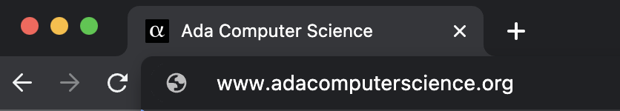
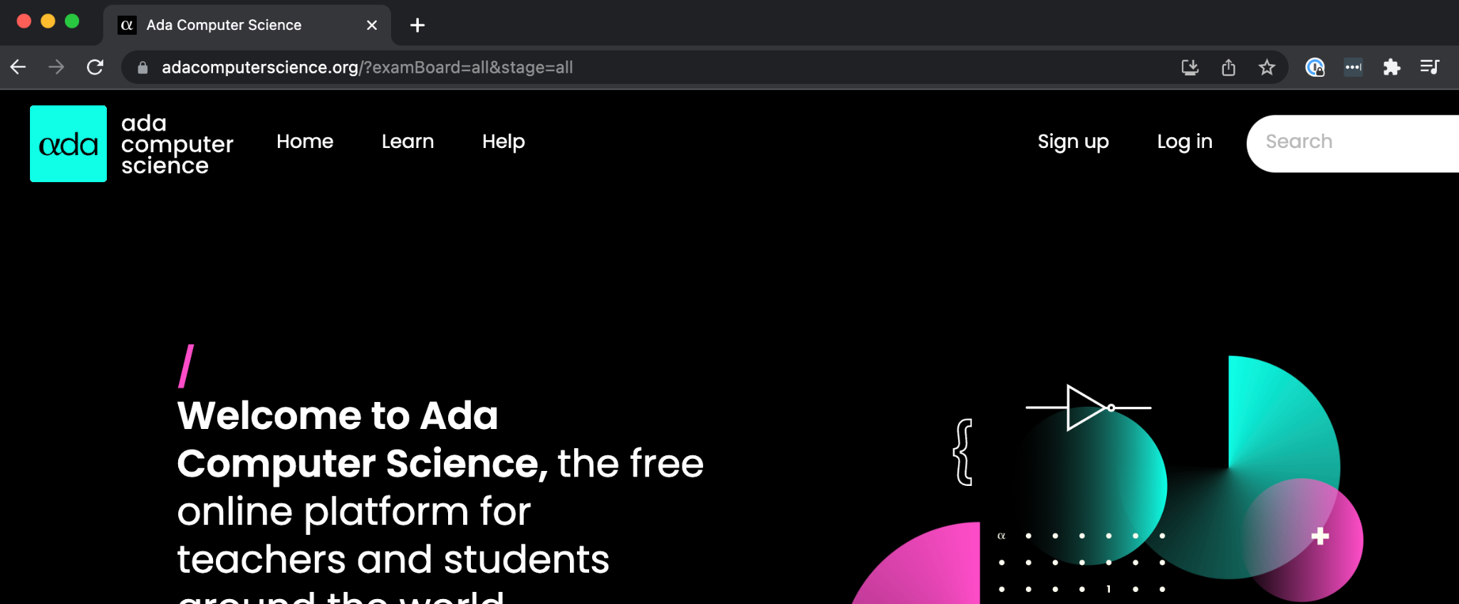
Which protocol is which?
Retrieval activity
The images below show the stages of a web request. What protocol is being used at each stage?
Stages of a web request | Protocol
Direct browser to URL. Domain name is mapped to IP address (the true location of the domain’s computers). adacomputerscience.org. → 128.232.21.139
The browser sends and receives the request and renders the document as requested.
DNS
HTTP

Slide 18
The IP address
Activity 4
Every single device that directly connects to the internet needs a unique address called an IP address.
An IP address is a 32-bit number that is usually displayed like the one seen here.
The address is split into four 8-bit chunks (octets). The four denary values are then written with a dot between them, which is referred to as dotted decimal notation.
The size of an IP address was chosen as 32 bits, which gave a colossal four billion addresses (IPv4).
Due to exponential growth of the internet, more addresses are needed. IPv6 is the successor of IPv4 and uses 128-bit IP addresses.
104.22.1.43
2001:db8:3333:4444:5555:6666:7777:8888
IPv4 address
IPv6 address

Slide 19
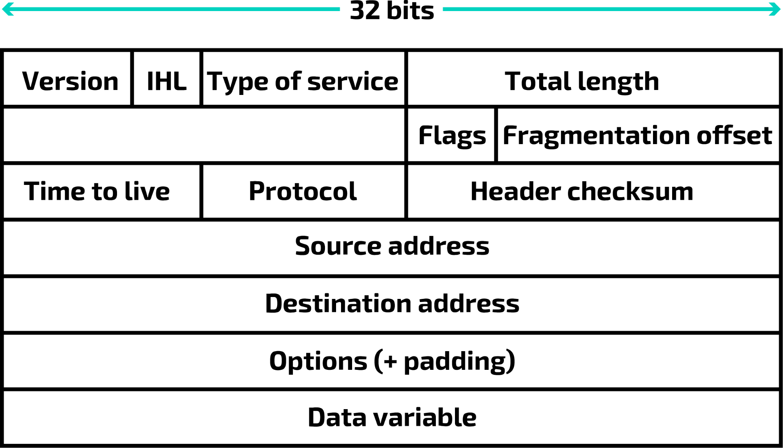
Packets
Activity 4
Last lesson you learnt about the different types of network and how networks can be arranged (topologies).
Now, you will explore how data is sent across a network.
Data files are broken down into smaller sections of data called packets.
There are different types of packet and each has its own structure.
The structure of an IP packet

Slide 20
Typical contents of a packet
Activity 4
Header
The address of the packet’s destination.
The address of the packet’s origin.
The sequence number of the individual packet (packet number).
The number of packets in the whole file.
Data that is used to check the packet for errors during transmission (checksum).
Payload
The actual data that is being sent by the packet.
Trailer/footer
Marks the end of the packet so the receiver knows that is the end of the packet.
May also contain error checking (if this is not in the header). This is commonly a cyclic redundancy check (CRC). A CRC is a mathematical algorithm that generates a unique checksum for a given set of data, which can then be used to verify the integrity of the data.

Slide 21




Packet switching
Activity 4
In packet switching, the packets are divided into smaller packets and are transmitted individually across the network.
Routers examine the destination IP address of each incoming packet and decide on which route the packet should be sent until the destination is reached.

Slide 22
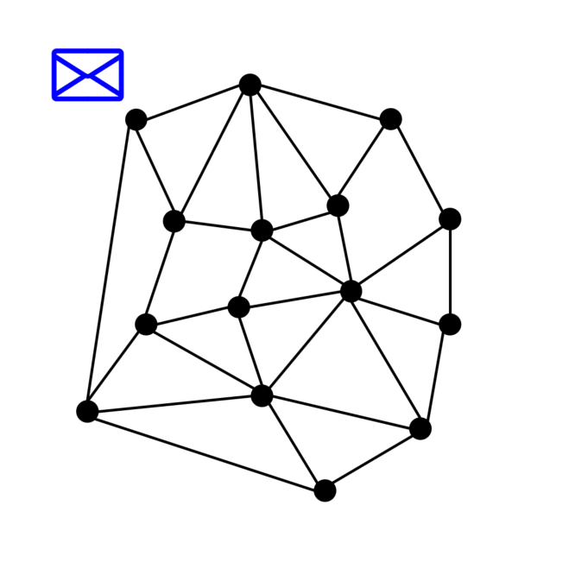
Packet switching
Activity 4
Different packets from the same file could be sent separately along the most efficient route.
At the destination, the packets are reassembled into the correct order.
Most traffic over the internet uses packet switching.
Hops: Refers to the number of routers or devices that a packet passes through on its route from source to destination

Slide 23
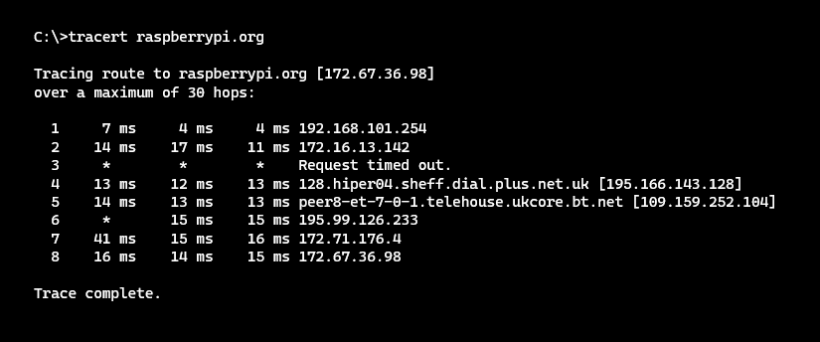
Traceroute
Activity 4
Traceroute
The Traceroute command (tracert) is a utility designed for displaying the time it takes for a packet of information to travel between a local computer and a destination IP address or domain.
Traceroute for Windows
If you are using Windows, follow the steps below to run Traceroute:
Press the Windows key
Type Command Prompt, and press Enter to launch
Type tracert raspberrypi.org
The Traceroute command (tracert) is a utility designed for displaying the time it takes for a packet of information to travel between a local computer and a destination IP address or domain. This is often used to detect if there are issues with a domain name.
Open and follow the instructions in the ‘A4 Activity sheet – Traceroute’ to explore how it works.

Slide 24
Retrieval practice
Retrieval activity
Question .
Which email protocol retrieves the email from the email server, delivers it to your computer or device, and then usually deletes it from the email server?
A SMTP
B POP
C IMAP
Question .
Which email protocol retrieves the email from the email server, delivers it to your computer or device, and then usually deletes it from the email server?
A SMTP
B POP
C IMAP
Question .
What type of server is used to replicate the functionality of a physical server?
Web server
File server
Virtual server
Domain Name Server
Question .
What type of server is used to replicate the functionality of a physical server?
Web server
File server
Virtual server
Domain Name Server
Question .
Which network device receives incoming data and broadcasts (copies and transmits) it to all other devices connected to it?
A Switch
B Router
C Hub
Question .
Which network device receives incoming data and broadcasts (copies and transmits) it to all other devices connected to it?
A Switch
B Router
C Hub
Notes:
Answers: server – C; email protocol – B; network device - C

Slide 25
Next lesson
Summary
In this lesson, you…
Discovered how communication takes place over a network
Recognised some common components of a network and their purpose
Described the role of protocols in network communication
Identified the contents and purpose of a packet in transmitting data across a network
Next lesson, you will…
Describe how applications communicate over a network
Compare the layers of the OSI and TCP/IP models
Distinguish between network layers and protocols that operate on each layer

