Slide 1
Lesson 8: Cloud environments
Digital environments
Notes:
Version 1, June 2024

Slide 2
Virtualisation – study question
Starter activity
A software developer working for an online retailer is creating a new website feature which will allow customers to see stock levels. Explain two reasons why the software developer would use a virtual environment to design and test this new feature.

Slide 3
Virtualisation – study question
Starter activity
A software developer working for an online retailer is creating a new website feature which will allow customers to see stock levels. Explain two reasons why the software developer would use a virtual environment to design and test this new feature.
Emulation means that the features can be tested on different software versions and the developer can create an exact replica of the live environment to test their work in.
Isolation means that if any new features do not work as expected, they will not interfere with the current system or cause any interruption of service for customers. The online retailer would not want their website to be unavailable for customers during the development of the new feature.

Slide 4
Starter activity
How does this organisation use the cloud to meet their business needs?
Notes:
A0 The cloud film: https://vimeo.com/883953099

Slide 5
Lesson 8: Cloud environments
Objectives
In this lesson you will:
Define what cloud storage is
Describe how organisations use cloud environments
Examine the different models of cloud deployment
Explore how the responsibility of ownership is distributed between subscriber and service provider
Distinguish between cloud service models
General competencies:
E2 - present information and ideas
E4 - summarise information
E5 - synthesise information
E6 - take part in discussions
D3 - communicate and collaborate

Slide 6
What is the cloud?
Activity 1
Notes:
Photo by Fillipe Gomes from Pexels: https://www.pexels.com/photo/photo-of-clouds-during-daytime-2093252/

Slide 7
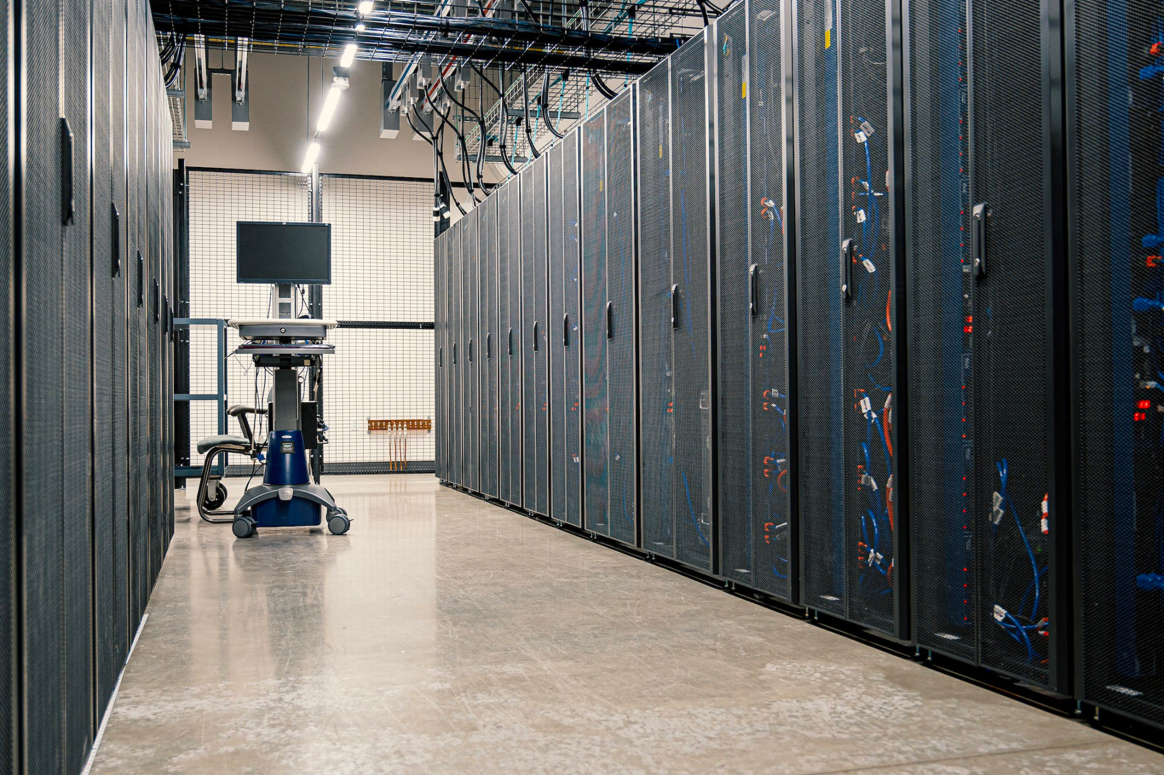
Cloud storage
Activity 1
Cloud computing is a model for providing on-demand network access to a shared pool of computing resources via the internet, such as networks, servers, storage, and applications.
With improved connectivity to the internet through fibre optics, 4G, and 5G, the use of cloud storage (sometimes called virtual storage) has become widespread.
Notes:
Photo by Brett Sayles from Pexels: https://www.pexels.com/photo/black-hardwares-on-data-server-room-4597280/

Slide 8
Cloud storage
Activity 1
The data is stored on servers that are owned and managed by commercial organisations.
A popular business model is to provide individual consumers with a certain amount of cloud storage free of charge, and then to charge per GB for additional storage needs. Businesses would typically have a package with a set amount of storage.
95% of respondents to the Cloud Industry 2023 research report have cloud-based services in place at their organisation today (cloudindustryforum.org).
Notes:
Image by bsdrouin from Pixabay: https://pixabay.com/photos/network-server-system-2402637/
Report from https://cloudindustryforum.org/wp-content/uploads/2023/04/Breaking-new-ground-with-cloud.pdf

Slide 9
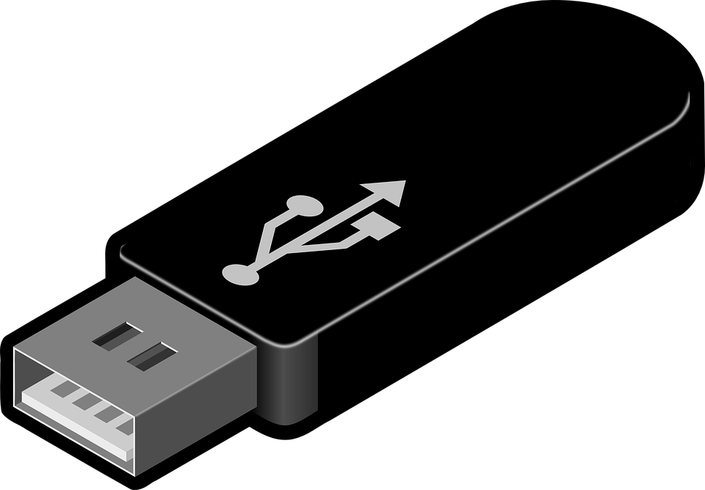
Cloud storage
Activity 1
Cloud storage has had a huge impact on the way we store files, and the way we move data between devices.
In particular, it has reduced the demand for portable storage devices such as optical discs and USB flash drives.
Nowadays, it is quite rare to get an optical disc drive as standard when you buy a desktop or laptop computer.
Notes:
Image by Clker-Free-Vector-Images from Pixabay: https://pixabay.com/vectors/usb-disk-disc-storage-technology-47552/

Slide 10
Cloud storage
Activity 1
Cloud storage can be configured so that it automatically synchronises with local drives.
This means that there is always a local copy, in case there is no available internet connection. Any changes made locally will be synchronised when the connection is next available.
Notes:
Image by Clkr-Free-Vector-images from Pixababy: https://pixabay.com/vectors/folder-synchronize-sync-computer-26706/

Slide 11
Cloud storage
Activity 1
A professional photographer works for an international news agency. They work alongside journalists to take photographs of current events which are uploaded to the main office to be included in printed and online articles.
What would be the benefits and limitations of the photographer and news agency using cloud storage?
Discuss with a partner and be prepared to share your answer.
Notes:
Photo by cottonbro studio from Pexels: https://www.pexels.com/photo/woman-in-gray-hijab-holding-a-camera-4626345/

Slide 12
Benefits of cloud storage
Activity 1
Capacity can expand or reduce as your needs change. This is much more cost-effective.
Files can be accessed anywhere in the world, on any device, provided there is a stable internet connection. This makes sharing files easier and offers opportunities for greater collaboration.
Cloud storage offers a safe way to back up your files. The provider takes responsibility for maintaining and protecting the data you store with them.
Notes:
Image source: https://pixabay.com/vectors/cloud-cloud-computing-3308170/

Slide 13
Limitations of cloud storage
Activity 1
Cloud storage requires a relatively fast, stable internet connection. This can exclude some people who cannot access or afford such a connection.
If you download or synchronise large files, it can take a long time.
Storing your files online carries some risks. For example, malicious individuals might gain access or steal your data. You can also lose the data if something happens to the provider's servers or hard drives. It is important for individuals and organisations to use reputable cloud storage service providers.

Slide 14
Cloud deployment models
Activity 2
There are four recognised deployment models of cloud computing:
Private cloud
Public cloud
Hybrid cloud
Community cloud
Notes:
Photo by cottonbro studio from Pexels: https://www.pexels.com/photo/person-in-white-shirt-using-computer-4709289/

Slide 15
Cloud deployment models
Activity 2
Private cloud | A one-to-one environment for a single customer. The cloud platform is implemented in a cloud-based, secure environment that is protected by powerful firewalls. Computing services and infrastructure are hosted privately within a company’s own intranet or data centre using proprietary resources. Examples include Oracle’s Private Cloud Appliance and HPE private cloud products.
Public cloud | A service that anyone can access. Cloud services are provided over the internet by a cloud vendor. Consumers (either individuals or organisations) typically pay a subscription to use the service. Examples include Google Cloud, Google App Engine, and Amazon Web Services.
Hybrid cloud | Incorporates features of both public and private cloud computing.
Community cloud | Is accessible by a group of organisations, normally within the same industry sector. Cloud services are distributed and are typically managed by a third party. An example of this is in banking where cloud services allow money and payments to be transferred between banks.

Slide 16
Cloud service models
Activity 2
There are three recognised cloud service models. These cloud service models would be deployed depending on the need of the organisation.
SaaS – Software as a Service
PaaS – Platform as a Service
IaaS – Infrastructure as a Service
SaaS
PaaS
IaaS

Slide 17
Cloud service models
Activity 2
Open and complete the ‘A2 Activity sheet – Cloud service models’ to discover more about each of these service models.
You will then be asked to recommend the most appropriate cloud service model for the given scenarios.
Cloud service models
There are three recognised cloud service models. These cloud service models would be deployed depending on the need of the organisation.
Software as a Service (SaaS) | The cloud service provider hosts the applications. Access for the end user is provided over the internet. End users configure applications to meet their own requirements. Common examples include Google Workspace, Google Drive, Microsoft OneDrive, and web-based email.
Platform as a Service (PaaS) | The cloud service provider hosts the hardware and software platform that the client needs on its own infrastructure. This provides a platform upon which clients can build and deploy their own applications. Access for developers is provided over the internet. Common examples include Google App Engine and Microsoft Azure.
Infrastructure as a Service (IaaS) | The cloud service provider sets up and manages the infrastructure (storage, servers, networking) on behalf of their clients. Access for clients is provided over the internet. IaaS typically includes virtual servers running on shared physical servers that are managed by the cloud service provider. Common examples include Amazon Web Services and Google Compute Engine.

Slide 18
Responsibility of ownership
Activity 3
Software as a Service (SaaS) |  | Platform as a Service (PaaS) |  | Infrastructure as a Service (IaaS)
Applications |  | Applications |  | Applications
Data |  | Data |  | Data
Runtime |  | Runtime |  | Runtime
Middleware |  | Middleware |  | Middleware
Operating system |  | Operating system |  | Operating system
Virtualisation |  | Virtualisation |  | Virtualisation
Servers |  | Servers |  | Servers
Storage |  | Storage |  | Storage
Networking |  | Networking |  | Networking
Provider manages
You manage

Slide 19
Concepts of cloud deployment
Activity 3
As illustrated in the diagram on the previous slide, the key distinction between the cloud service models is the amount of management the cloud service provider is responsible for compared to the user.
Open and complete the ‘A3 Activity sheet – Cloud deployment’ to ensure you understand some of the key concepts and terminology in relation to cloud deployment.
Cloud deployment
The key distinction between the cloud service models is the amount of management the cloud service provider is responsible for.
Software as a Service (SaaS) |  | Platform as a Service (PaaS) |  | Infrastructure as a Service (IaaS)
Applications |  | Applications |  | Applications
Data |  | Data |  | Data
Runtime |  | Runtime |  | Runtime
Middleware |  | Middleware |  | Middleware
Operating system |  | Operating system |  | Operating system
Virtualisation |  | Virtualisation |  | Virtualisation
Servers |  | Servers |  | Servers
Storage |  | Storage |  | Storage
Networking |  | Networking |  | Networking

Slide 20
Retrieval practice
Retrieval activity
Question .
In recent years, the use of cloud storage has greatly increased.
Which three of the following characteristics are important reasons to use cloud storage to store files?
Expandable storage capacity
Sharing files
Cost
Safe backups
Speed of access
Question .
Which cloud deployment model does the following describe?
“Accessible by a group of organisations. Cloud services are distributed and are typically managed by a third party”
Hybrid cloud
Public cloud
Community cloud
Question .
In recent years, the use of cloud storage has greatly increased.
Which three of the following characteristics are important reasons to use cloud storage to store files?
Expandable storage capacity
Sharing files
Cost
Safe backups
Speed of access
Question .
Which cloud deployment model does the following describe?
“Accessible by a group of organisations. Cloud services are distributed and are typically managed by a third party”
Hybrid cloud
Public cloud
Community cloud
Notes:
Answers: cloud storage – A, B and D; cloud deployment model - C

Slide 21
Apply it – activity
Apply it
Trainer Trader is a supplier of limited edition designer trainers that was started by Sam whilst they were studying at University. It has now developed into a large web-based company that sells to customers across the world.
As the business has developed, Sam has employed more staff to help meet customer demand. Sam now employs a team of five staff who all work in a small office attached to the distribution warehouse. Currently all staff have a networked PC with all applications installed on the individual computers.
Sam wants to make it easier for staff to collaborate with each other and share documents. They also want to ensure that data is backed up and held securely.
Prepare a presentation to Sam to recommend a cloud deployment and service model.
Notes:
Photo by Arthur Ogleznev from Pexels: https://www.pexels.com/photo/person-wearing-white-and-blue-air-jordan-1-s-1102777/

Slide 22
Apply it – sample solution
Apply it
Cloud deployment model | A private cloud deployment model would be most suitable for Sam and the web-based business. Sam would not want to have public access to their business documentation or website content.
Cloud service model | Software as a service (SaaS) would allow for Sam’s employees to share and work collaboratively. With SaaS, the cloud service provider is also responsible for data, which means that Sam can pass responsibility for data being backed up and held securely to an external provider.

Slide 23
Next lesson
Summary
In this lesson, you…
Defined what cloud storage is
Described how organisations use cloud environments
Examined the different models of cloud deployment
Explored how the responsibility of ownership is distributed between subscriber and service provider
Distinguished between cloud service models
Next lesson, you will…
Recognise the concept of DaaS
Discover how DaaS is used and the benefits and drawbacks it provides for organisations
Identify what is meant by cloud sourcing and cloud portability
Explore the ways in which organisations use cloud environments to provide access to digital tools, services, and storage

