Slide 1
Science
Route: Health & Science
Topic: Working within the health and science sectors
Lesson 1: Organisational policies and procedures
Notes:
Image ©: iStock 1441663123

Slide 2
In this lesson, we will:
Introduction
Skills:
CS2.1 Conduct a review of independently selected scientific literature and other appropriate primary/secondary sources
CS3.1 Identify their own role in relation to the wider team.
CS3.2 Meet their responsibilities when working in a wider team by ensuring that the project is compliant.
CS4.1 Make creative, innovative improvements to scientific practice, processes and outcomes by following an evaluation cycle.
General competencies:
English:
GEC2 Present information and ideas
GEC3 Create texts for different purposes and audiences
GEC4 Summarise information/ideas
GEC5 Synthesise information
GEC6 Take part in/lead discussions.
Digital:
GDC2 Design, create and edit documents and digital media
GDC3 Communicate and collaborate.
name the key organisational policies (Equality, Diversity and inclusion policy, Safeguarding policy, Employment contracts, Performance reviews, Disciplinary policy, Grievance policy) and describe their purpose
summarise the features of each policy
justify the use of different policies in real-life scenarios.
Lesson 1: Organisational policies and procedures

Slide 3
What are the policies in your place of study?
Introduction
Policies underpin the operations of all organisations.
What is the attendance and punctuality policy for your educational insitution?
What is the student ID policy?
What is the dress code or uniform policy for your subject area?
Lesson 1: Organisational policies and procedures

Slide 4
Policies and procedural research
Activity 1
Research six key organisational policies.
Feed your findings back to the group to produce an overall class table which summarises the key features of each policy.
Resources needed
L1 Activity 1 Worksheet
Lesson 1: Organisational policies and procedures

Slide 5

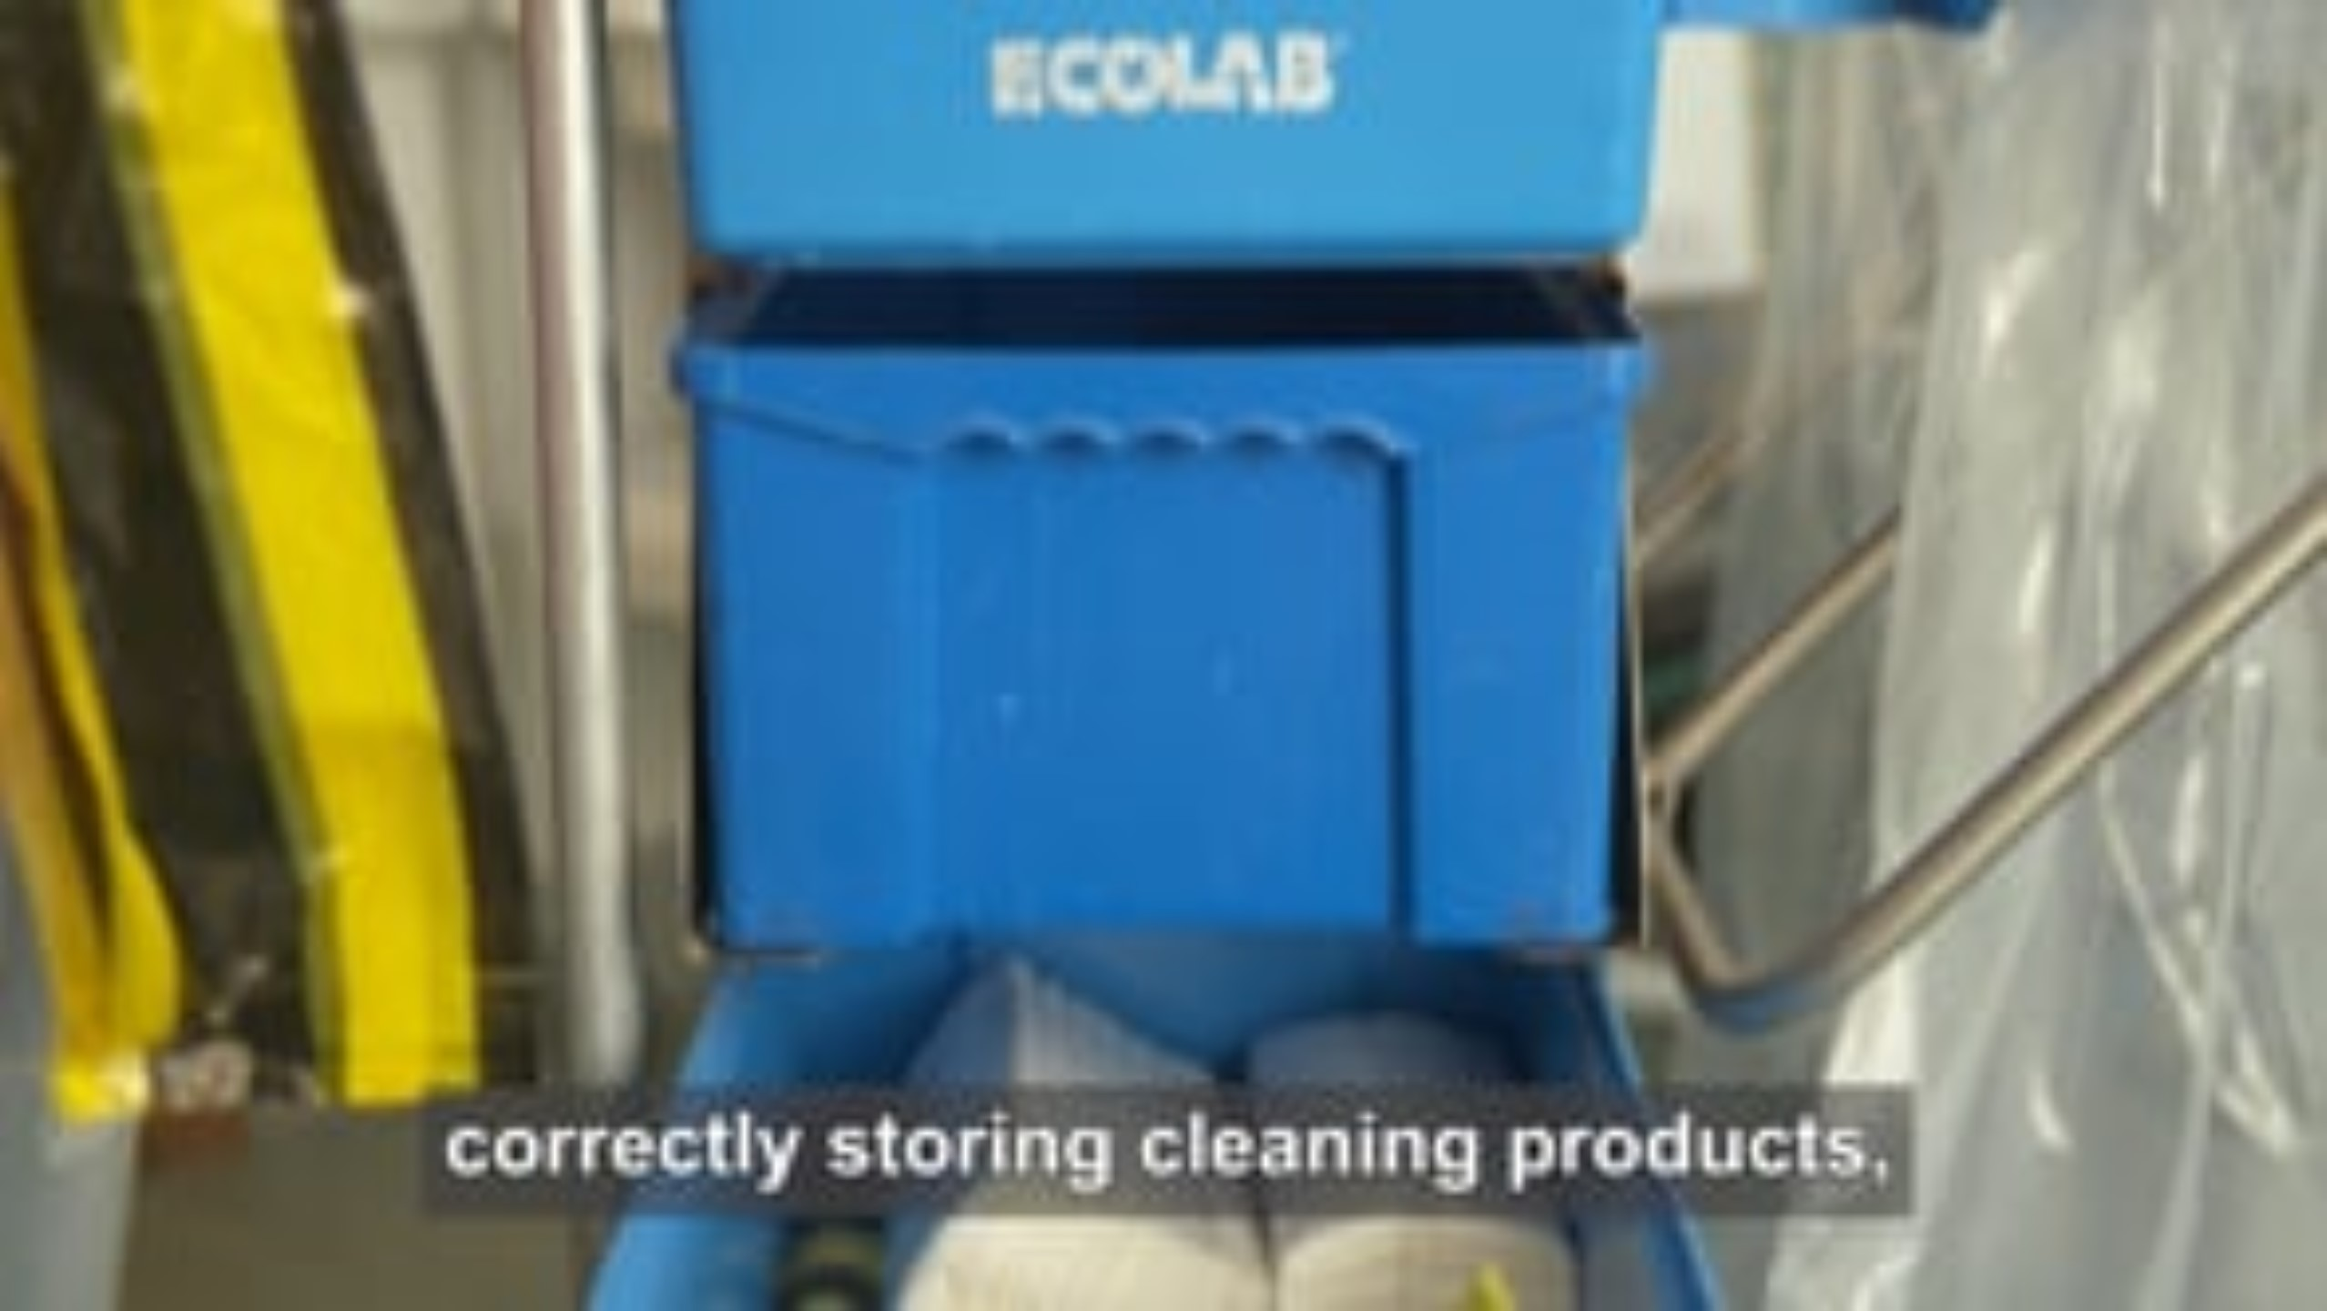
Policy scenario films
Activity 2
Lesson 1: Organisational policies and procedures
Notes:
Films to introduce safeguarding and health and safety/disciplinary policies:
Scenario 1 - https://vimeo.com/889410676?share=copy
Scenario 2 - https://vimeo.com/889410735?share=copy

Slide 6

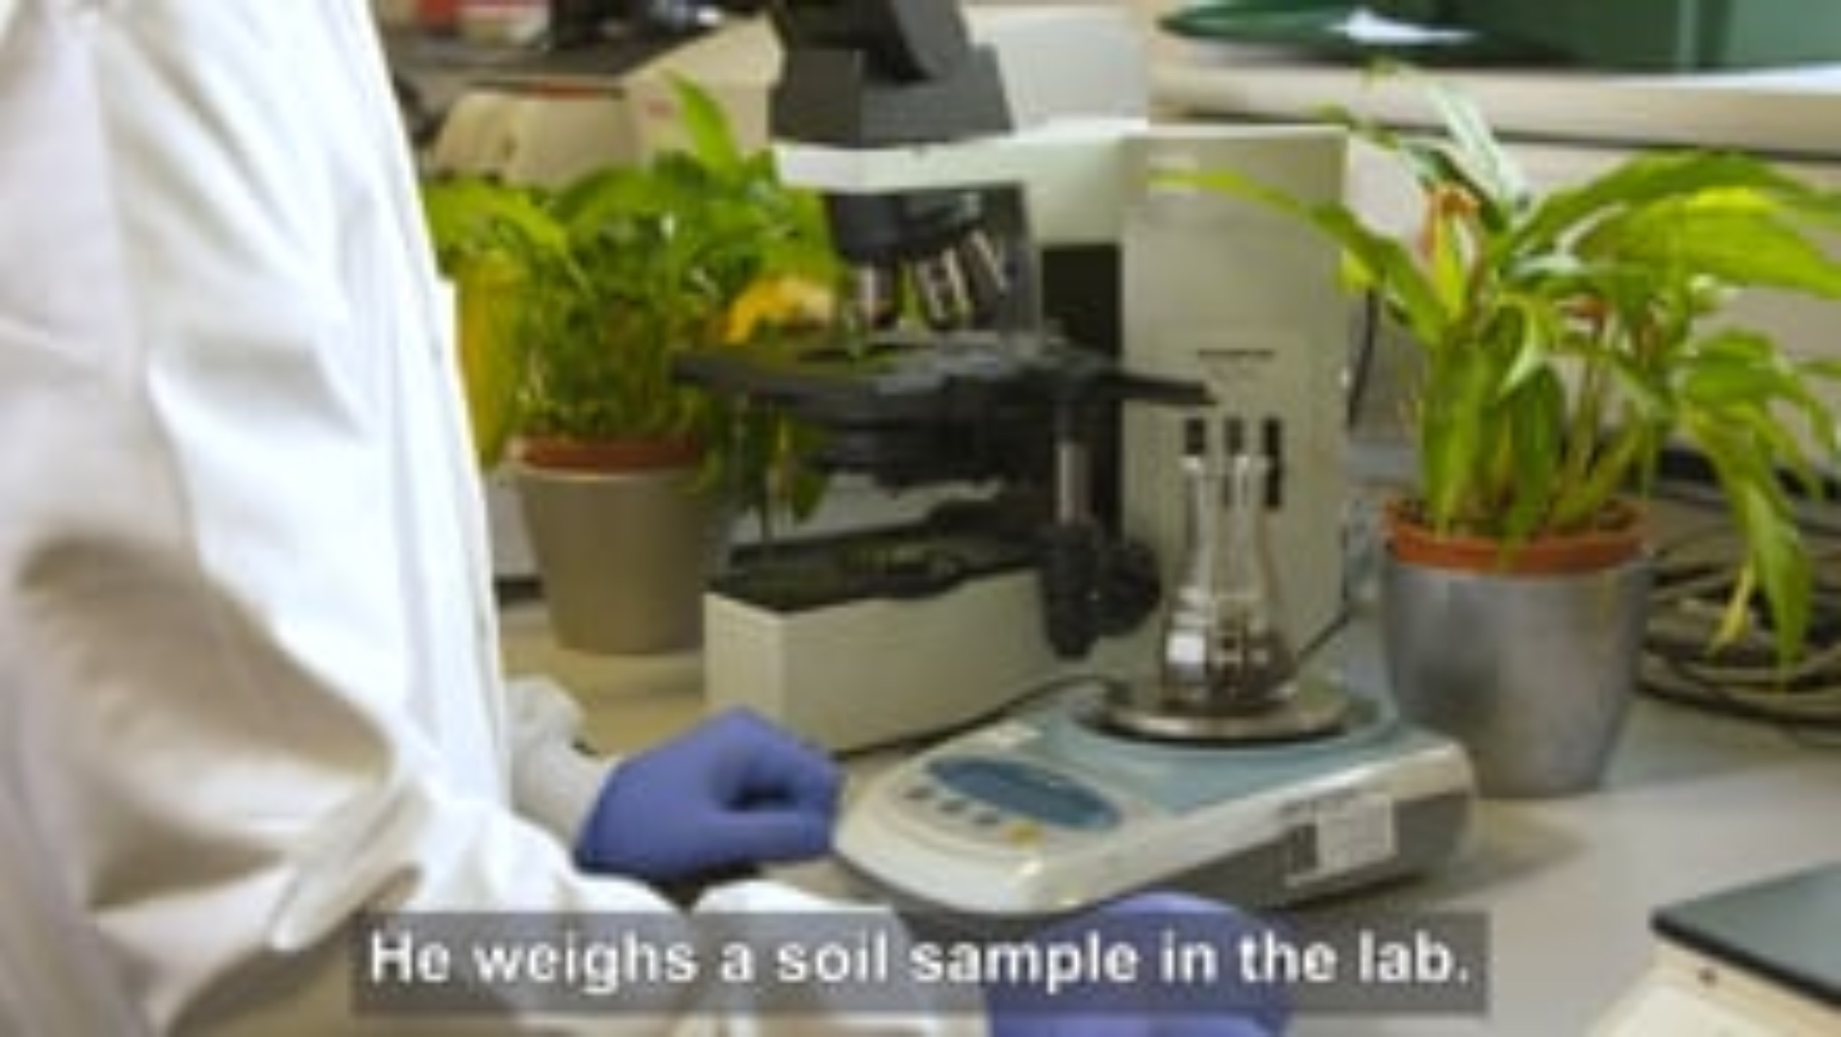
Policy scenario films
Activity 2
Lesson 1: Organisational policies and procedures
Notes:
Films to introduce Equality and health and Grievance policies:
Scenario 3 - https://vimeo.com/889410812?share=copy
Scenario 4 - https://vimeo.com/889410863?share=copy

Slide 7

Policy scenario films
Activity 2
Lesson 1: Organisational policies and procedures
Notes:
Film to introduce Safeguarding policy:
Scenario 5 - https://vimeo.com/889410922?share=copy

Slide 8
Multiple choice questions
Plenary
Which of the following policies must a student be shown before collecting data from a sample of children?
A – Equality, diversity and inclusion policy
B – Safeguarding policy
C – Disciplinary policy
D – Grievance policy
(1 mark)
Lesson 1: Organisational policies and procedures

Slide 9
Multiple choice questions
Plenary
Which of the following policies must a student be shown before collecting data from a sample of children?
A – Equality, diversity and inclusion policy
B – Safeguarding policy
C – Disciplinary policy
D – Grievance policy
(1 mark)
Answers
A01
B – Safeguarding policy
(A1.1 – The purpose of organisational policies and procedures in the health and science sector)
Lesson 1: Organisational policies and procedures

Slide 10
Multiple choice questions
Plenary
A laboratory technician believes they have not been considered for a promotion as their manager knows that they are hoping to start a family.
Which of the following documents should they refer to when raising their concerns with the Human Resources (HR) department in their organisation?
A – Equality, diversity and inclusion policy
B – Performance review
C – Employment contract
D – Safeguarding policy
(1 mark)
Lesson 1: Organisational policies and procedures

Slide 11
Multiple choice questions
Plenary
A laboratory technician believes they have not been considered for a promotion as their manager knows that they are hoping to start a family.
Which of the following documents should they refer to when raising their concerns with the Human Resources (HR) department in their organisation?
A – Equality, diversity and inclusion policy
B – Performance review
C – Employment contract
D – Safeguarding policy
(1 mark)
Answers
A01
A – Equality, diversity and inclusion policy
(A1.1 – The purpose of organisational policies and procedures in the health and science sector)
Lesson 1: Organisational policies and procedures

Slide 12
Case study
Consolidation
In scenario 2, the employee has not suffered any consequences to their health from the injury. However, they have submitted a written grievance about health and safety processes and are concerned that this accident could happen again but have more serious consequences.
Read this information from the Health and Safety Executive which summarises steps to keep sharps safe. Write a paragraph summarising the mistakes that have been made.
Lesson 1: Organisational policies and procedures
Notes:
Weblinks on this slide:
www.hse.gov.uk/biosafety/blood-borne-viruses/avoiding-sharps-injuries.htm
Scenario 2 film:
https://vimeo.com/889410735?share=copy

Slide 13
In this lesson, we have:
Consolidation
named the six key organisational policies and described their purpose
summarised the features of each policy
justified the use of different policies in real-life scenarios.
Skills:
CS2.1 Conduct a review of independently selected scientific literature and other appropriate primary/secondary sources
CS3.1 Identify their own role in relation to the wider team.
CS3.2 Meet their responsibilities when working in a wider team by ensuring that the project is compliant.
CS4.1 Make creative, innovative improvements to scientific practice, processes and outcomes by following an evaluation cycle.
General competencies:
English:
GEC2 Present information and ideas
GEC3 Create texts for different purposes and audiences
GEC4 Summarise information/ideas
GEC5 Synthesise information
GEC6 Take part in/lead discussions.
Digital:
GDC2 Design, create and edit documents and digital media
GDC3 Communicate and collaborate.
Lesson 1: Organisational policies and procedures

