Slide 1
Digital
Route: Digital
Topic: Emerging issues and impact of digital
Lesson 1: The ethical and moral challenges of digital expansion
Notes:
Image © iStock Inc. Gorodenkoff

Slide 2
In this lesson, we will:
Introduction
Learn about the evolving nature of technology and how this impacts on moral and ethical issues
Understand the environmental impacts of technology
Understand what is meant by globalisation and autonomous operation
Learn about open-source software and Creative Commons licences and how they are used
Describe what is meant by the digital divide
Skills:
Research skills
Summarising information skills
Presentation skills
General competencies:
English:
E2 Present information and ideas
E4 Summarise information/ideas
E5 Synthesise information
Digital:
D5 Be safe and responsible online
Lesson 1: The ethical and moral challenges of digital expansion

Slide 3

Interviews: Morals and ethics in the workplace
Activity 1
Video: Introducing organisational culture, morals and ethics in the workplace. Interviews with Cisco Corporate Social Responsibility (CSR) Programme Manager and Mesma Chief Executive Officer.
Lesson 1: The ethical and moral challenges of digital expansion
Notes:
Industry video can be watched here:
https://vimeo.com/875898394

Slide 4

Is this the workplace of today?
Activity 2
Lesson 1: The ethical and moral challenges of digital expansion
Notes:
Image © Shutterstock Inc. KeyStock

Slide 5

Technology and our evolving society
Activity 2
The society we are part of is now so much bigger than ever before. Digital technology has changed the way we communicate with organisations, businesses, healthcare, banks, services and government.
We are living an ‘always connected’ lifestyle – the internet gives us access to the world through news, video and images. This has created a need for 24 hours services and people willing to work outside of office hours.
Social media allows us to see how people live and work around the world, however this is through a skewed “lens” of how they choose to be presented and seen.
Lesson 1: The ethical and moral challenges of digital expansion
Notes:
Image © Shutterstock Inc. Erdal Sekerr

Slide 6

Technology and our evolving society
Activity 2
Employment, services, banking, healthcare, entertainment, news, education and utilities all have online integration.
Not everyone in society has the same access to technology or opportunities. We need to ask, is this fair? How can we make it fair for everyone? What are those without missing out on?
Lesson 1: The ethical and moral challenges of digital expansion
Notes:
Image © Shutterstock Inc. Gorodenkoff

Slide 7
Technology and our evolving society
Activity 2
As of July 2023, a Digital Global Statshot report concluded:
How do these percentages compare to your class?
69.1% of the world
(5.56 billion) have a mobile phone.
64.5% of the world (5.19 billion) has access to the internet.
60.6% of the world
(4.88 billion) has a social media content.
Lesson 1: The ethical and moral challenges of digital expansion
Notes:
https://datareportal.com/reports/digital-2023-july-global-statshot

Slide 8

Benefits of evolving technology
Activity 2
Users and customers have access to a world-wide organisations for
products and services at any time.
Increased access to technology means we can talk to friends and family more than ever in more locations.
More affordable computers and consistent internet access means
that many of us can work from home. Remote working may provide flexible employment opportunities for those who are unable to travel, for example, medical reasons, caring responsibilities.
We are more aware of different cultures, lifestyles and ways of working, and we can reach out to others across the world more quickly.
Lesson 1: The ethical and moral challenges of digital expansion

Slide 9

Impacts of evolving technology
Activity 2
For example:
Remote working is not suitable for all: people working in service industries and healthcare, for example, still need to be in their place of work.
Remote working may mean never meeting our employers or colleagues in person and can lead to people being physically more isolated.
Increased social media use has changed the way we communicate with others. Instant messaging acronyms and emoticons often clash with traditional business formality.
Lesson 1: The ethical and moral challenges of digital expansion
Notes:
Image © Shutterstock Inc. Rawpixel.com

Slide 10
Inclusivity
Activity 2
People are all different and online communication has
raised awareness of these differences worldwide.
A more inclusive approach is evolving in society and the workplace, but it is an ongoing process.
People have different skills and needs and these should
be considered in recruitment and employee support.
An inclusive workplace values the ideas and opinions of all employees, regardless of position and employment type.
Inclusivity must also be applied to users, customers and other stakeholders that organisations serve and supply.
Workplace policies need to consider all aspects of inclusivity,
for example:
  disabilities
  medical considerations
  race
  gender
  neurodiversity.
Lesson 1: The ethical and moral challenges of digital expansion

Slide 11
Diversity
Activity 2
People are of different ages, religions, ethnicities, genders, sexual orientations and disabilities.
These are all examples of protected characteristics.
Any form of discrimination is unacceptable and understanding and valuing these differences is a moral and legal requirement of employers. The Equality Act 2010 ensures there is a framework to follow.
Organisations also need to ensure they do not discriminate against any of the users or customers they serve or supply.
You can read more about the Equality Act:
www.gov.uk/guidance/equality-act-2010-guidance
Lesson 1: The ethical and moral challenges of digital expansion

Slide 12

Recruitment practices
Activity 2
Employers take steps to actively recruit people from
a range of backgrounds to help build a diverse
workforce. For example, blind recruitment
removes any personal identification details
from applications to remove bias.
Within educational settings, colleges and
universities work hard to ensure females
have access to historically male dominated
destination pathways, jobs and course of study,
for example, in STEM subjects, such as digital
and engineering.
Lesson 1: The ethical and moral challenges of digital expansion

Slide 13

Workplace culture
Activity 2
The culture of a workplace reflects the values and beliefs of its employees and leadership.
Increased connectivity means that worldwide reputations are more widely shared and discussed, so company culture is more important than ever.
The way the leadership behaves and the
standards it expects can create a positive, or negative, culture.
Choosing an organisation with a positive culture has become as important to many as the salary and position.
Lesson 1: The ethical and moral challenges of digital expansion
Notes:
Image © iStock/SolStock

Slide 14
Workplace culture – pulse surveys
Activity 2
A popular way for employers to regularly check in on employee satisfaction is to use a ‘pulse’ survey.
A pulse survey is a short set of survey questions. The survey is carried out continuously to gain employees’ views on subjects such as roles, communication and relationships, and work environment.
You can learn more about creating a pulse survey here:
www.surveymonkey.co.uk/mp/how-to-create-a-pulse-survey-for-any-audience/
Lesson 1:
Lesson 1: The ethical and moral challenges of digital expansion

Slide 15
Working practices
Activity 2
Rules and regulations within all organisations must be updated to meet the needs of the digital world. These are some areas that are affected.
Digital platforms used to collect employee feedback/provide support and training.
Workplace communications are supportive, suitable and focused.
Digital processes to improve productivity, e.g. automating the creation of documents
Employment flexibility for working hours and increased popularity of remote working.
Usage and access rules for remote working.
Health and safety processes to address potential dangers when using technology.
Lesson 1: The ethical and moral challenges of digital expansion

Slide 16
Acceptable use
Activity 2
An acceptable use policy outlines rules about access to, and use of workplace digital technology, including:
limiting internet access to only work-related sites;
access to social media;
keeping emails professional and not for personal use;
protecting against cyber-related problems by only allowing
approved methods of file sharing;
ensuring work-related sensitive information is not shared
outside the business;
use of secure systems in public areas, such as working remotely in a café.
Acceptable use describes how individuals conduct themselves in a moral and ethical way in the workplace.
Lesson 1:
Lesson 1: The ethical and moral challenges of digital expansion

Slide 17

Monitoring employees
Activity 2
The expansion of digital working means employees spend more time at a workstation than ever before.
Remote and home working means an employer may have staff in multiple locations around the world. This has increased the need for monitoring of:
  workplace communication, for example, non-essential email use or internet browsing;
  time spent logged in at a workstation;
  start and finish times, especially with more people working flexible hours.
Lesson 1: The ethical and moral challenges of digital expansion
Notes:
Image © Shutterstock Inc. Travelpixs

Slide 18
Business case studies
Activity 2
The speed of digital expansion has meant organisations have had to change ways of working quickly.
Research how each of these organisations have adapted, successfully or not.
  Google
  X (Twitter)
Present your findings to the class.
Resources needed:
L1 Activity 2 Worksheet: Research and present
Lesson 1: The ethical and moral challenges of digital expansion

Slide 19
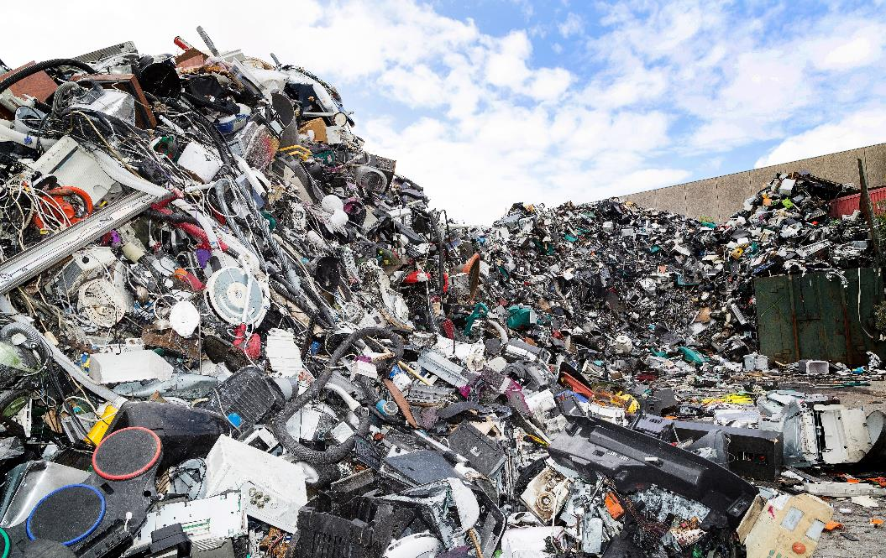
Worldwide issues
Activity 3
Electronic landfill
Lesson 1: The ethical and moral challenges of digital expansion
Notes:
Image © Shutterstock Inc. Morten B

Slide 20

Environmental issues
Activity 3
Climate change impacts every aspect of society, including the digital sector. Environmental issues can include:
energy use;
renewable energy;
e-waste and recycling;
use of rare materials.
Many companies are embedding ‘lean’ principles to reduce waste in their production cycles. This includes removing unnecessary tasks and process as well as limiting resources to the minimum required.
Lesson 1: The ethical and moral challenges of digital expansion
Notes:
Image © Shutterstock Inc. Roschetzky Photography

Slide 21

Environmental issues
Activity 3
Energy
More devices require more power.
Devices have a high carbon footprint from manufacture and delivery.
Increasing energy prices has led to reconsideration of energy use and investment in solar and renewables.
E-waste/recycling
Old devices are often still in working order and can be used by someone else.
Devices in landfill can leak harmful chemicals.
People around the world are exploited into picking out materials from landfill.
Rare materials
Some materials used in smart devices are rare earth minerals with a finite supply.
Recycling can help, but technology is needed to help develop synthetic replacements.
Lesson 1: The ethical and moral challenges of digital expansion

Slide 22
Globalisation
Activity 3
Digital technology has no borders.
Emails, messages and data files take the same amount of time to reach the next town as the next continent.
Businesses now work seamlessly with clients around the world whilst often never physically meeting.
Economically, businesses can choose where they are based, causing a financial imbalance.
If more organisations are based in the most attractive locations financially, what happens to everywhere else?
Lesson 1: The ethical and moral challenges of digital expansion

Slide 23

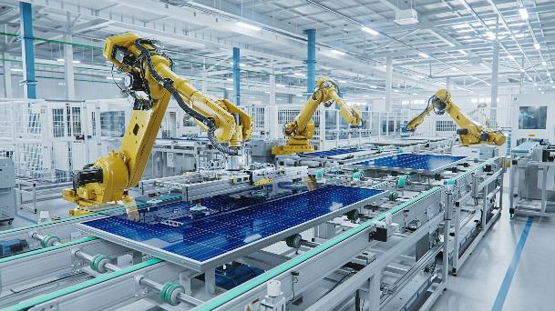
Autonomous operation
Activity 3
Autonomous technology is designed to replace human activity in a more efficient way.
Autonomous technology can be:
  computer system-based automation;
  physical automation systems.
Lesson 1: The ethical and moral challenges of digital expansion
Notes:
Image credits
Phone: © Shutterstock Inc. Tero Vesalainen
Production line: © Shutterstock Inc. IM Imagery

Slide 24
Autonomous operation
Activity 3
Computer system-based automation
includes:
AI (artificial intelligence) based chatbot response programs, answering questions and suggesting solutions via online chat;
LLM (large language model) systems – a type of AI that can be trained to analyse huge data sources and generate responses in a specified format and style;
protection from malware (malicious software), checking computers, communications and websites for viruses and online attacks.
Physical automation systems include:
production line manufacture, from cars to smartphones;
food and drink processing;
transport systems across land, sea and air.
Lesson 1: The ethical and moral challenges of digital expansion

Slide 25

Interviews: Sustainability in the workplace
Activity 3
Video: Sustainability interviews with Cisco Corporate Social Responsibility (CSR) Programme Lead and Mesma Chief Executive Officer.
Lesson 1: The ethical and moral challenges of digital expansion
Notes:
Industry video can be watched here:
https://vimeo.com/875898487

Slide 26
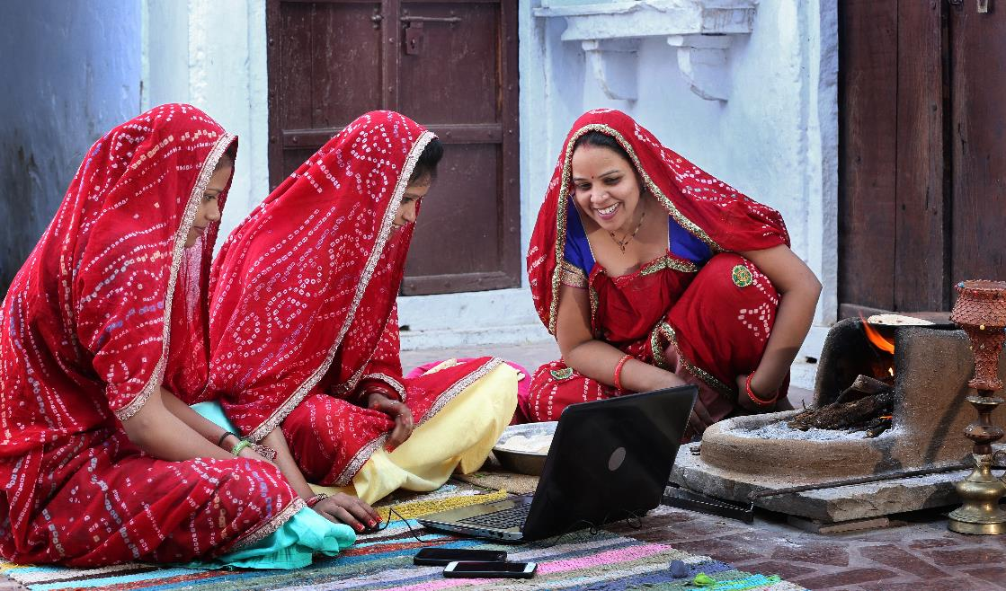
Ethical access
Activity 4
Lesson 1: The ethical and moral challenges of digital expansion
Notes:
Image © Shutterstock Inc. Mukesh Kumar Jwala

Slide 27
Open-source software
Activity 4
Many programmers believe in free and open
access to technology and write applications to
be shared with the world at no cost.
They promote the idea of other programmers
taking these applications, adapting them further
and continuing to share for free.
This is called open-source programming.
There are open-source versions of many popular
commercial applications used today, including:
  Open Office suites;
  photo and video editing suites;
  operating systems and utilities.
Lesson 1: The ethical and moral challenges of digital expansion

Slide 28
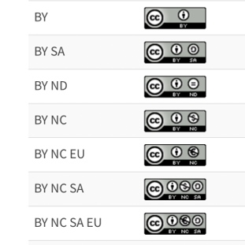
Creative Commons licences
Activity 4
Digital creators often share their artwork, music, video and written material online for others to use and enjoy.
Although the creators own the copyright of their work, the ease of internet downloads leads to the duplication and sharing of works.
Creative Commons licenses, created in 2001, were developed to give creators some control over how their work is used. They can apply a license that lets the user know what they can do and if they need to acknowledge the original author. https://creativecommons.org/share-your-work/
Lesson 1: The ethical and moral challenges of digital expansion
Notes:
Creative Commons logos: https://creativecommons.org/about/downloads/
A useful introduction video is available to show students on this page: https://creativecommons.org/share-your-work/

Slide 29

Collection and use of data
Activity 4
Data is one of the world’s most valuable currencies. It is traded around the world,
much of it without the owner’s permission.
Social media platforms are built on free access for users, with revenue generated from the personal data they provide, which is a permission often granted when the user accepts the terms and conditions. This can include user interests, contacts, messaging and willingness to interact with advertising.
Advancements in technology, for example, in data collection, AI and surveillance systems have led to concerns about privacy infringement.
Lesson 1: The ethical and moral challenges of digital expansion
Notes:
Image © Shutterstock Inc. Song_about_summer

Slide 30
Collection and use of data
Activity 4
The Data Protection Act 2018:
www.gov.uk/data-protection
EU GDPR guidelines:
gdpr.eu
Data protection and the EU (from the Information Commissioner’s Office (ICO)): https://ico.org.uk/for-organisations/data-protection-and-the-eu/data-protection-and-the-eu-in-detail/the-uk-gdpr/
There are much stricter rules for businesses dealing with employee and customer data.
It must be carefully controlled.
Regulations such as the Data Protection Act 2018 promote data transparency and limitations on what can be stored and
processed. This act is the UK implementation of the EU GDPR guidelines.
Lesson 1: The ethical and moral challenges of digital expansion

Slide 31

Unequal access to technology and services
Activity 4
The increased use of digital technology means that organisations and individuals rely on access to modern devices and a stable communication network wherever we are.
In many places, it is possible to purchase devices from a commercial market designed for a range of budgets, and access high-speed internet access via telephone and 5G.
Even with the same area, access can be inconsistent with some areas having much faster access than others as new infrastructure is upgraded in stages and often poorer areas are left with slow connectivity. This creates a digital divide:
  In some remote areas and developing countries, internet speeds can be inconsistent and unreliable.
  Access is linked to a person's financial situation;
  equipment and internet connections are not
  affordable for everyone.
  There are still many people who don’t want access to
  devices, and many digital skills taught in schools today
  didn’t exist for older generations, creating a skills gap.
Limited access to online education, news, shopping, and employment opportunities
can further perpetuate the effects of the digital divide.
Lesson 1: The ethical and moral challenges of digital expansion

Slide 32
Data access and privacy
Activity 4
Discuss these statements and decide if you agree or disagree with them. What are the positive and negative outcomes of your choice?
All media content on the internet should be copyright free and free for anyone to use.
I do not care what companies do with my data, as long as I do not have to pay to use it.
If people do not have access to or want to use technology, then that is their choice.
Resources needed:
L1 Activity 4 Worksheet: Discuss and respond, Data access and privacy
Lesson 1: The ethical and moral challenges of digital expansion

Slide 33
Retrieval questions
Plenary
State three examples of diversity we recognise today.
Lesson 1: The ethical and moral challenges of digital expansion

Slide 34
Retrieval questions
Plenary
State three examples of diversity we recognise today.
Answer
Any three of:
age, religion, ethnicity, gender, sexual orientation, disability
Lesson 1: The ethical and moral challenges of digital expansion

Slide 35
Retrieval questions
Plenary
Which of these is not an effective way to control e-waste?
A. Recycling old devices
B. Reusing devices
C. Destruction and landfill
D. Promoting longer use of devices
Lesson 1: The ethical and moral challenges of digital expansion

Slide 36
Retrieval questions
Plenary
Which of these is not an effective way to control e-waste?
A. Recycling old devices
B. Reusing devices
C. Destruction and landfill
D. Promoting longer use of devices
Answer
C. Destruction and landfill
Lesson 1: The ethical and moral challenges of digital expansion

Slide 37
Retrieval questions
Plenary
Which two pieces of legislation deal with the processing of personal information?
A. GDPR
B. Equality Act 2010
C. Working Time Regulations 1998
D. Data Protection Act 2018
Lesson 1: The ethical and moral challenges of digital expansion

Slide 38
Retrieval questions
Plenary
Which two pieces of legislation deal with the processing of personal information?
A. GDPR
B. Equality Act 2010
C. Working Time Regulations 1998
D. Data Protection Act 2018
Answer
A. GDPR
D. Data Protection Act 2018
Lesson 1: The ethical and moral challenges of digital expansion

Slide 39
Retrieval questions
Plenary
Select the correct difference between commercially produced and open-source software.
A. Open source is subscription based, commercial is free.
B. Open source can be edited and reshared, commercial cannot.
C. Open source is limited to one computer, commercial is not.
D. Open source has free support,
commercial has no support.
Lesson 1: The ethical and moral challenges of digital expansion

Slide 40
Retrieval questions
Plenary
Select the correct difference between commercially produced and open-source software.
A. Open source is subscription based, commercial is free.
B. Open source can be edited and reshared, commercial cannot.
C. Open source is limited to one computer, commercial is not.
D. Open source has free support,
commercial has no support.
Answer
B. Open source can be edited and reshared, commercial cannot.
Lesson 1: The ethical and moral challenges of digital expansion

Slide 41
Retrieval questions
Plenary
Which organisation was created to promote the sharing and recognition of original digital content?
A. Royal Commons
B. Open-Source Images
C. Creative Commons
D. Creative Imagery
Lesson 1: The ethical and moral challenges of digital expansion

Slide 42
Retrieval questions
Plenary
Which organisation was created to promote the sharing and recognition of original digital content?
A. Royal Commons
B. Open-Source Images
C. Creative Commons
D. Creative Imagery
Answer
C. Creative Commons
Lesson 1: The ethical and moral challenges of digital expansion

Slide 43
In this lesson, we have:
Plenary
Learnt about the evolving nature of technology and how this impacts on moral and ethical issues
Understood the environmental impacts of technology
Understood what is meant by globalisation and autonomous operation
Learnt about open-source software and Creative Commons licences, and how they are used
Described what is meant by the digital divide
Skills:
Research skills
Summarising information skills
Presentation skills
General competencies:
English:
E2 Present information and ideas
E4 Summarise information/ideas
E5 Synthesise information
Digital:
D5 Be safe and responsible online
Lesson 1: The ethical and moral challenges of digital expansion

Slide 44
Next lesson, we will cover:
Plenary
How a workplace defines its culture
What is included in the code of conduct document
What is included in external professional guidelines and internal policy documents
Whistleblowing and in what circumstances it can happen
What is meant by strategic planning
Situational awareness and how to respond to changes in behaviour
Lesson 1: The ethical and moral challenges of digital expansion

